Slide 1
Predicting Ozone Nonattainment in US Counties
with Supervised Learning | Team No : 25 | 1. Name : ATHARVA SIDRAMAPPA GOUNI | SRN : PES2UG24CS094 |2. Name : B. Kodandapaani Reddy | SRN : PES2UG24CS108 | Machine Learning project

Slide 2
Introduction & problem statement
Ozone near the ground harms health; EPA limit = 0.070 ppm (design value)
Nonattainment counties face costly, mandatory controls
Goal: predict daily ozone, then flag county nonattainment + severity tier early
Base: CS229 (2019) ozone regression paper; we fix its drawbacks and add county-level output

Slide 3
Paper drawbacks and our fixes
Seasonal split (val Jan-Jun, test Jul-Dec) -> whole-year temporal split
Non-standard R2 and oversized SVR epsilon (R2 = -2.36) -> standard metrics, tuned SVR
Numeric site ID feature -> latitude/longitude; inner joins -> LEFT JOIN + imputation
Regression only -> exceedance classifier, design value, severity tiers
No feature analysis -> permutation importance and ablation

Slide 4
Dataset
EPA Historical Air Quality daily summaries, Google BigQuery public data (2000-2017)
Ozone target + temperature, pressure, wind, humidity, NO2, VOC per site-day
Engineered: calendar cycles, lags, rolling temperature, lat/lon, trend
Split: train <=2014 (54,23,797), val 2015 (3,81,166), test 2016-17 (7,77,669)
1965 monitoring sites, 934 counties; sites missing a sensor are kept and imputed

Slide 5
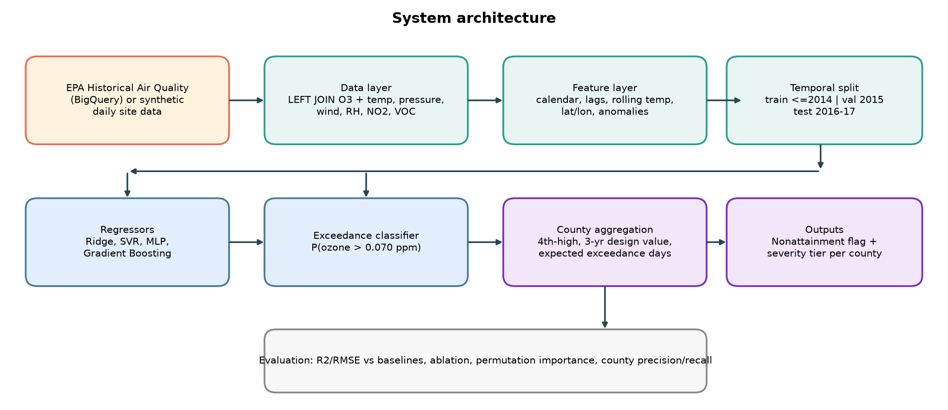
System architecture

Slide 6
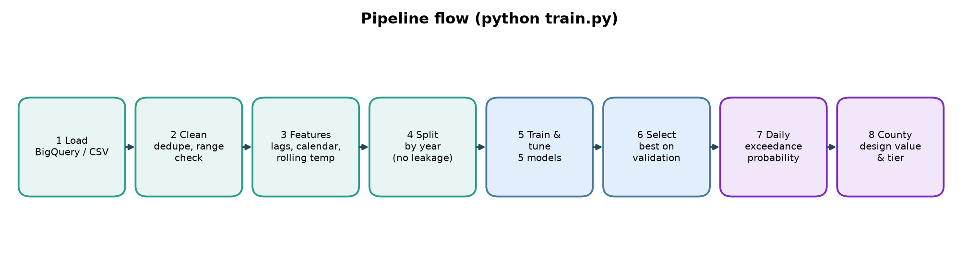
Pipeline flow
python train.py runs steps 1-8 end to end and writes metrics, plots, saved model

Slide 7
Algorithms used
Ridge: linear baseline, y = theta.x with L2 penalty
SVR (RBF): epsilon-insensitive loss, scaled target, grid-tuned C/epsilon
MLP: 128-128-64, ReLU, adaptive learning rate, early stopping
Gradient boosting: tree ensemble, handles missing sensors natively; also the exceedance classifier
Baselines: persistence and site-month climatology
County: 4th-high -> 3-yr design value -> tier; expected exceedance days = sum of P(exceed)

Slide 8
Implementation
Python: pandas, scikit-learn, matplotlib; modular src/ package
Leakage safe: lags use only past days, normalisation fitted on train only, time-based splits
Model chosen on validation RMSE; test years touched once
demo.py: per-county what-if (e.g. +4 F) for the live demonstration
6 pytest unit tests; README with setup and run steps; private GitHub repo shared with faculty/TAs

Slide 9
Results: daily ozone regression (test 2016-17)
Best: HGB
RMSE 0.0075 ppm
No-lag ablation R2 0.48
Exceedance ROC-AUC 0.97

Slide 10
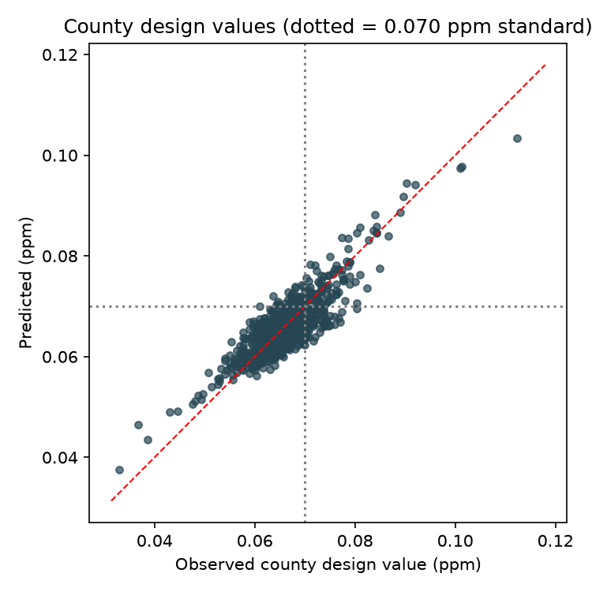
Results: county nonattainment
County-year accuracy 0.87, F1 0.67
Exceedance-count method accuracy 0.87
2017 design value MAE 0.0026 ppm
Severity tier exact 0.86, within one 1.00

Slide 11
Limitations and future work
Weather + precursors alone explain only part of daily ozone (no-lag R2 0.48); nonattainment recall 0.59
Target is 1-hour max, not the regulatory 8-hour average; MLP stopped early and SVR trained on a 15k subsample for time
No completeness rules, exceptional events, or emission-source features (factories, highways, census)
Future: 8-hour metrics, spatial/graph models, uncertainty intervals, other pollutants

Slide 12
Conclusion
HGB is the best model (test R2 0.63) on a fair, leakage-free split
County design values: 0.87 accuracy, tiers within one level 1.00
Every paper drawback addressed; pipeline reproducible with one command
Live demo: python demo.py --state 01 --county 012 --temp-delta-f 4

