Slide 1
Read Write and Create File
Read
Write
Create

Slide 2

Read File
Use built-in open() function.

Slide 3

Read File
Use built-in open() function.
Using the with keyword

Slide 4

Read File
Use built-in open() function.
Read Only Parts of the File

Slide 5

Read File
Use built-in open() function.
By looping through the lines of the file

Slide 6
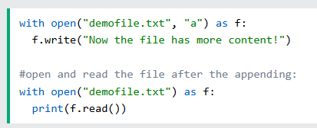
Write File
To write to an existing file, you must add a parameter to the open() function:
  "a" - Append - will append to the end of the file
  "w" - Write - will overwrite any existing content

