Slide 1

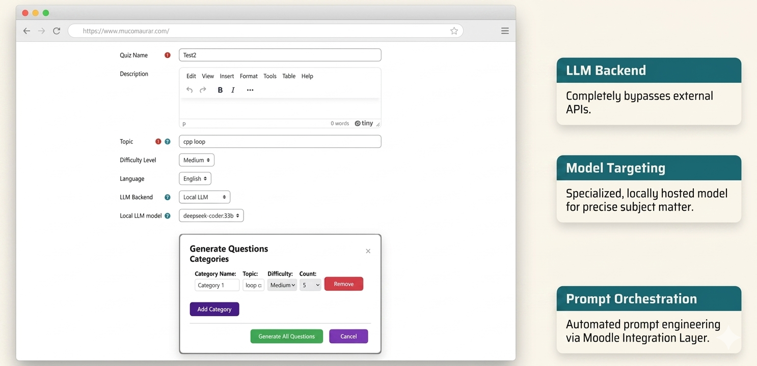
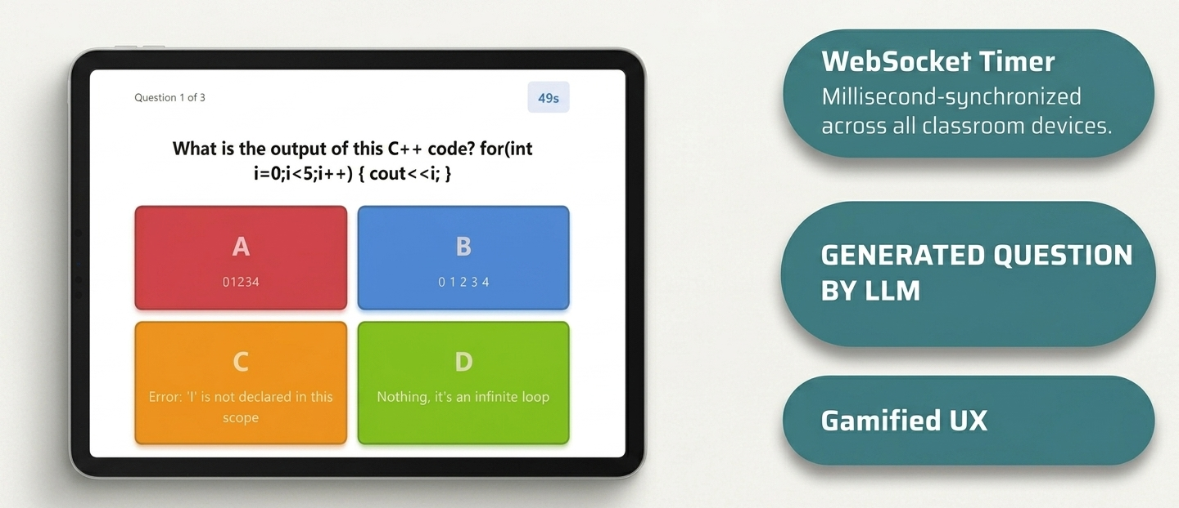
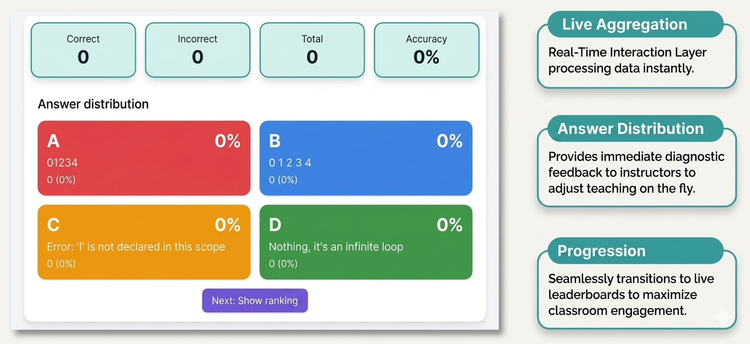






Design and Evaluation of an AI-Enhanced Gamified Quiz Plugin for Moodle: Integrating Local LLM-Based Question Generation
Titya ENG¹, Samart HORN², Sokhan CHAN³, Ham HENG⁴, Mengseu SAK⁵
^{1,2,3,4,5} National University of Battambang
eng.titya@nubb.edu.kh, horn.samart@nubb.edu.kh,
chan.sokha@nubb.edu.kh, ham.heng@nubb.edu.kh, sakmengseu007@gmail.com
Poster ID: SD150191
Abstract
This study proposes a privacy-preserving AI-enhanced assessment framework for Moodle integrating locally hosted Large Language Models (LLMs) and WebSocket-based real-time classroom interaction. The system supports automated quiz generation, live leaderboards, synchronized timers, and instant feedback while eliminating dependency on cloud-based AI services. The proposed architecture combines GPU-accelerated local inference with real-time communication to support large classroom participation with low latency and reduced operational cost.
User Interface
Instructor interface
Research Contributions
Privacy-preserving local LLM integration for Moodle assessment
Real-time gamified classroom interaction architecture
Open-source Moodle plugin architecture for AI-enhanced real-time assessment
Realtime quiz and answer
Problem statement
Problem Statement
Traditional Moodle quizzes require significant manual preparation.
Existing AI-based assessment systems rely heavily on cloud APIs.
Cloud-based AI introduces:
- recurring operational cost
- institutional data privacy concerns
Real-time classroom engagement is limited in conventional Moodle assessments.
OBJECTIVE
Live analytics
Research objectives
Develop an AI-enhanced Moodle assessment framework using local LLMs
Enable synchronous gamified classroom interaction
Reduce dependency on cloud-based AI services
Evaluate system latency and usability
Experimental Results:
Local LLM deployment & performance:
Ollama + deepseek-r1:8b on Apple M5 (16 GB RAM)
125 prompts (5 domains × 25 MCQs); mean 58.9 s/Q (p95 83.0 s)
API/JSON success 100% (n=3); expert rubric (2 raters, n=125)
WebSocket: 30/30 clients, RTT 1.6 ms (p95 6.1 ms)
Quality: adherence [XX]%, accuracy [XX]% ([NN]/125), P [X.XX] R [X.XX] F1 [X.XX], κ [0.XX]
methodology
Instructor Configures Quiz in Moodle
- Model Selection and Quiz Parameter Configuration
conclusion:
This research presents a privacy-preserving AI-enhanced gamified quiz system for Moodle using locally hosted Large Language Models (LLMs) and WebSocket-based real-time interaction. The proposed architecture demonstrates the feasibility of integrating local AI technologies into digital learning environments while improving classroom engagement, increasing student interaction, reducing instructor workload in quiz preparation, and minimizing dependency on cloud-based services.
Moodle Integration Layer
- Quiz workflow orchestration
- Structured prompt engineering
- JSON schema enforcement
- REST-based inference request generation
LLM Inference Layer
- Transformer-based Local LLM Processing
- Automated quiz generation
- JSON-formatted response generation
Moodle Database and Validation Layer
- Response validation
- Persistent Data Storage
- Quiz content management
References:
[1] E. Kasneci et al., “ChatGPT for good? On opportunities and challenges of large language models for education,” Learning and Individual Differences, vol. 103, p. 102274, 2023.
[2] O. Zawacki-Richter, V. I. Marín, M. Bond, and F. Gouverneur, “Systematic review of research on artificial intelligence applications in higher education,” International Journal of Educational Technology in Higher Education, vol. 16, no. 1, p. 39, 2019.
[3] S. Deterding, D. Dixon, R. Khaled, and L. Nacke, “From game design elements to gamefulness: Defining gamification,” in Proc. 15th Int. Academic MindTrek Conf., 2011, pp. 9–15.
[4] S. Kurdi, J. Leo, and D. Parsia, “A Systematic Review of Automatic Question Generation for Educational Purposes,” International Journal of Artificial Intelligence in Education, vol. 30, pp. 121–204, 2020.
[5] D. López, P. M. Guerrero, and L. Molina, “Real-time collaborative learning systems for classroom interaction,” Computers in Human Behavior, vol. 92, pp. 247–257, 2019.
[6] Moodle HQ, “Moodle AI subsystem documentation,” 2024. [Online]. Available: https://moodledev.io
Real-Time Interaction Layer
- WebSocket communication
- Live leaderboard synchronization
- Real-time timer broadcasting
- Instant answer submission handling
Student Participation and Feedback
- Students join synchronized quiz session
- Real-time feedback
- Low-latency synchronized assessment experience

