Slide 1


Slide 2
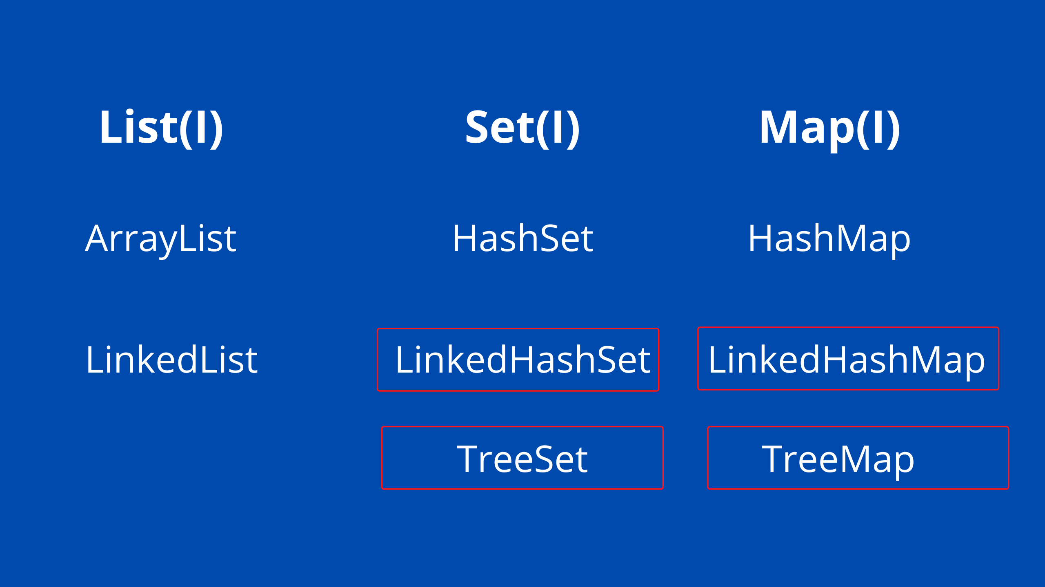
Interview Q&A
1. what all collection you used in your project ?
java.util.concurrent.*
CopyOnWriteArrayList
CopyOnWriteArraySet
ConcurrentHashMap

Slide 3
Interview Q&A
2. What is the difference between list and set ?
3. What is the Difference between ArrayList and LinkedList ?
ArrayList | LinkedList
ArrayList internally uses a dynamic array to store the elements | LinkedList internally uses a doubly linked list to store the elements.
Manipulation with ArrayList is slow because it internally uses an array. If any element is removed from the array, all the bits are shifted in memory | Manipulation with LinkedList is faster than ArrayList because it uses a doubly linked list, so no bit shifting is required in memory.
ArrayList is better for storing and accessing data | LinkedList is better for manipulating data.
CopyOnWriteArrayList
CopyOnWriteArraySet
ConcurrentHashMap

Slide 4
Interview Q&A
4. List object creation scenario
ArrayList arrayList=new ArrayList<String>();
List<String> list=new ArrayList<>();
5. Declaring a List field with the final keyword ?
6. How Can I write Custom ArrayList where I don’t want to allow duplicate ?
7. Why Set doesn’t allow duplicate Element ?
8. What is the difference between Comparable and Comparator ?

Slide 5
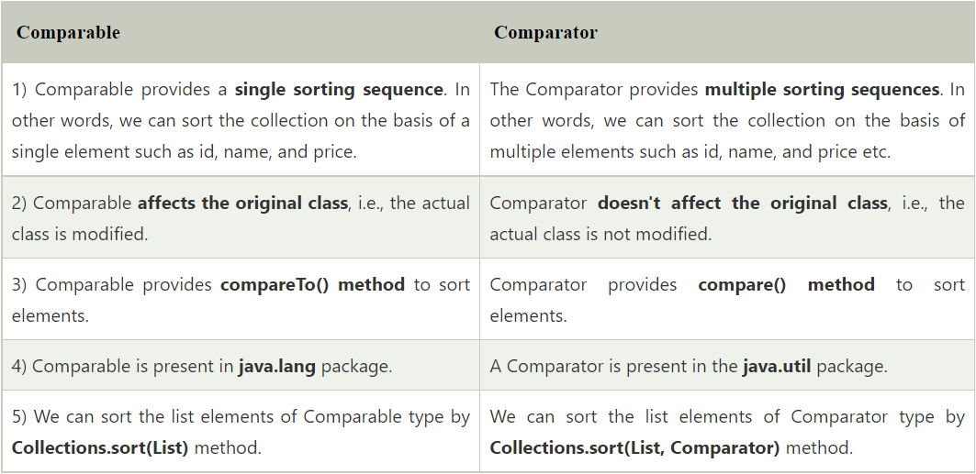
Interview Q&A
CopyOnWriteArrayList
CopyOnWriteArraySet
ConcurrentHashMap

Slide 6
Interview Q&A
9. Multi Comparing using Comparator Scenario
10. What is the difference between fail fast and fail safe iterator
A iterator which will fail fast when we do any modification while iterating a collection is called fail fast iterator Ex : (ArrayList ,HashMap and Vector)
Iterator who allow us to modify in middle while iterating a collection is called Non-Fail Fast Iterator Ex: (CopyOnWriteArrayList , CopyOnWriteArraySet, ConcurrentHashMap)
Example
Internal Flow

Slide 7
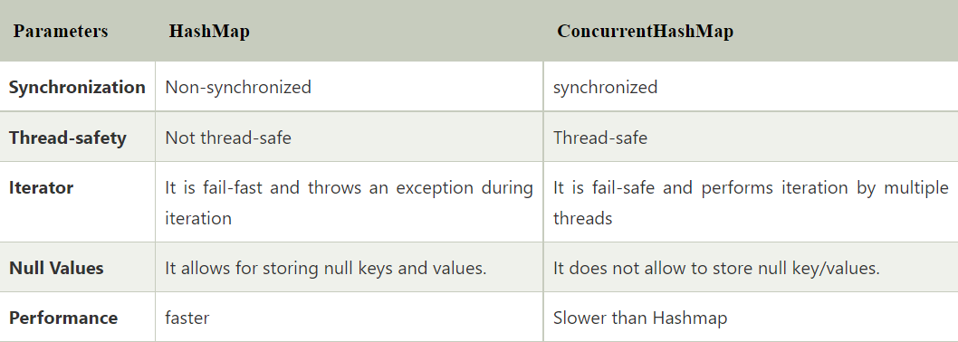
Interview Q&A
11. What is the need of ConcurrentHashMap and How it is different from HashMap ?

Slide 8
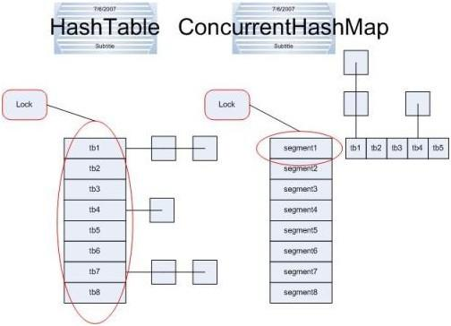
Interview Q&A
12. If we have Hashtable which is already synchronized then why we need ConcurrentHashMap ?
Ans : Locking Mechanism still same as per HashMap (lock whole underlaying DS)

Slide 9
Interview Q&A
13. We Can Synchronize a HashMap using Collections then why can’t we use that instead using ConcurrentHashMap ?
Ans : if we used Collections.synchronizedMap(map) it will act as a synchronized Hashtable only where again locking mechanism is different
14. How HashMap Internally Works

Slide 10
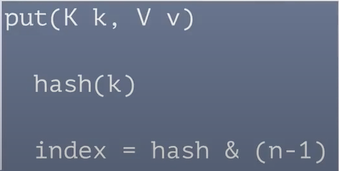
LinkedList
Interview Q&A
null | UI | 6789 | null
0
1
2
3
4
5
6
7
8
9
10
11
12
13
14
Node
key | value | hash | next
Map<Employee, String> map=new HashMap<>();
Employee e1=new Employee(101,”Basant”)
Employee e2=new Employee(102,”peter”)
e2.equals(e3)
Employee e3=new Employee(103,”John”)
Employee e4=new Employee(104,”Sham”)
e1 | Dev | 1011 | null
e4 | UI | 6789 | null
e3 | UI | 7976 | null
map.put(e1,”Dev”)
map.put(e2,”QA”)
map.put(e3,”UI”)
6
map.put(e4,”UI”)
e2 | QA | 2345 | null
9
6
7
map.put(null,”UI”)
15

Slide 11
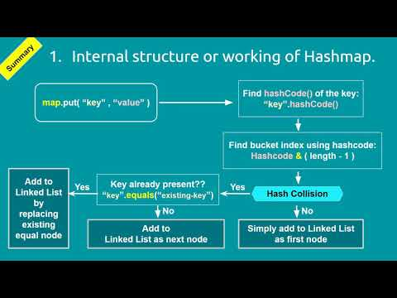
Interview Q&A

Slide 12
Interview Q&A
15. If key is null in HashMap then where that entry will store in map ?
16. Map enhancement in java 8
17. How TreeMap internally works

