Slide 1
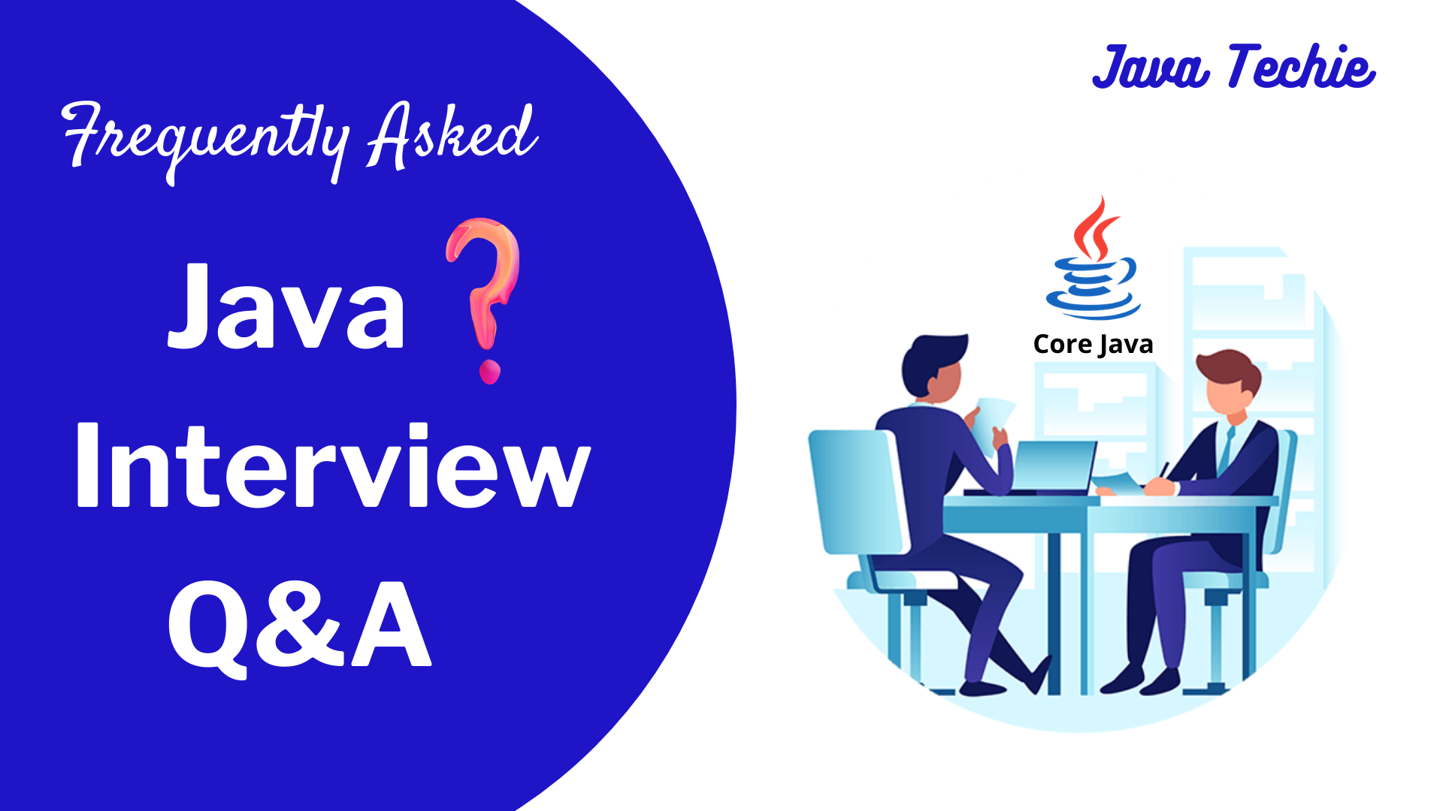

Slide 2
Interview Q&A
What is the pillar of oops concept
Encapsulation
Inheritance
Polymorphism
Abstraction
Where did you use this concepts in your project
Explain Exception hierarchy in Inheritance
parent child override scenario
can we override static and private method ?
what is the difference of java 7 and java 8 interface
Java 8 Default method ,static method

Slide 3
Interview Q&A
7. What is final, finally and finalize ?
final : keyword
finally : block
finalize : method
8. What is equals and hashcode method and its contract
Hashcode : used to generate unique or reference number of an object through which we can easily identify uniqueness of an object
Equals : used to compare object based on its content
Both method present in java.lang.Object class

Slide 4
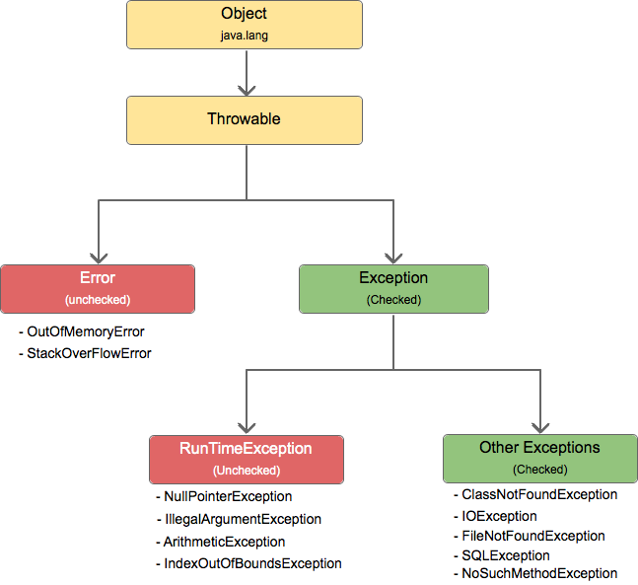
Interview Q&A
9. What is exception and its hierarchy

Slide 5
Interview Q&A
10. why checked exception also called as compile time exception , is it occurs in compile time ?
11. How to write custom exception
12. Throw and throws Exception
13. Exception tricky programming question (Exception order)
14. try , catch finally return statement scenario questions
15. is finally block always executed ?

Slide 6
Interview Q&A
16. How many way we can create String object ?
17. String object creation scenario
18. What is SCP and how it works ?

Slide 7
Interview Q&A
19. Why String is immutable
Immutable simply means unmodifiable or unchangeable.
Key points :
String pool is possible only because String is immutable in Java. This way Java Runtime saves a lot of heap space because different String variables can refer to the same String variable in the pool.
If String is not immutable then it would cause a severe security threat to the application. For example, database username, password are passed as String to get database connection and in socket programming host and port details passed as String. Since String is immutable, its value can’t be changed otherwise any hacker could change the referenced value to cause security issues in the application.
Since String is immutable, it is safe for multithreading. A single String instance can be shared across different threads. This avoids the use of synchronization for thread safety.
Since String is immutable, its hashcode is cached at the time of creation and it doesn’t need to be calculated again. This makes it a great candidate for the key in a Map and its processing is faster than other HashMap key objects. This is why String is the most widely used as HashMap keys.

Slide 8
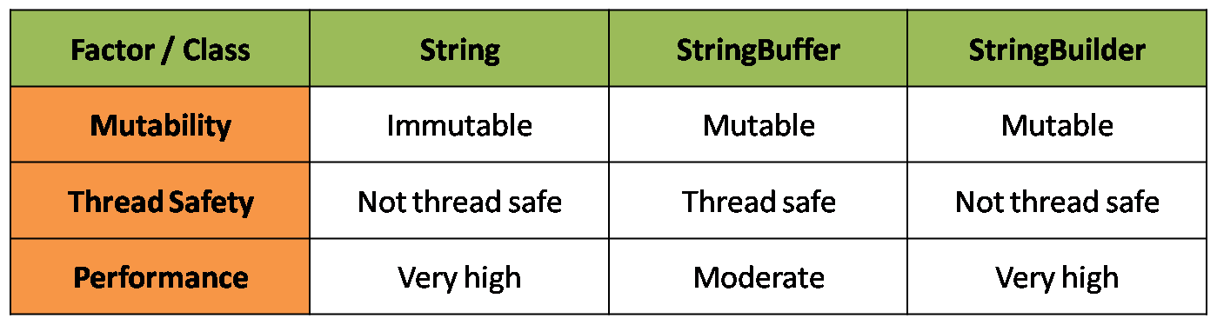
Interview Q&A
20. how to use mutable class and what is the difference between StringBuffer and StringBuilder

Slide 9
Interview Q&A
21. How to write your own custom immutable class
Make your class final
Declare all instance variable with private and final
Say no to setter methods
Initialize all variables in constructor
You can initialize variables in constructor
Perform cloning of mutable objects while returning from getter method
you can go with clone method but its always not recommended, I will show you its disadvantages

Slide 10
Interview Q&A
22. Which one is good to store password in java String or char[] & Why
Here are a few reasons which make sense to believe that character array is a better choice for storing the password in Java than String
Since Strings are immutable in Java if you store the password as plain text it will be available in memory until the Garbage collector clears it and also String literal is stored String pool for reusability there is a pretty high chance that it will remain in memory for long duration
Because its difficult to destroy literal from SCP as GC unable to perform cleanup activity in SCP only it will destroy once jvm restarted so which may leads a high security threat
Since anyone who has access to memory dump can find the password in clear text and that's another reason you should always use an encrypted password than plain text

Slide 11
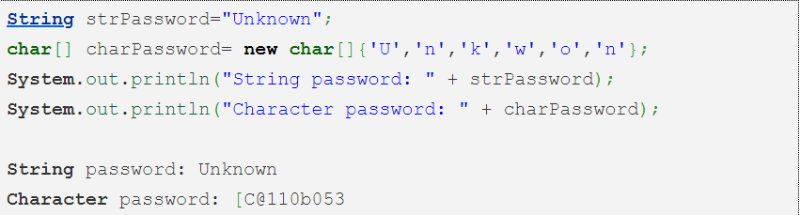
Interview Q&A
Since Strings are immutable there are no way contents of Strings can be changed because any change will produce new String, while if you char[] you can still set all his elements as blank or zero. So Storing the password in character array clearly mitigates security risk of stealing passwords.
With String there is always a risk of printing plain text in log file or console but if use Array you won't print contents of array instead its memory location get printed. though not a real reason but still make sense.

Slide 12
Interview Q&A
23. What is Marker interface (tagging interface) ? Can we create our own marker interface ?
A marker interface is an interface that has no methods or constants inside it. Java has many built-in marker interfaces, such as Serializable, Cloneable, and Remote.
It provides run-time type information about objects, so the compiler and JVM have additional information about the object.
Let's take the example of the Cloneable interface. If we try to clone an object that doesn't implement this interface, the JVM throws a CloneNotSupportedException. Hence, the Cloneable marker interface is an indicator to the JVM that we can call the Object.clone() method.

