Slide 1
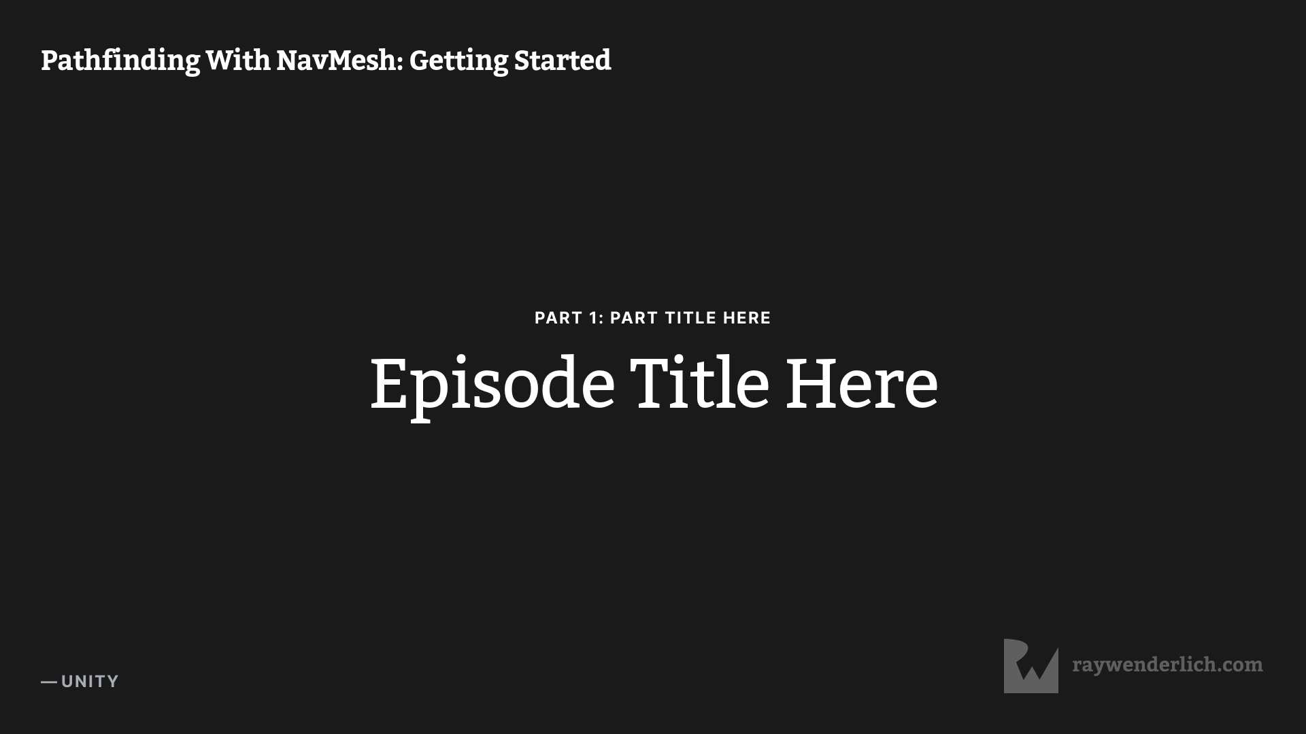

Slide 2
A* Pathfinding
Notes:
Hey everyone, I’m your Unity certified instructor, Myles, and in this video course I’ll be showing you how Pathfinding with Navmesh works - in Unity
The A * algorithm calculates the shortest path between two points by reading the cost of each cell and picking the cheapest one to move to next.
This process is repeated until the destination is reached.

Slide 3
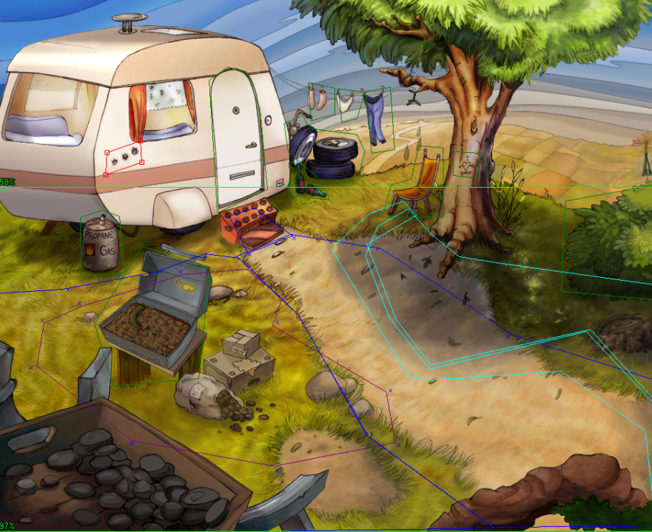
Point & Click Design Pattern
http://dead-code.org/graphics/web/SceneEdit2.png
Notes:
This solution is useful in a lot of ways especially in video games. Let’s say you want the character in your game to move to the location of a mouse click. This is pretty easy when the path is a straight line but what if there is obstacles in the way such as rocks and trees in an exterior environment or furniture if it’s an interior environment. The character should be able to maneuver around these obstacles and still reach the destination of the mouse click in the shortest time.

Slide 4
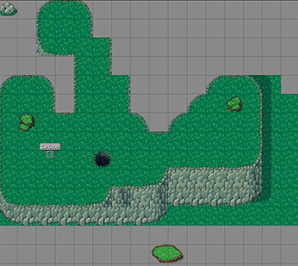
Navigational Meshes
https://forum.defold.com/t/multiple-tilesources-in-one-tilemap/45214
Notes:
In order to figure out the shortest path using the A* algorithm we first need to convert our environment into a navigational mesh but dividing it into nodes or cells that we can use to calculate the path.
A* can work with other shapes, too! All the algorithm needs is a graph of connected nodes, and a grid of squares is merely one such graph. You can even use A* with maps of the real world: The intersections of roads are nodes, and roads are the connections between nodes.
Unity allows us to do this very easily. Let’s have a look.

