Slide 1
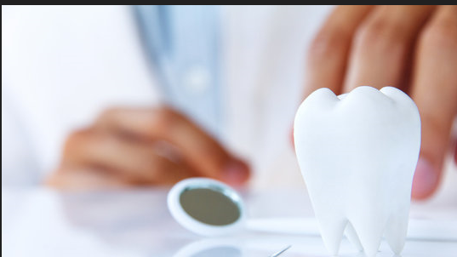

Dentist Appointment Scheduler System
Group 5 Jacob Turnage
Sandhya Kodem
Alejandro Cruz-Bautista

Slide 2
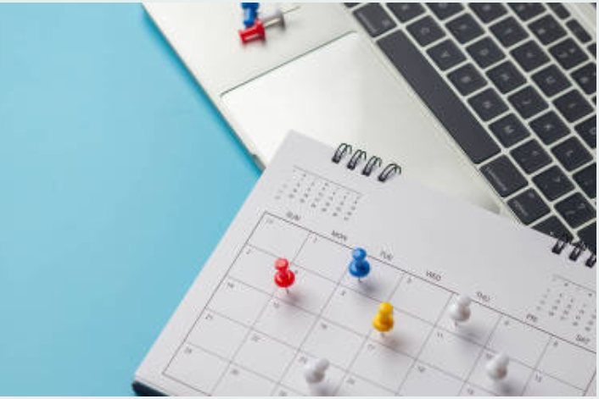
OBJECTIVE
To create online Dentist Appointment Scheduler System to help avoid the limitations of Manual booking.

Slide 3
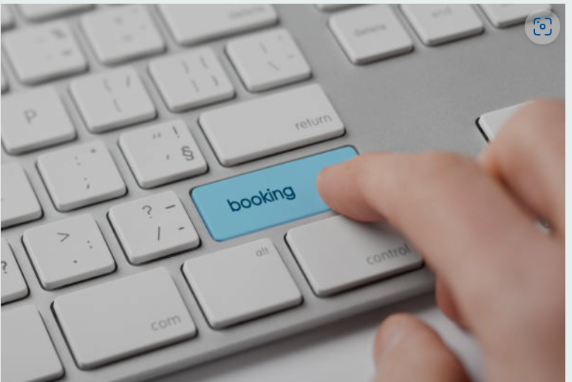
INTRODUCTION:
Booking an appointment can be done in several ways like through phone call, in-person, e-mail, however the easiest and most convenient way of scheduling an appointment is online booking.
Dental Clinics are the most significant beneficiaries as online appointment schedulers allow doctors to review their schedules at any given time and save time of patients waiting on the phone calls during business hours to book an appointment.

Slide 4

MOTIVATION:
Most of the health care providers require patients to phone their help desk to book an appointment and a lot of times phones are busy, patients must wait for a long time on the phone.
Another limitation with the help desk booking is that the patient must call during business hours.
Considering this, we want to develop a website which can allow a patient to book Dentist appointment online.
we also want to include video calls and audio call appointments which will help the elderly patients and patients who cannot take a trip to the hospitals and clinic.

Slide 5
DEMO:
SITE NAVIGATION - Home page, navigation bar, patient login option
PATIENT LOGIN - Validate patient login details
DENTIST LOGIN - verify appointment details and treatment update
BOOK APPOINTMENT - Patients book an appointment with interested dentist provider.
CONFIRMED BOOKINGS - view confirmed bookings
PATIENT AND DENTIST STATISTICS – Statistical data

