Slide 1
Starting a bike rental business
Good locations near larger european airports

Slide 2
Airline travel – both fast and slow
People often have to wait for hours, and it may be boring to travel to the airport
With 1.6 billion passengers each year, much time is wasted on larger European airports
We think that offering bike rentals near airports may give a better experience, given that the conditions are right
  By bikes, we mean e-bikes, e-scooters and traditional bikes
Are there many European airports where a new bike rental business could be viable?
Possible view from inside airports…

Slide 3
Data acquisition and cleaning
Data of larger European airports were scraped from Wikipedia, and cleaned
  https://en.wikipedia.org/wiki/List_of_the_busiest_airports_in_Europe
  A few airports were dropped
Airport and city names were used to get location data with Nominatim
Distance from airport to city found using geopy
Regional classification information was added, among other:
  UN immigration dataset (from the data visualization module)
  https://europa.eu/european-union/about-eu/countries_en#28members

Slide 4
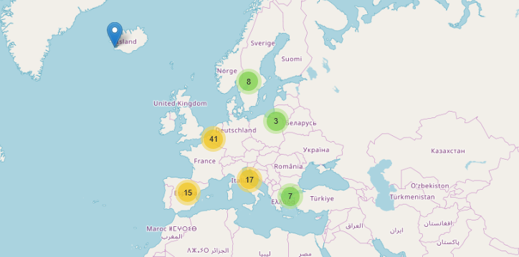
A folium map showing clusters with all the airports (92)

Slide 5
Foursquare data – very useful
We collected venue information from Foursquare, and searched by using unique category Ids
Transportation venues
  Bike rentals – whether the airports have such businesses already or not
  Train stations
    Including other rail passenger transportation (such as metro stations)
Selected venues near the airport
  Beaches, gyms, museums

Slide 6
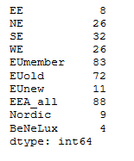
Do all regions have about the same number of airports?
We see that Northern, Southern and Western Europe have about the same number of airports. There are fewer larger airports in Eastern Europe.
This division in EE/NE/SE/WE seems to be the best overall regional division for the scope of this project.

Slide 7
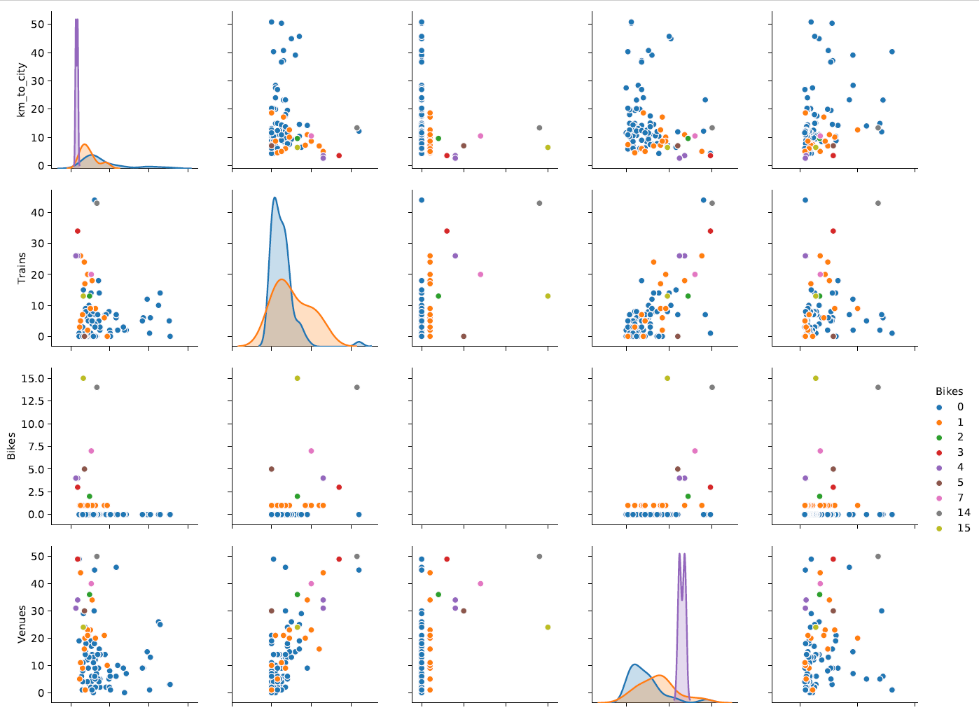
A Seaborn pairplot was useful to see possible correlation of various features. The second to the left on the top row shows distance to city vs. number of bikes. We can see that none of the airports that are far from the city have bike rentals nearby (blue dots = 0 bikes).
We can also see that for several other features, there may seem to be not a strong correlation.

Slide 8
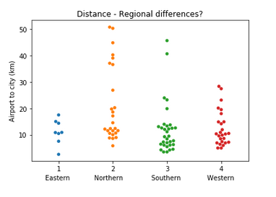
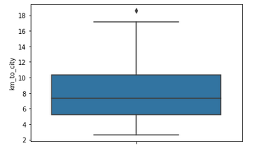
None of the airports in eastern europe are far from the city, in northern europe, quite a few are
Box plot that shows how far airports with bike rentals are from the cities

Slide 9
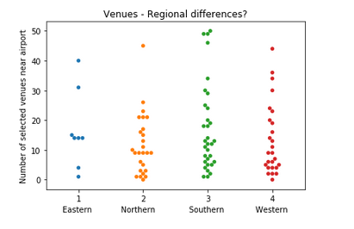
Airports in nothern europe seems to have less venues near the airport

Slide 10
Airports with the most selected venues nearby
(Insert table)

Slide 11
Selecting weights to calculate total score for finding the most attractive airports
We used the z score, and multiplied with -1 where a low z score was attractive
We also used weights (0 to 10)
For bikes we gave bonus points if no rental service, to increase the difference between 0 and 1
For trains and bikes, we also used square values to reduce difference between 1 and, say, 20.
The airport furthest to the north received a few minus points
Weights (weight, -1/+1):
  Distance (10, -1)
  No. of passengers (3,1)
  Increased traffic (3,1)
  Bike rentals (5, -1) *adjusted
  Trains (1,1) *adjusted
  Venues (3,1)
The weights can easily be adjusted

Slide 12
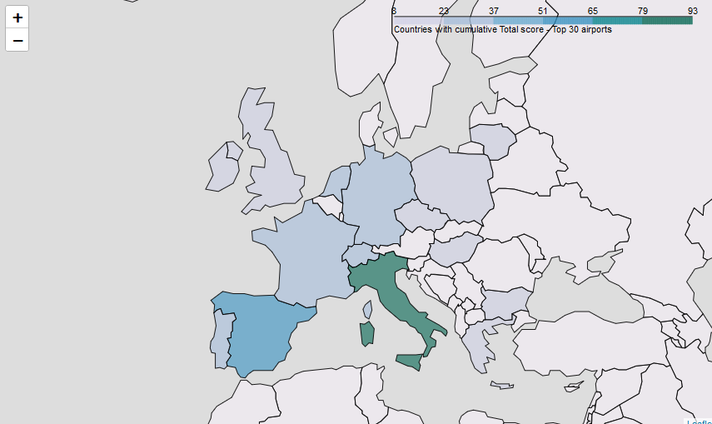
Best countries to start rental business – total country score of top 30 airports

Slide 13
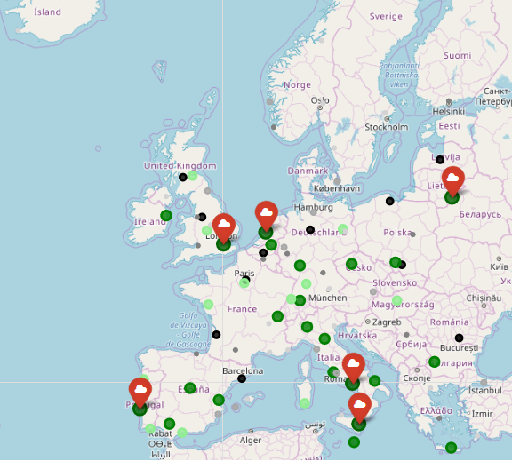
The airports with the lowest score are light gray. Then comes dark gray, black, light green, dark green and large dark green.
The top airports are the dark green that has a cloud marker as well.
We can see that Italy might be the best country to establish rental businesses. But there are also a number of other airports that could be really interesting.

Slide 14
Conclusion and direction for future work
There are substatial differences among European aiports, and also differences between regions. There seem to be a number of airport that could be good places to start bike rental businesses, but also airport where this is probably a bad idea.
There seem to be various «open data» sites (but that may be less available due to fragmentation, different languages and more).
We see a rapid development of e-scooters/e-bikes. Over the next months/years much will happen, and we would then have a lot more data to analyze and apply machine learning techniques to.
Furhter studies would have to be made before one could conclude what airports/ countries are best for bike rentals. Other factors (such as regulation) could be important.

