Slide 1

COCOMO Models

Slide 2
Project Management and Mr. Murphy
Logic is a systematic method of coming to the wrong conclusion with confidence.
Technology is dominated by those who manage what they do not understand.
Nothing ever gets built on schedule or within budget.
If mathematically you end up with the incorrect answer, try multiplying by the page number.
Mr. Murphy was an optimist

Slide 3
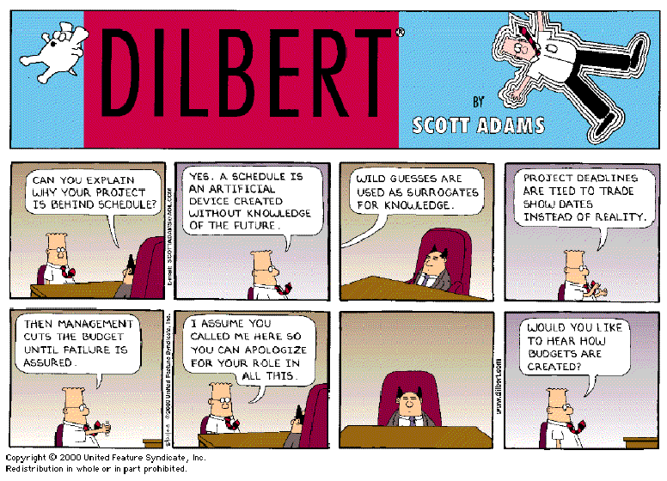

Slide 4
Motivation
The software cost estimation provides:
The vital link between the general concepts and techniques of economic analysis and the particular world of software engineering.
Software cost estimation techniques also provides an essential part of the foundation for good software management.

Slide 5
Planning Prerequisites
The planning process requires the following inputs:
  Required human effort (man-months)
  Project duration (months)
  Project costs ($)
We would like our estimates to be perfectly precise and accurate
  But this requirement is impossible until the project is over

Slide 6
Cost of a project
The cost in a project is due to the requirements for software, hardware and human resources
The cost of software development is due to the human resources needed
Most cost estimates are measured in person-months (PM)
At any point, the accuracy of the estimate will depend on the amount of reliable information we have about the final product.
The cost of the project depends on the nature and characteristics of the project

Slide 7
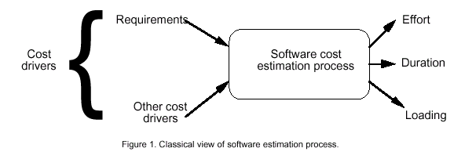
Software Cost Estimation

Slide 8
Importance of Estimates
In the early days of computing,
  Software costs were a small part of the total system cost
    Even large errors (order of magnitude) = little impact on the total system cost
  Today, software costs are the largest component of total system cost
    Large errors in estimating cost equate to
      The difference between profit and loss or
      Survival and demise

Slide 9
Reasons for Inaccuracy in Estimates
Too many uncertainties in the variables that determine the cost
In the following categories
  Human
    The developers and their skills are not perfectly known
  Technical
    May need to use new or unfamiliar technology
  Environmental
    May need to run on unfamiliar computer or operating systems
  Political
    Internal company or client politics

Slide 10
Estimation Techniques
Five main categories of techniques
  Expert judgment
  Estimation by analogy
  Pricing to win
  Parkinson pricing
  Algorithmic models

Slide 11
Expert Judgment
Several experts in the application domain independently prepare estimates
Estimates are compared (together with the rationale for the estimate)
Differences are resolved by discussion
It is not
  Estimation by committee
  An averaging of the independent estimates

Slide 12
Estimation by Analogy
Cost of a new project is estimated by analogy to similar systems previously developed
  Identify differences and estimate cost of these differences
How to handle no previously developed similar systems?
What about changes in development environment?
  How to handle employee turnover?
  How to handle new language, case tools, …

Slide 13
Pricing to Win
The cost is what you believe the customer is willing to spend
What circumstances would lead you to price a project this way?

Slide 14
Parkinson Pricing
Parkinson’s Law
  Parkinson’s Law – The work expands to fill the time available
Cost is determined by available resources rather than by objective analysis
Example
  If the software is needed in 1 year and you have 5 developers available to work on the project, the effort is 60 man-months

Slide 15
Importance of Deviation
It is important to identify changes from previous projects, especially when employing
  Expert Judgment or
  Estimation by Analogy
Failure to identify change and account for its influence
  Distorts the estimate
    Perhaps to the point that the estimate is of little value

Slide 16
Importance of Deviation (cont)
Examples of change affecting estimates
  Object-oriented versus structured techniques
  Client-server systems versus stand-alone applications
  COTS components versus developed components
  Reuse versus all new development
  CASE tools / code generators versus unsupported development

Slide 17
Algorithmic Models
A formula (or set of formulae) is evaluated to provide an estimate
Size or functionality metrics are the independent variables
Constants in the formula are based upon historic cost data

Slide 18
Algorithmic Cost Modeling
The most systematic approach to cost modeling
  The most precise method, but
  Don’t confuse with the most accurate
A formula or set of formulae is used to predict cost based on project size, and sometimes other project factors
Most algorithmic cost models have an exponential component
  Realizing that cost does not scale linearly with size

Slide 19
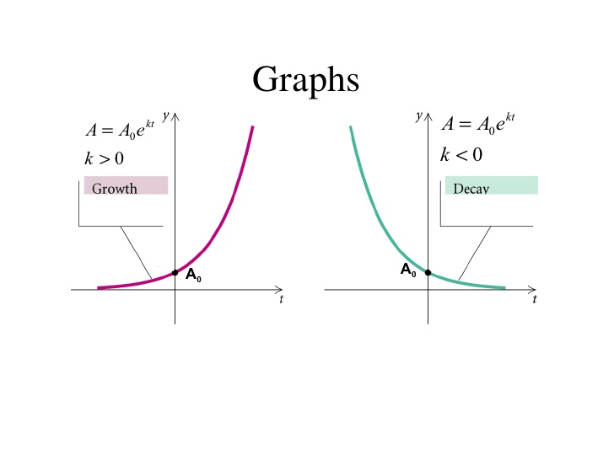

Slide 20
Algorithmic Modeling (cont)
The simplest model is a static single-variable model
Where
  A is a constant factor
    Factor incorporating process, product and development characteristics
  Size code size or a function oriented value
  B A constant typically in the range of 1 to 1.5
  Effort or PM is in person-months
  1 person-month =152 working hours
Notes:
A person-month is equivalent to hours of labor (160 hours is a common value)

Slide 21
Size Metrics
Two common categories of size metrics
  Lines of code
  Function oriented metrics
While lines of code (LOC) not the only size metric
  LOC is the most commonly used measure of size

Slide 22
Effort
Effort Equation
  PM = C * (KDSI)^{n} (person-months)
    where PM = number of person-month (=152 working hours),
    C = a constant,
    KDSI = thousands of "delivered source instructions" (DSI) and
    n = a constant.

Slide 23
Productivity
Productivity equation
  (DSI) / (PM)
    where PM = number of person-month (=152 working hours),
    DSI = "delivered source instructions"

Slide 24
Schedule
Schedule equation
  TDEV = C * (PM)^{n} (months)
    where TDEV = number of months estimated for software development.

Slide 25
Average Staffing
Average Staffing Equation
  (PM) / (TDEV) (FSP)
    where FSP means Full-time-equivalent Software Personnel.

Slide 26
Cost Estimation Process
Cost=SizeOfTheProject x Productivity

Slide 27
Cost Estimation Process
Effort
Size Table
Lines of Code
Number of Use Case
Function Point
Development Time
Estimation Process
Number of Personnel
Errors

Slide 28
Project Size - Metrics
Number of functional requirements
Cumulative number of functional and non-functional requirements
Number of Customer Test Cases
Number of ‘typical sized’ use cases
Number of inquiries
Number of files accessed (external, internal, master)
Total number of components (subsystems, modules, procedures, routines, classes, methods)
Total number of interfaces
Number of System Integration Test Cases
Number of input and output parameters (summed over each interface)
Number of Designer Unit Test Cases
Number of decisions (if, case statements) summed over each routine or method
Lines of Code, summed over each routine or method

Slide 29
Project Size – Metrics(.)
Availability of Size Estimation Metrics:
Development Phase
Available
Metrics
a
Requirements Gathering
1, 2, 3
b
Requirements Analysis
4, 5
d
High Level Design
6, 7, 8, 9
e
Detailed Design
10, 11, 12
f
Implementation
12, 13

Slide 30
LOC Metric
There are two different ways of implementing LOC
  Lines of Code (LOC or KLOC)
    Count all lines
  Thousand of delivered source instructions (KDSI)
    Count of the physical source statements, includes:
      Format statements
      Data declarations
    Excludes
      Comments
      Unmodified utilities

Slide 31
Problems associated with lines of code as a metric
Lack of Accountability:
Lack of Cohesion with Functionality:
Adverse Impact on Estimation:
Developer’s Experience:
Difference in Languages:
Advent of GUI Tools:
Problems with Multiple Languages:
Lack of Counting Standards:
Psychology:

Slide 32
Lack of Accountability:
  Not useful to measure the productivity of a project using only results from the coding phase, which usually accounts for only 30% to 35% of the overall effort
Lack of Cohesion with Functionality:
  Effort may be highly correlated with LOC, but functionality is not so much!
  skilled developers may be able to develop the same functionality with far less code,
  developer who develops only a few lines may still be more productive than a developer creating more lines of code
Adverse Impact on Estimation:
  Because of point 1 estimates based on lines of code can adversely go wrong
Developer’s Experience:
  Implementation of a specific logic differs based on the level of experience of the developer. Hence, number of lines of code differs from person to person.
  An experienced developer may implement certain functionality in fewer lines of code than another developer of relatively less experience does, though they use the same language.
Difference in Languages:
  Consider two applications that provide the same functionality (screens, reports, databases). One of the applications is written in C++ and the other application written in a language like COBOL. The number of function points would be exactly the same, but aspects of the application would be different. The lines of code needed to develop the application would certainly not be the same. As a consequence, the amount of effort required to develop the application would be different

Slide 33
Advent of GUI Tools:
  GUI-based programming languages and tools such as Visual Basic, allow programmers to write relatively little code and achieve high levels of functionality.
  a user with a GUI tool can drag-and-drop and other mouse operations to place components on a workspace.
Problems with Multiple Languages:
  software is often developed in more than one language depending on the complexity and requirements.
  Tracking and reporting of productivity and defect rates poses a serious problem in this case since defects cannot be attributed to a particular language subsequent to integration of the system.
Lack of Counting Standards:
  There is no standard definition of what a line of code is. Do comments count? Are data declarations included? What happens if a statement extends over several lines?
  Organizations like SEI and IEEE have published some guidelines in an attempt to standardize counting, it is difficult to put these into practice since new languages being introduced every year.
Psychology:
  A programmer whose productivity is being measured in lines of code will have an incentive to write unnecessarily verbose code.
  This is undesirable since increased complexity can lead to increased cost of maintenance and increased effort required for bug fixing.

Slide 34
FFP
Proposed by van der Poel and Schach
  Medium Size Projects ( 1- 10 man years)
  Identify and score 3 basic structural elements
    Files, Flows, and Processes
Notes:
Files Flows Processes (FFP) - A metric usually used to estimate the cost of MEDIUM SIZE product
- File: a collection of logically/physically related records in product
- Flows: a data interface between the product and the environment
- Process: a functionality defined logical or arithmetical manipulation of data
- Steps of finding FFP:
1. Size(S) = Files(Fi) + Flow(Fl) + Process(Pr)
2. Cost(C) = Efficiency(b) x Size(S)
- Issues
1. It does not include the database
2. maintenance can be inaccurately measured

Slide 35
Structural elements
  Files
    Permanent files only
      Do not count temporary or transaction files
  Flows
    Interfaces between the product and the environment
      Input / Output Screens
      Reports
  Processes
    Functionally coherent manipulations of data
      Sorting
      Validating
      Transforming

Slide 36
FFP (cont)
Size
  The size is the sum of the Files, Flows and Processes
Cost
  The product of Size and a constant d
    Constant varies from organization to organization
    Based on historic cost and size data
Notes:
- Steps of finding FFP:
1. Size(S) = Files(Fi) + Flow(Fl) + Process(Pr)
2. Cost(C) = Efficiency(d) x Size(S)

Slide 37
FFP (cont)
Note:
  This metric is based upon the functionality of the application
    High level property of the system
    Can be more accurate earlier in the life-cycle than LOC metrics

Slide 38
Class Exercise
An application maintains 8 files: a sorted master data file, 3 index files, 1 transaction file and 3 temporary files. It has 3 data input screens, 3 display screens, generates 4 printed reports, and 6 error message boxes. The processing includes sorting the master file, updating transactions, calculating report data from master file data. Assume a value of 800 for d .
Determine the Size and Cost using FFP.

Slide 39
FFP Summary
Advantages
  A simple algorithmic model
    Based on easy-to-count characteristics of a high level design
Disadvantages
  All items are equally weighted
  Requires historic data based upon a particular organization
  Has not been extended to correctly count databases
  Something unsettling about adding unlike quantities

Slide 40
Function Points
A similar approach taken by Albrecht
Based on 5 functionality characteristics
  Input items, output items, inquiries, master files, and interfaces
First calculate the number of unadjusted function points
Notes:
- Method of estimating S/W size with "measurable quantities"
- Steps of finding FP:
1. Determine whether the product is simple, average, or complex
2. Find the corresponding complexity values of "input, output, inquiry, masterfile, interface"
3. UFP = a x Input + b x output + c x inquiry + d x masterfile + e x interface
4. TCF = 0.65 + 0.01 x DI (degree of influence)
5. FP = UFP x TCF
- Issues:
1. maintenance can be inaccurately measured
2. possible to make major changes without changing

Slide 41
Function Points
Measure size in terms of the amount of functionality in a system. Function points are computed by first calculating an unadjusted function point count (UFC). Counts are made for the following categories
External inputs – those items provided by the user that describe distinct application-oriented data (such as file names and menu selections)
External outputs – those items provided to the user that generate distinct application-oriented data (such as reports and messages, rather than the individual components of these)
External inquiries – interactive inputs requiring a response
External files – machine-readable interfaces to other systems
Internal files – logical master files in the system

Slide 42
Function Points (cont)
The constants are determined from the following table

Slide 43
Function Points (cont)
The next step is to calculate a technical complexity factor
Each of 14 technical factors is assigned a value from 0 to 5
  0 - Not present or no influence
  5 - Strong influence throughout
The degree of influence DI obtained by summing the above values

Slide 44
Function Points (cont)
1 | Data communication
2 | Distributed data processing
3 | Performance criteria
4 | Heavily utilized hardware
5 | Online data entry
6 | End-user efficiency
7 | Transaction Rate
8 | Online updating
9 | Complex computations
10 | Reusability
11 | Ease of installation
12 | Ease of operation
13 | Maintainability
14 | Multiple Sites
The 14 technical factors are:

Slide 45
Function Points (cont)
Calculate the technical complexity factor TCF
  TCF values are in the range of 0.65 to 1.35
Finally the number of function points FP is calculated from

Slide 46
Function Point Calculations
You may find the following template useful

Slide 47
Class Exercise
An application has 5 simple inputs, 4 complex inputs, 30 average outputs, 5 simple queries, 10 average master files and 8 complex interfaces. The degree of influence is 50. Calculate the number of unadjusted function points and the number of function points.

Slide 48
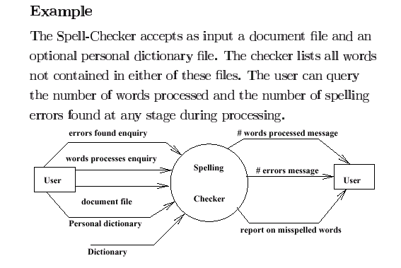
Class Exercise

Slide 49
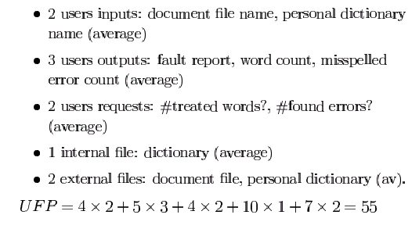
Solution

Slide 50
Solution
    Technical Complexity Factors:
      1. Data Communication 3
      2. Distributed Data Processing 0
      3. Performance Criteria 4
      4. Heavily Utilized Hardware 0
      5. High Transaction Rates 3
      6. Online Data Entry 3
      7. Online Updating 3
      8. End-user Efficiency 3
      9. Complex Computations 0
      10. Reusability 3
      11. Ease of Installation 3
      12. Ease of Operation 5
      13. Portability 3
      14. Maintainability 3
        DI =30 (Degree of Influence)

Slide 51
Solution
Function Points
  FP=UFP*(0.65+0.01*DI)= 55*(0.65+0.01*30)=52.25
  That means FP=52.25

Slide 52
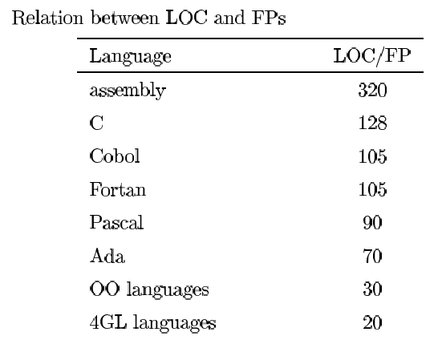
Relation between LOC and FP
Relationship:
  LOC = Language Factor * FP
  where
    LOC (Lines of Code)
    FP (Function Points)

Slide 53
Relation between LOC and FP(.)
Assuming LOC’s per FP for:
Java = 53,
C++ = 64
KLOC = FP * LOC_per_FP / 1000
It means for the SpellChekcer Example: (Java)
LOC=52.25*53=2769.25 LOC or 2.76 KLOC

Slide 54
Simple Object-Oriented Estimation
Simple 4 step model developed by Lorenz and Kidd
The number of estimated classes served as the size parameter

Slide 55
The Four Steps
Determine the number of problem domain classes in the application
Determine the interface and the associated weight
Calculate the number of total classes by multiplying the number of problem domain classes by the interface weight and add it to the number of problem domain classes
Calculate the number of man-days by multiplying the total number of classes by a productivity constant in the range of 15 - 20

Slide 56
Interface Weights
Interface Type | Weight
No user interface | 2.0
Simple text-based interface | 2.25
Graphical user interface | 2.5
Complex graphical user interface | 3.0

Slide 57
Class Exercise
An object-oriented application has an estimated 50 problem domain cases and a graphical user interface. Assuming a productivity constant of 18, calculate the number of man-days that will needed to develop the application.

Slide 58
COCOMO
COCOMO is a static single variable model
COCOMO is an acronym for Constructive Cost Model that was developed by Barry Boehm
The COCOMO models are defined for three classes of software projects.
    (1) organic mode
    (2) semi-detached mode
    (3) embedded mode

Slide 59
Introduction to COCOMO models
The COstructive COst Model (COCOMO) is the most widely used software estimation model.
The COCOMO model predicts the effort and duration of a project based on inputs relating to the size of the resulting systems and a number of "cost drives" that affect productivity.

Slide 60
COCOMO
COCOMO is actually a hierarchy of models of the following form
  Basic COCOMO – estimates software development effort and cost as a function of program size in lines of code
  Intermediate COCOMO - estimates software development and cost as a function of program size in lines of code and a set of “cost drivers”
  Advanced COCOMO – incorporates the characteristics of intermediate COCOMO with an assessment of the cost driver impact on each phase of the software development cycle
The more complex models account for more factors that influence software projects, and make more accurate estimates.
The most important factors contributing to a project's duration and cost is the Development Mode

Slide 61
Project Types/Levels of COCOMO
The level of difficulty was broken into three modes
Organic Mode
  Constraints on development are mild
  Many similar projects previously developed by the organization
  Relatively small, simple software projects in which small teams with good application experience work to a set of less than rigid requirements (e.g., a thermal analysis program developed for a heat transfer group)
Semi-detached Mode
  More constraints on development, but some flexibility remains
  Few similar projects previously developed by the organization
  An intermediate (in size and complexity) software project in which teams with mixed experience levels must meet a mix of rigid and less than rigid requirements (e.g., a transaction processing system with fixed requirements for terminal hardware and data base software)
Embedded Mode
  Very tight constraints
  No similar projects previously developed
  A software project that must be developed within a set of tight hardware, software and operational constraints (e.g., flight control software for aircraft).
Notes:
Organic Mode: The project is developed in a familiar, stable environment, and the product is similar to previously developed products. The product is relatively small, and requires little innovation.
Semidetached Mode: The project's characteristics are intermediate between Organic and Embedded.
Embedded Mode: The project is characterized by tight, inflexible constraints and interface requirements. An embedded mode project will require a great deal of innovation.

Slide 62
Modes

Slide 63
Modes (.)

Slide 64
Effort Computation
The Basic COCOMO model computes effort as a function of program size. The Basic COCOMO equation is:
  Effort = aKLOC^b
Effort for three modes of Basic COCOMO.
Mode | a | b
Organic | 2.4 | 1.05
Semi-detached | 3.0 | 1.12
Embedded | 3.6 | 1.20

Slide 65

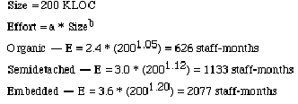
Example

Slide 66
Example

Slide 67
COCOMO (cont)
The intermediate model calibrated on
  40 software development projects
Further work revealed certain difficulty factors that dramatically influenced the effort estimates and schedule

Slide 68
Intermediate COCOMO Calculations
Intermediate COCOMO calculations proceed by
  First, determine the mode (organic, semi-detached, embedded)
  This determines the constants A - D
Parameter | Organic | Semi-detached | Embedded
A | 3.2 | 3.0 | 2.8
B | 1.05 | 1.12 | 1.20
C | 2.5 | 2.5 | 2.5
D | 0.38 | 0.35 | 0.32

Slide 69
Intermediate COCOMO (cont)
  Second, using the appropriate constants from the previous table, calculate the nominal effort and schedule from
  Third, calculate a difficulty multiplier that depends upon the cost drivers (include subjective assessments of attributes in the general areas of )
    Product
    Hardware
    Personnel
    Project

Slide 70
Intermediate COCOMO (cont)
  Fourth, the adjusted effort E is the nominal effort E_{nominal} multiplied by the difficulty multiplier
  Fifth, the project duration is calculated from

Slide 71
Effort Computation
The intermediate COCOMO model computes effort as a function of program size and a set of cost drivers. The Intermediate COCOMO equation is:
  E = aKLOC^b*EAF
Effort for three modes of intermediate COCOMO.
Mode | a | b
Organic | 3.2 | 1.05
Semi-detached | 3.0 | 1.12
Embedded | 2.8 | 1.20

Slide 72
Effort computation(.)
Effort Adjustment Factor
Cost Driver
Very
Low
Low
Nominal
High
Very
High
Extra
High
Required Reliability
.75
.88
1.00
1.15
1.40
1.40
Database Size
.94
.94
1.00
1.08
1.16
1.16
Product Complexity
.70
.85
1.00
1.15
1.30
1.65
Execution Time Constraint
1.00
1.00
1.00
1.11
1.30
1.66
Main Storage Constraint
1.00
1.00
1.00
1.06
1.21
1.56
Virtual Machine Volatility
.87
.87
1.00
1.15
1.30
1.30
Comp Turn Around Time
.87
.87
1.00
1.07
1.15
1.15
Analyst Capability
1.46
1.19
1.00
.86
.71
.71
Application Experience
1.29
1.13
1.00
.91
.82
.82
Programmers Capability
1.42
1.17
1.00
.86
.70
.70
Virtual machine Experience
1.21
1.10
1.00
.90
.90
.90
Language Experience
1.14
1.07
1.00
.95
.95
.95
Modern Prog Practices
1.24
1.10
1.00
.91
.82
.82
SW Tools
1.24
1.10
1.00
.91
.83
.83
Required Dev Schedule
1.23
1.08
1.00
1.04
1.10
1,10
Each of the 15 attributes receives a rating on a six-point scale that ranges from "very low" to "extra high" (in importance or value).
The product of all effort multipliers results in an effort adjustment factor (EAF).
Notes:
Consult Wikipedia for the format used in the exam

Slide 73
Effort Computation (..)
Total EAF = Product of the selected factors
Calculating Adjusted value of Effort or Adjusted Person Months:
E= (Total EAF) * E_{Nominal}

Slide 74


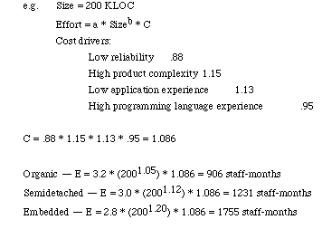
Example

Slide 75
Software Development Time
Development Time Equation Parameter Table:
Development Time, TDEV = C * E ^{D}
Number of Personnel, NP = E/ TDEV
where E is the Adjusted Effort
Parameter | Organic | Semi-detached | Embedded
C | 2.5 | 2.5 | 2.5
D | 0.38 | 0.35 | 0.32

Slide 76
COCOMO II
COCOMO II was developed to address several issues that did not exist when the original COCOMO was developed
  The waterfall model was the software lifecycle development model
  Most software ran on mainframes
  Client-server and object oriented technologies were unknown, or at least were not widely used
  Simple reuse in effect – no inheritance, etc

Slide 77
COCOMO II (cont)
Major differences
  COCOMO was based upon lines of codes estimate
    COCOMO II allows the use of other metrics, i.e. function points
  COCOMO had a constant exponent, depending upon which of three modes is selected
    COCOMO II allows the exponent to continuously vary between 1.01 and 1.26
  COCOMO assumes that savings due to reuse are directly proportional to the amount of reuse
    COCOMO II uses a non linear model – even a small amount of reuse may incur a huge effort in understanding the code

Slide 78
COCOMO II (cont)
  COCOMO II modified the difficulty factors
  COCOMO II was calibrated with 83 projects

Slide 79
Distribution of Effort
A development process typically consists of the following stages:
  Requirements Analysis
  Design (High Level + Detailed)
  Implementation & Coding
  Testing (Unit + Integration)

Slide 80
Distribution of Effort (.)
The following table gives the recommended percentage distribution of Effort (APM) and TDEV for these stages:
Percentage Distribution of Effort and Time Table:
Req
Analysis
Design,
HLD + DD
Implementation
Testing
Effort
23%
29%
22%
21%
100%
TDEV
39%
25%
15%
21%
100%

Slide 81
Error Estimation
Calculate the estimated number of errors in your design, i.e.total errors found in requirements, specifications, code, user manuals, and bad fixes:
  Adjust the Function Point calculated in step1
AFP = FP ** 1.25
  Use the following table for calculating error estimates
Error Type | Error / AFP
Requirements | 1
Design | 1.25
Implementation | 1.75
Documentation | 0.6
Due to Bug Fixes | 0.4

Slide 82
All Together
Design
Classes*(2Function Points)
DI=∑ratings of selected factors
₁₄
TCF=0.65+0.01*∑(DI)_{j}
¹
Min[TCF]=0.65; Max[TCF]=1.35
Unadjusted Function Point (UFP table)
LOC=13.20*Num of Method
LOC=18.25*Num of Method
TCF
Modify
FP=UFP*TCF
bKLOC=∑ (LOCs for all Classes)/1000
AFP=FP*1.25
aKLOC=FP*LOC_per_FP/1000
Java=53; C++=64
Compute Errors = AFP*Y
KLOC=Max[aKLOC, bKLOC]
Compute Effort: Person Month, PM=A*(KLOC**B)
Result
EAF=Product of selected factor
Adjusted PM: APM=(total EAF)*PM
NP | Effort | time
Req | APM | TDEV
Factor:1-15
Development Time: TDEV=C*(APM**D)
Number of personnel: NP=APM/TDEV

