Slide 1
Software Engineering
CPSC 439/539
Spring 2014

Slide 2
Wanted: LaTeX Design Editor
Dear students,
The Yale Journal of Economics is seeking a LaTeX Design Editor for the Spring 2014 semester, and we’re inviting you to apply!
ABOUT THE JOURNAL:
Launched last year with the support of the Economics Department, the Journal showcases outstanding research in economics by undergraduates at Yale and across the globe. The Journal published its first issue last spring and its second issue this fall; these issues featured work by students at Yale, MIT, Princeton, and the University of Chicago on topics like Spotify’s effect on music piracy, laptops in the classroom, and IPO performance. Our work has reached students and professors across the United States and around the world.
ABOUT THE POSITION:
Our design team is responsible for typesetting and laying out the Journal using LaTeX. We’re looking for a new design editor who has previous experience using this software and who wants to be part of a new and rapidly growing publication.
HOW TO APPLY:
Please send an email to yaleeconomicsjournal@gmail.com with your name, college, and class year, as well as why you’re interested in the position and your relevant experience. Applications will be considered on a rolling basis. For additional information about the Journal, feel free to email us with questions. We hope to hear from you soon!
Regards,
Antonia Woodford, Editor-in-Chief
Moss Weinstock, Managing Editor

Slide 3
Acknowledgements
Many slides courtesy of Rupak Majumdar
Additinally, Rupak thanked Alex Aiken, Ras Bodik, Ralph Johnson, George Necula, Koushik Sen, A J Shankar
This course is inspired by various courses available on-line that combine software engineering and formal methods
  Alex Aiken’s course at Stanford
  Darko Marinov’s course at the University of Illinois

Slide 4
UML: Unified Modeling Language

Slide 5
Modeling
Describing a system at a high level of abstraction
  A model of the system
  Used for requirements and specification
Many notations over time
  State machines
  Entity-relationship diagrams
  Dataflow diagrams

Slide 6
History: 1980’s
The rise of object-oriented programming
New class of OO modeling languages
By early ’90’s, over 50 OO modeling languages

Slide 7
History: 1990’s
Three leading OO notations decide to combine
  Grady Booch (BOOCH)
  Jim Rumbaugh (OMT: Object Modeling Technique)
  Ivar Jacobsen (OOSE: OO Soft. Eng)
Why?
  Natural evolution towards each other
  Effort to set an industry standard
Notes:
･Grady Booch had done a lot of work with Rational Software in developing Ada systems.
Jim Rumbaugh led a team at the research labs at General Electric, which came out with a very popular book about a method called Object Modeling Technique (OMT).
･Ivar Jacobson built his books on his experience with telephone switches for Ericsson and introduced the concept of use cases in the first one. See Jacobson (1992 and 1995).

Slide 8
UML
UML stands for
Unified Modeling Language
Design by committee
  Many interest groups participating
  Everyone wants their favorite approach to be “in”

Slide 9
UML (Cont.)
Resulting design is huge
  Many features
  Many loosely unrelated styles under one roof
Could also be called
Union of all Modeling Languages

Slide 10
This Lecture
We discuss
  Use Case Diagrams for functional models
  Class Diagrams
  Object Diagrams
  Sequence Diagrams
  Activity Diagrams for dynamic models
  State Diagrams
This is a subset of UML
  But probably the most used subset
Book UML Distilled by Martin Fowler
for structural models

Slide 11
Use Case Diagram
Elements
  Actors
  Use cases
  Relations
Use case diagram shows relationship between actors and use cases
Use
case
actor
Use
case
actor
Notes:
Actors are users of the system—human users of other systems—stick figures if human user—box annotated with <<Actor>> for system
Use Cases --- functionality or services provided by a system to users-oval shaped
Relations: --lines connecting use cases ad use cases and actors

Slide 12
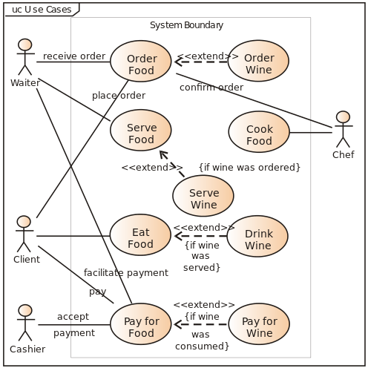
Use Case Diagram Example
Notes:
Source: Wikipedia

Slide 13
Project and Resource Management System
A resource manager manages resources
A project manager manages projects
A system administrator is responsible for administrative functions of the system
A backup system houses backup data for the system

Slide 14
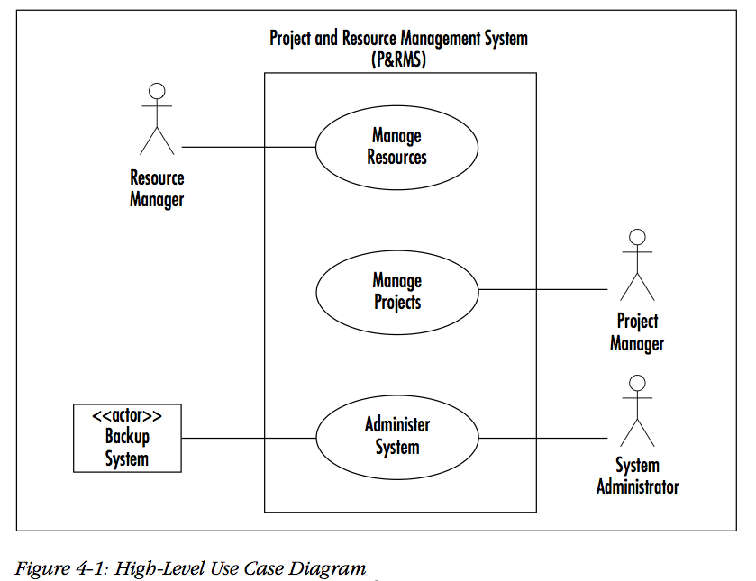

Slide 15
Manage Project Use Case
A project manager can add, remove, and update a project
Remove and update project requires to find project
A project update may involve
  Add, remove, or update activity
  Add, remove, or update task
  Assign resource to a task or unassign resource from a task

Slide 16
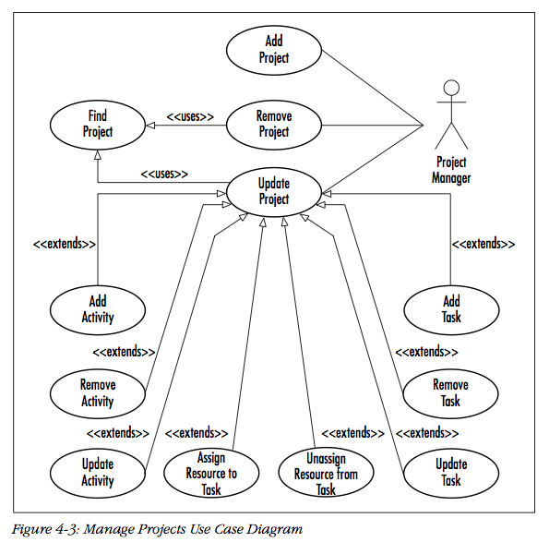

Slide 17
Class Diagrams
Train
lastStop
nextStop
velocity
doorsOpen?
addStop(stop);
startTrain(velocity);
stopTrain();
openDoors();
closeDoors();
Describe classes
  In the OO sense
Class diagrams are static -- they display what interacts but not what happens when they do interact
Each box is a class
  List fields
  List methods

Slide 18
Class Diagrams: Relationships
Many different kinds of edges to show different relationships between classes
Mention just a couple

Slide 19
Association
Association between two classes
  if an instance of one class must know about the other in order to perform its work.
Label endpoints of edge with cardinalities
  Use * for arbitrary
Can be directional (use arrows in that case)
Customer
1
*
Order

Slide 20
Aggregation Composition
An association in which one class belongs to a collection
  Shared: An object can exist in more than one collections
  No ownership implied
Denoted by hollow diamond on the “contains” side
An association in which one class belongs to a collection
  No Sharing: An object cannot exist in more than one collections
  Strong “has a” relationship
  Ownership
Denoted by filled diamond on the “contains” side

Slide 21
Car
Project
1
1
4
1..*
Wheels
Consultant

Slide 22
Composition Aggregation
Car
Project
1
1
4
1..*
Wheels
Consultant

Slide 23
CPSC439
AKW
1
1
*
1..*
Student
classroom

Slide 24
Aggregation Composition
CS439
AKW
1
1
*
1..*
Student
Classroom

Slide 25
Generalization
Inheritance between classes
Denoted by open triangle
Button
RequestButton
EmergencyButton

Slide 26
Generalization
(Think subclassing)
Doctor
Hospital Doctor
General Practitioner
Cardiologist

Slide 27
Composition vs Aggregation in Java
final class Car {
private Engine engine;
void setEngine(Engine engine) {
this.engine = engine;
}
void move() {
if (engine != null)
engine.work();
}
}
final class Car {
private final Engine engine;
Car(EngineSpecs specs) {
engine = new Engine(specs);
}
void move() {
engine.work();
}
}

Slide 28
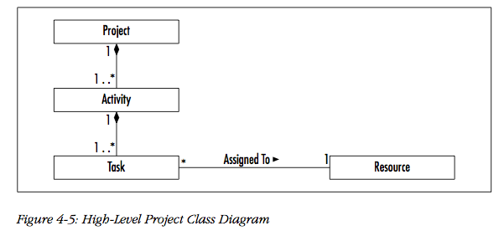

Slide 29
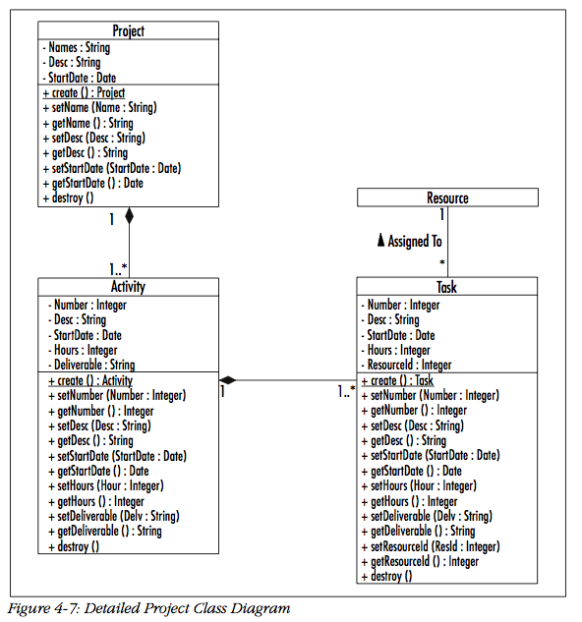

Slide 30
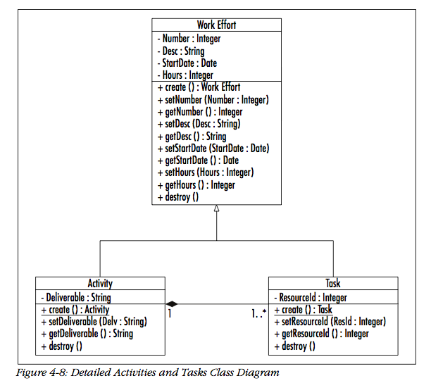

Slide 31
Object Diagram
Object diagram is an instantiation of a class diagram
Represents a static structure of a system at a particular time
Now obsolete (link)

Slide 32
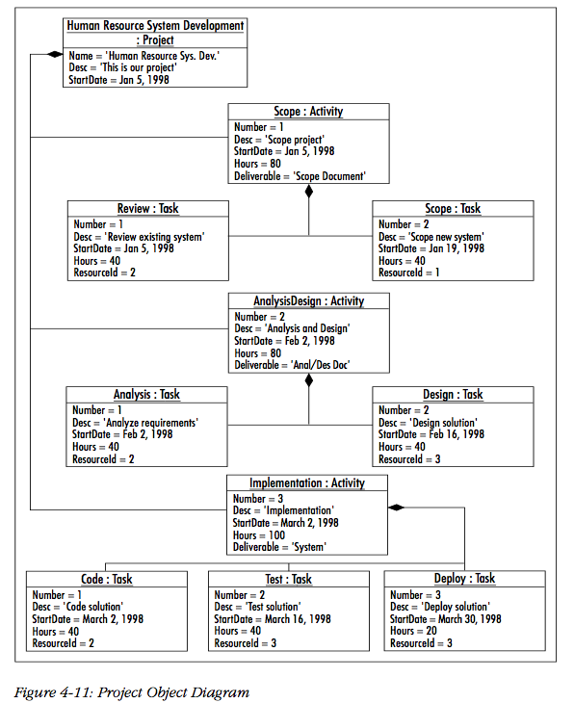

Slide 33
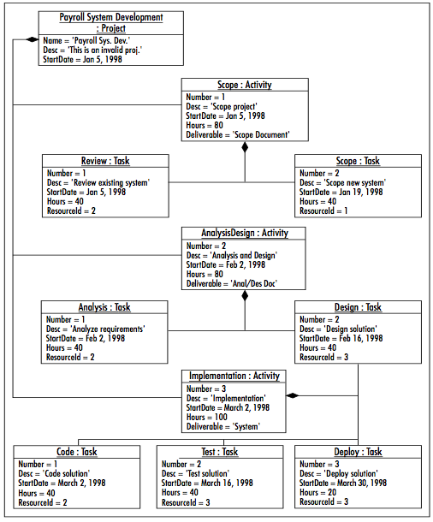
Invalid
Object
Diagram
Notes:
Link from Design: Task to Impl : Activity should not be there

Slide 34
Sequence Diagrams
Sequence diagrams
  Refine use cases
  Gives view of dynamic behavior of classes
    Class diagrams give the static class structure
Not orthogonal to other diagrams
  Overlapping functionality
  True of all UML diagrams

Slide 35
Sequence Diagrams
Class roles: roles that objects play
Lifelines: the existence of an object over time
Activations: time during which an object is performing an operation
Messages: communications between objects

Slide 36
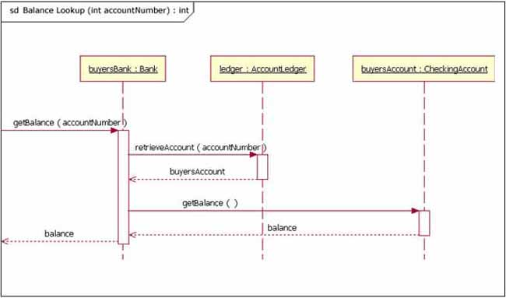
link

Slide 37
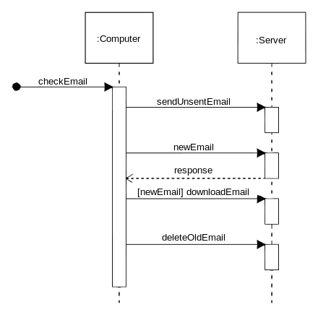
Notes:
Source: Wikipedia

Slide 38
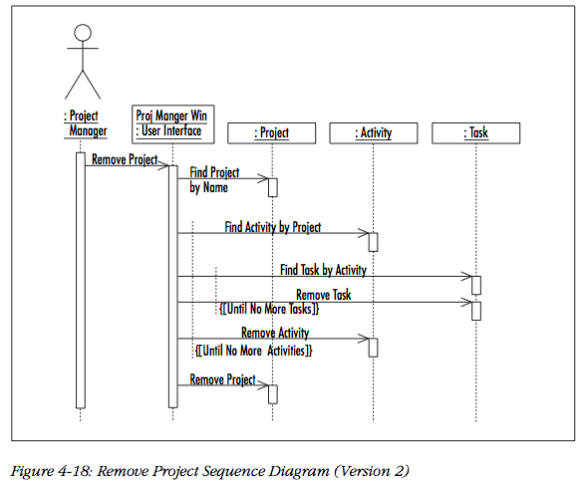

Slide 39
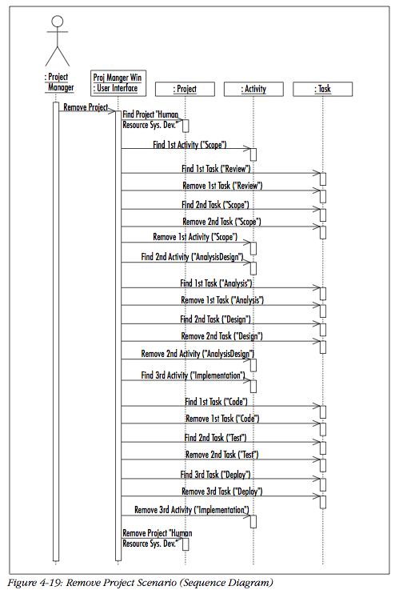

Slide 40
Activity Diagrams
Reincarnation of flow charts
  Uses flowchart symbols
Emphasis on control-flow

Slide 41
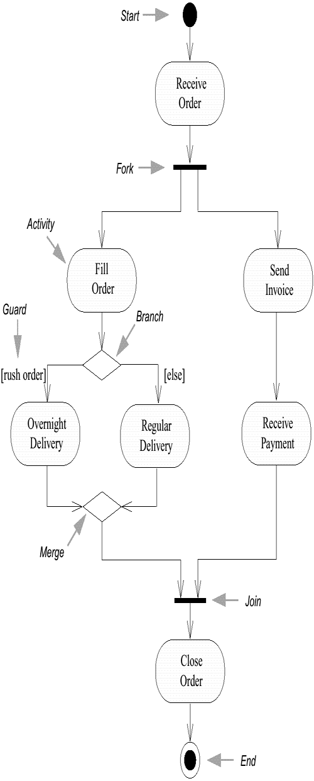

Slide 42
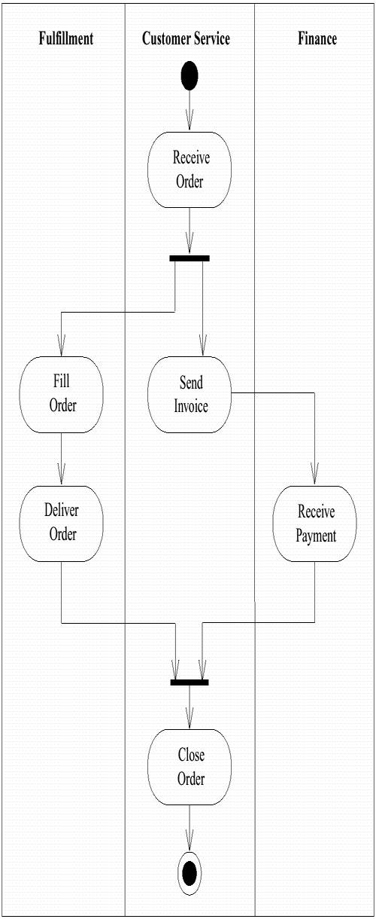

Slide 43
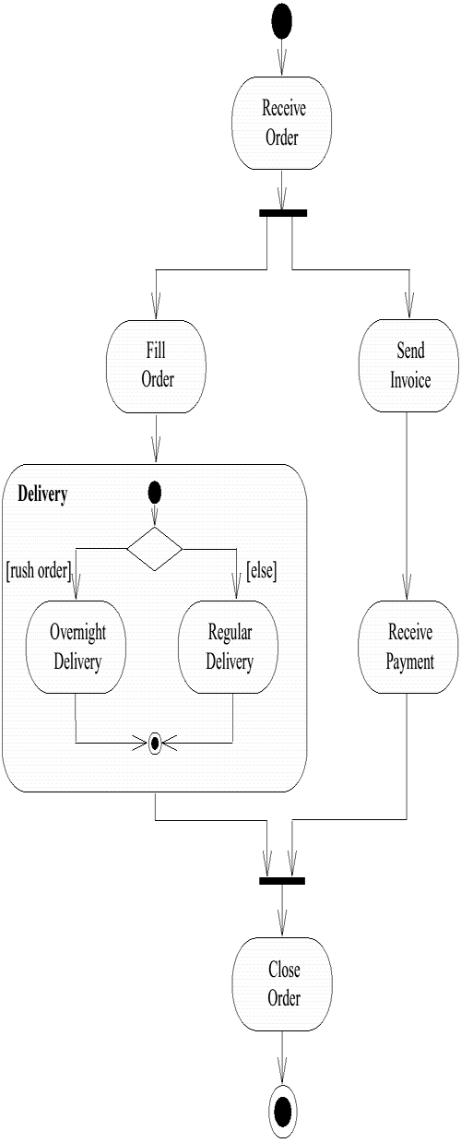
Order (input parameter)
Order (output parameter)

Slide 44
Question
How will you model the following situation:
In parallel, you accept payment and send order to warehouse to be delivered.
Then the warehouse throws an exception to denote product is not available
Then you must put back the charge on the CC
In general, how do you handle exceptions?

Slide 45
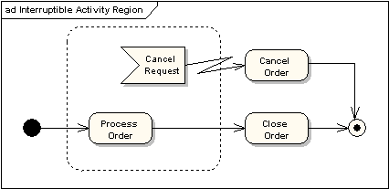

Slide 46
Activity Diagrams
Swimlanes: responsibility of one or more objects
Action states: steps in the execution of an algorithm
Action flows: relationship between the different action states
Object flow: utilization of objects by action states

Slide 48
StateChart Diagrams
Hierarchical finite automata
  Invented by David Harel, 1983
Specify automata with many states compactly

Slide 49
Example Simple StateChart
Button
off
depart
push
on

Slide 50
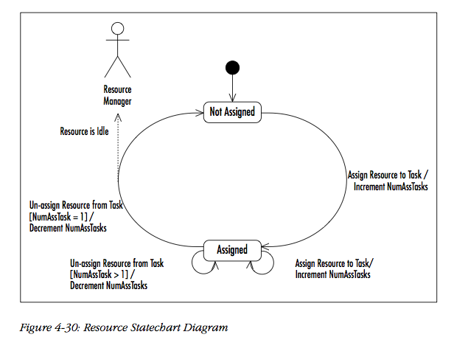

Slide 51
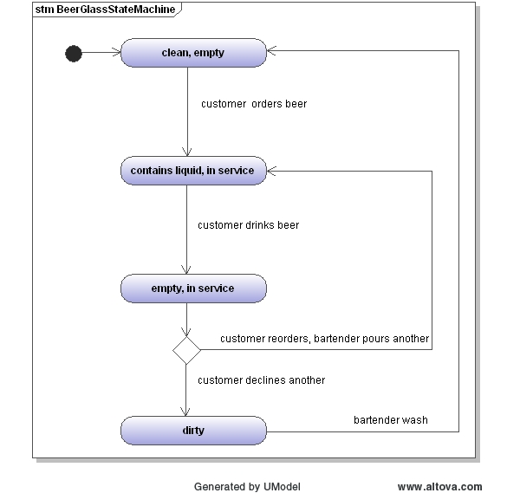

Slide 52
This Lecture
We discussed
  Use Case Diagrams for functional models
  Class Diagrams
  Object Diagrams
  Sequence Diagrams
  Activity Diagrams for dynamic models
  State Diagrams
This is a subset of UML
  But probably the most used subset
for structural models

Slide 53
Opinions about UML: What’s Good
A common language
  Makes it easier to share requirements, specs, designs
Visual syntax is useful, to a point
  A (good) picture is worth 1000 words
  For the non-technical, easier to grasp simple diagrams than simple pseudo-code
To the extent UML is precise, it forces clarity
  Much better than natural language
Commercial tool support
  Something natural language could never have

Slide 54
Opinions On UML: What’s Bad
Hodge-podge of ideas
  Union of most popular modeling languages
  Sublanguages remain largely unintegrated
Visual syntax does not scale well
  Many details are hard to depict visually
    Ad hoc text attached to diagrams
  No visualization advantage for large diagrams
    1000 pictures are very hard to understand

Slide 55
UML is Happening
UML is being widely adopted
  By users
  By tool vendors
  By programmers
A step forward
  Seems useful
  First standard for high-levels of software process
  Expect further evolution, development of UML

Slide 56
Exercise
Decide on a high-level specification
  E.g., Structure of the government in the US, or your own system of choosing classes to attend this semester
Work in groups of 3-4
No talking or writing in any natural language
ONLY using UML to communicate, see if you can come up with a thorough design of the system so that all of you agree on the design of the system

Slide 57
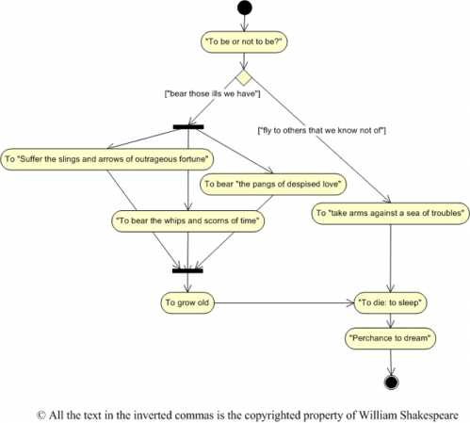
Hamlet Activity

