Slide 1

Microservices
Architecture and Apps for Libraries
Marshall Breeding
Independent Consultant, Author, and
Founder and Publisher, Library Technology Guides
https://librarytechnology.org/
https://twitter.com/mbreeding
Internet Librarian 2018
October 17, 2018

Slide 2
Summary
Get an introduction to the microservices architecture and how it differs from the monolithic style of software development. Microservices have emerged as the preferred approach for complex business applications deployed at massive scale. This architecture has increasingly been incorporated into new applications for libraries. Breeding provides perspective on how this style of software development and deployment will increasingly enter the library sphere.

Slide 3
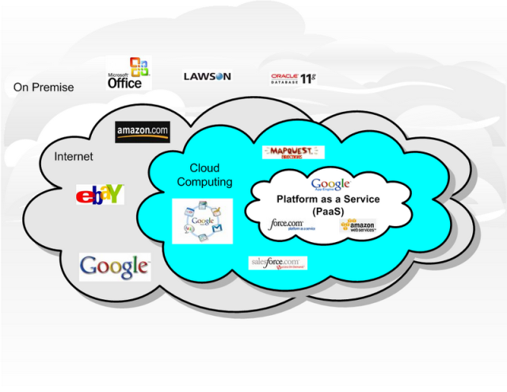
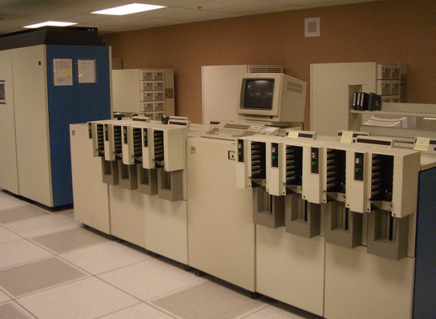
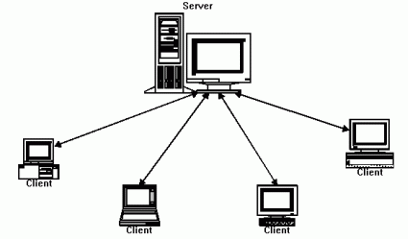
Fundamental technology shift
Mainframe computing
Client/Server
Cloud Computing
http://www.flickr.com/photos/carrick/61952845/
http://soacloudcomputing.blogspot.com/2008/10/cloud-computing.html
http://www.javaworld.com/javaworld/jw-10-2001/jw-1019-jxta.html

Slide 4
Microservices
Current prevailing approach for large scale globally distributed applications
Common choice for new development projects for business software
Many organizations are also evolving existing monolithic applications to Microservices

Slide 5
What are microservices?
A model of technical architecture
  Small independent functional applications
  Each microservices built on appropriate technical components
A software development pattern
  Decentralization of technical components
  Distributed programming / DevOps teams
  Responsibility to deploy, operate, and maintain services

Slide 6
From apps to systems
Many microservices are assembled to create a complex business application
Separate independent components
Brought together via middleware or API gateway

Slide 7
Software Development Styles
Monolithic Applications
  Codebase of application deployed as a single bundle of executables and libraries on a unified platform
Microservices Architecture
  Multiple independent software components orchestrated to form a unified application
  Common infrastructure:
    User interface toolkit
    API Gateway
    Persistence layer

Slide 8
An internal architecture
Not necessarily apparent to users whether the application is based on microservices
Needed for fast performance, high availability, extreme transaction loads
Decentralized architecture does not imply fragmented user experience

Slide 9
Who uses Microservices
Uber
Netflix
Amazon
Ebay
Twitter
PayPal

Slide 10
Alternative approach: Monolithic software
Consolidated executable application
  Plus supporting libraries and modules
Can be massively distributed across computing clusters
Entire application based on a uniform technology stack:
  Server platform
  Operating system
  Programming language
  Database layer
Enhancements mean recompilation of entire application

Slide 11
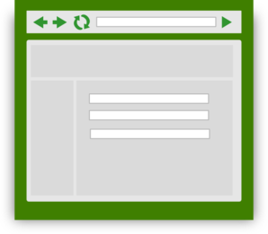

Monolithic Application Conceptual Model
Scripts/
Third Party Systems
User
Interfaces
API endpoints
Web service
Presentation Layer
Application software
Business Logic
Run time libraries
Database Engine
Table
Table
Table
Table
Table
Table
Table
Table
Table
Table
Table
Table
Table
Table
Table
Table

Slide 12
Services-oriented Architecture
Longstanding approach to business application development
Monolithic application based on reusable services
Complex applications rely on an enterprise service bus to manage communications among services, database connectivity, event triggers, etc
Single uniform technology platform
Code assembled into a monolithic package
Scales to very high performance through clustered deployment

Slide 13
SOA development issues
Services are closely interrelated throughout the application
Developers must understand all aspects of the application
Single technology stack
Small changes require full recompilation
Complex applications can hit hardware or OS limits
Centralized development pattern
Operations separated from Development

Slide 14
Monolithic Application: Enterprise SOA Model
Scripts/
Third Party Systems
User
Interfaces
API endpoints
Web service
Presentation Layer
Application software Business Logic
}
Reusable
Composable
Services
Enterprise Service Bus
Database Engine
Table
Table
Table
Table
Table
Table
Table
Table
Table
Table
Table
Table
Table
Table
Table
Table

Slide 15
Building a microservice
Small unit of functionality
Complete and independent technology stack
Separate data stores
  Synchronization with other services as needed through persistence layers
Invoked through API Request / Response
Usually: REST, HTTP, JSON
Self-contained components
Inner workings not exposed externally
  Developers have free reign to select tech components

Slide 16
Microservice conceptual model
Request
Response
REST / HTTPS
Microservice
Web service
Service components
Application
software
Run time libraries
Data Store

Slide 17
Assembling an application
Each microservice performs a small limited task
  Not intended to be standalone applications
Surrounded by specialized infrastructure
Manage communications
Orchestrate services into complex chains of tasks
Load balancing
API Gateway
User Interface layer
Externally exposed APIs
Multiple instances of any microservice launched as needed

Slide 18

Microservices-based Application
Scripts/
Third Party Systems
User
Interfaces
API endpoints
Presentation Layer / UI Toolkit
API Gateway
Microservice
Web service
Microservice
Microservice
Microservice
Service components
Web service
Web service
Web service
Microservice
Service components
Service components
Service components
Web service
Microservice
Microservice
Microservice
Service components
Application
software
Web service
Web service
Microservice
Microservice
Web service
Service components
Service components
Web service
Web service
Service components
Application
software
Application
software
Service components
Application
software
Service components
Run time libraries
Application
software
Application
software
Run time libraries
Application
software
Run time libraries
Run time libraries
Application
software
Application
software
Data Store
Application
software
Run time libraries
Run time libraries
Data Store
Run time libraries
Data Store
Data Store
Run time libraries
Run time libraries
Run time libraries
Data Store
Data Store
Data Store
Data Store
Data Store
Data Store
Persistence / System
Layer

Slide 19
Beyond Virtual Machines to Containers
Virtual machines are a common technology for optimizing use of computing hardware
Most applications use a small portion of computing and storage capacity
VM managers enable multiple instances of operating environments to co-exist on each physical server

Slide 20
Virtual Machine Environment
Multiple Virtual Machines can share a single physical server
VMs allocated via a Virtual Machine Monitor or Hypervisor
Each VM contains its own operating system, code libraries, applications, web services, and other components
Each VM independent: can host any OS, libraries, apps
VM-1
VM-2
VM-3
VM-4
Apps
Apps
Apps
Apps
Code libraries
Code libraries
Code libraries
Code libraries
Guest OS
Guest OS
Guest OS
Guest OS
Virtual Machine Monitor
Host operating system
Server Hardware

Slide 21
Containers
Server hardware provides OS Kernel to any container
Code libraries and binaries, memory, disk storage, and other resources residing on the server can be provisioned to any container
Containers can be rapidly deployed based on pre-defined configuration sets
Containers require fewer resources: do not run an entire copy of OS and support services
Containers can differ or replicate
  High demand microservices may require many instances
Containers share resources but are designed to be rigidly independent
Container engine ensures against resource collisions
microservice
microservice
microservice
microservice
microservice
microservice
microservice
microservice
Binaries / Libraries set A
Bins / Libs B
Container Engine (eg: Docker)
Host operating system
Server Hardware

Slide 22
API Gateway
Requests to microservices usually not made directly from external agents
Need a layer to manage access to Microservices to enable flexible deployment
Multiple microservices may be required to perform a complex task
Usually many instances of each microservice
API Gateways provide a single entry point for all requests into the application.
Developers do not need to know physical address of each service (nothing should be hardwired)
Manage authentication, protocol conversions, communications, routing, load balancing

Slide 23
DevOps
Merges development with operations
A single team takes responsibility for development, deployment, operations, and maintenance of a microservice
Make independent technology decisions
  Programming language
  Databases
  (probably limited to contain technical overhead for the organization)
No need to understand all aspects of the application

Slide 24
Contracts
Any given microservice will not necessarily be aware of all the ways in which it is consumed
Microservices must be persistent to avoid failures in the broader application / ecosystem
Agreement to provide specific requests/responses
Versioning is an essential characteristic
Any deprecation must be (technically) negotiated and propagated through the microservice ecosystem
Functionality cannot be withdrawn until it is no longer required

Slide 25
Docker
Leading technical environment for the management of containers
Supported in most infrastructure environments
  Amazon Web Services

Slide 26
Containers
Allocate computing resources in even smaller increments than Virtual Machines
Share low-level components
Self-contained pre-configured operating environment
Container management environments provide fast and easy approach to deploy microservices or other computing components
Used in all types of computing environments, but especially well suited to microservices.

Slide 27
Container orchestration
In a complex environment tools are needed to manage the deployment of containers
Components need to be allocated and deallocated dynamically based on load and demand
Examples:
  Docker Swarm
  Kubernentes (developed by Google)
  Apache Mesos

Slide 28
Benefits of Microservices
Rapid development
Quick path to MVP (minimal viable product)
Distributed teams
Modularity
Scalability

Slide 29
Evolving from the Monolith to Microservices
Many organizations eventually press the limits of applications built with SOA monolithic style
Gradually offload selected tasks to microservices
Full-fledged migration to microservices can be long and expensive

Slide 30
State of the Art
Business environments based on monolithic style remain viable
Trend to base new large-scale web applications on microservices
Well accepted, modern approach among tech giants
A technical style that supports a level of scale not previously possible
Beginning to gain acceptance for mid-scale development projects.

Slide 31
Library Context: FOLIO
New open source library services platform based on the microservices architecture

Slide 32
FOLIO
Open source library services platform
Designed for multitenancy
Based on Microservices architecture
Designed for multiple deployments
In development phase: expect first libraries to go into production in 2018

Slide 33
EBSCO Supports new Open Source Project
FOLIO
  the Future of the Library is Open
https://www.folio.org/
A community collaboration to develop an open source Library Services Platform designed for innovation.
American Libraries feature:
  https://americanlibrariesmagazine.org/2016/04/22/ebsco-kuali-open-source-project/

Slide 34
FOLIO background
Initially oriented to academic libraries
Academic libraries interested in Library Services Platform
Narrow options (Ex Libris Alma, OCLC WorldShare Management Services)
Unbundle Discovery from Resource Management
  Choice for patron-facing services
Alternative functional approach based on apps and modules

Slide 35
Technology
Microservices architecture
Modular
Enables choice for discovery
Pluggable modules
Not monolithic

Slide 36
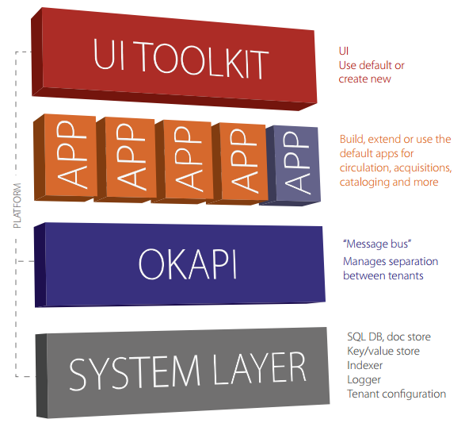
FOLIO Platform

