Slide 1
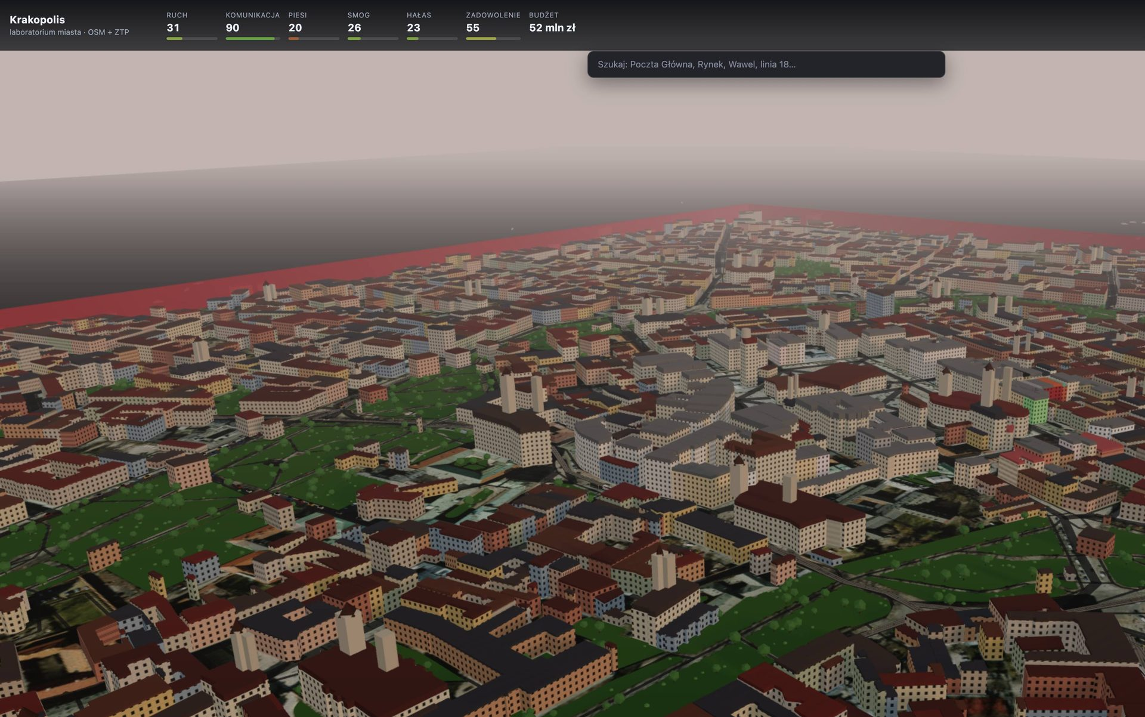
KRAKOPOLIS
Build the city. Test the decision. See the consequences.
KRAKOPOLIS · HackYeah 2026 · Smart City
1/10

Slide 2
PROBLEM
Cities are complex systems.
People see one decision — not the chain of consequences.
NEW ESTATE
+420 res.
MORE TRAFFIC
JUNCTION
LONGER TRIPS
INFRA
MODEL EST.
≈10× highrise
local load ↑
overload
travel time ↑
schools · transit
Estate scenario = MODEL ESTIMATE from catalog units (1 highrise = +44). Not an official Kraków forecast.
KRAKOPOLIS · HackYeah 2026 · Smart City
2/10

Slide 3
SOLUTION
Turn urban decisions into experiments.
1
2
3
4
BUILD
SIMULATE
OBSERVE
DECIDE
Place a change
Run the model
Read impacts
Commit or undo
Krakopolis: city-builder UX on real Kraków OSM — consequence engine underneath.
KRAKOPOLIS · HackYeah 2026 · Smart City
3/10

Slide 4
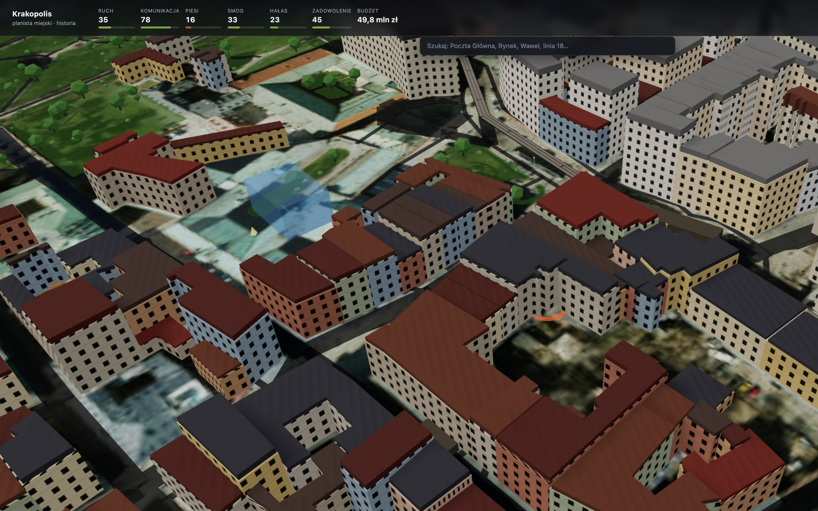
HOW IT WORKS
Decision → Simulation
→ Consequences
1 Choose
2 Preview
3 Press Enter
4 Approve
5 Simulate
6 Observe
KRAKOPOLIS · HackYeah 2026 · Smart City
4/10

Slide 5
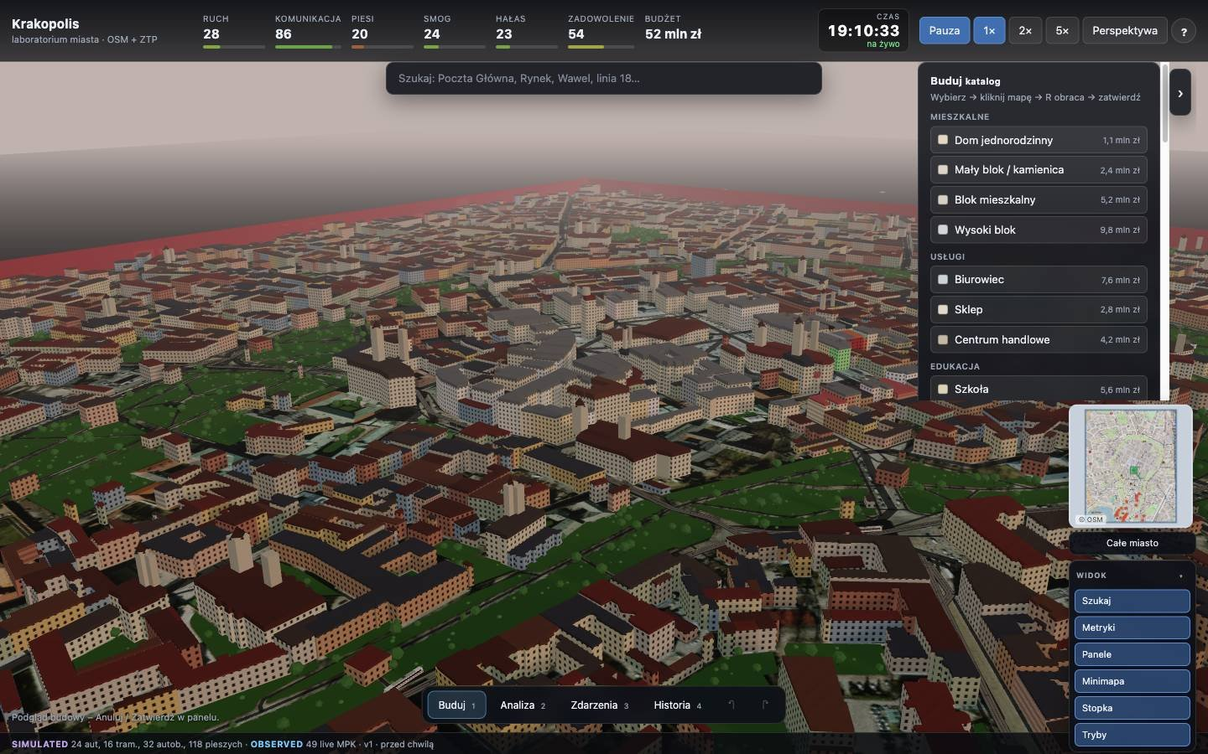
DEMO
One decision.
Visible consequences.
+44
↑ traffic
residents
local load
catalog
SIMULATED
schools ↑
9.8 mln zł
demand
budget
MODEL EST.
SIMULATED
Catalog example: Wysoki blok — labels are SIMULATED / MODEL ESTIMATE.
KRAKOPOLIS · HackYeah 2026 · Smart City
5/10

Slide 6
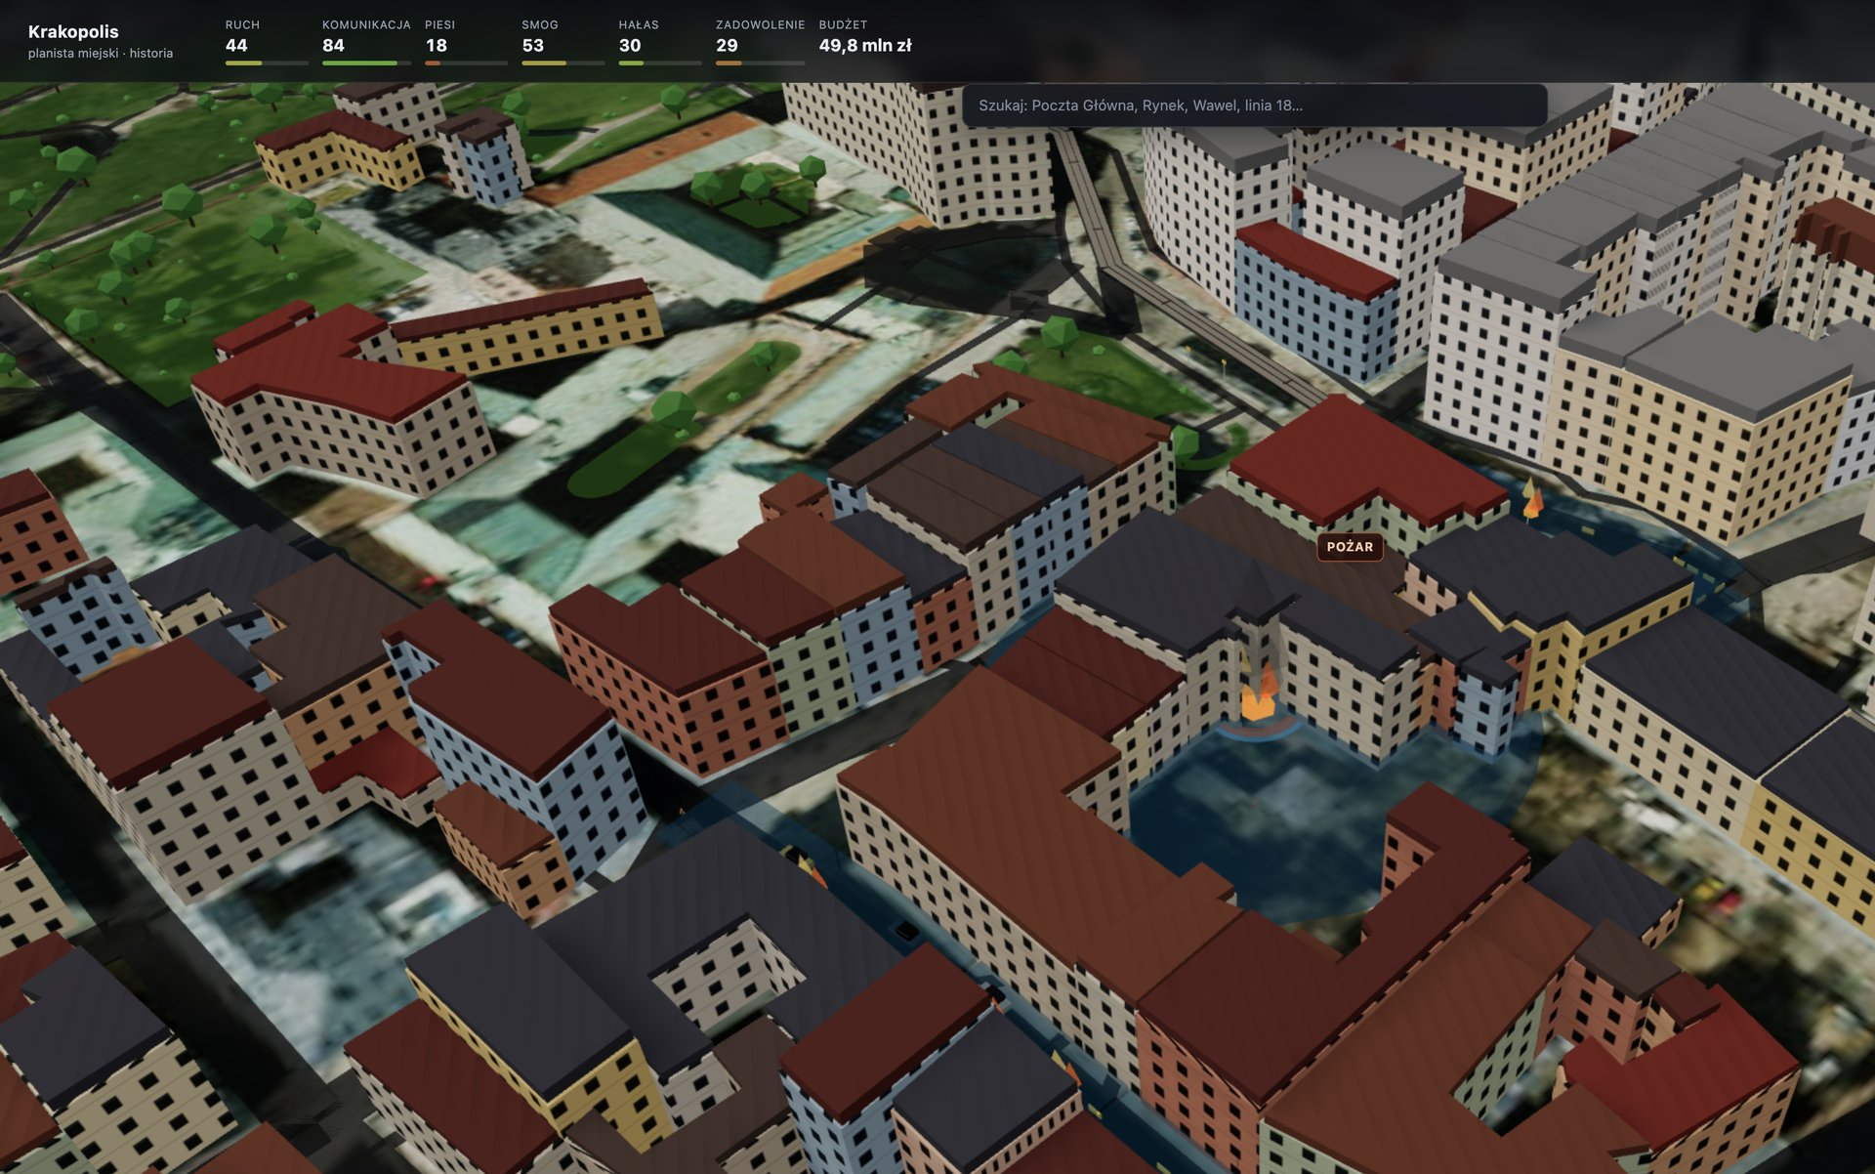
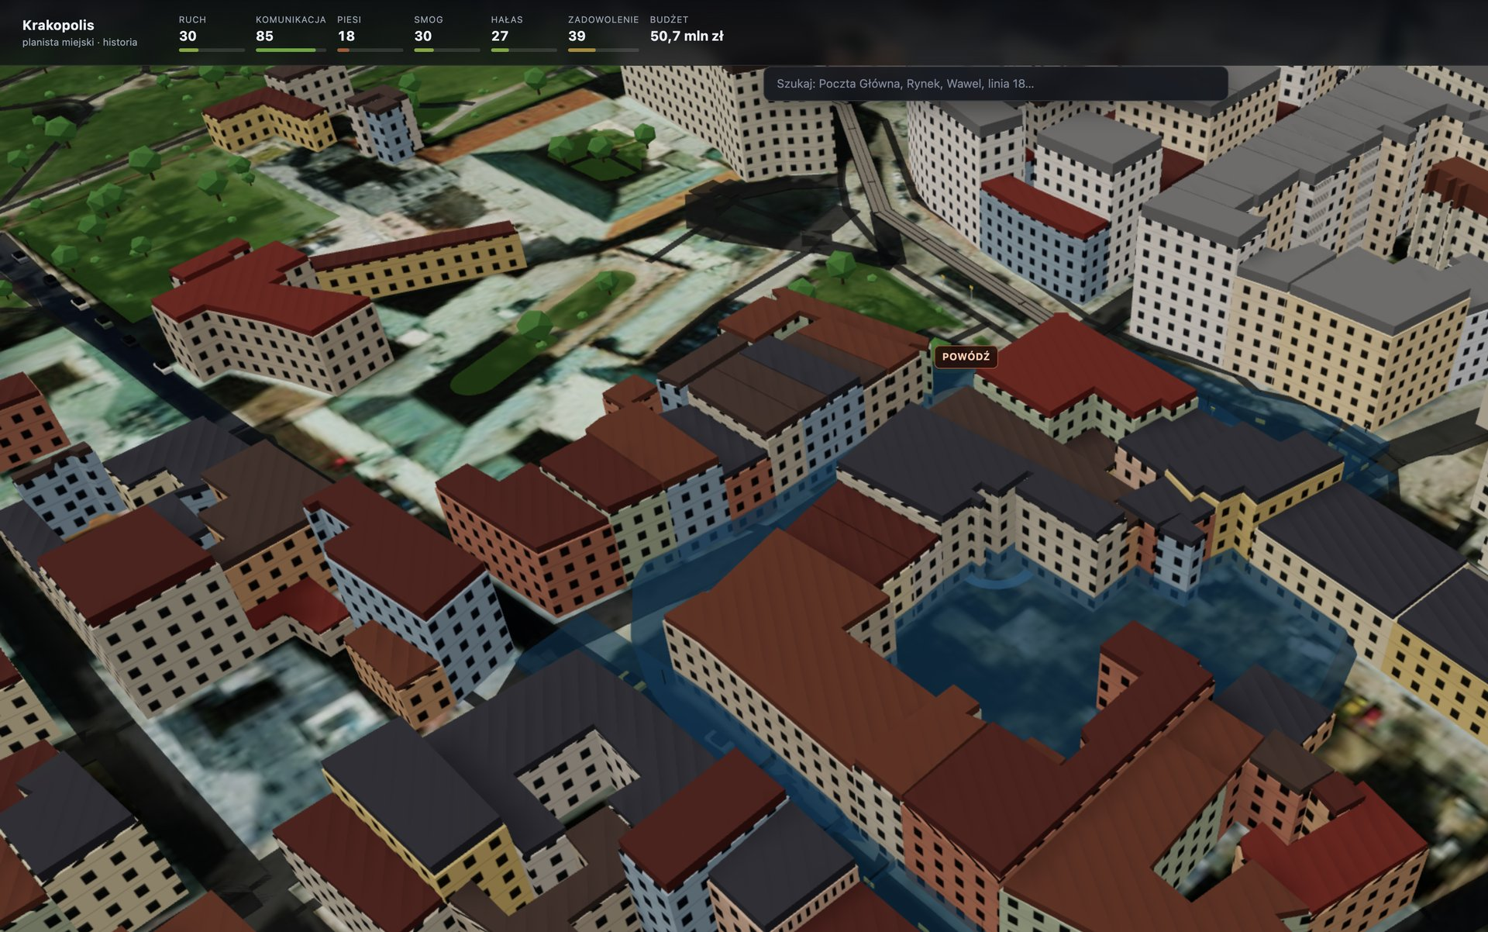
DISASTERS
Disasters are events, not animations.
FIRE · POŻAR
FLOOD · POWÓDŹ
Exact click location · roads & metrics shift · MODEL ESTIMATE for people in range
Water starts at the chosen point · spreads · closes access · SIMULATED impact
KRAKOPOLIS · HackYeah 2026 · Smart City
6/10

Slide 7
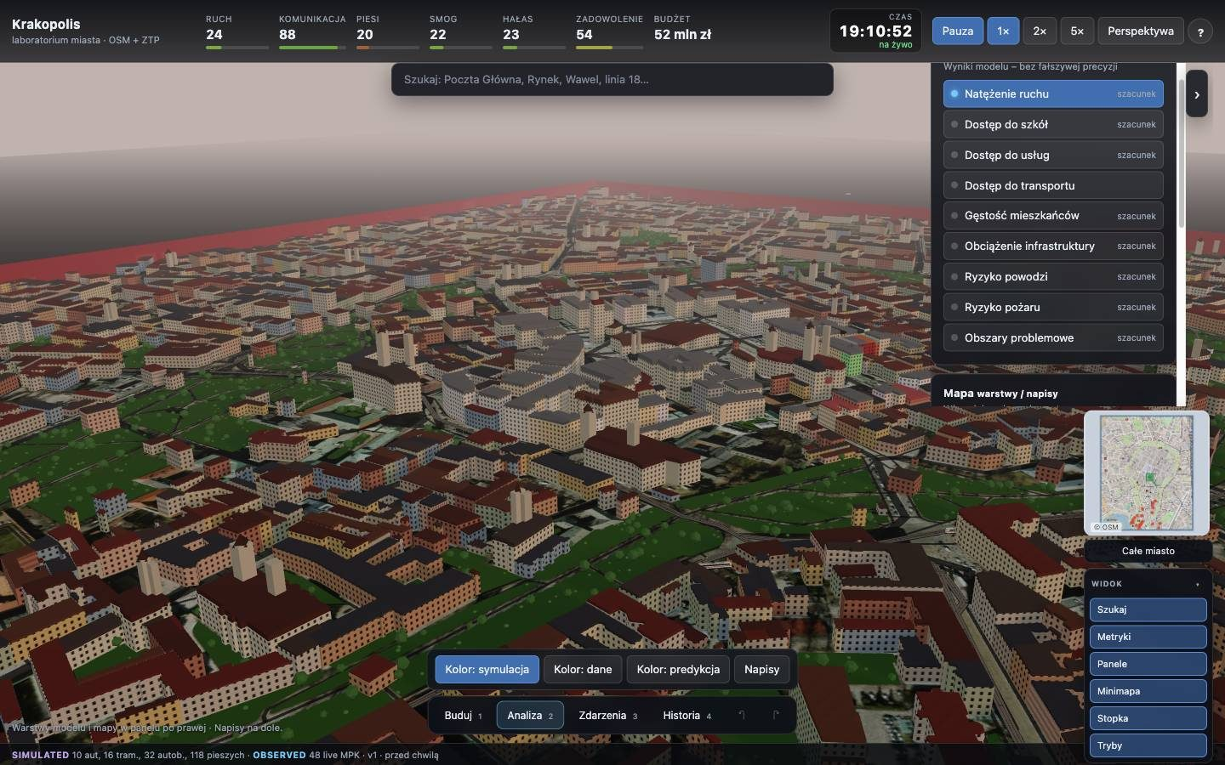
WHAT IF
What happens next?
NOW
SHORT
COMPARE
DECIDE
Immediate
Pressure
Alt. path
Commit
Analysis layers: traffic, access, risk.
All marked as szacunek / MODEL ESTIMATE.
What if we close a street?
What if we build elsewhere?
KRAKOPOLIS · HackYeah 2026 · Smart City
7/10

Slide 8
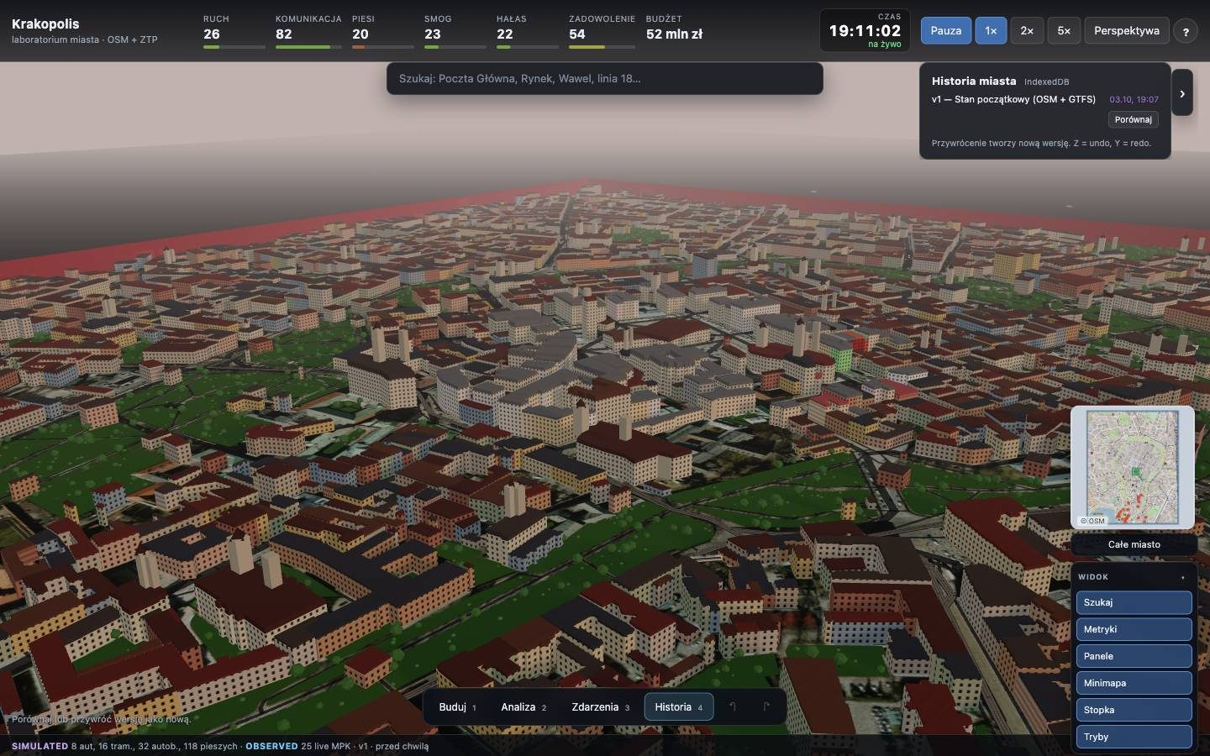
CITY MEMORY
Every decision
leaves a trace.
v1
v2
v3
v4
Compare versions
Restore earlier state
Undo / redo — history persists
Persistent city state, not a one-shot viz.
KRAKOPOLIS · HackYeah 2026 · Smart City
8/10

Slide 9
WHY KRAKOPOLIS
Simple on the surface.
Analytical underneath.
CITY-BUILDER UX
Intuitive. Fast. Playable.
LOCATION-BASED SIM
Real Kraków OSM · live transit where available
CONSEQUENCE ENGINE
Preview → confirm → observe · OBSERVED vs SIMULATED
KRAKOPOLIS · HackYeah 2026 · Smart City
9/10

Slide 10

KRAKOPOLIS
Build the city.
Test the decision.
See the consequences.
https://krakopolis.pages.dev
Try the demo
HackYeah 2026 · Smart City
KRAKOPOLIS · HackYeah 2026 · Smart City
10/10

