Slide 1
KRAKOPOLIS
3D city lab for Kraków — real OSM + ZTP data, simulated consequences
https://krakopolis.pages.dev
Hackathon pitch · Cloudflare Pages

Slide 2
Problem
• Urban decisions are hard to explain without a shared spatial model
• Open city data (OSM, GTFS/GTFS-RT) stays in silos — not playable
• Most sims invent traffic; Kraków has no open road-volume API
• Need OBSERVED vs SIMULATED made explicit — no fake AI certainty
Krakopolis · https://krakopolis.pages.dev

Slide 3
Solution
• Interactive 3D Kraków (Old Town / Kazimierz / Wawel) in the browser
• Build, analyze, run events — consequence reports before commit
• Live MPK vehicles from ZTP GTFS-RT; roads & buildings from OSM
• Every metric tagged: OBSERVED · PREDICTED · SIMULATED
• Version history (IndexedDB) — undo / compare / restore
Krakopolis · https://krakopolis.pages.dev

Slide 4
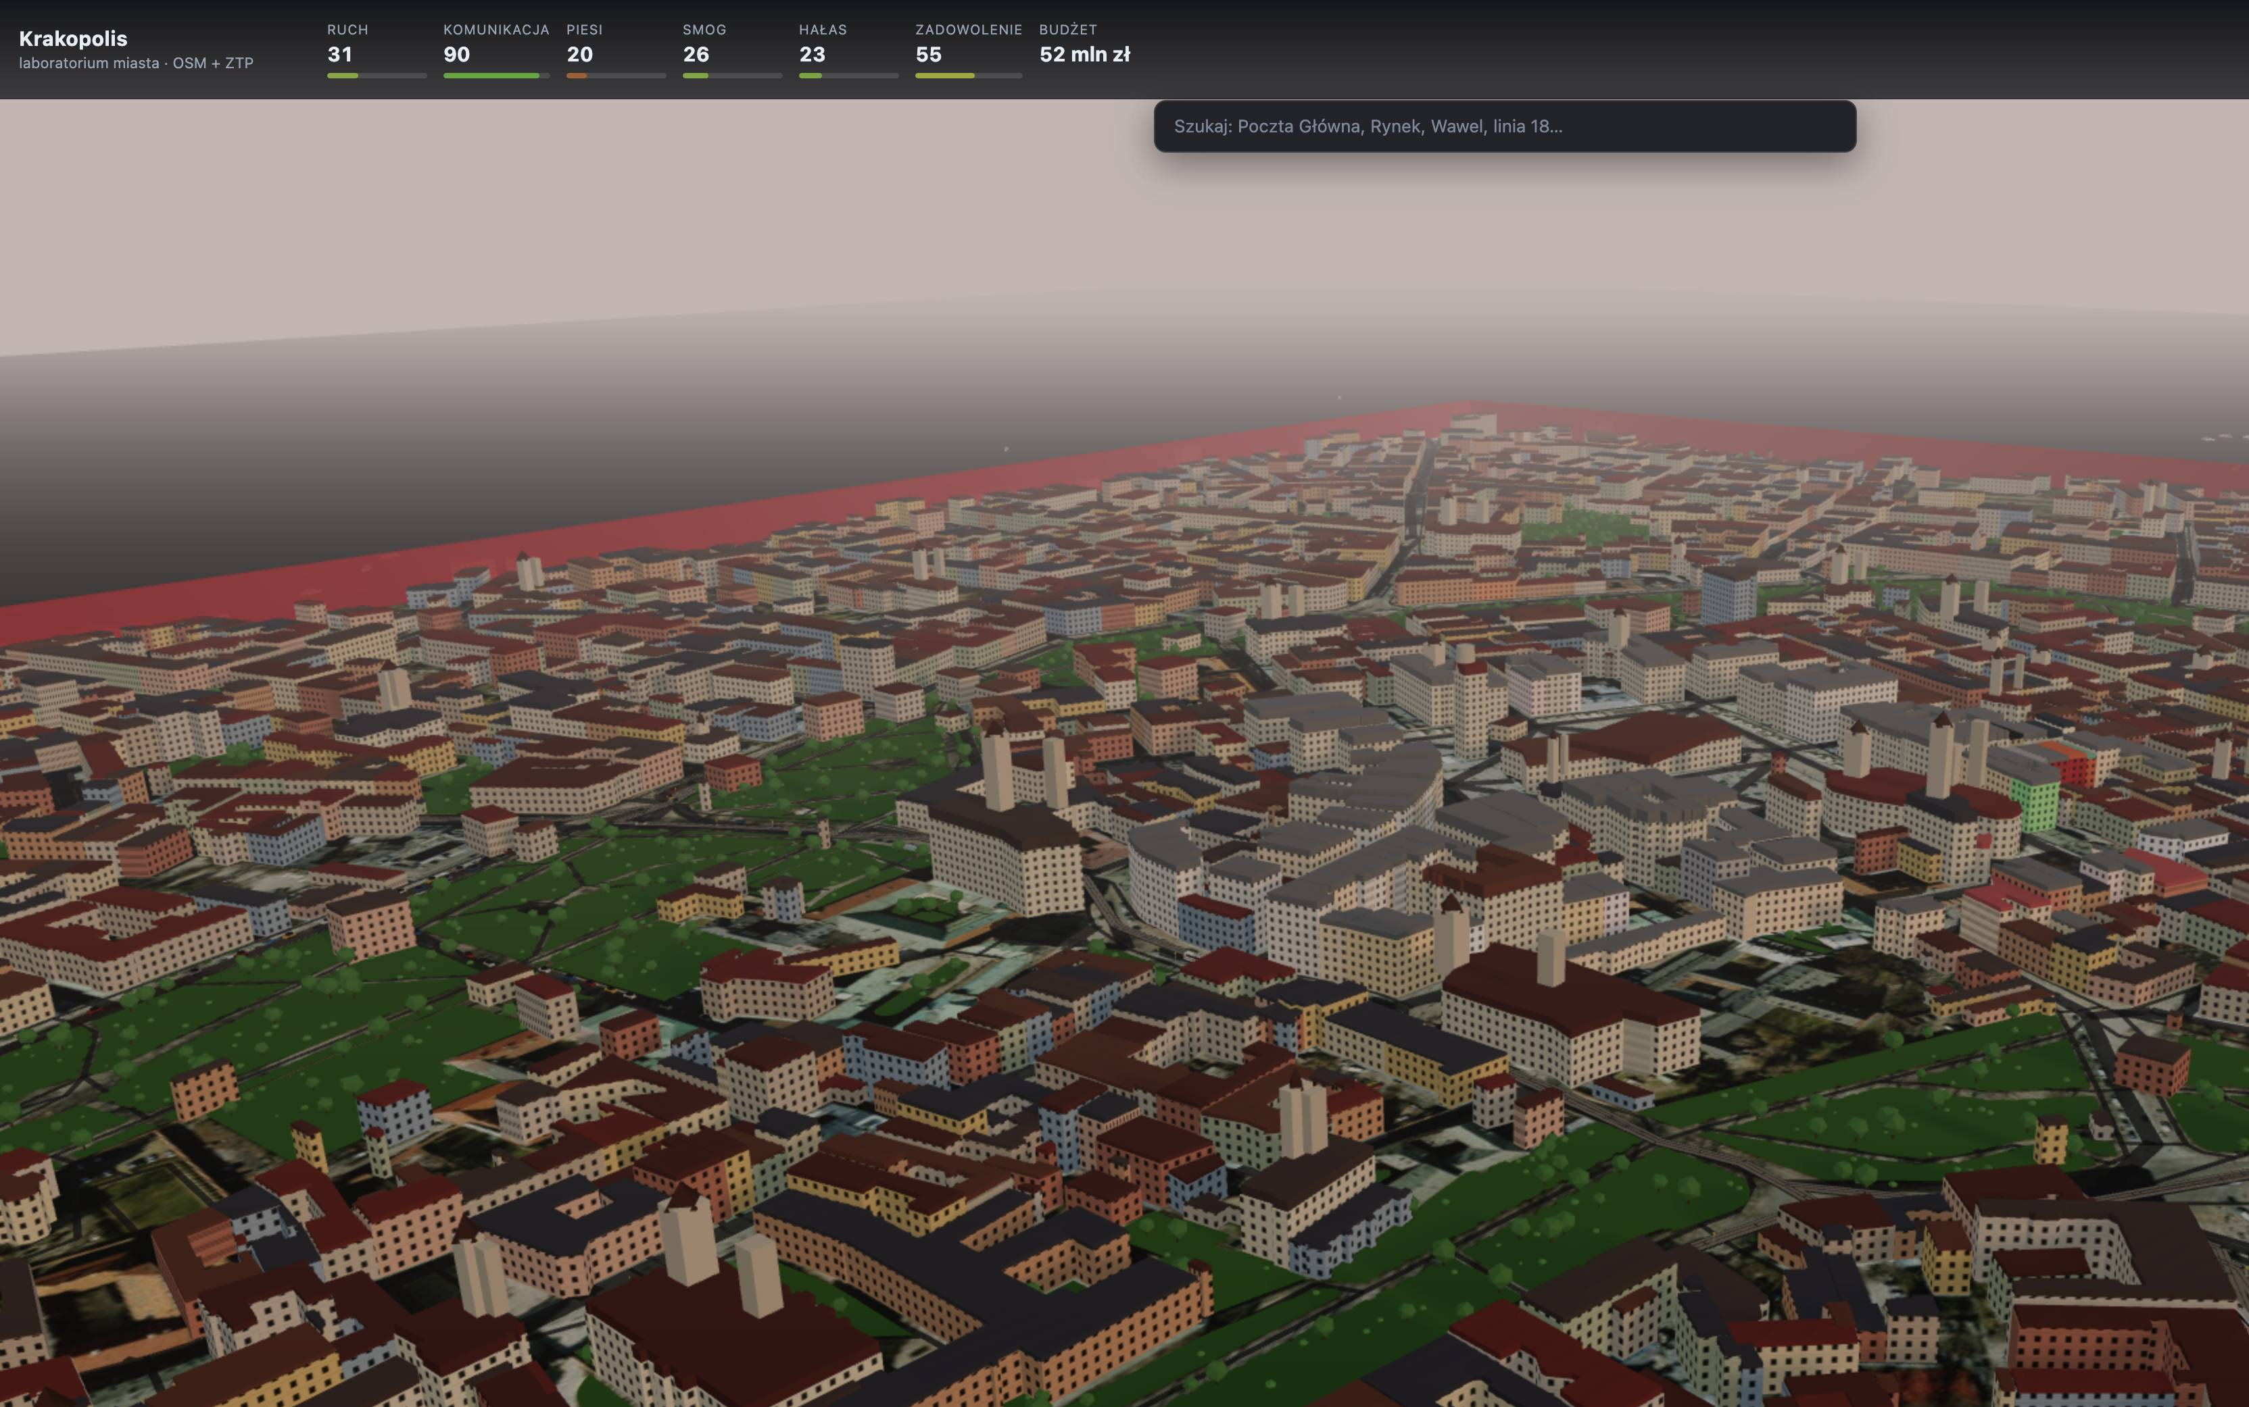

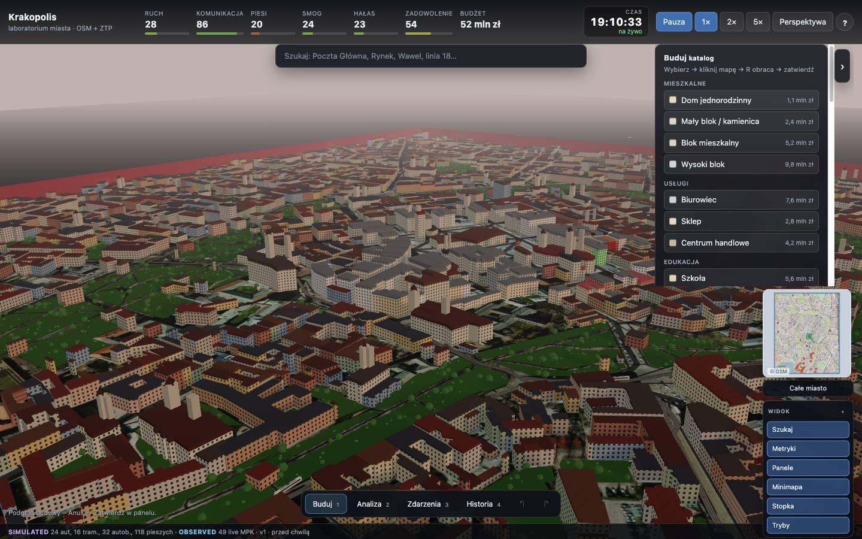
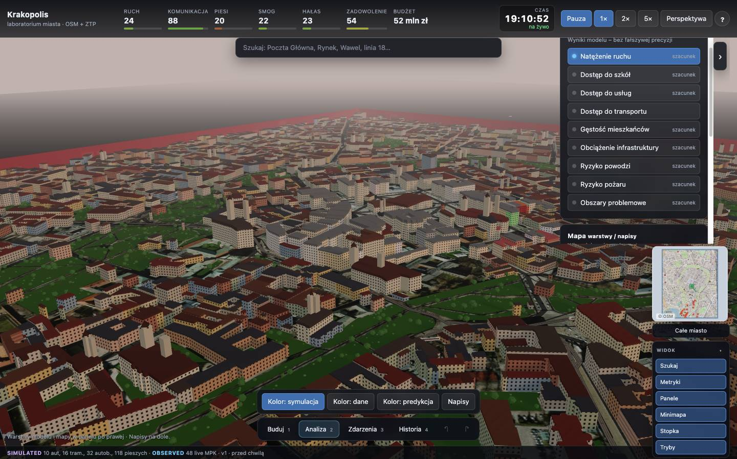
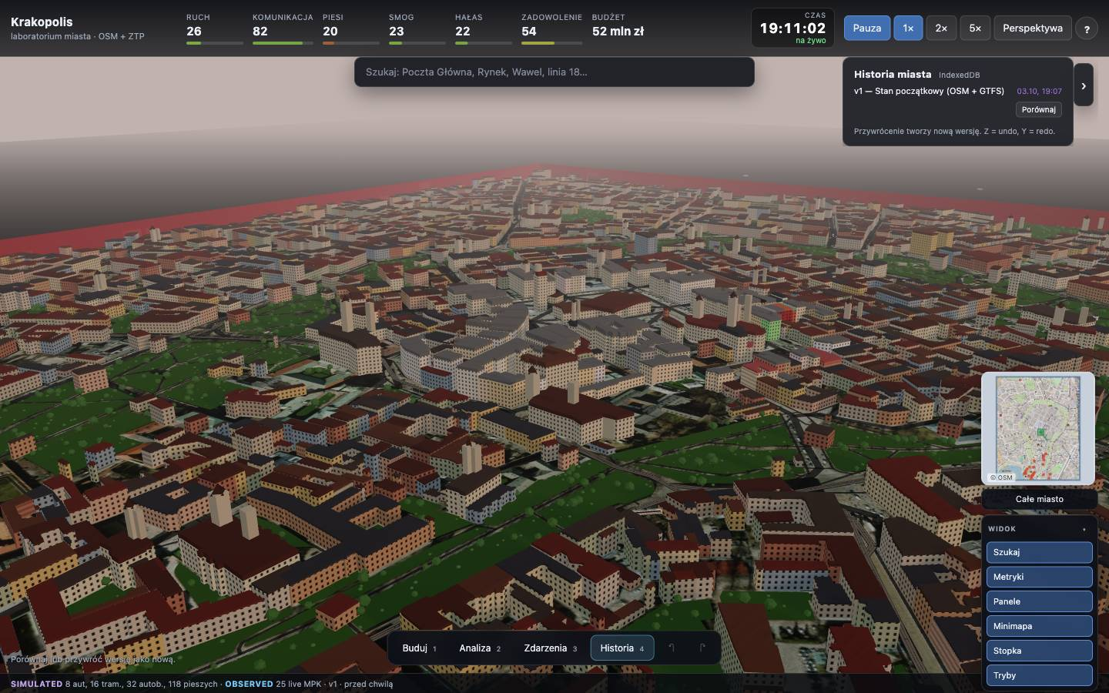
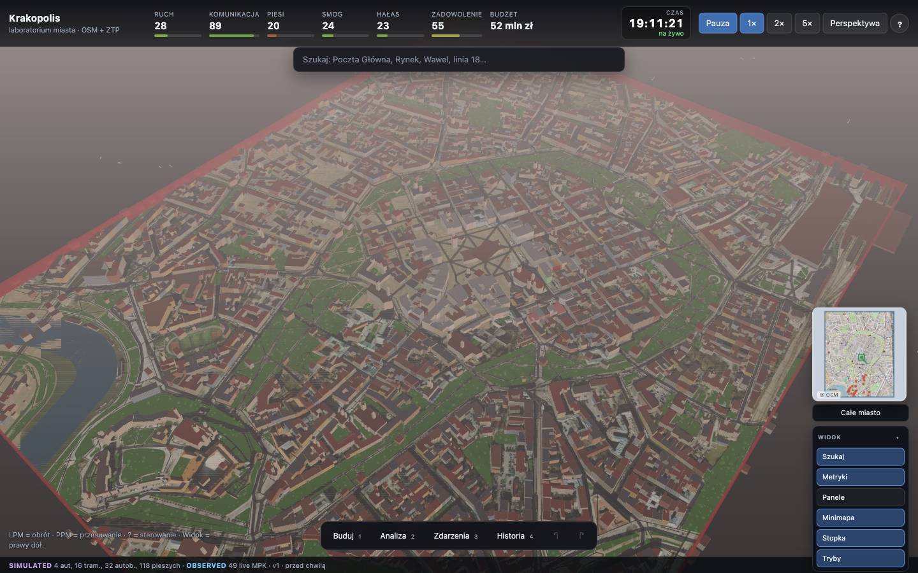
Demo / Product
3D city + HUD
Build catalog
Consequences
Analysis layers
Version history
Minimap + View
Krakopolis · https://krakopolis.pages.dev

Slide 5
Data: OBSERVED vs SIMULATED
OBSERVED
PREDICTED
SIMULATED
• OSM roads, buildings, water, parks
• ZTP GTFS routes & stops
• GTFS-RT vehicle GPS (LIVE)
• Congestion_level from ZTP
• Traffic reassignment after closure
• Derived speeds from positions
• Service / school access layers
• Always labeled as estimate
• Player buildings & parks
• Pedestrian agents
• City metrics (smog, noise…)
• Never mixed with live feeds
Krakopolis · https://krakopolis.pages.dev

Slide 6
Features
• Modes: Build · Analysis · Events · History
• Consequence preview → Confirm / Cancel before mutate
• Map layers + model overlays (traffic, access, flood risk…)
• OSM minimap + View dock (search, metrics, panels)
• Live clock, speed, perspective; green rings = real vehicles
• Offline ingest pipeline; LIVE refresh for GTFS-RT & weather
Krakopolis · https://krakopolis.pages.dev

Slide 7
Tech stack + Cloudflare
• React 18 + TypeScript + Vite
• Three.js / React Three Fiber / Drei — instanced city scene
• Custom sim engine: road graph, BPR travel time, incremental assignment
• Cloudflare Pages deploy (krakopolis.pages.dev)
• Proxy-friendly architecture for CORS-limited public feeds
• IndexedDB city versioning on the client
Krakopolis · https://krakopolis.pages.dev

Slide 8
What’s next / Ask
• Expand bbox + richer ZTP / city open-data connectors
• Deeper policy scenarios for planners & civic workshops
• Performance pass for denser districts & mobile
• Ask: teammates for UX research, data partnerships, storytelling
• Ask: mentors — validation with Kraków open-data stakeholders
Try it → https://krakopolis.pages.dev
Krakopolis · https://krakopolis.pages.dev

