Slide 1
PROSTHETIC HAND USING EXG SENSOR
By Jano koesh M

Slide 2
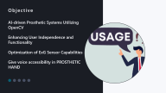



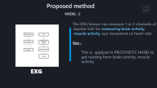




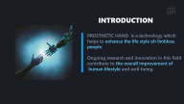
AGENDA
SIT BACK | RELAX | ENJOY
iNTRO
BODY

Slide 3
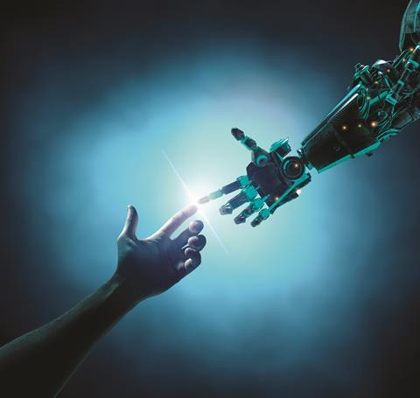
INTRODUCTION
PROSTHETIC HAND is a technology which helps to enhance the life style oh limbloss
people.
Ongoing research and innovation in this field
contribute to the overall improvement of
human lifestyle and well-being.

Slide 4
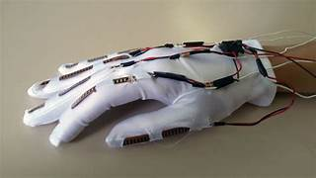
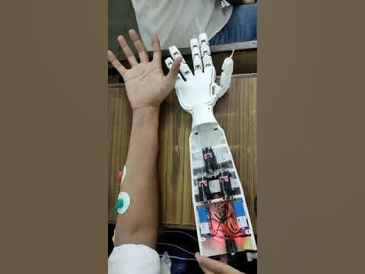
Existing system
Flex based hand
EMG based hand

Slide 5
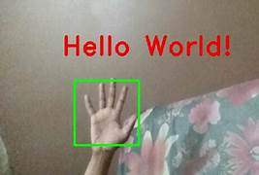
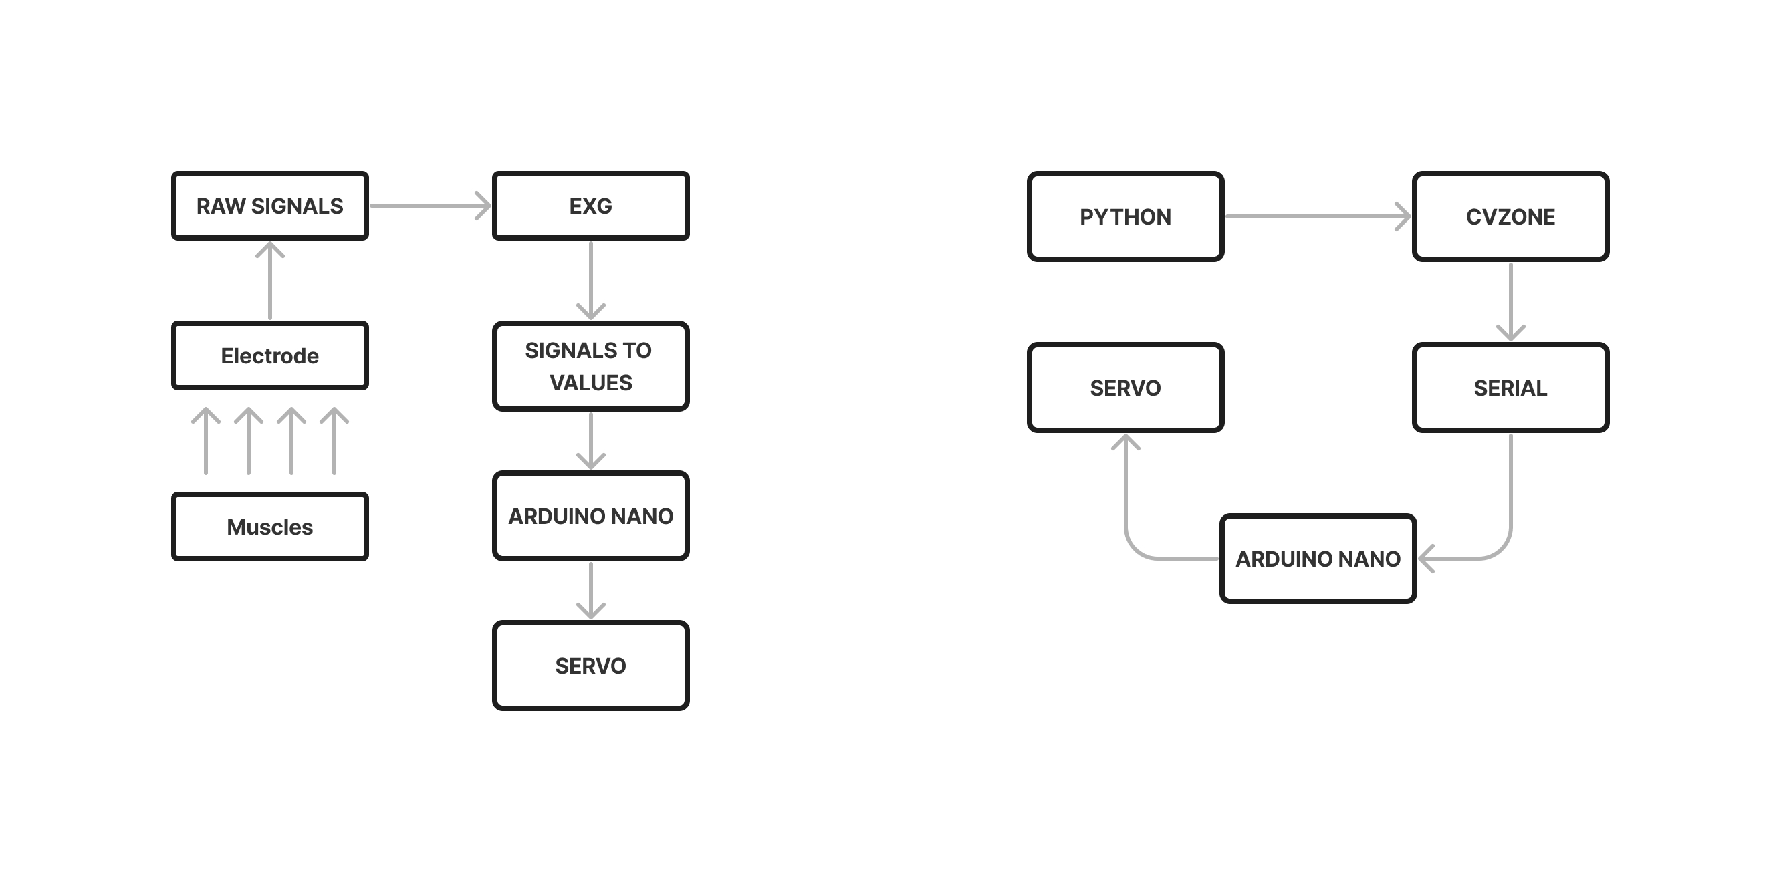
Proposed method(2 models)
MODEL : 1
Open cv is used to imitate the human hand
behavior.They are highly responsive
Use :
This can be used in Automobile industry
Flow Chart :
OPEN-CV

Slide 6
Proposed method
MODEL : 2
The EXG Sensor can measure 1 or 2 channels of
bipolar ExG for measuring brain activity,
muscle activity, eye movement or heart rate
Use :
This is applyed in PROSTHETIC HAND to
get reading from brain activity, muscle
activity
EXG

Slide 7


Objective
23%
AI-driven Prosthetic Systems Utilizing OpenCV
Enhancing User Independence and Functionality
Optimization of ExG Sensor Capabilities
Give voice accessibility in PROSTHETIC HAND

Slide 8


References
75%
Hiader, S. A. A., Nasir, A., Ameen, M., Raza, A., Waleed, A., & Ali, Z. (2021, November). Design and Development of Low Cost, Wireless Controlled, 3D Prosthetic Hand using Flex Sensors. In 2021 International Conference on Innovative Computing (ICIC) (pp. 1-6). IEEE.
Development of EMG based Prosthetic Arm,Ashik Ali Abdhul; Deepika Subramani; Janarthanan Ganesan; Sadhana Subramaniam; K.G. Dharani

Slide 9
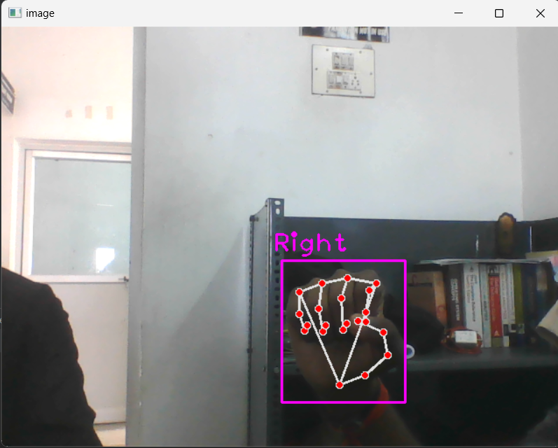

Result
75%

Slide 10


