Slide 1
AI – BASED
HEAD COUNTING
SYSTEM
Enhancing Analytics
By : Jano koesh M
Hari
Vijayamadaeshwar M

Slide 2








AGENDA
SIT BACK | RELAX | ENJOY
Body
End

Slide 3

INTRODUCTION
We have developed a automated solution
for counting people using AI
By combining the power of an AI camera
with the YOLO (You Only Look Once)
algorithm, we aim to create a robust and
efficient system for real-time people
counting.

Slide 4

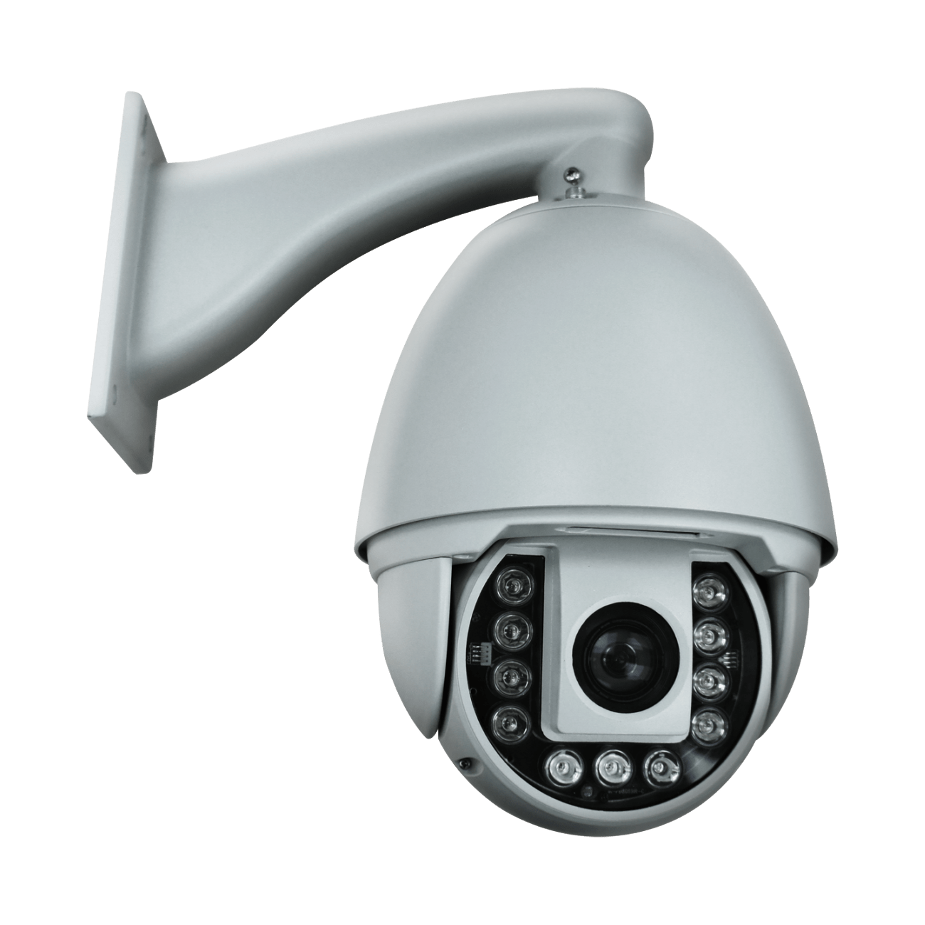


Methodology
CCTV
INFORMATION
Live stream
video
Raw Data
YOLO V3

Slide 5
WHY YOLO ?
Processes images at up to 45 frames per
second (fps) on a high-end GPU, making it
highly suitable for real-time applications.
Other : Faster R-CNN makes 5-7 fps.
YOLO achieves high accuracy by seeing the
entire image
Unified Architecture:
YOLO detects objects and their labels
in one step, making the process faster
and simpler.
YOLO 3

Slide 6

Requirement
High-End GPUs:
NVIDIA GeForce RTX 4090:
CUDA Cores: 16,384
Memory: 24 GB GDDR6X
Tensor Cores: 512 (for AI acceleration)
Mid-Range GPUs:
NVIDIA GeForce RTX 3070:
CUDA Cores: 5,888
Memory: 8 GB GDDR6
Tensor Cores: 184
Key Features: Strong performance

Slide 7

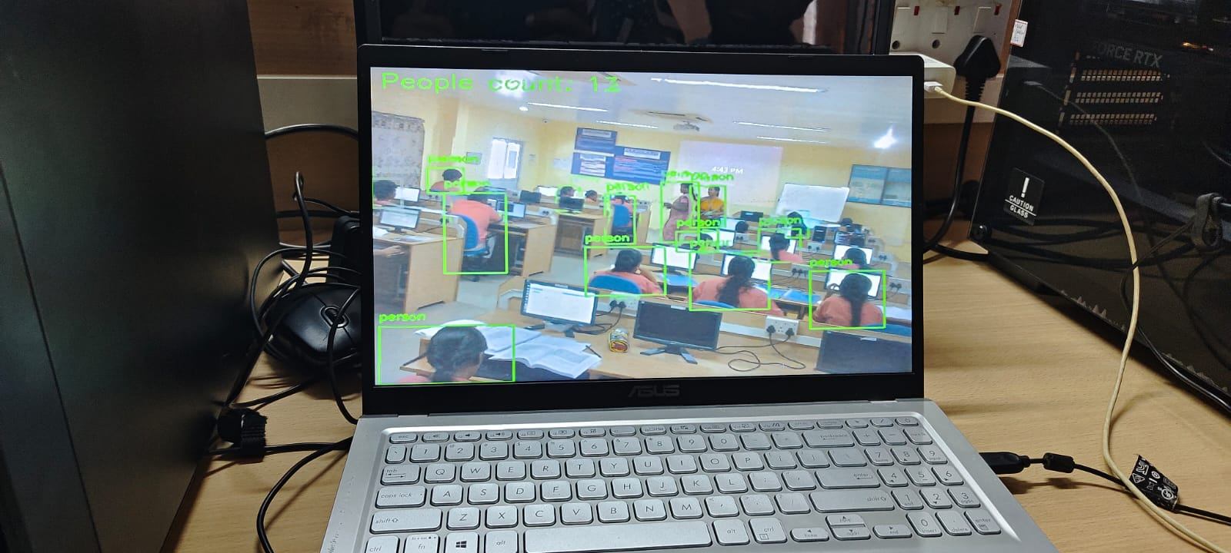
PROTOTYPE
Stream video

Slide 8


