Slide 1
Weekly Sharing
IT DIVISION - BANDES
23 April 2024
Jakarta

Slide 2

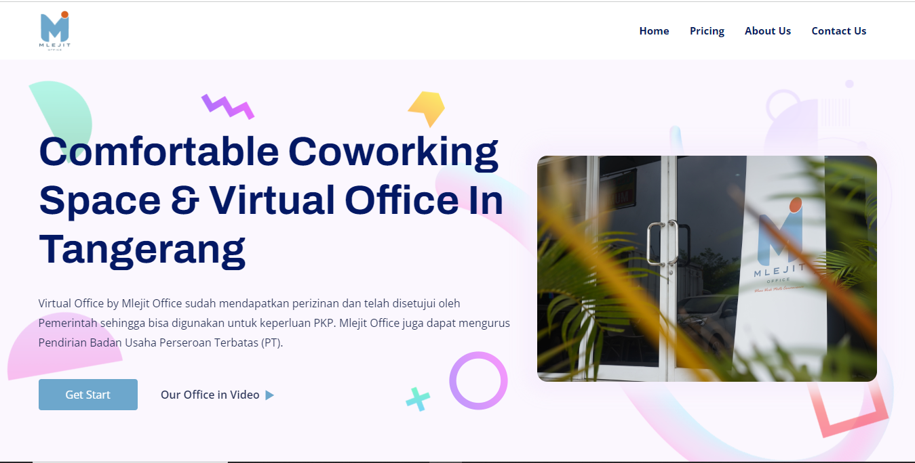
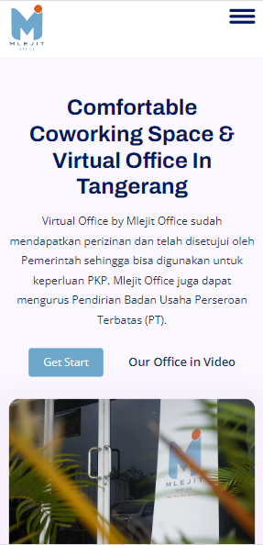
Date//Time//Year
VIRTUAL OFFICE
Status: On Progress
Update
Landing page (On Progress)
Booking system by Whatsapp and e-mail (Done).
For progress can check in https://mlejitoffice.id

Slide 3
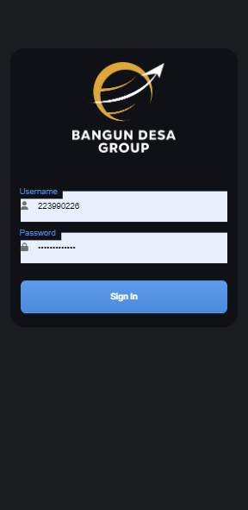
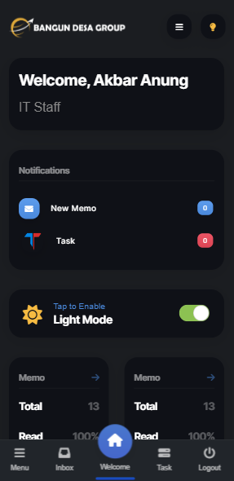
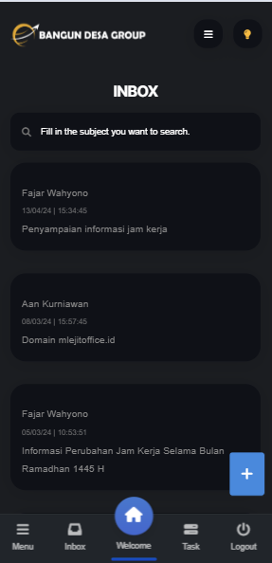
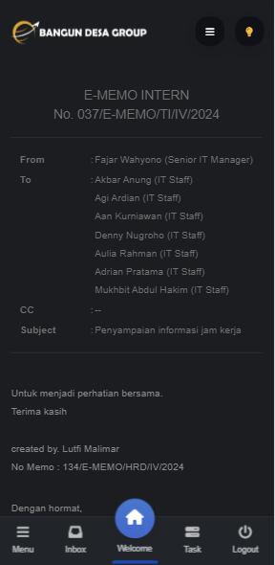
BOC Mobile Application
DARK MODE
Memo BOC (Done)
Task Management/Tello (On Progress 80%) -> Target 24/04/2024
Switch dark mode and light mode (Done)

Slide 4
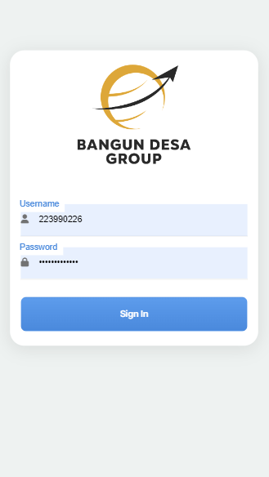
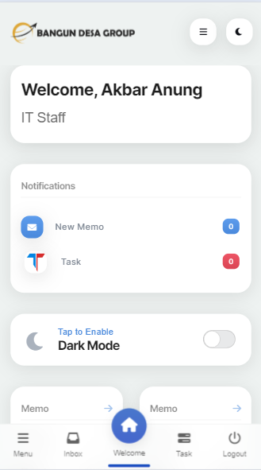
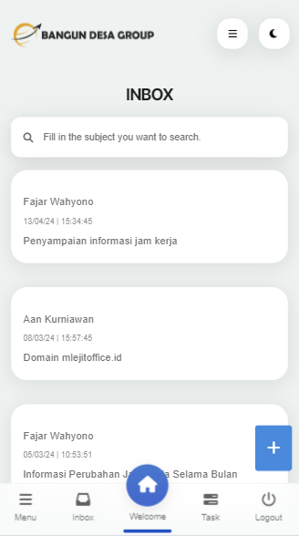
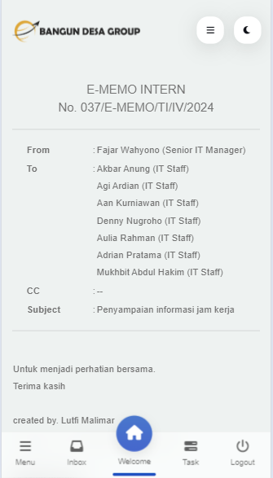
BOC Mobile Application
LIGHT MODE

Slide 5
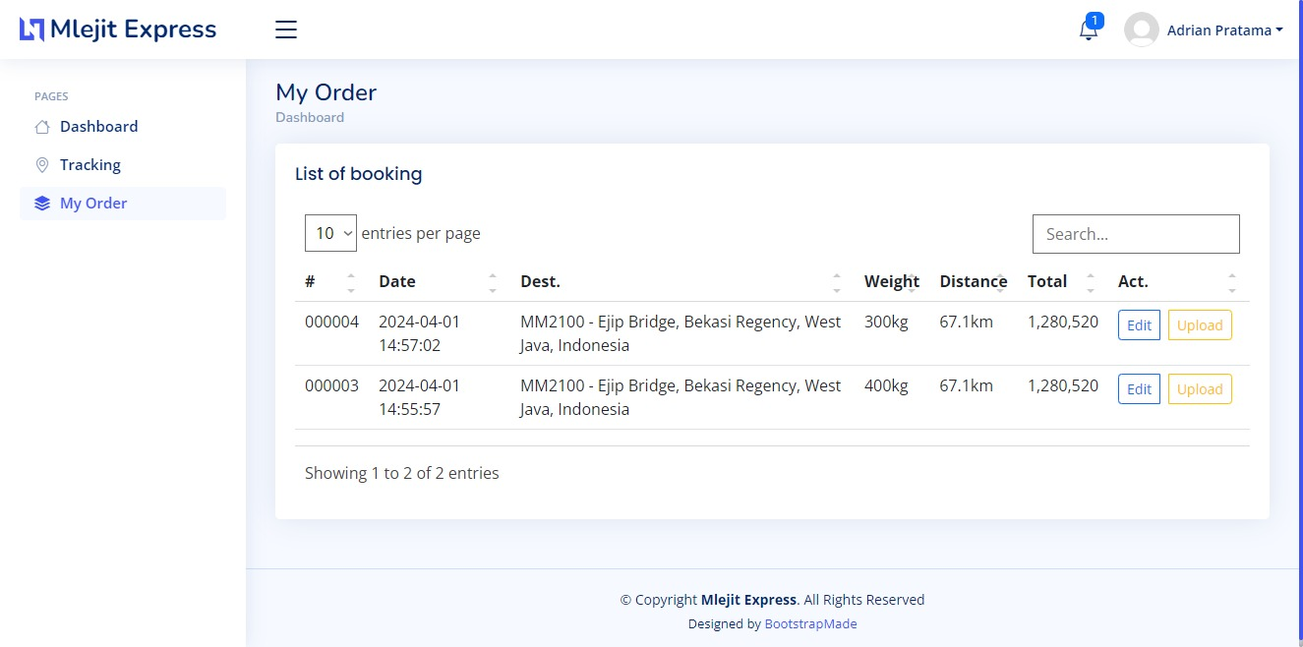
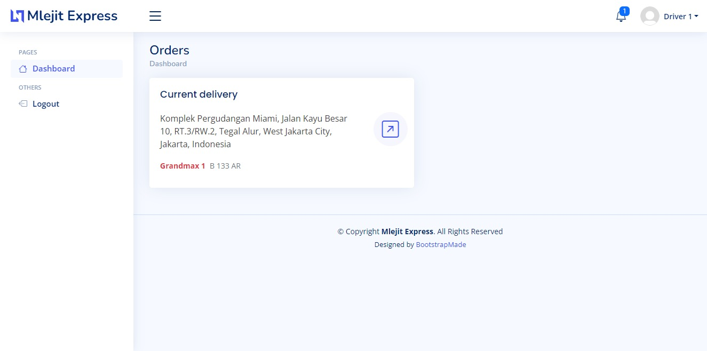
MLEJIT EXPRESS
Status: On Progress
Currently working on the Mlejit Express Application
Authentication pages (Done)
Reservations (Done)
Order pages for customers (Done)
Admin Menu (Done)
Driver Menu (Done)
Rute for driver from latitude and longitude. (On Progress)

Slide 6

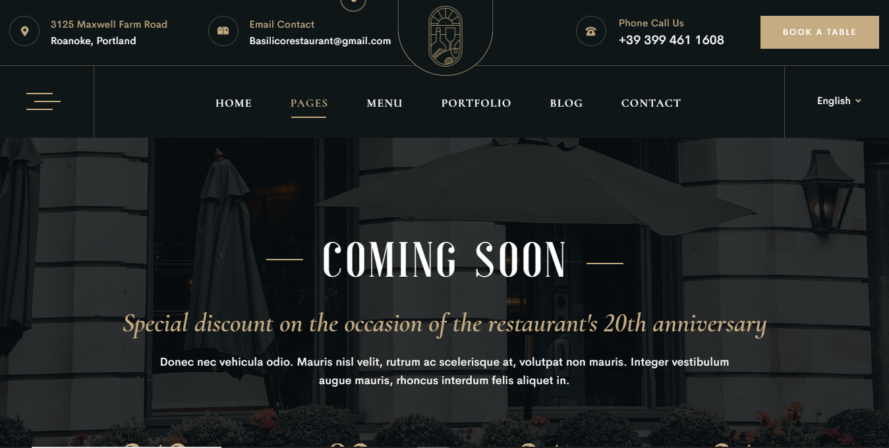
Date//Time//Year
Zafira Garden Lounge
Status: On Progress
Waiting a final website content.
Purchase selected website templates. (Done).
Booking system (Done).
Customizing content with the new template (On Progress).
Selected Template:
https://themesflat.co/html/restaurant/luxury/coming-soon.html

Slide 7
Thank You

