Slide 1
HAND
BY
F.O. IGELIGE

Slide 2
Important Structures of the Hand
The important structures of the hand can be divided into several categories. These include;
bones and joints
ligaments and tendons
Muscles, nerves, blood vessels
The front, or palm-side, of the hand is referred to as the palmar side. The back of the hand is called the dorsal side.

Slide 3
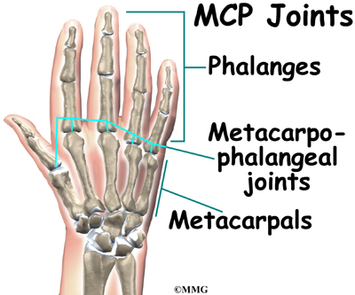
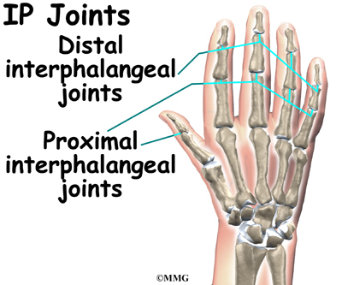
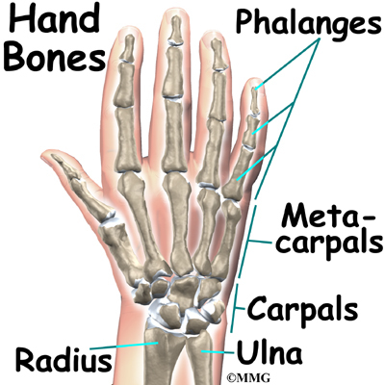
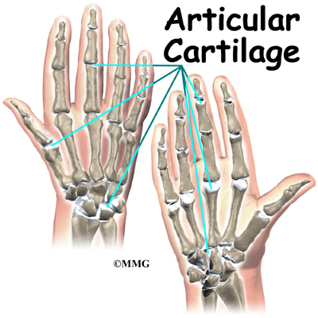
Bones and Joints

Slide 4
INTRODUCTION
The hand is composed of many different bones, muscles, and ligaments that allow for a large amount of movement and dexterity.
There are three major types of bones in the hand itself;
Phalanges. These 14 bones are found in the fingers of each hand and also in the toes of each foot. Each finger has three phalanges (the distal, middle, and proximal). The thumb only has two.
Metacarpal bones. These five bones make up the middle part of the hand.
Carpal bones. These eight bones create the wrist. The two rows of carpal bones are connected to two bones of the arm—the ulna bone and the radius bone.

Slide 5
Numerous muscles, ligaments, tendons, and sheaths can be found within the hand.
The muscles are the structures that can contract, allowing movement of the bones in the hand.
The ligaments are fibrous tissues that help bind together the joints in the hand. The sheaths are tubular structures that surround part of the fingers.
The tendons connect muscles in the arm or hand to the bone to allow movement and typically pass through the sheaths.
In addition, there are arteries, veins, and nerves within the hand that provide blood flow and sensation to the hand and fingers.

Slide 6
There are 27 bones within the wrist and hand. The wrist itself contains eight small bones, called carpals.
The carpals join with the two forearm bones, the radius and ulna, forming the wrist joint. Further into the palm, the carpals connect to the metacarpals.
There are five metacarpals forming the palm of the hand. One metacarpal connects to each finger and thumb. Small bone shafts called phalanges line up to form each finger and thumb.
The main knuckle joints are formed by the connections of the phalanges to the metacarpals.
These joints are called the metacarpophalangeal joints (MCP joints). The MCP joints work like a hinge when you bend and straighten your fingers and thumb.

Slide 7
The three phalanges in each finger are separated by two joints, called interphalangeal joints (IP joints).
The one closest to the mcp joint (knuckle) is called the proximal IP joint (PIP joint).
The joint near the end of the finger is called the distal IP joint (DIP joint). The thumb only has one IP joint between the two thumb phalanges.
The IP joints of the digits also work like hinges when you bend and straighten your fingers and thumb.
The joints of the hand, fingers, and thumb are covered on the ends with articular cartilage. This white, shiny material has a rubbery consistency.
The function of articular cartilage is to absorb shock and provide an extremely smooth surface to facilitate motion. There is articular cartilage essentially everywhere that two bony surfaces move against one another, or articulate.

Slide 8
LIGAMENTS
Ligaments are tough bands of tissue that connect bones together.
Two important structures, called collateral ligaments, are found on either side of each finger and thumb joint.
The function of the collateral ligaments is to prevent abnormal sideways bending of each joint.
In the pip joint (the middle joint between the main knuckle and the DIP joint), the strongest ligament is the volar plate.
This ligament connects the proximal phalanx to the middle phalanx on the palm side of the joint.
The ligament tightens as the joint is straightened and keeps the PIP joint from bending back too far (hyperextending).
Finger deformities can occur when the volar plate loosens from disease or injury.

Slide 9
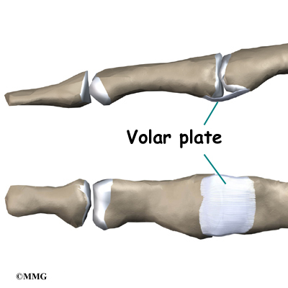
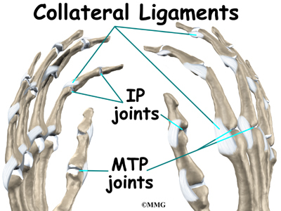
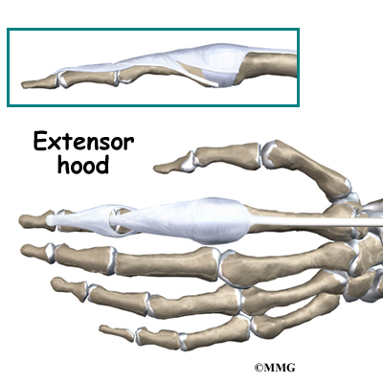
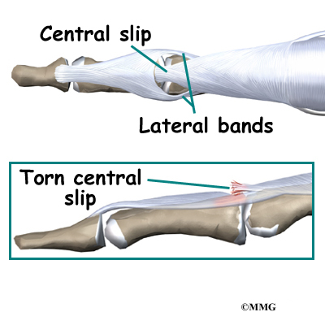
Ligaments and Tendons

Slide 10
TENDONS
The tendons that allow each finger joint to straighten are called the extensor tendons.
The extensor tendons of the fingers begin as muscles that arise from the backside of the forearm bones.
These muscles travel towards the hand, where they eventually connect to the extensor tendons before crossing over the back of the wrist joint.
As they travel into the fingers, the extensor tendons become the extensor hood. The extensor hood flattens out to cover the top of the finger and sends out branches on each side that connect to the bones in the middle and end of the finger.
The place where the extensor tendon attaches to the middle phalanx is called the central slip.
When the extensor muscles contract, they tug on the extensor tendon and straighten the finger. Problems occur when the central slip is damaged, as can happen with a tear.

Slide 11
Muscles
Many of the muscles that control the hand start at the elbow or forearm.
They run down the forearm and cross the wrist and hand. Some control only the bending or straightening of the wrist.
Others influence motion of the fingers or thumb. Many of these muscles help position and hold the wrist and hand while the thumb and fingers grip or perform fine motor actions.
Most of the small muscles that work the thumb and pinky finger start on the carpal bones. These muscles connect in ways that allow the hand to grip and hold.
Two muscles allow the thumb to move across the palm of the hand, an important function called thumb opposition.

Slide 12
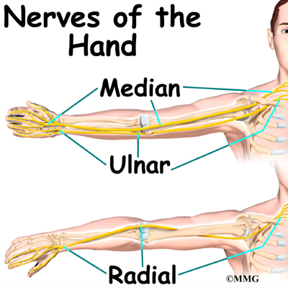
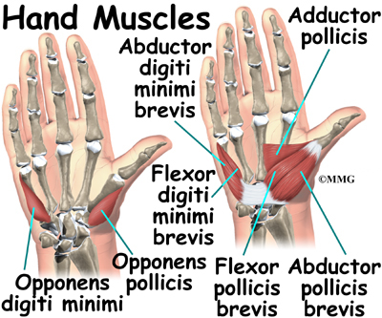
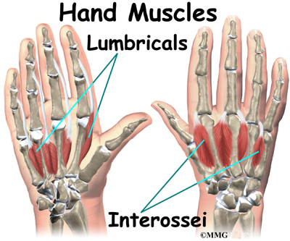
The smallest muscles that originate in the wrist and hand are called the intrinsic muscles. The intrinsic muscles guide the fine motions of the fingers by getting the fingers positioned and holding them steady during hand activities.

Slide 13
All of the nerves that travel to the hand and fingers begin together at the shoulder: the radial nerve, the median nerve, and the ulnar nerve.
These nerves carry signals from the brain to the muscles that move the arm, hand, fingers, and thumb. The nerves also carry signals back to the brain about sensations such as touch, pain, and temperature.
The radial nerve runs along the thumb-side edge of the forearm. It wraps around the end of the radius bone toward the back of the hand.
It gives sensation to the back of the hand from the thumb to the third finger. It also supplies the back of the thumb and just beyond the main knuckle of the back surface of the ring and middle fingers.

Slide 14
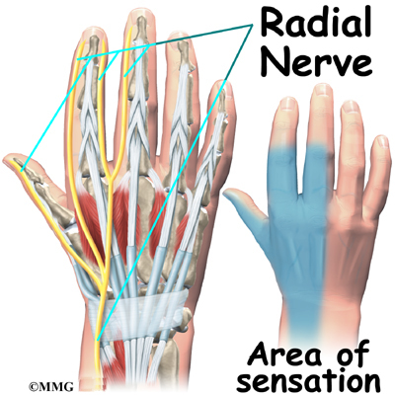
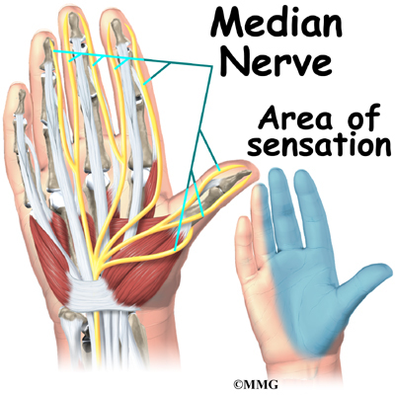
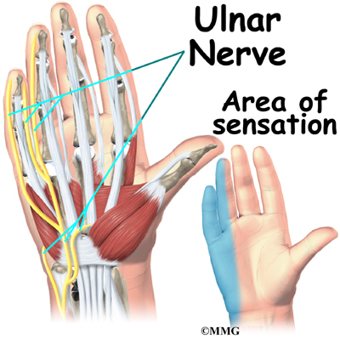

Slide 15
The median nerve travels through a tunnel within the wrist called the carpal tunnel. This nerve gives sensation to the thumb, index finger, long finger, and half of the ring finger. It also sends a nerve branch to control the thenar muscles of the thumb.
The thenar muscles help move the thumb and let you touch the pad of the thumb to the tips each of each finger on the same hand, a motion called opposition.
The ulnar nerve travels through a separate tunnel, called Guyon’s canal. This tunnel is formed by two carpal bones, the pisiform and hamate, and the ligament that connects them.
After passing through the canal, the ulnar nerve branches out to supply feeling to the little finger and half the ring finger.
Branches of this nerve also supply the small muscles in the palm and the muscle that pulls the thumb toward the palm.

Slide 16
The nerves that travel to the hand are subject to problems. Constant bending and straightening of the wrist and fingers can lead to irritation or pressure on the nerves within their tunnels and cause problems such as pain, numbness, and weakness in the hand, fingers, and thumb.
Blood Vessels
Traveling along with the nerves are the large vessels that supply the hand with blood.
The largest artery is the radial artery that travels across the front of the wrist, closest to the thumb.
The radial artery is where the pulse is taken in the wrist. The ulnar artery runs next to the ulnar nerve through Guyon’s canal (mentioned earlier).
The ulnar and radial arteries arch together within the palm of the hand, supplying the front of the hand, fingers, and thumb. Other arteries travel across the back of the wrist to supply the back of the hand, fingers, and thumb.

Slide 17
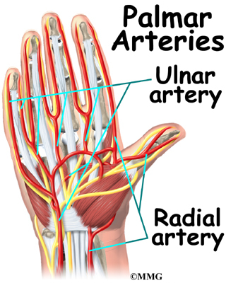
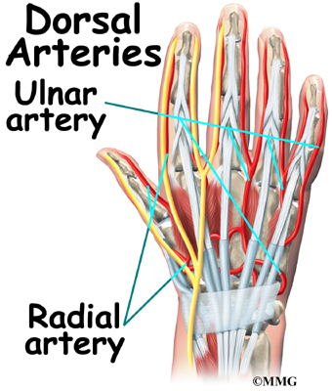

Slide 18
The muscles that act on the hand can be divided into two groups:
Extrinsic muscles – located in the anterior and posterior compartments of the forearm. They control crude movements and produce a forceful grip.
Intrinsic muscles – located within the hand itself. They are responsible for the fine motor functions of the hand.

Slide 19
Thenar Muscles
The thenar muscles are three short muscles located at the base of the thumb. The muscle bellies produce a bulge, known as the thenar eminence. They are responsible for the fine movements of the thumb.
The median nerve innervates all the thenar muscles.
Opponens Pollicis
The opponens pollicis is the largest of the thenar muscles, and lies underneath the other two.
Attachments: Originates from the tubercle of the trapezium and the associated flexor retinaculum. It inserts onto the lateral margin of the first metacarpal.
Actions: Opposes the thumb, by medially rotating and flexing the metacarpal on the trapezium.
Innervation: Median nerve (recurrent branch).

Slide 20
Abductor Pollicis Brevis
The abductor pollicis brevis forms the anterolateral aspect of the thenar eminence, overlying the opponens pollicis.
Attachments: Originates from the tubercles of the scaphoid and trapezium, and from the associated flexor retinaculum. Attaches to lateral side of proximal phalanx of the thumb.
Actions: Abducts the thumb.
Innervation: Median nerve (recurrent branch).
Flexor Pollicis Brevis
The flexor pollicis brevis forms the medial aspect of the thenar eminence. It is described as having a superficial and deep part – although the deep component is variable in size.
Attachments: Originates from the tubercle of the trapezium and from the associated flexor retinaculum. Attaches to the base of the proximal phalanx of the thumb.
Actions: Flexes the metacarpophalangeal joint of the thumb.
Innervation: Median nerve (recurrent branch). The deep head is innervated by the deep branch of the ulnar nerve.

Slide 21
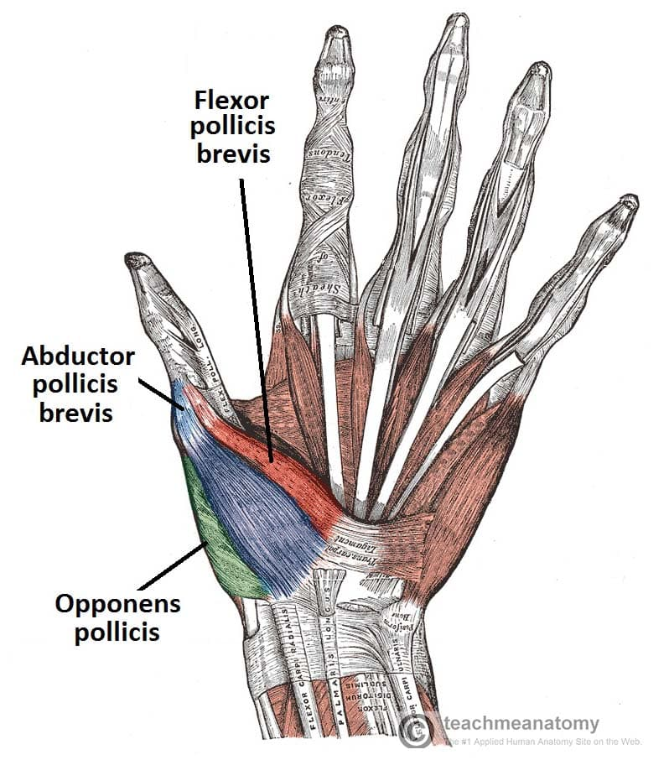
Palmar view of the thenar muscles.

Slide 22
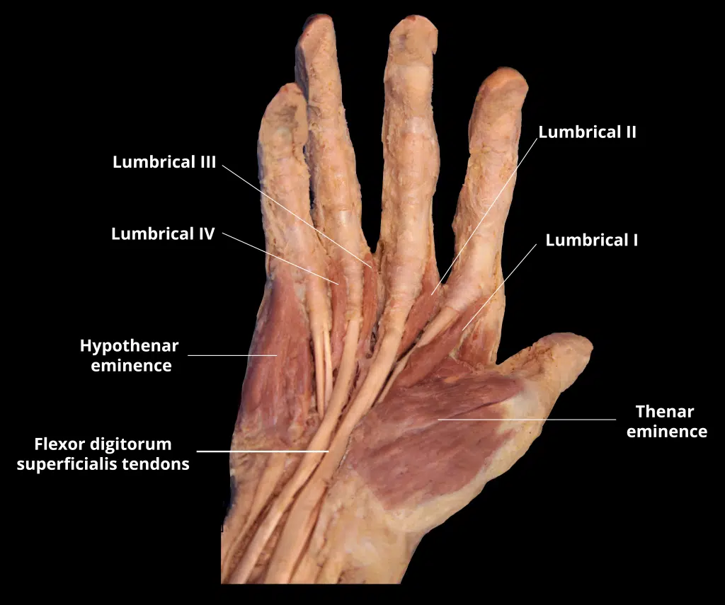

Slide 23
Hypothenar Muscles
The hypothenar muscles form the hypothenar eminence – a muscular protrusion on the medial side of the palm, at the base of the little finger. These muscles are similar to the thenar muscles in both name and organisation.
The ulnar nerve innervates the muscles of the hypothenar eminence.
Opponens Digiti Minimi
The opponens digit minimi lies deep to the other hypothenar muscles.
Attachments: Originates from the hook of hamate and associated flexor retinaculum, inserts into the medial margin of metacarpal V.
Actions: It rotates the metacarpal of the little finger towards the palm, producing opposition.
Innervation: Ulnar nerve.

Slide 24
Abductor Digiti Minimi
The abductor digiti minimi is the most superficial of the hypothenar muscle group.
Attachments: Originates from the pisiform and the tendon of the flexor carpi ulnaris. It attaches to the base of the proximal phalanx of the little finger.
Actions: Abducts the little finger.
Innervation: Ulnar nerve.
Flexor Digiti Minimi Brevis
The flexor digiti minimi brevis lies laterally to the abductor digiti minimi in the hand.
Attachments: Originates from the hook of hamate and adjacent flexor retinaculum, and inserts into the base of the proximal phalanx of the little finger.
Actions: Flexes the metacarpophalangeal joint of the little finger.
Innervation: Ulnar nerve.

Slide 25
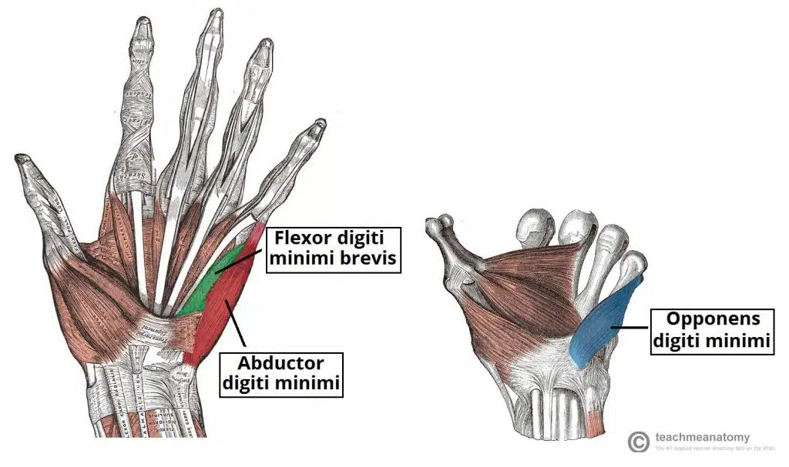
Superficial and deep layers of the hypothenar muscles

Slide 26
Lumbricals
There are four lumbricals in the hand, each associated with a finger. They are very crucial to finger movement, linking the extensor tendons to the flexor tendons.
Denervation of these muscles is the basis for the ulnar claw and hand of benediction.
Attachments: Each lumbrical originates from a tendon of the flexor digitorum profundus. They pass dorsally and laterally around each finger, and inserts into the extensor hood.
Actions: Flexion at the MCP joint and extension at the interphalangeal (IP) joints of each digit.
Innervation: The lateral two lumbricals (of the index and middle fingers) are innervated by the median nerve. The medial two lumbricals (of the little and ring fingers) are innervated by the ulnar nerve.

Slide 27
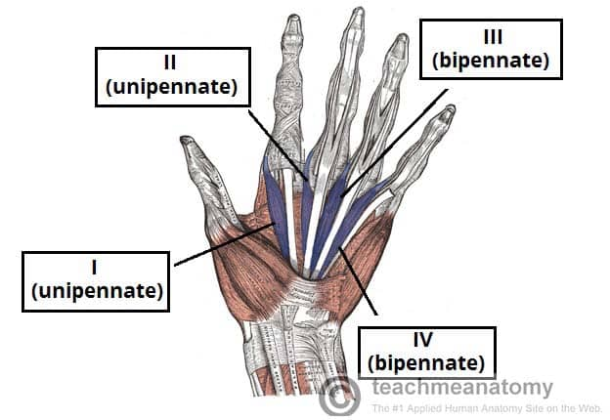
The lumbricals of the hand. Note the differing unipennate and bipennate structure.

Slide 28
Interossei
The interossei muscles are located between the metacarpal bones of the hand. They can be divided into two groups – dorsal and palmar.
In addition to their actions of abduction (dorsal interossei) and adduction (palmar interossei) of the fingers, the interossei also assist the lumbricals in flexion at the MCP joints and extension at the IP joints.
Dorsal Interossei
The most superficial of all dorsal muscles, these can be palpated on the dorsum of the hand. There are four dorsal interossei muscles.
Attachments: Each interossei originates from the lateral and medial surfaces of the metacarpals. They attach into the extensor hood and proximal phalanx of each finger.
Actions: Abduction of the digits. Assists in flexion at the metacarpophalangeal joints and extension at the interphalangeal joints.
Innervation: Ulnar nerve.

Slide 29
Palmar Interossei
These are located anteriorly on the hand. There are three palmar interossei muscles (although some texts describe a fourth muscle at the base of the proximal phalanx of the thumb).
Attachments: Each interossei originates from a medial or lateral surface of a metacarpal, and attaches into the extensor hood and proximal phalanx of same finger.
Actions: Adduction of the digits. Assists in flexion at the met
acarpophalangeal joints and extension at the interphalangeal joints.
Innervation: Ulnar nerve.

Slide 30
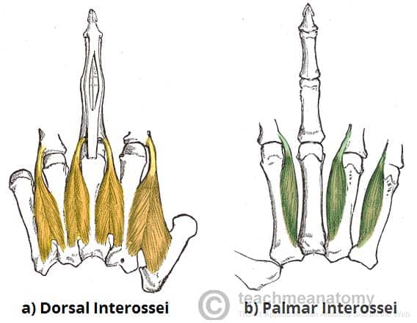
The dorsal and palmar interossei of the hand.

Slide 31
There are two other muscles in the palm that are not lumbricals or interossei and do not fit in the hypothenar or thenar compartments:
Palmaris Brevis
The palmaris brevis is a small, thin muscle, found superficially in the subcutaneous tissue of the hypothenar eminence.
Attachments: Originates from the palmar aponeurosis and flexor retinaculum, attaches to the dermis of the skin on the medial margin of the hand.
Actions: Wrinkles the skin of the hypothenar eminence and deepens the curvature of the hand, improving grip.
Innervation: Ulnar nerve.

Slide 32
Adductor Pollicis
The adductor pollicis large triangular muscle with two heads. The radial artery passes anteriorly through the space between the two heads, forming the deep palmar arch.
Attachments: One head originates from metacarpal III. The other head originates from the capitate and adjacent areas of metacarpals II and III. Both attach into the base of the proximal phalanx of the thumb.
Actions: Adductor of the thumb.
Innervation: Ulnar nerve.

Slide 33
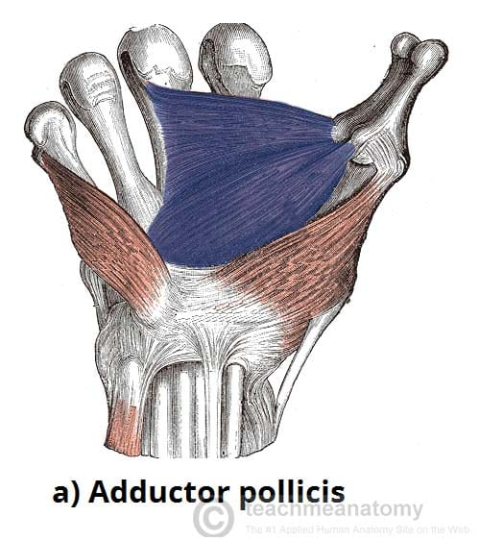
The adductor pollicis. Note the two heads of the muscle.

