Slide 1

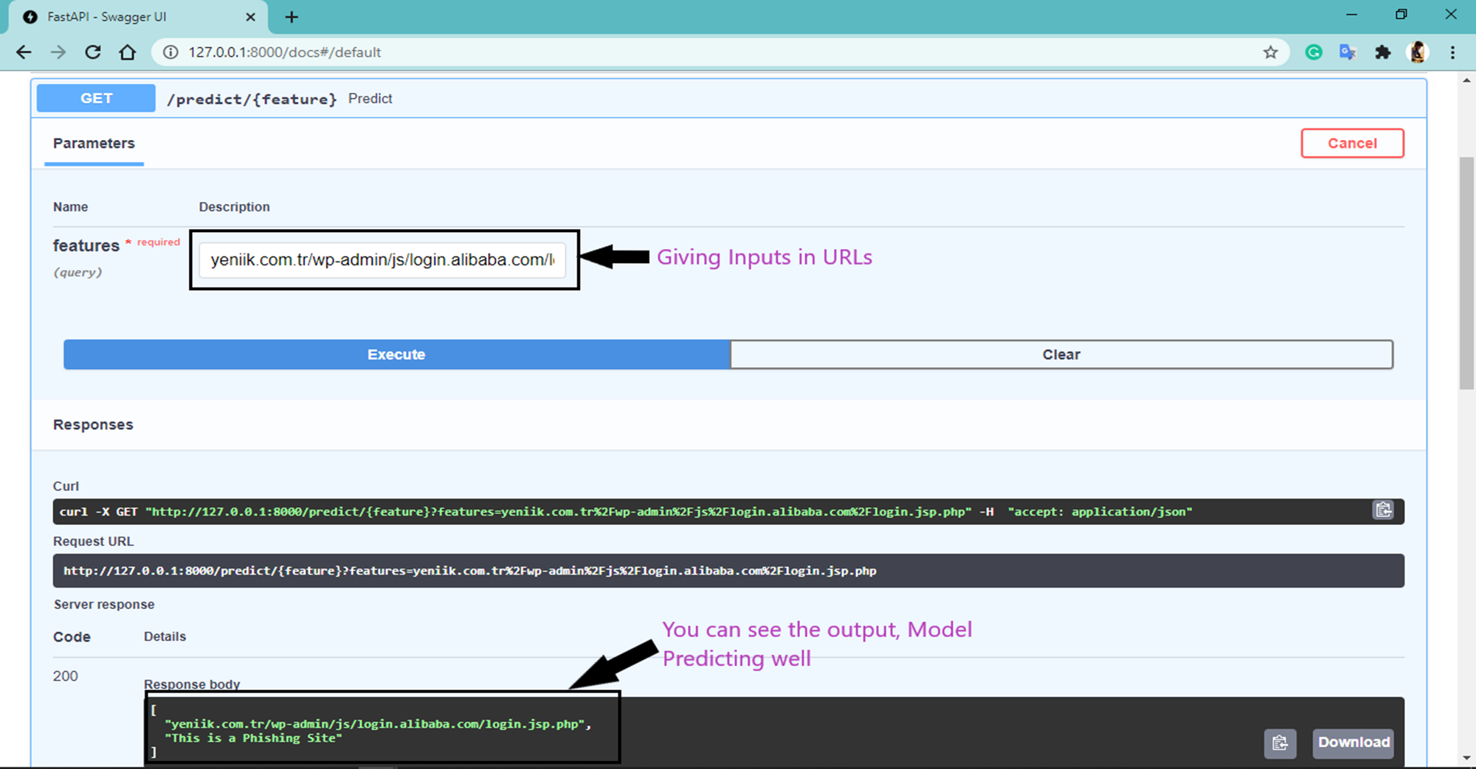
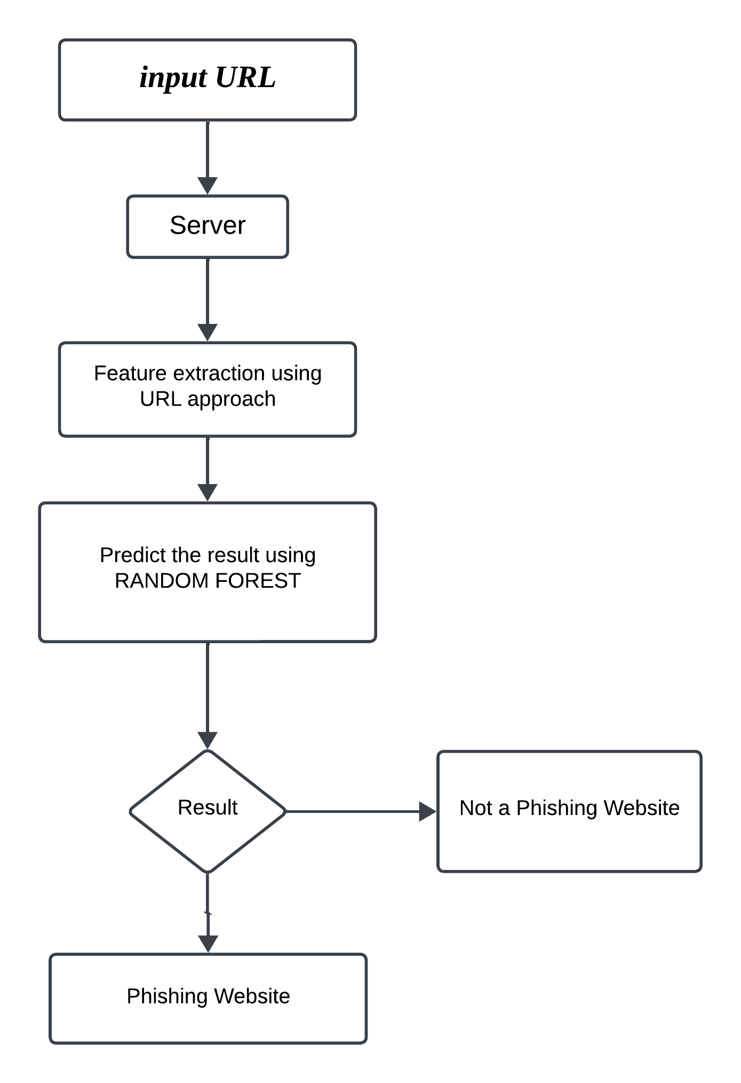
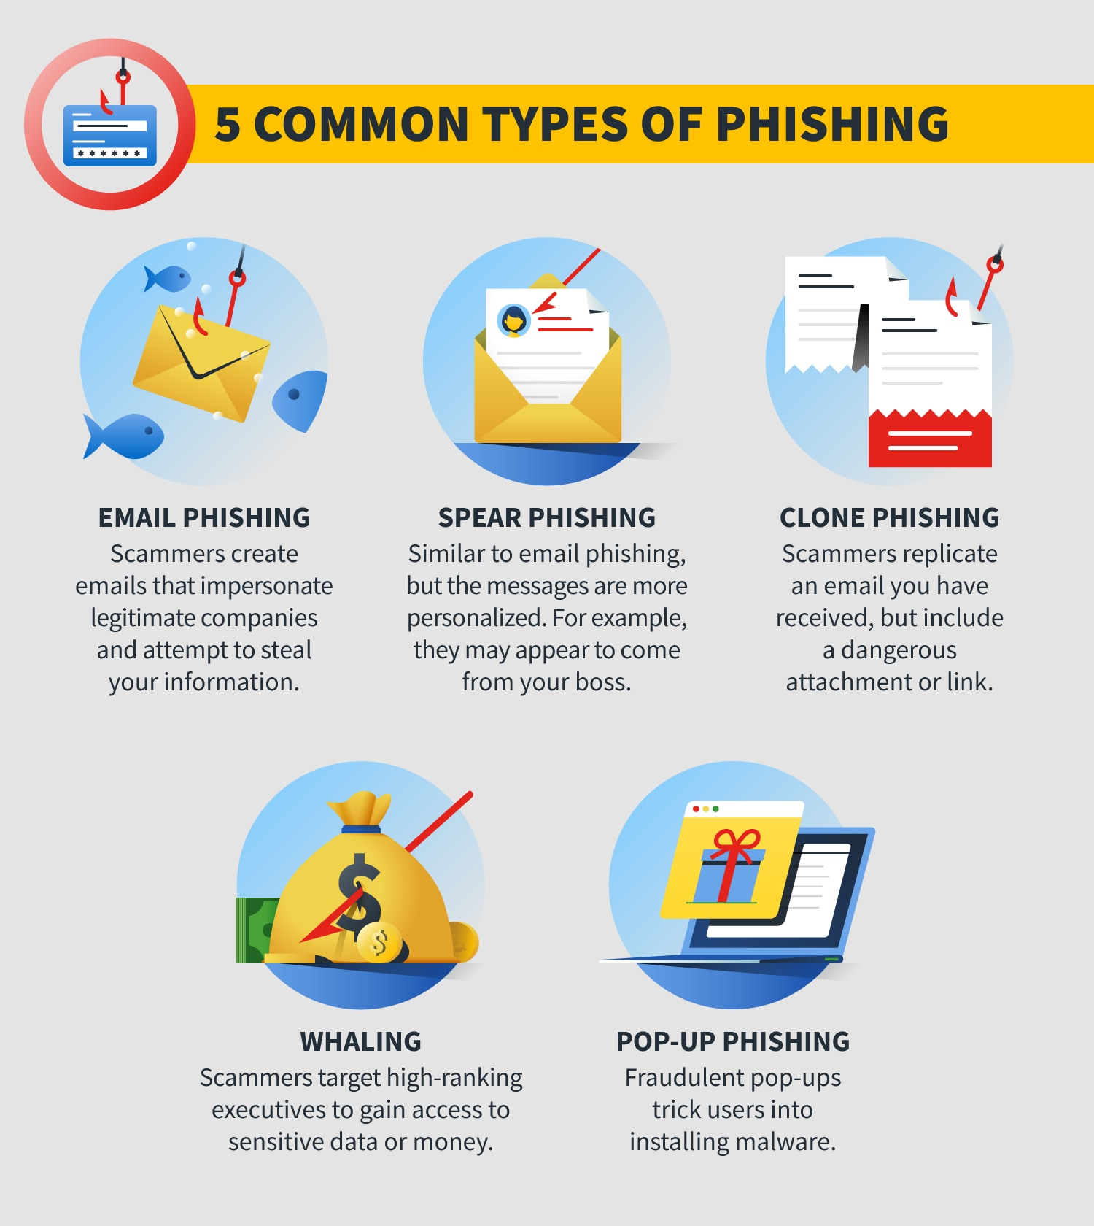
s
DETECTING PHISHING WEBSITES USING AI-ML
DR ramesha M¹, Kodidela Dinesh Naidu², Boksam Nithin Varma², Mange Amith Das², R Nikhil Kumar²
¹Associate Professor, Department of Electrical, Electronics and Communication Engineering
²B. Tech Students, Department of Electrical, Electronics and Communication Engineering
Gandhi Institute of Technology and Management(GITAM) University, Bengaluru
Abstract
Objectives
Results
Phishing can be explained as the process of attaining sensitive or familiar information from the users by attracting them through replicating websites
Phishing being the major internet security problem that targets human vulnerabilities. To overcome this, we use machine learning precisely the supervised learning method.
There are many methods that can be used to overcome this problem but we use random forest method here rather than any other methods. As a result, we can expect the good performance and accuracy by using random forest
To create an advanced machine learning model, employing techniques such as Random Forest, to accurately identify and classify phishing websites.
Develop educational components within the project to raise awareness among users about common phishing tactics and the importance of verifying website authenticity.
Methodology
Introduction
Output of the model prediction
Phishing is a very in famous method of operation in cybercrime activities. Phishers began to make money and started doing this in a very organized fashion
These phishers have used a range of techniques to conduct threats on unsuspecting users such as VOIP, online messages, authentic false websites, spoofed connections and legitimate looking URLs.
Machine learning algorithms are also used to detect the phishing websites as they are one of the most powerful techniques for this application
The spoofed links are placed on widespread websites or sent through email to the victim. URLs of phishing websites usually contain some distinctive characteristics which build completely unique from URLs of the legitimate website..
Conclusion
The system that is proposed allows people to use the internet while having a safe experience and exercising secure communication. It allows the users to refrain from revealing private details that must not be made public.
we adapt the Random forest algorithm to avail maximum accuracy.
The scope to work on this proposed system of detecting phishing websites is almost infinite. As long as phishers come up with newer ways to fool the common internet browsing user, the patterns have to be detected and noted for further classification
Future Scope
Explore and integrate more advanced machine learning techniques and algorithms, such as deep learning and neural networks, to enhance the model's ability to discern complex patterns associated with phishing attacks.
Extend the project to cover a wider range of platforms and devices, including mobile applications, IoT devices, and other emerging technologies, to provide a more holistic protection against phishing attacks.
Block diagram of the proposed system
Acknowledgement
We would like to express our gratitude to the Gandhi Institute of Technology and Management (GITAM) University for supporting this project.

