Slide 1

DETECTING PHISHING WEBSITES USING AI-ML
AY 2020-24
GITAM UNIVERSITY
Major Project
Project ID: XX
A University should be a place of light, of liberty, and of learning.
Department of Electrical Electronics and Communication Engineering
Project Team:
322010403006 Kodidela Dinesh Naidu
322010403031 Boksam Nithin Varma
322010402033 Mange Amith Das
322010402004 R Nikhil Kumar
Project Mentor:
Dr RAMESHA M
www.gitamedu.com

Slide 2





Project Group – Details
Photo
Track
Roll No
Name
EECE AI/ML
322010403006
Kodidela Dinesh Naidu
EECE AI/ML
322010403031
Boksam Nithin Varma
EECE AI/ML
322010402033
Mange Amith Das
EECE AI/ML
322010402004
R Nikhil Kumar

Slide 3
Objective and Goals
Objective
To create an advanced machine learning model, employing techniques such as Random Forest, to accurately identify and classify phishing websites.
Develop educational components within the project to raise awareness among users about common phishing tactics and the importance of verifying website authenticity.
Goals
Main Goals
Enhance Detection Accuracy of phishing websites
Reduce False Positives of Random forest method
Real-time Monitoring of websites
Additional Goals
User Awareness about phishing websites

Slide 4
Project Plan
Gant Chart - Milestones and Activities
Kick Off
Milestone #2
Sign Off
2 Dec
2 Jan
Checkpoint B
5 Apr
6 Dec
Checkpoint A
Milestone #1
Milestone #3
24 Apr
29 Feb
1 Mar
Dec
Dec
Jan
Feb
Mar
Apr
Preparatory Phase
100%
02 Dec – 06 Dec
Phase 1 Work Effort
100%
07 Dec – 22 Dec
Phase 2 Work Effort
80%
02 Jan – 02 Feb
Phase 3 Work Effort
60%
06 Feb – 28 Feb
Testing Phase
01 Mar – 22 Mar
Delivery Phase
24 mar – 12 Apr

Slide 5
Literature Survey
Key Publications
R. Kiruthiga, D. Akila, “Phishing Websites Detection Using Machine Learning”, 2019 International Journal of Recent Technology and Engineering (IJRTE) ISSN: 2277-3878, Volume-8, Issue-2S11, September 2019.
Sandeep Kumar Satapathy, Shruti Mishra, Pradeep Kumar Mallick, Lavanya Badiginchala, Ravali Reddy Gudur, and Siri Chandana Guttha, “Classification of Features for detecting Phishing Web Sites based on Machine Learning Techniques”, International Journal of Innovative Technology and Exploring Engineering(IJITEE) ISSN: 2278-3075, Volume-8 Issue-8S2, June 2019.
G. Jaspher Willsie Kathrine, Paradise Mercy Praise, A. Amrutha Rose, and Eligious Kalaivani. C, “Variants of phishing attacks and their detection techniques”, Proceedings of the Third International Conference on Trends in Electronics and Informatics (ICOEI 2019) IEEE Xplore Part Number: CFP19J32-ART; ISBN:978-1-5386-9439-8.
Abdul basit, A., Zafar, M., Liu, X. et al. A comprehensive survey of AI-enabled phishing attacks detection techniques. Telecommun System 76, 139–154 (2021). techniques

Slide 6
Literature Survey
Existing Implementations – Products| Opensource| GitHub etc
The Phish – It is an automated phishing email analysis tool
https://github.com/emalderson/ThePhish.git
Chrome extension for detecting phishing web sites
https://github.com/philomathic-guy/Malicious-Web-Content-Detection-Using-Machine-Learning.git

Slide 7
Analysis - SWOT
Strengths
Weaknesses
W1. False Positives
W2. Dependency on Data Quality
W3. Evolving Techniques
S1. Accuracy and Efficiency
S2. User Education
S3. Adaptability
Threats
Opportunities
T1. Sophisticated Attacks
T2. Regulatory Changes
T3. Limited Awareness
O1. Integration with Security Solutions
O2. Collaboration with Industry
O3. Customization for Different Sectors

Slide 8
Analysis – 4W1H
What: To detect phishing website using AI-ML with the help of Random forest technique
Why: Random forest technique has a high accuracy & it has ability to handle large and diverse datasets
Where: websites & social media platforms
When: Real-time response, near-instantaneous alert generation
How: It can identify phishing websites Ensemble of decision trees,feature selection,voting mechanism
Refined Objective: To develop and deploy a robust and scalable cybersecurity solution leveraging the Random Forest algorithm, aimed at enhancing the precision and efficiency of phishing website detection

Slide 9
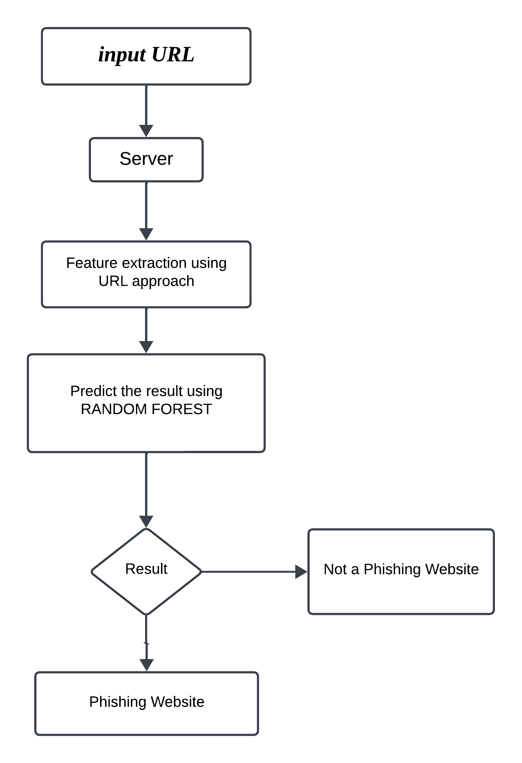
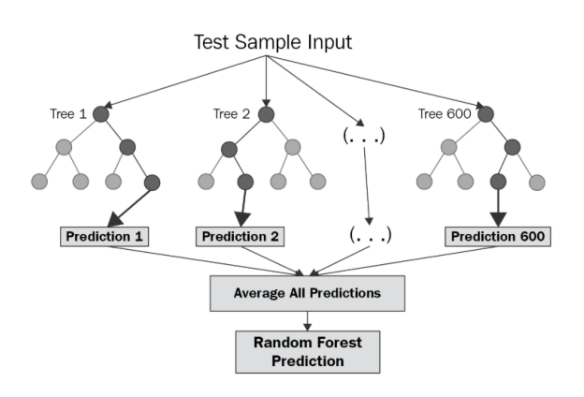
Architecture
Structural Diagram
Block Diagram
Behaviour Diagram
Flow chart

Slide 10
Use Cases & Testing
What: Testing phishing websites with the help of Random forest method
Why: Random foretst is robust to overfitting and performs well on a wide range of datasets without much tuning and also gives maximum accuracy upto 96%.
Where: websites & social media platforms
When: Real-time detection
How: Use a variety of dataseta with different characterstics to evaluate the generalization performance of the Random forest model
Refined Objective: To optimize model parameters and features to achieve the best possible performance

Slide 11
Implementation and Results
How does the model works?
Data Collection:
Web Scraping: Use web scraping techniques to extract data from the provided link https://newgstudent.gitam.edu/Home.
HTML Parsing: Parse the HTML content of the web page to extract relevant information such as text content, HTML tags, and other elements.
Feature Extraction:
HTML Tags: Identify and extract specific HTML tags that contain valuable information, such as <title>, <meta>, <a>, etc.
URL Structure: Extract features from the URL itself, such as domain name, path, query parameters, etc.
Model Loading:
Load Pre-trained Model: Load the Random Forest model that has been previously trained on relevant data. This could be a model trained specifically for web page classification tasks.

Slide 12
Implementation and Results – Iteration 1
How does the model works?
Feature Engineering:
Data Preprocessing: Preprocess the extracted features to ensure they are in a suitable format for model input. This may involve steps such as cleaning, tokenization, stemming/lemmatization, and encoding categorical variables.
Prediction:
Input Preparation: Prepare the extracted features from the input link according to the format expected by the Random Forest model.
Model Prediction: Use the loaded Random Forest model to make predictions on the input data. This will produce a probability distribution over the possible classes

Slide 13
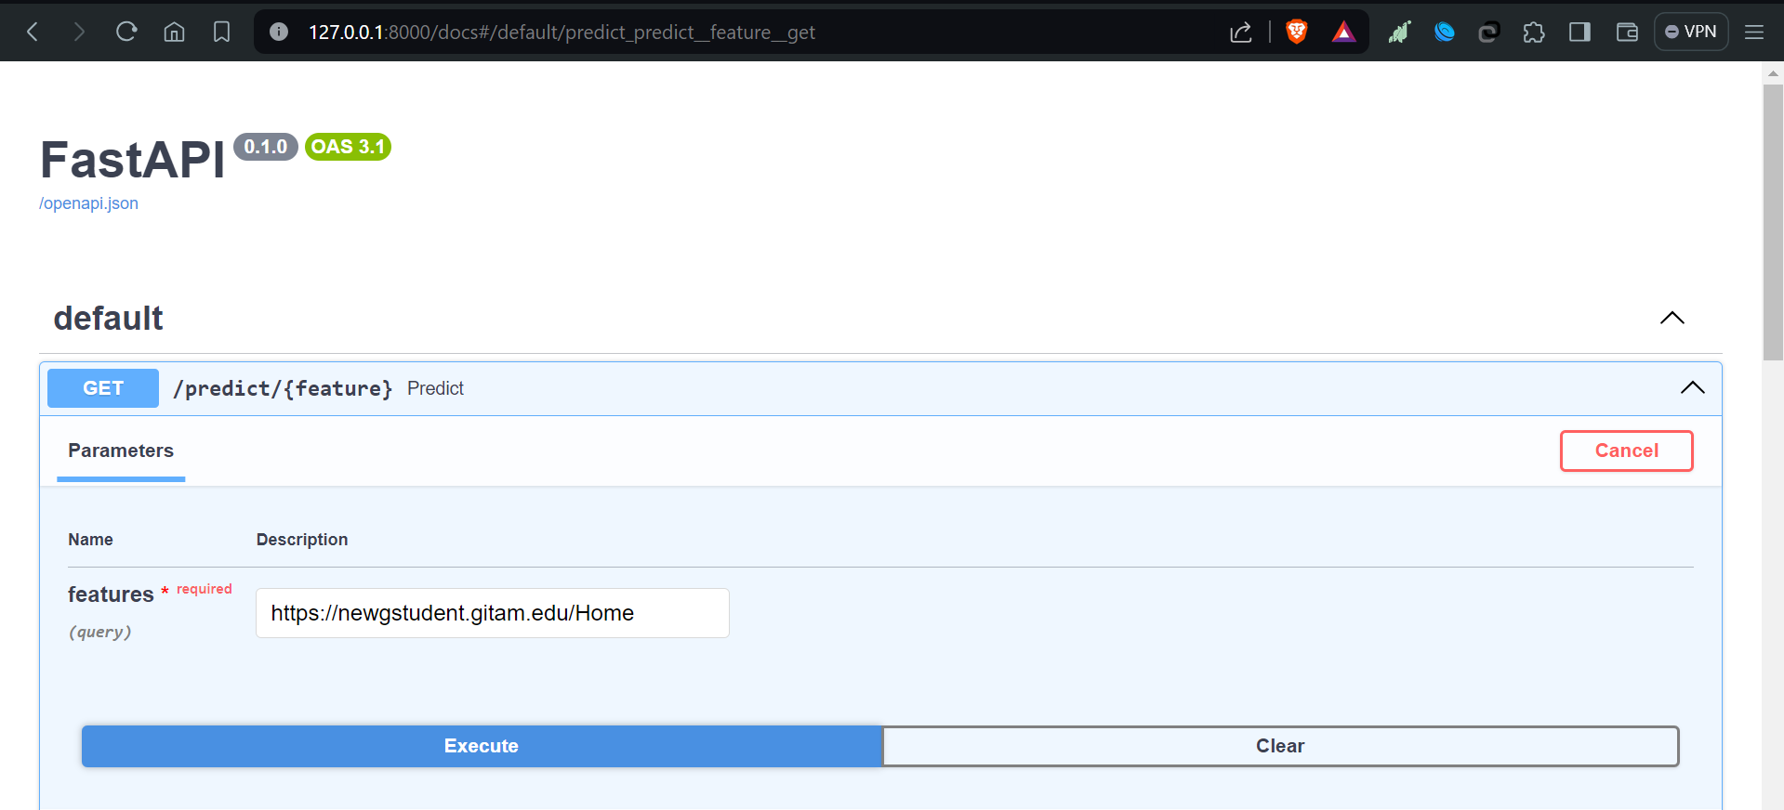
Implementation and Results – Iteration 1
Iteration 1 : Input

Slide 14
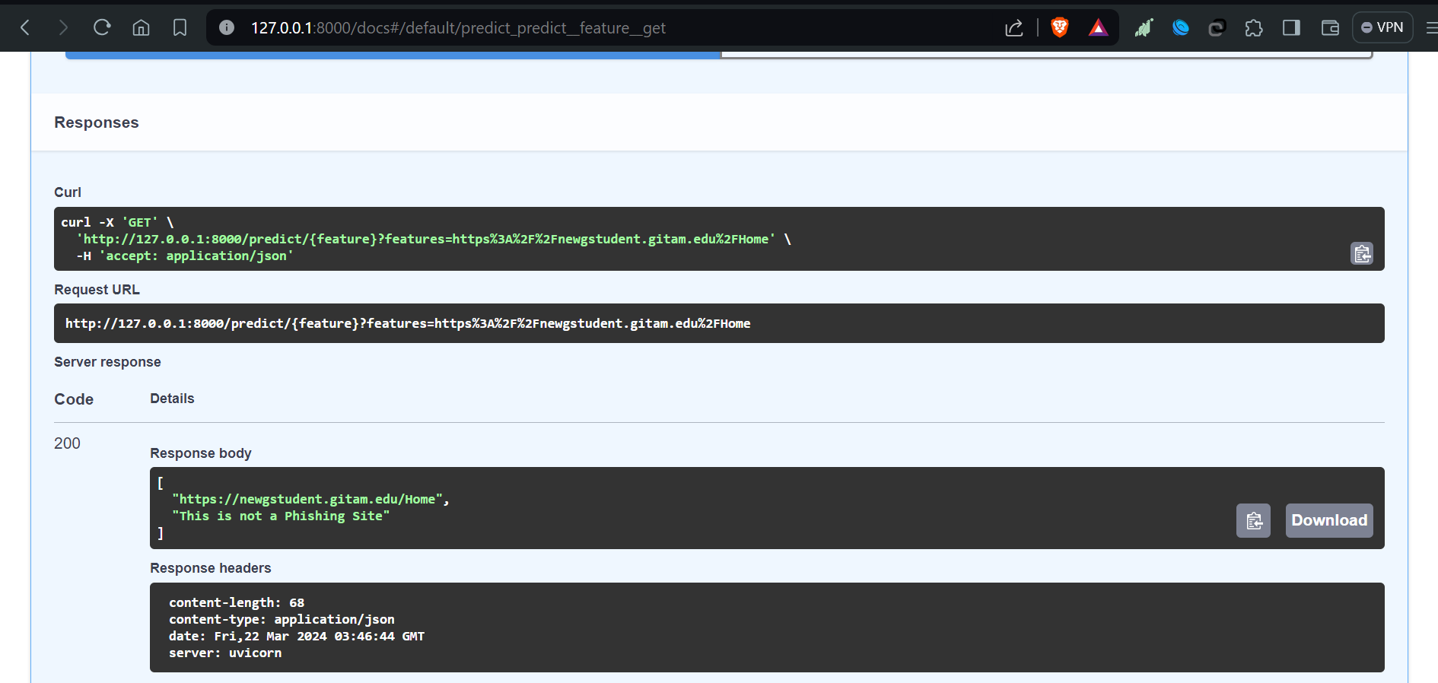
Implementation and Results – Iteration 1
Iteration 1 : Result

Slide 15
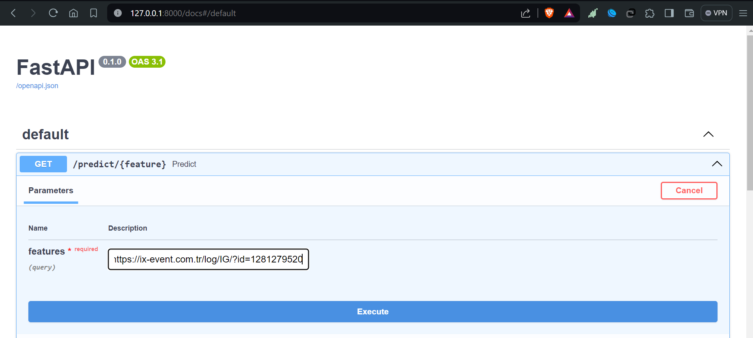
Implementation and Results – Iteration 2
Iteration 2 : Input

Slide 16
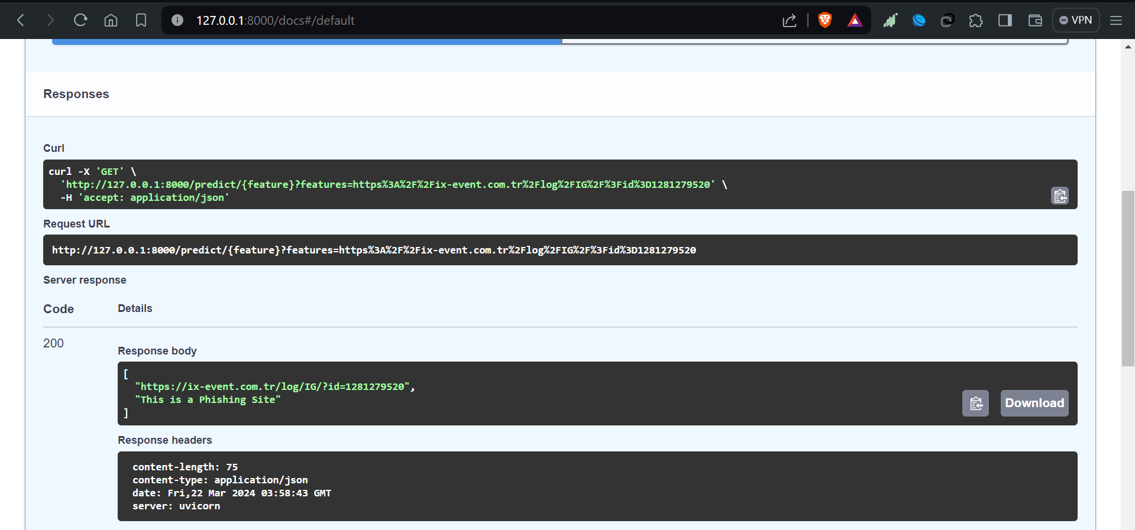
Implementation and Results – Iteration 2
Iteration 2 : Result

Slide 17
Contribution
Team Progress and Movement
Collecting Data sets
Analayzing
Planning
Design
Individual Contribution
Key contributions: Kodidela Dinesh Naidu
Research on existing articles & projects
Key contributions: Boksam Nithin Varma
Analyzing Random forest method
Key contributions: Mange Amith Das
Analyzing random forest method
Key contributions: R Nikhil Kumar
Documentation

Slide 18
Conclusion & Future Work
Summary and Conclusion
The system that is proposed allows people to use the internet while having a safe experience and exercising secure communication.
It allows the users to refrain from revealing private details that must not be made public.
Providing internet users with this system as an extension allows increases the ease of use.
In this concept, we have achieved a maximum accuracy. This system gives upto 96% accuracy in real time.

Slide 19

THANK YOU

