Slide 1
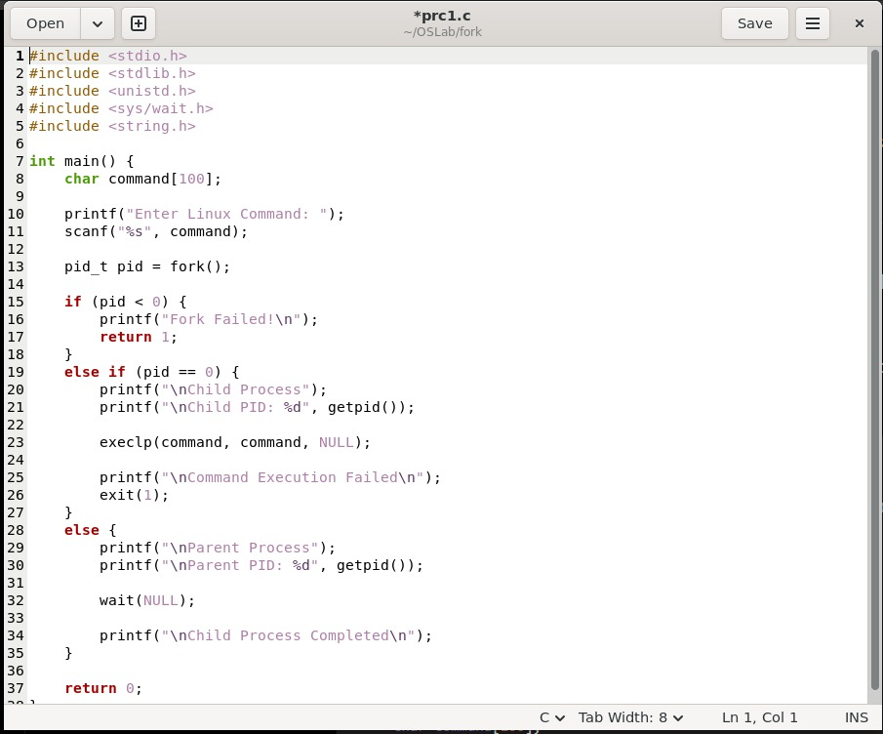
OSSP Practical-1

Slide 2
