Slide 1
SignBridge
Intelligent Two-Way Sign Language Translator
System Architecture & Database Design
K. Hasini – 2520090209 | L. Lavanya – 2520090009

Slide 2
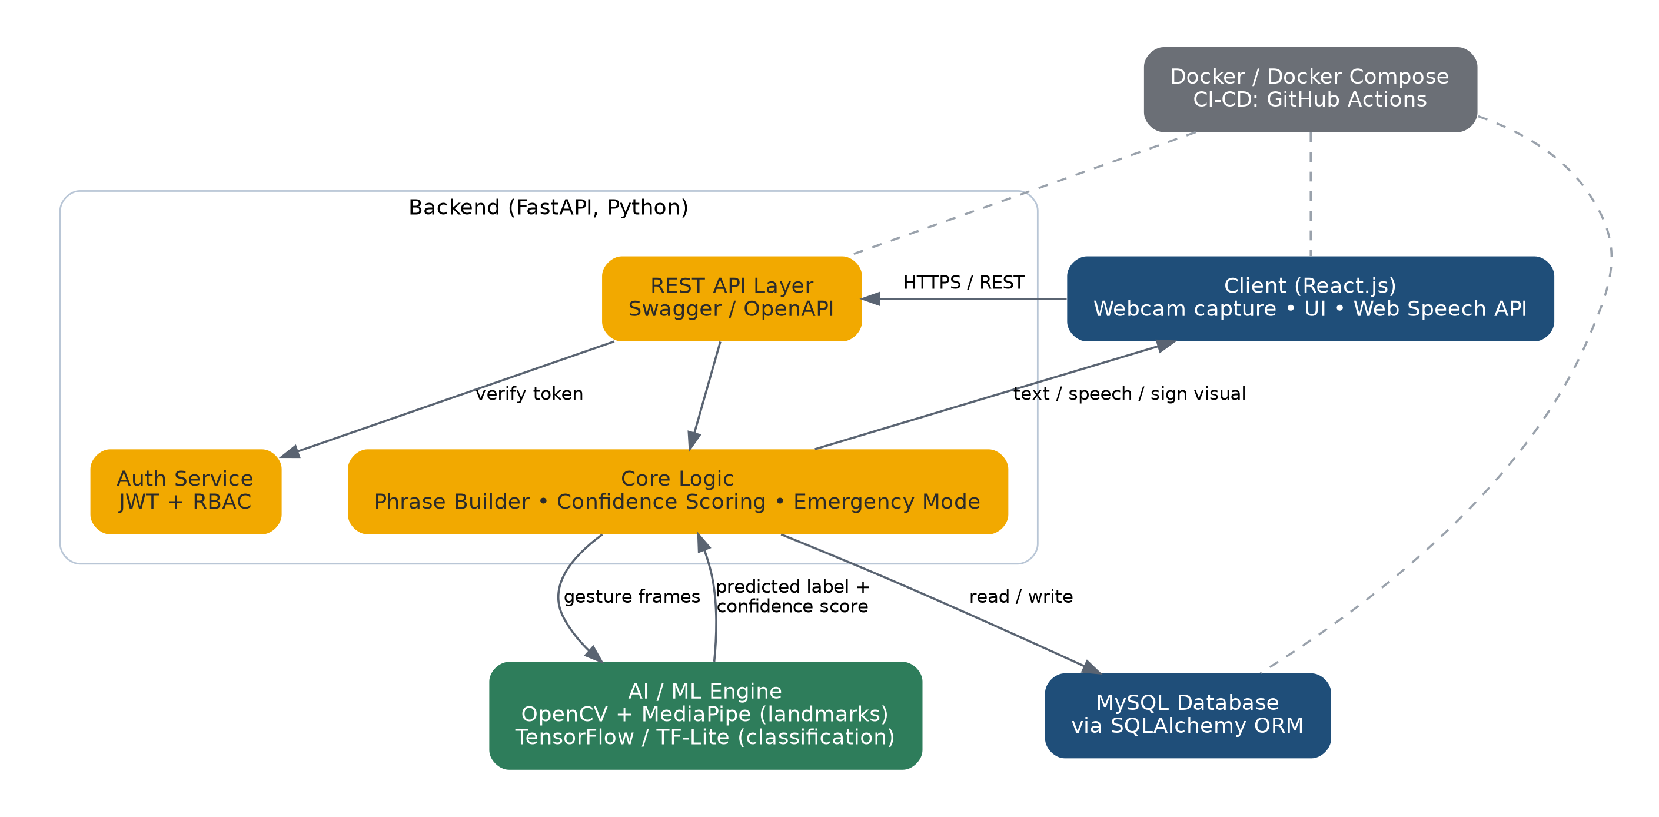
System Architecture
React client • FastAPI backend • AI/ML engine • MySQL

Slide 3
Core Modules
What each part of the system does
Gesture Recognition
Two-Way Translation
OpenCV + MediaPipe landmarks, TensorFlow / TF-Lite classifier
Gesture → text/speech and text/voice → sign visual
Confidence Feedback Loop
Smart Phrase Builder
Flags uncertain predictions and asks the user to repeat
Joins recognized signs into coherent sentences
Emergency Mode
Teach the AI
One-tap access to critical predefined phrases
Users add and label their own custom gestures
Auth & RBAC
Dashboard & Sign Library
JWT login with admin / user / guest roles
Known signs, saved phrases, translations, custom gestures

Slide 4
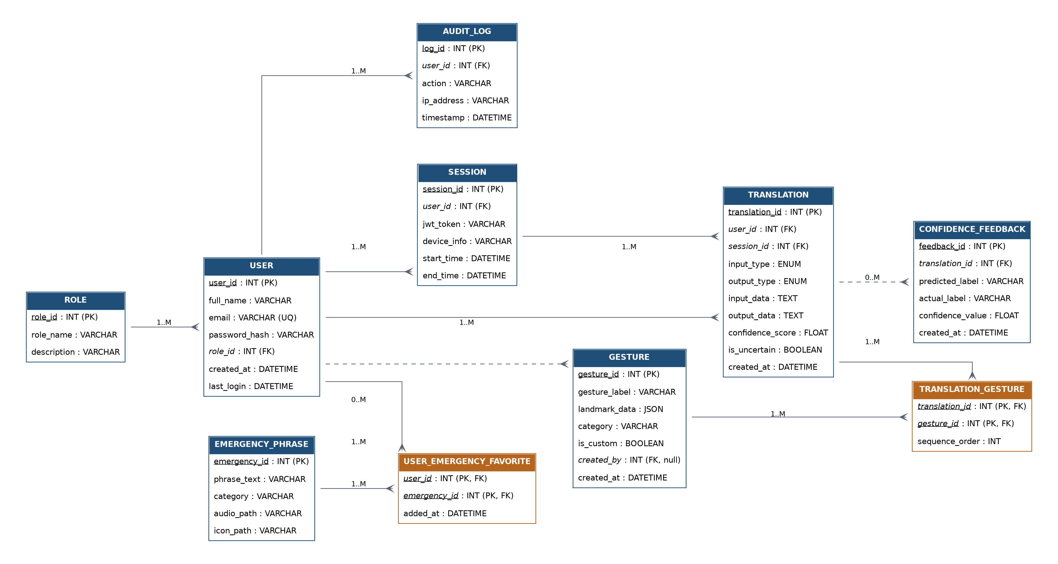
ER Diagram (Logical)
Crow's foot notation – 10 tables with PK / FK relationships

Slide 5
Database Schema
MySQL, accessed via SQLAlchemy ORM
Table | Key Columns
role | role_id (PK), role_name, description
user | user_id (PK), full_name, email, role_id (FK)
session | session_id (PK), user_id (FK), jwt_token, device_info
gesture | gesture_id (PK), gesture_label, landmark_data, created_by (FK)
translation | translation_id (PK), user_id (FK), session_id (FK), confidence_score
translation_gesture | translation_id, gesture_id (PK, FK), sequence_order
confidence_feedback | feedback_id (PK), translation_id (FK), predicted_label, actual_label
emergency_phrase | emergency_id (PK), phrase_text, category
user_emergency_favorite | user_id, emergency_id (PK, FK), added_at
audit_log | log_id (PK), user_id (FK), action, timestamp

