Slide 1
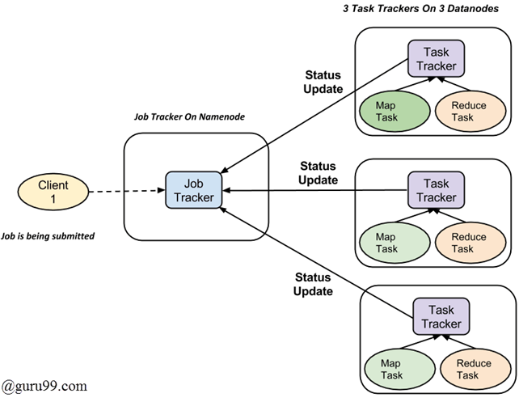
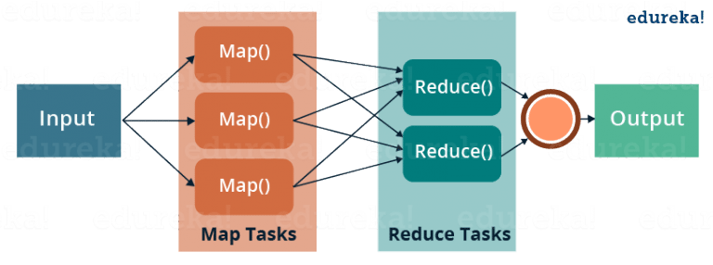
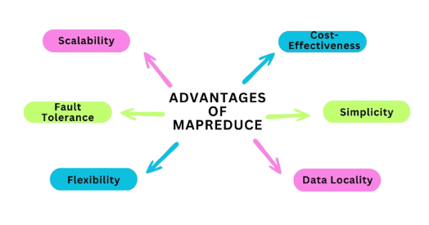
MapReduce
A programming model and framework for processing and generating large datasets in parallel across a distributed cluster of computers.
It was popularized by Google and is the core component of Apache Hadoop, an open-source framework for distributed storage and processing of big data.

Slide 2
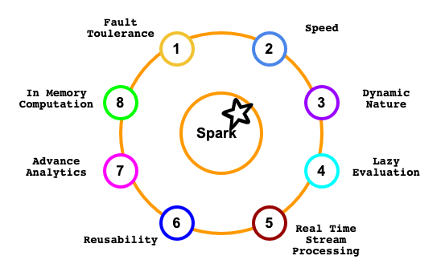
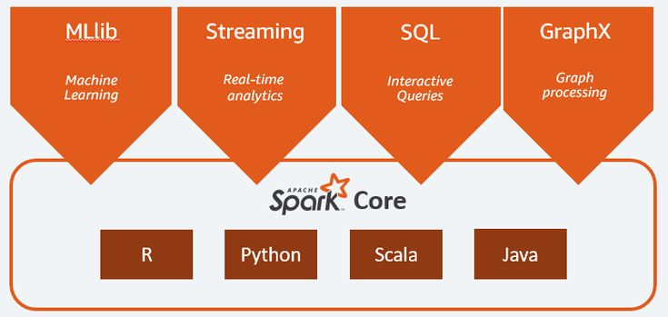
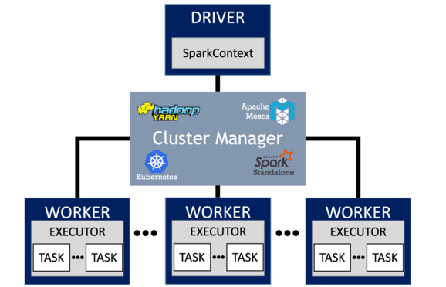
Apache Spark
Apache Spark is an open-source distributed computing system that provides an interface for programming entire clusters with implicit data parallelism and fault tolerance. It is designed to be fast and general-purpose, with APIs in several programming languages like Scala, Java, Python, and R.

