Slide 1
Algo-did-NFT
Kodiswaran Babu Janardhanan
Thanuja K Ramiya

Slide 2
PRODUCT OVERVIEW
Anchor billions of decentralized identity on Algorand, issue and verify verifiable credentials
SaaS Platform
Identity Wallet
Offering to create your decentralized identity on Algorand, issue verifiable credentials and verification of credentials
Credential Wallet to store credentials and exchange them for verification

Slide 3
MARKET OVERVIEW
8BPeople
Having endless use cases of using DIDs to receive credentials and verify it
Enterprises
Needs DIDs on public chain to issue and verify credentials
Machines
Anchor billions of machines identity on Algorand to
Record life cycle events

Slide 4
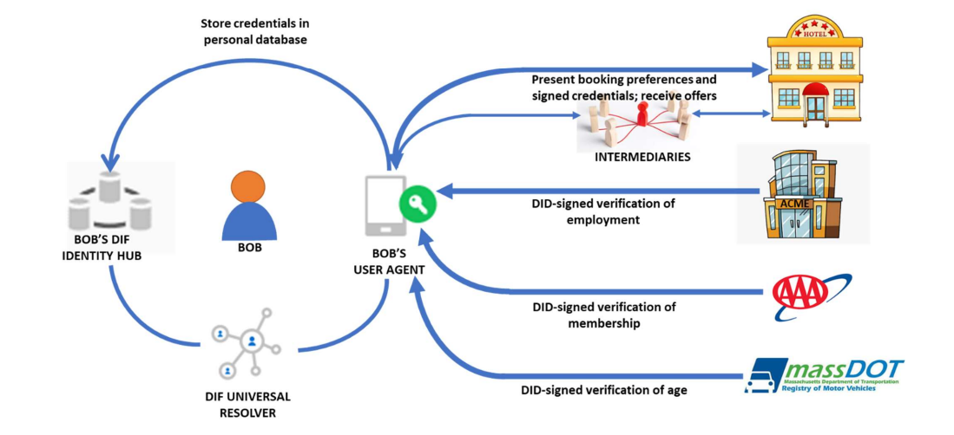
Product use case flow

Slide 5


BUSINESS MODEL
SAAS PLATFORM
Identity Wallet
Pay to create DIDs
Pay to issue credentials to a DID
Pay to verify a credential
Pay to backup your credentials

Slide 6
Market FIT
NEED
Loss of time and money costing consumers due to verifying credentials
MARKET GAP
People are taking initiatives to anchor DIDs on multiple block-chain but not on Algorand
Cost
Customers want something cost effective solution to anchor their DIDs on Algorand like block-chain

Slide 7
TEAM
Team consists of ex Qualcomm and Fidelity engineers having 20+ years of experience in software and 2+ years of experience in block chain and Algorand. Total head count is 4 so far.

Slide 8

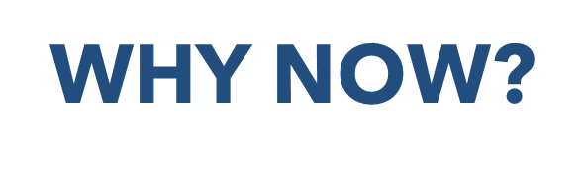
Why BLOCKCHAIN?
Decentralization requires public blockchain
Cost effective and superior tech and support
SSI is growing at 80% to be valued at 6.8B by 2027

Slide 9
What can you accomplish in the next 3 to 5 months?
MVP working on mainnet having few real customers

Slide 10
OUR COMPETITION
Algo-did
COMPETITORS (Other chains)
Affordability and great tech are the main draw for our consumers to our product
Permission less
All L1 features
DizMe, Accumulate, Sphereon on other chains
Expensive
Complicated tech
Propertiery
Permissioned
Centralised

Slide 11
SUMMARY
Algo-DID is the compelling product that is being built to serve the decentralized identity market and attract more market share into the Algorand chain because of greater tech and affordability when compared to other chains.
Team is already excited about this opportunity and started developing carrier grade and scalable product and requires mentoring, guidance and funding to accelerate the development and take it to the market soon.

Slide 12
Are you seeking investment, how much and what would you use the money to accomplish?
Yes, seed funding of 500k
test the product for scale
sales and marketing
take the product to market

Slide 13
THANK YOU
Kodiswaran Babu Janardhanan and Thanuja K Ramiya
+91-9945101015
kodisj@gmail.com

Slide 14
Problem in hand
World needs decentralized identifiers on a cost effective block chain for receiving and verifying their credentials

Slide 15
SOLUTION
CLOSE THE GAP
COST SAVINGS
Build the solution to anchor decentralized identity on Algorand and give the customers the superior tech for a very affordable cost
One time cost or reduced cost of maintaining decentralized identifiers for life
TARGET AUDIENCE
USE
Humans, Machines and Organizations
Use Algo-DID to receive verifiable credentials and share with the verifiers

