Slide 1

REVA - Centralized Campus Services Platform
Reva is a centralized web-based platform designed to unify essential campus services such as lost & found reporting, financial aid fundraising, and event management into a single, user-friendly dashboard. It aims to enhance accessibility, engagement, and security for university students by providing real-time notifications and streamlined service access.

Slide 2

Introduction: Background and Challenges
Background
Current Issues
University campuses currently rely on multiple disconnected systems for services like lost & found, fundraising, and event notifications, leading to inefficiencies and low student engagement.
Fragmented platforms require students to visit multiple sites or offices, causing confusion and delays. Lost & found lacks real-time updates, fundraising is external, and event management is manual.
Problem Statements
Students face delays in recovering lost items, limited fundraising participation, and difficulty accessing timely event information due to lack of centralized, real-time platforms.

Slide 3
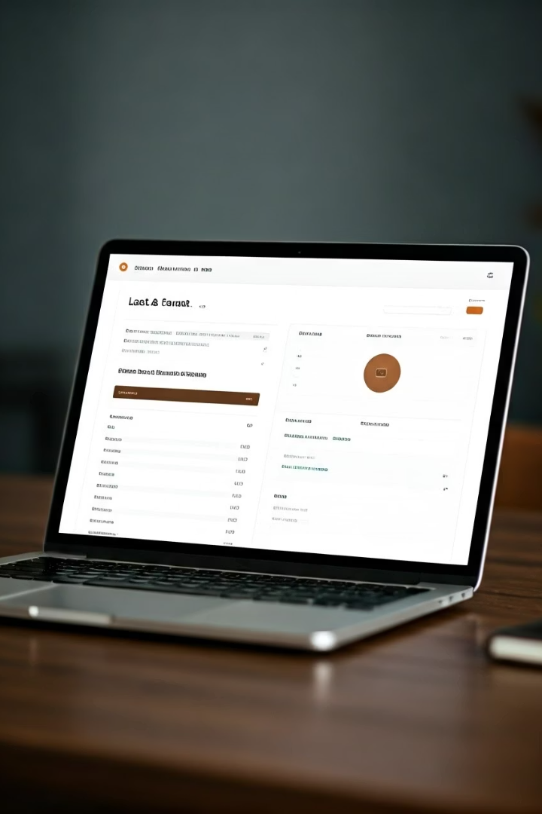
Proposed Solution: Reva Platform Overview
Centralized Web Application
Real-Time Notifications
Integrates lost & found reporting, financial aid fundraising, and campus event management into a single dashboard accessible anytime, anywhere.
Alerts for lost item matches, fundraising progress updates, and event changes enhance user engagement and responsiveness.
Security and Usability
Employs AES-256 encryption and OAuth 2.0 authentication with an intuitive interface tailored for diverse student backgrounds.

Slide 4

Existing Systems and Their Limitations
System
Year
Features
Strengths
Limitations
University Lost & Found Portal
2020
Report lost/found items, basic search
Simple interface, campus-specific
No real-time notifications, manual matching
GoFundMe
2023
Crowdfunding, donor communication
Wide reach, established platform
Not campus-specific, no integration
Eventbrite
2022
Event listings, ticket booking, reminders
Popular platform, user-friendly UI
Not university-focused

Slide 5

Scope and Target Users
1
Target Audience
2
Included Services
Reva is designed specifically for university students, focusing on enhancing campus community engagement through centralized services.
Lost & Found reporting
Financial aid fundraising
Campus event management
3
Exclusions
Off-campus services and non-student users are excluded to maintain focus on campus-specific needs.

Slide 6





Proposed System Modules
Lost & Found
Fundraising
Event Management
Report items with details
Create campaigns with goals
Event listings and details
Real-time match notifications
Track progress live
Secure ticket booking
Communicate with donors
Real-time notifications
Search with filters
Admin Module
Secure login
User account management

Slide 7

Application and Impact
Campus Service Improvement
Reva streamlines lost & found recovery, increases financial aid fundraising participation, and informs students about upcoming events efficiently.
Alignment with SDG Goals
SDG 4: Enhances educational access through fundraising
SDG 10: Reduces inequalities by providing financial aid opportunities
SDG 16: Promotes inclusive and organized campus communities

Slide 8



Hardware and Software Requirements
Hardware
Client devices: Desktop/laptop or mobile with 4GB RAM, 2GHz processor
Server: Cloud-based (e.g., AWS EC2) with 8GB RAM, 4-core CPU
Network: Stable internet with minimum 10 Mbps speed
Software
Frontend: React for responsive UI
Backend: ASP.NET for server logic
Database: Firebase for real-time data
Authentication: OAuth 2.0 or JWT
Encryption: AES-256
Browsers: Latest Chrome, Firefox, Safari
Development Tools: Visual Studio Code, Node.js, .NET Core SDK

