Slide 1

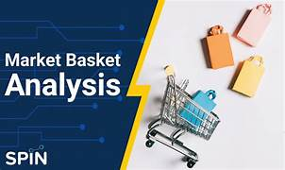


Introduction to Market Basket Analysis
Market basket analysis is a powerful technique that helps retailers uncover hidden insights into customer purchasing behavior. By analyzing the items customers buy together, businesses can optimize their product assortment, pricing, and marketing strategies to drive sales and profitability.
By K. Varun (192210536) P . Naga Surendra(192211536)
VV

Slide 2
Understanding Customer Purchasing Patterns
Basket Composition
Purchase Frequency
Customer Segmentation
Analyze the items customers frequently purchase together to identify complementary products and cross-selling opportunities.
Understand how often customers buy specific products or product combinations to forecast demand and optimize inventory.
Group customers based on their purchasing habits to tailor marketing and merchandising strategies for each segment.

Slide 3
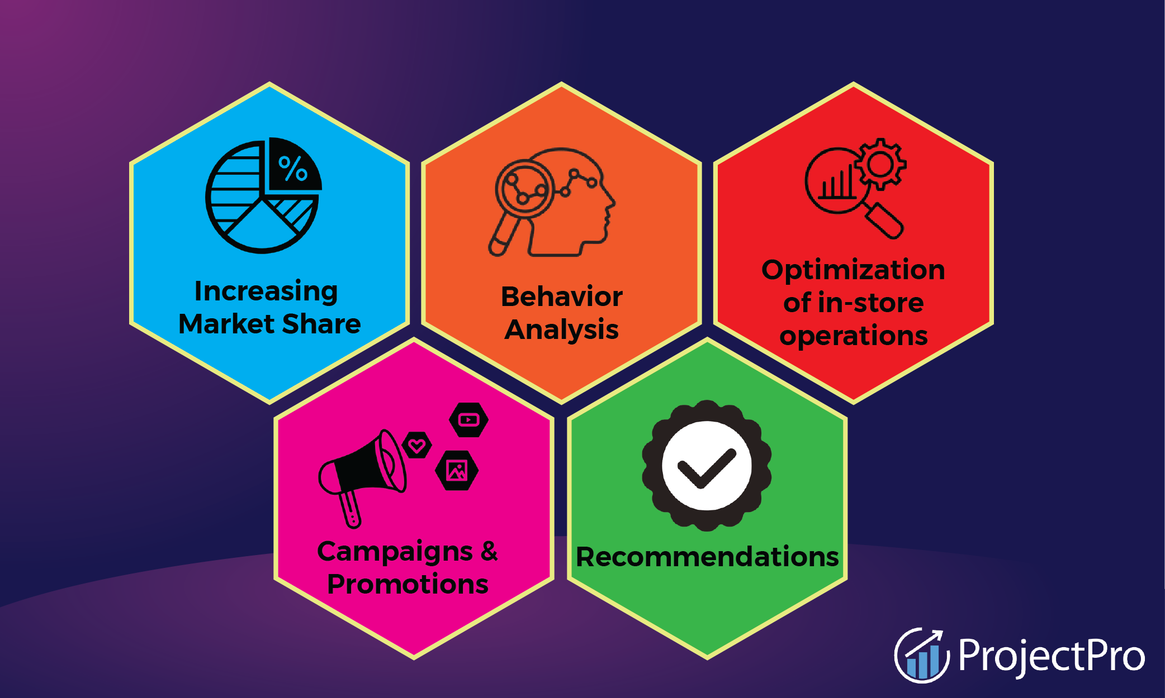
Identifying Associations and Correlations
1
Association Rules
Discover which products are frequently purchased together and the strength of their relationship.
2
Lift and Confidence
Measure the likelihood of one product being purchased given another to prioritize promotional opportunities.
3
Clustering and Segmentation
Group products and customers based on their purchasing patterns to identify key affinities.

Slide 4
Applying Market Basket Analysis to Retail
Optimizing Shelf Space
Bundling and Promotions
Merchandise complementary products together to increase basket size and impulse purchases.
Create effective product bundles and targeted promotions based on purchase associations.
Personalized Recommendations
Inventory Management
Suggest relevant add-on items to customers based on their past purchases and behaviors.
Forecast demand and optimize inventory levels to avoid stockouts and excess inventory.

Slide 5
Improving Inventory Management and Merchandising
1
Demand Forecasting
2
Product Placement
Predict future sales of products and product combinations to optimize inventory levels.
Strategically place complementary products together to increase cross-selling and upselling.
3
Assortment Planning
4
Promotional Optimization
Curate the right product mix based on customer purchase patterns and affinities.
Identify the best products to bundle or discount based on their relationship to other items.

Slide 6




Enhancing Targeted Marketing Strategies
Email Campaigns
Social Media Ads
Loyalty Programs
Personalized Recommendations
Send personalized product recommendations and promotions based on customer purchase history.
Target customers with ads for complementary products they're likely to purchase together.
Reward customers for their buying behavior and encourage repeat purchases of related items.
Suggest additional products customers may like based on their past purchases and affinities.

Slide 7




Optimizing Cross-Selling and Upselling Opportunities
Identify Affinities
Recommend Complementary Items
Increase Average Order Value
Discover which products are frequently purchased together.
Drive higher sales per customer by encouraging the purchase of related or more premium products.
Suggest additional products that customers are likely to buy based on their purchase history.

Slide 8
Conclusion and Key Takeaways
1
Unlock Hidden Insights
2
Optimize Retail Strategies
Market basket analysis reveals valuable customer purchasing patterns and product affinities.
Apply insights to improve inventory management, merchandising, marketing, and sales.
3
Drive Business Growth
Increase sales, profitability, and customer loyalty by delivering a more personalized shopping experience.

