Slide 1
PBI
Amazon E-Commerce
Analytics & Business Strategy
A data-driven exploration of revenue, customers, delivery performance,
and growth opportunities across the Amazon e-commerce dataset.
Presented by
Sandeep Koduru

Slide 2
DATA DESCRIPTION
Dataset Schema — Column Overview
Orders Table — 17 columns
Customers Table — 3 columns
OrderDate
OrderID
Delivery Date
CustomerID
Location
Zone
Delivery Type
Product Category
SubCategory
Product
Unit Price
Shipping Fee
Order Quantity
Sale Price
Status
Reason
Rating
CustomerID
Customer Age
Customer Gender
Relationship
One-to-Many via CustomerID — links each customer to their order history for age & gender-based analysis.
02

Slide 3
DATA DESCRIPTION
Sample Data — Customers & Orders Tables
Customers Table (sample rows)
CustomerID | Customer Age | Customer Gender
230459067 | 38 | M
230459068 | 38 | M
230459069 | 38 | M
230459072 | 38 | M
230459073 | 38 | M
Orders Table (sample rows)
OrderDate | OrderID | CustomerID | Location | Delivery Type | Category | Qty | Sale Price | Status
31-05-2020 | 5136486 | 230569424 | Western | Express | Fashion | 2 | 260.00 | Returned
31-05-2020 | 5136457 | 230568182 | Western | Standard Delivery | Health & Beauty | 7 | 446.40 | Returned
31-05-2020 | 5136465 | 230567584 | Weija | Standard Delivery | Health & Beauty | 10 | 1026.00 | Delivered
31-05-2020 | 5136488 | 230563788 | Greater Accra | Express | Phones & Tablet | 7 | 2716.00 | Delivered
31-05-2020 | 5136449 | 230563726 | Weija | Shipped Abroad | Fashion | 9 | 1092.00 | Delivered
113,199 order records • 113,000 unique customers • 17 order attributes • 3 customer attributes
03

Slide 4
REVENUE ANALYSIS
Total Revenue Trend (2015 – 2020)
₹
Key Points
Total revenue reached ₹611M overall — 2020 alone hit ₹136M, up ~42% vs prior years.
2016–2019 revenue was remarkably stable, hovering between ₹92M–₹96M each year.
The sharp 2020 jump suggests a demand surge — likely tied to increased online shopping activity.
→
What Drove It
DAX measure: Total Revenue = SUMX(Orders, Order Quantity × Sale Price), shown as a Card visual KPI.
Year extracted via YEAR(OrderDate) to enable the trend comparison.
Sustaining 2020's momentum should be a top strategic priority going into next year.
04

Slide 5
PRODUCT PERFORMANCE
Revenue by Product Category
✦
Key Points
Phones & Tablet dominates with ₹270M (44% of total revenue) despite a mid-range average price.
Electronics earns ₹92M from far fewer units — highest revenue-per-unit of any category.
Fashion, Health & Beauty, and Home & Office each contribute a fairly even ~₹80–86M.
★
Recommendation
Double down on Phones & Tablet marketing and stock depth — it's the clear revenue engine.
Bundle slower Home & Office items with top Phones & Tablet sellers to lift their visibility.
Use Matrix visuals (Product × Year) to keep tracking category-level growth or decline.
05

Slide 6
CUSTOMER GROWTH
Unique Customers by Year
✦
Key Points
Customer base held steady at ~17,500 per year from 2015 through 2019.
2020 saw a sharp jump to 25,179 unique customers — a 44% year-over-year increase.
DISTINCTCOUNT(CustomerID) with YEAR(OrderDate) powers this trend measure.
↑
What It Means
The 2020 acquisition surge aligns with the revenue spike seen the same year.
New customer acquisition, not just higher spend per customer, is driving growth.
A loyalty program (see slide 10) can help convert these new customers into repeat buyers.
06

Slide 7
QUALITY & RETURNS
Product Returns by Category
✦
Key Points
30,526 orders were returned overall — about 27% of all orders in the dataset.
Health & Beauty (32%) and Fashion (30%) drive nearly two-thirds of all returns.
Electronics has the lowest return share at just 9%, despite strong revenue.
↺
Recommendation
Investigate sizing and description accuracy specifically for Fashion and Beauty listings.
Total Returns = CALCULATE(COUNTA(OrderID), Status = "Returned") flags the trend early.
Tighter QC on high-return categories can meaningfully lift customer satisfaction scores.
07

Slide 8
GEOGRAPHIC INSIGHTS
Revenue by Location (Top 8)
◉
Key Points
Greater Accra (₹154M) and Ashanti (₹129M) together generate 46% of total revenue.
The top 4 regions produce roughly 74% of all sales — revenue is highly concentrated.
Many smaller regions contribute under ₹5M each, indicating untapped potential.
→
Recommendation
Place a regional distribution hub near Accra/Ashanti to cut delivery time and cost further.
Run localized promotions and region-specific pricing to grow low-revenue markets.
Use location-based segmentation to plan targeted expansion and resource allocation.
08

Slide 9
SEASONALITY
Monthly Revenue Pattern
△
Key Points
January leads all months at ₹58M, likely a post-holiday / New Year shopping carry-over.
September is the lowest month at ₹45.5M — an 18% dip versus the January peak.
Revenue is fairly seasonal, dipping mid-to-late in the year before recovering.
→
Recommendation
Launch flash sales, bundle deals, and loyalty-exclusive offers in September to lift demand.
Use free shipping or cashback incentives to smooth the mid-year revenue dip.
Plan inventory and staffing ahead of the January peak to avoid stockouts.
09

Slide 10
OPERATIONS & STRATEGY
Delivery Performance & Loyalty Strategy
⏱
Key Points
Shipped from Abroad takes ~15 days on average — 4x longer than Express (3.5 days).
Delivery speed, not product category, is the main driver of delivery-time variation.
Nearly half of all orders receive a low (1–2 star) rating, tied closely to wait time.
★
Recommended Strategy
Tiered loyalty program: Platinum / Gold / Silver, segmented by spend & order frequency.
Offer faster shipping upgrades and proactive tracking to reduce low-rating orders.
Reward repeat customers with free shipping and early access to boost retention.
47% of orders rate 1–2 stars.
Longer delivery + higher shipping cost strongly correlate with these low ratings.
10

Slide 11
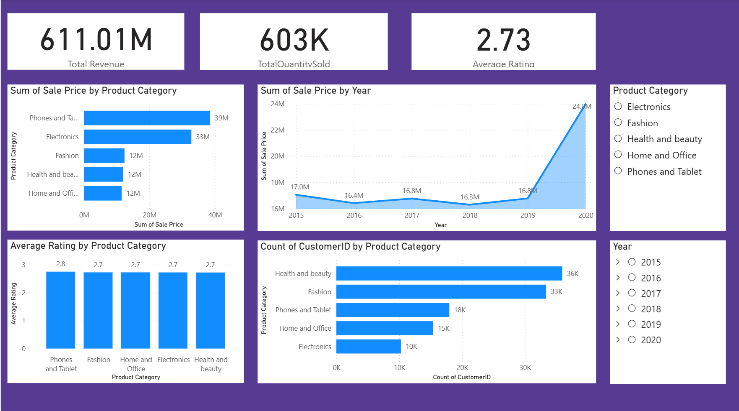

Slide 12
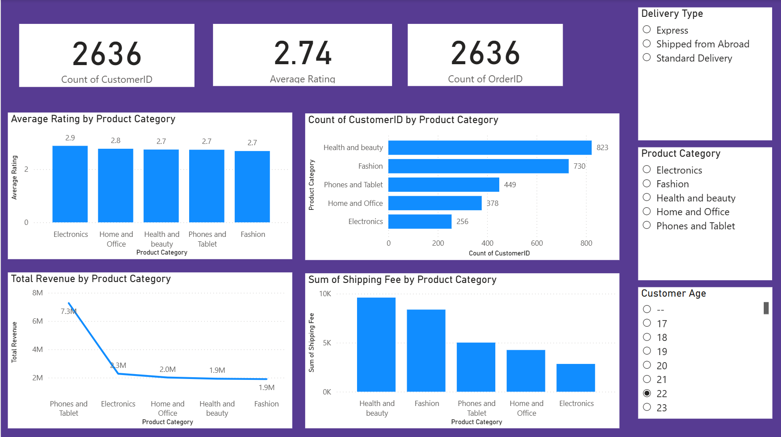

Slide 13
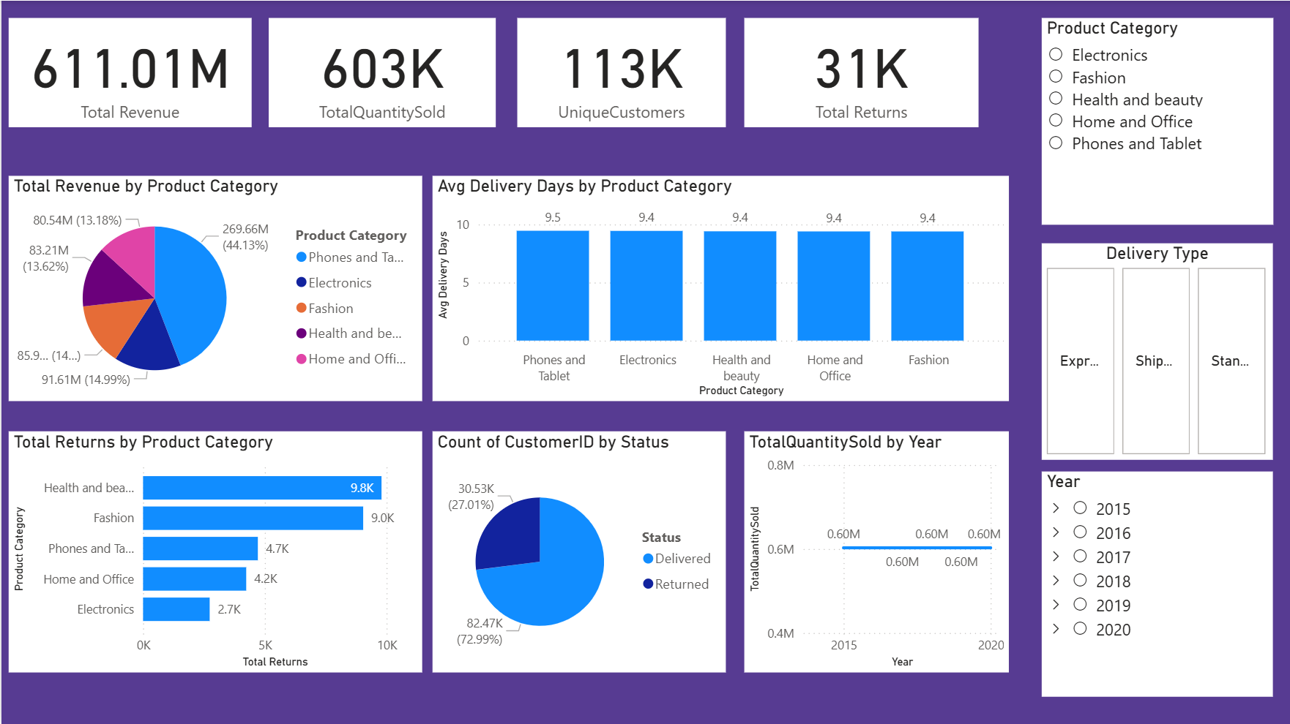

Slide 14
✓
Thank You
Amazon E-Commerce Analytics — Power BI Project
Sandeep Koduru
Questions & Discussion Welcome

