Slide 1




Manufacturing Analysis
A Comparative Study using Excel, Power BI, Tableau & MySQL
“Transforming 10,000 rows of raw production data into actionable insights.”
Date : 29/10/2025
Group Number : 2

Slide 2

Introduction & Objective
To analyze 2015 manufacturing data to uncover patterns in rejection rates and enhance production efficiency.
What We Analyzed | Why It Matters
2015 manufacturing data (10 K rows) | To find relation between manufactured and rejected quantities
Machine & product performance | Identify bottlenecks and improve efficiency
KPIs – Manufactured Qty, Rejected Qty, Wastage % | Support data-driven decisions
Project Overview / Workflow
Raw Data
Excel
Power BI / Tableau
Insights

Slide 3
Comparative Manufacturing Data Analysis – Multi-Tool Approach
This project helped us to:
Track production vs. rejection rate
Identify which products or machines have higher defect rates
Measure efficiency of manufacturing processes
Analyze 10K+ records of 2015 manufacturing data to generate insights
Evaluate key KPIs: Manufactured Qty, Rejected Qty, Wastage %, Processed Qty

Slide 4
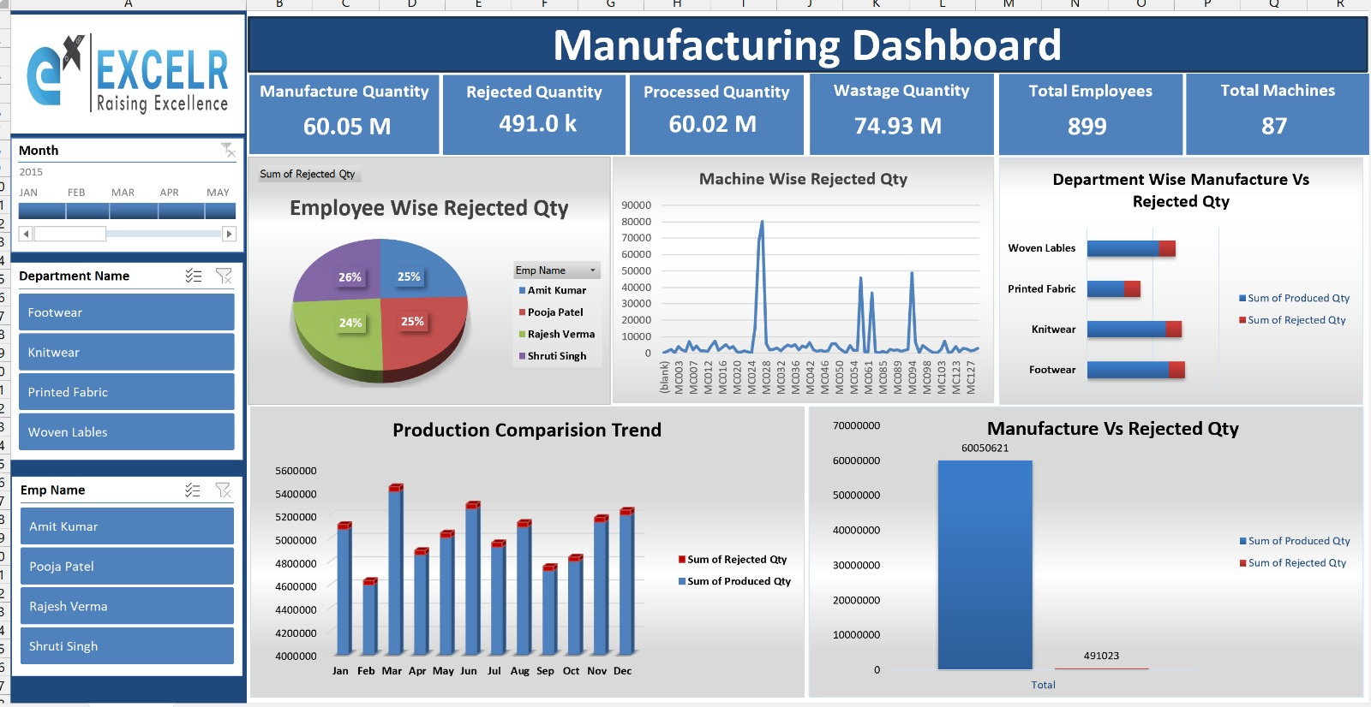
Dashboard Visuals – Excel | Power BI
“Excel Dashboard”
Built KPI dashboards using charts, slicers, and pivot tables.Learned data cleaning & interactivity.

Slide 5
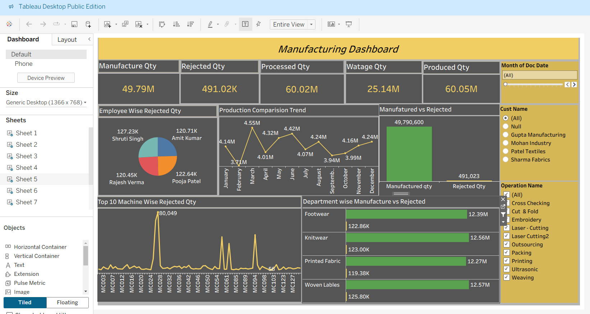
Power BI
“Power BI Dashboard”
Developed dynamic visuals using filters and cards
Practiced data modeling, relationship management, and automation

Slide 6
Dashboard Visuals –Tableau
“Tableau Dashboard”
Designed interactive dashboards with hierarchy and story-telling visuals.
MySQL – Queried KPIs & trends. Strengthened data querying and aggregation logic

Slide 7
sql
Wrote queries to extract KPIs and identify production trends
Strengthened understanding of aggregation and analytical queries

Slide 8
Challenges Faced
Challenges | Description / Impact
Data inconsistency | Some data had missing or incorrect values
Understanding relationships | Hard to find direct cause for rejection
.Visualization errors | Initially graphs didn’t reflect correct KPIs
“We faced both technical hurdles and coordination difficulties while maintaining data accuracy across multiple tools.”

Slide 9
Advantages:
        Enhances production efficiency
        Minimizes wastage and cost
        Enables data-driven decision-making
        Quickly pinpoints process bottlenecks
Limitations:
  Accuracy depends on the quality of input data
  Analysis may not consider external factors (like human error or raw material quality)
  Time-consuming to clean and prepare data

Slide 10
Learnings:
  • Excel → Simplicity and foundational analytics — mastered KPI visualization and data setup
  • Power BI → Dynamic, automated reporting — learned relationships and live data integration
  • Tableau → Visual storytelling — gained creative presentation and interactivity
  skills
  • MySQL → Analytical backbone — learned logical querying and KPI calculation
Conclusion:
This project effectively highlighted inefficiencies in the production process and demonstrated the power of data visualization in decision-making.
Future work could expand toward real-time dashboards and predictive analytics for preventive maintenance.

Slide 11
Teamwork & Challenges Faced
Challenges:
• Data cleaning and tool synchronization
• KPI standardization across platforms
• Time and task management
How We Solved It:
• Weekly sync meetings to track progress
• Task division based on skill strengths (SQL, BI tools, design)
• Peer reviews for consistency
“This experience taught us teamwork, adaptability, and patience — as essential as technical skill.”

Slide 12
THANK YOU

