Slide 1
Understanding the Learning Curve to Implementing a Just Culture
Kody Pope
11-14-24
Assignment 9.2

Slide 2
(“Just Culture Toolkit”) shares with us the following slides

Slide 3

Understanding Just Culture
Just Culture considers systemic issues when things go wrong, allowing professionals to learn without fear of retribution.
It balances organizational responsibility and individual accountability after an error occurs.

Slide 4
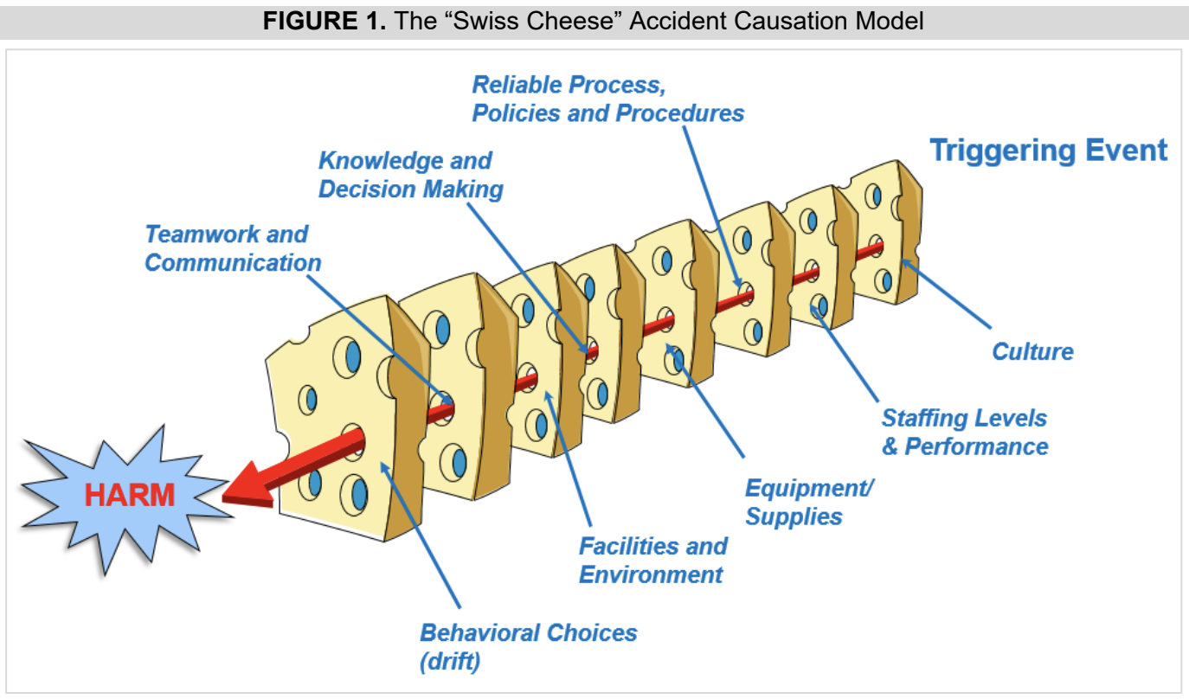
(“Just Culture Toolkit”)

Slide 5
(Page) shares with us the following slides

Slide 6
Principles of Just Culture
Shift from blame to trust: Adverse events are learning opportunities, not immediate blame assignments.
Focus on transparency, openness, and learning from incidents.

Slide 7
(Murray et al.) shares with us the following slides

Slide 8

Implementation Strategies
Build Awareness: Educate staff about Just Culture principles.
Policy Support: Implement policies that align with Just Culture.
Daily Practices: Integrate Just Culture principles into daily work processes.

Slide 9

Benefits
We have improved patient safety.
Increased reporting of errors and near misses.
Shift towards a fair and just approach.

Slide 10
Works Cited
“Just Culture Toolkit.” https://www.ashp.org/-/media/assets/pharmacy-practice/resource-centers/patient-safety/Just-Culture-Toolkit_-Final.pdf
Murray, John S, et al. “Implementing Just Culture to Improve Patient Safety.” Military Medicine, vol. 188, no. 7-8, 18 May 2022, https://doi.org/10.1093/milmed/usac115.
Page, Alison. “Making Just Culture a Reality: One Organization’s Approach.” Ahrq.gov, Oct. 2007, psnet.ahrq.gov/perspective/making-just-culture-reality-one-organizations-approach.

