Slide 1
The Technology Value Stream
Kody Pope
6-1-24
Assignment 1.2

Slide 2
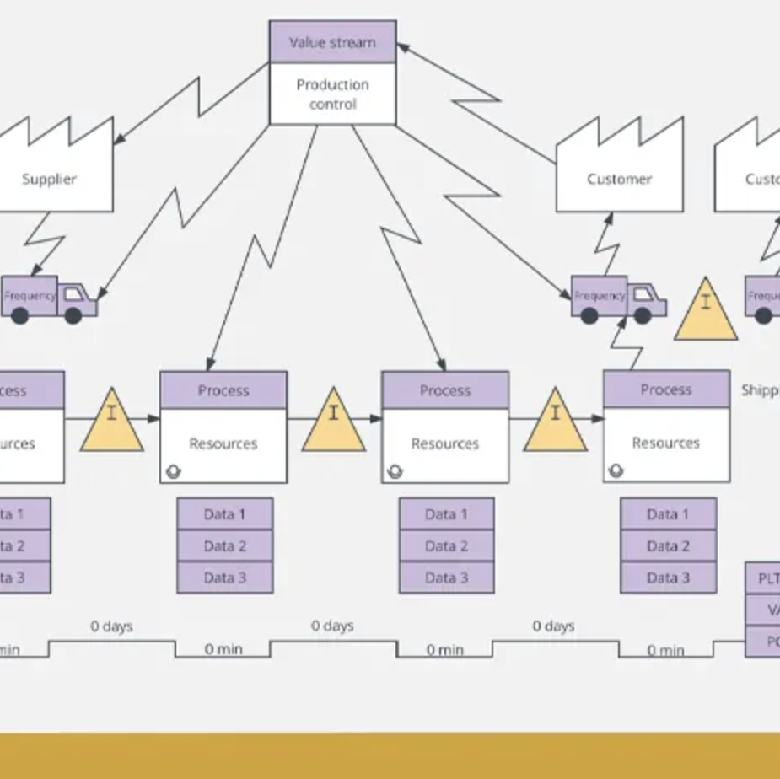
What is value stream mapping?
According to (Leaper), Value stream mapping is a map that shows how the product will make it from start to finish. For example, if you were to build a car, then there would be a diagram showing what would happen to make the car from when the customer placed the order to when the vehicle is being delivered to the customer.
The map can be a diagram, such as below.

Slide 3
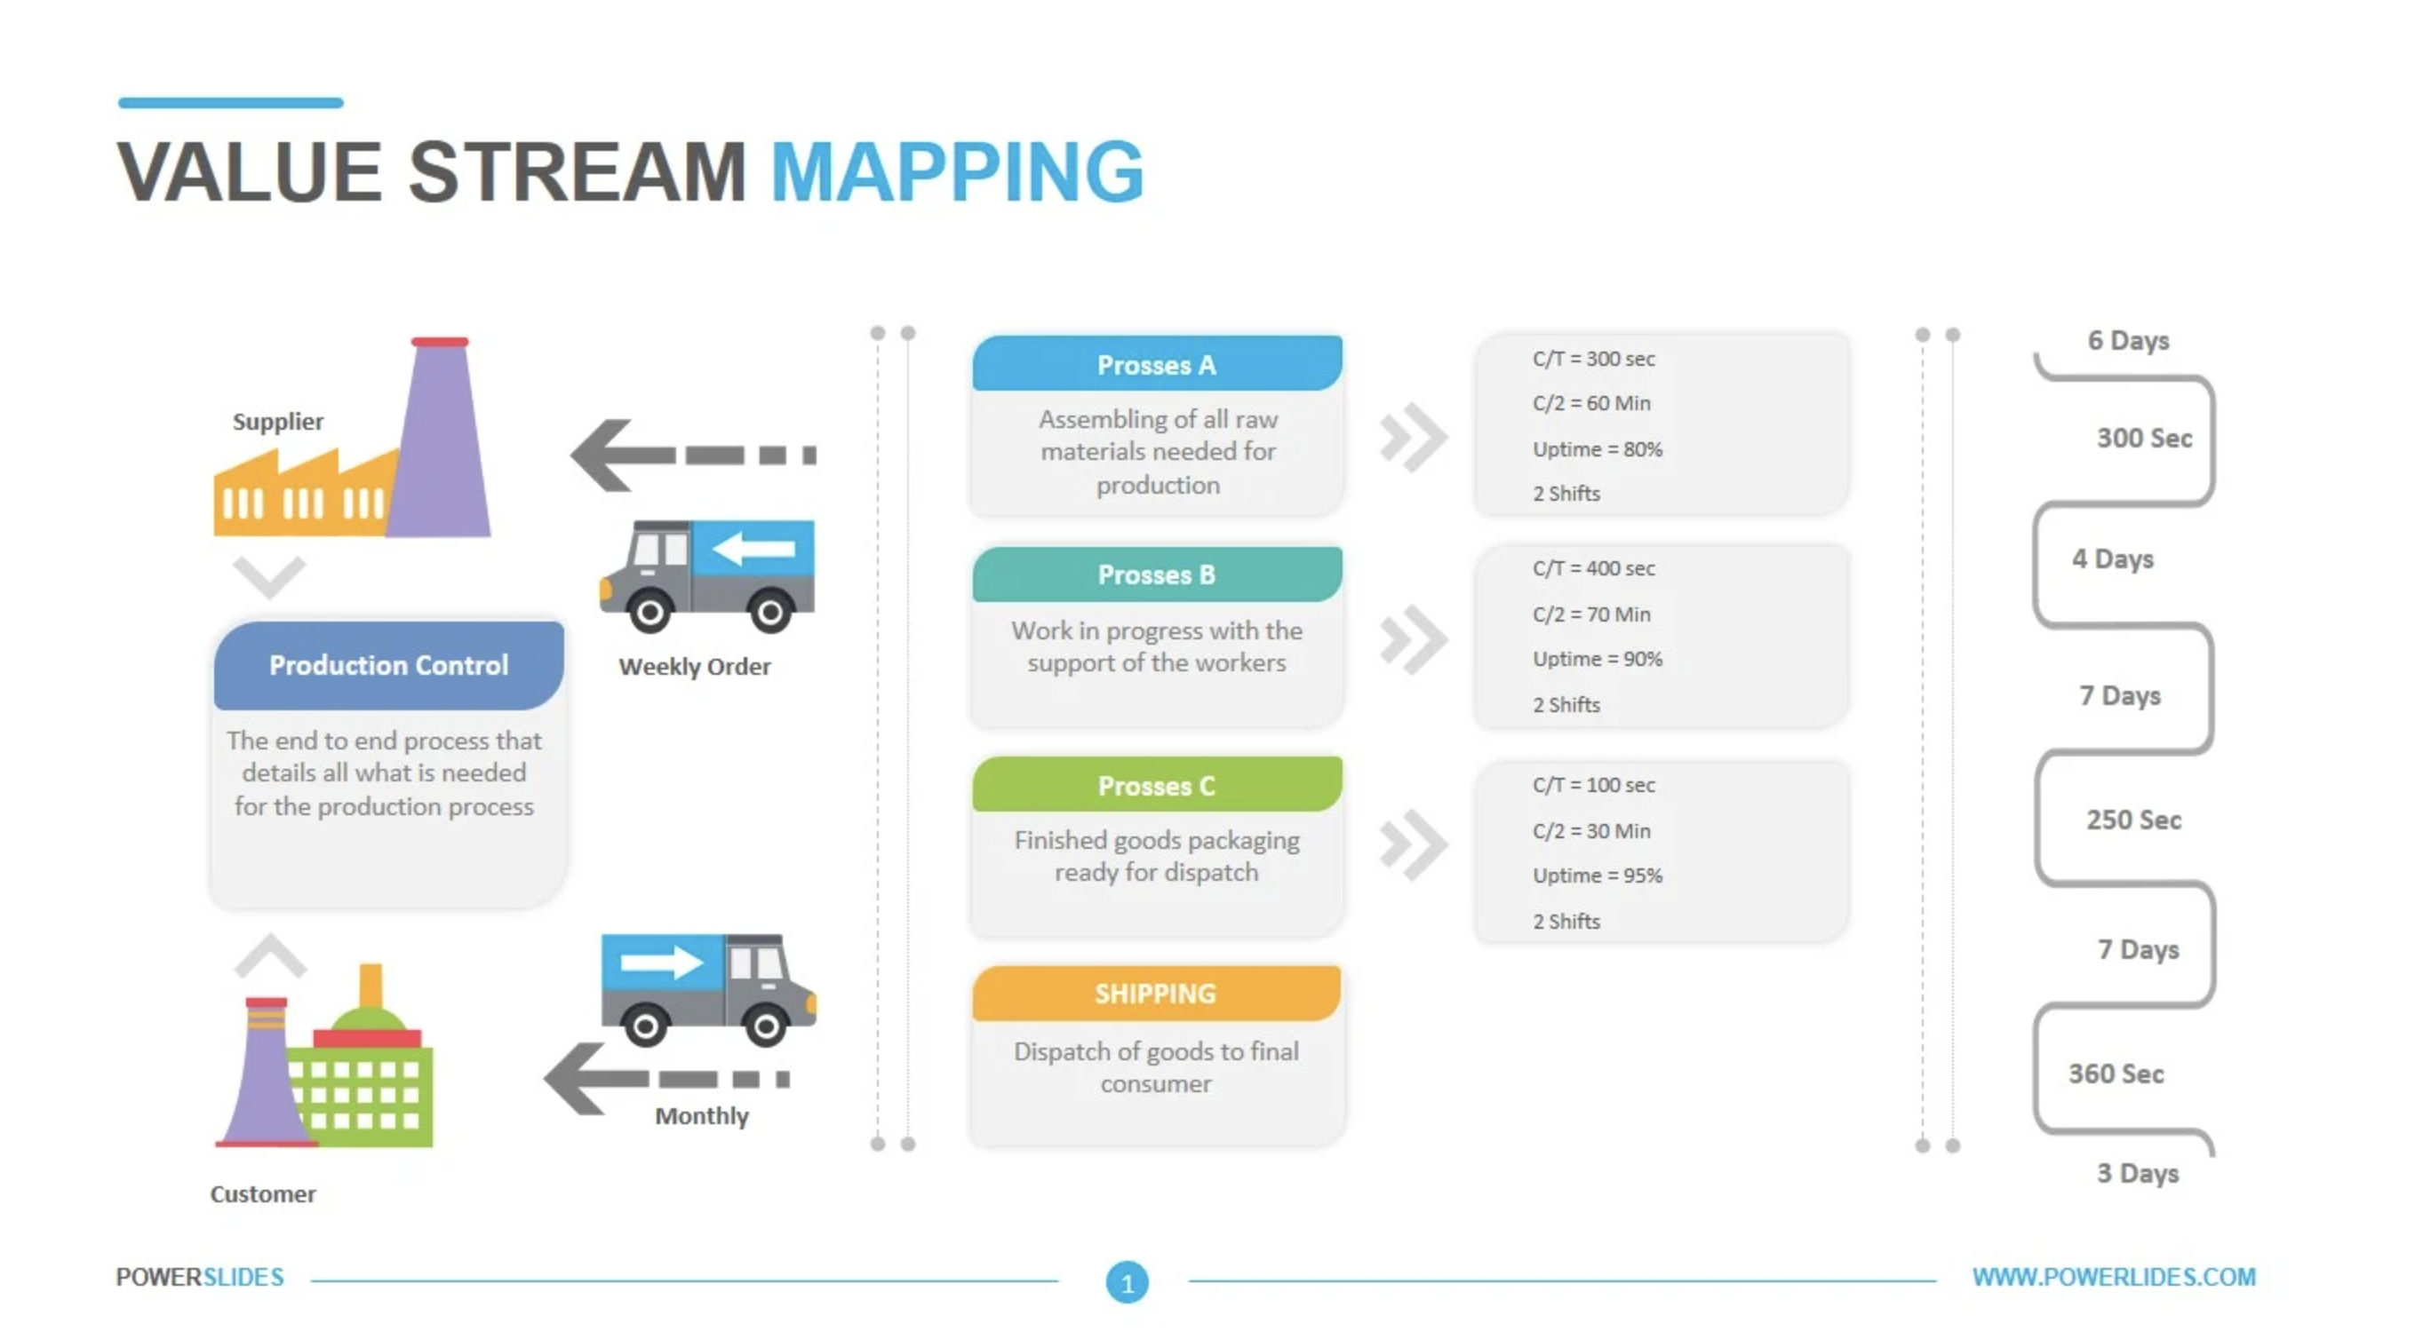
Or this

Slide 4
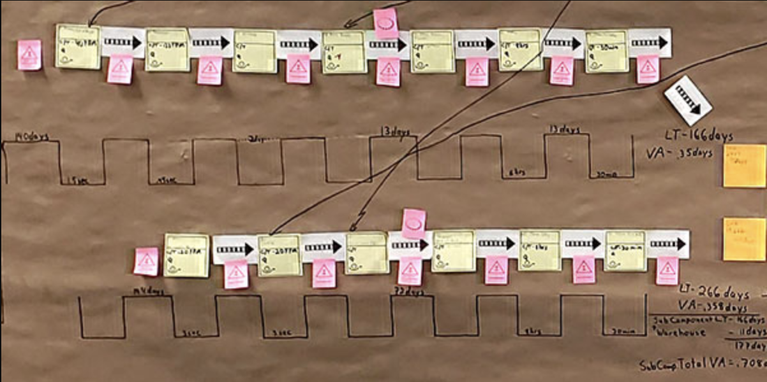
Or this

Slide 5
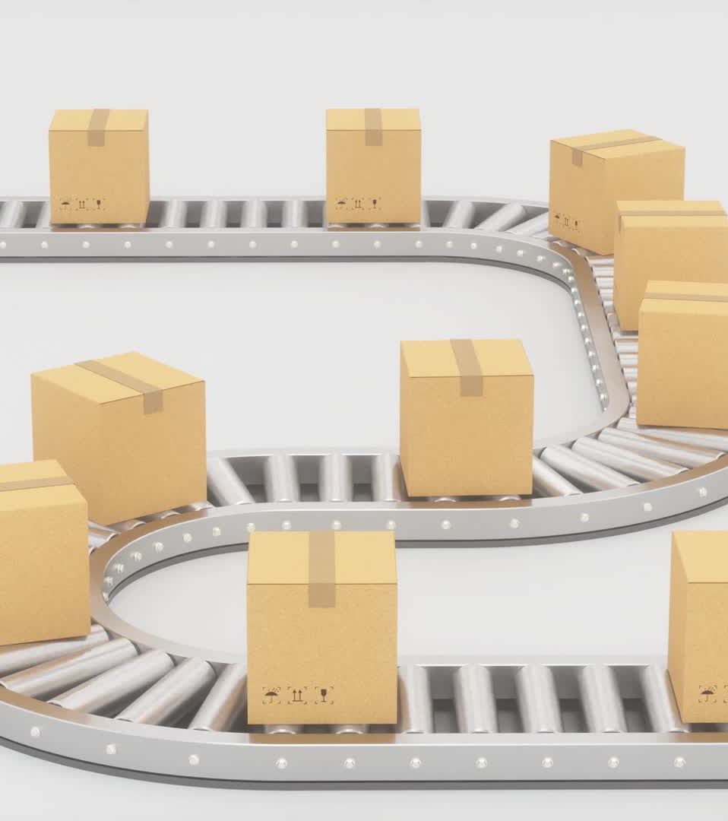
Process time
According to (Staff), process time is the time it takes for a product to be delivered to the customer. (how long will the customer wait for their car to be delivered)

Slide 6

Lead time
(Staff), shares that lead time is the estimated time it will take for the process time to complete.
The estimate is calculated using information available, such as stock on hand, the time it will take for materials to be delivered to the factory, the time the factory needs to develop the materials into products, and the time to ship the item.

Slide 7

Processing time
(Staff), processing time is the actual time it took To develop the items once the materials needed are acquired
If you want to build an app, the process can only occur once the company hires a software developer.
The time to hire the developer and the time the developer will time is the lead time
The time the developer took to make the app is the process time.

Slide 8

Deployment Lead Times Requiring Months
According to (Kim et al.) The lead time requiring months is when a development needs to take a long to produce a deliverable.
This may be due to a large amount of work needing to be completed
Many approvals need to be made
And large amounts of rework if the work completed does not pass any of our tests

Slide 9

Deployment Lead Times of Minutes
According to (Kim et al.), lead times of minutes are the lead situation in which teams quickly receive feedback on their products and can make many small changes individually.
They may not need approval to implement their changes
The changes should be small so as not to affect the overall performance, hindering the product from being able to pass any testing.

Slide 10
Works Cited
Kim, Gene, et al. The Devops Handbook How to Create World-Class Agility, Reliability, and Security in Technology Organizations. It Revolution Pr, 2015.
Leaper, Lean. “Understanding the Fundamentals of Value-Stream Mapping.” Lean Enterprise Institute, 25 Aug. 2022, www.lean.org/the-lean-post/articles/understanding-the-fundamentals-of-value-stream-mapping/.
Staff, iSixSigma. “Lead Time vs. Cycle Time: What’s the Difference?” Isixsigma.com, 22 Aug. 2022, www.isixsigma.com/methodology/lead-time-vs-cycle-time-whats-the-difference/.

