Slide 1
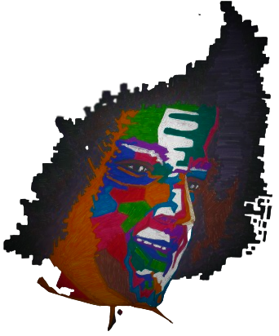


Offering Our Collective Efforts
At Thy Lotus Feet.

Slide 2
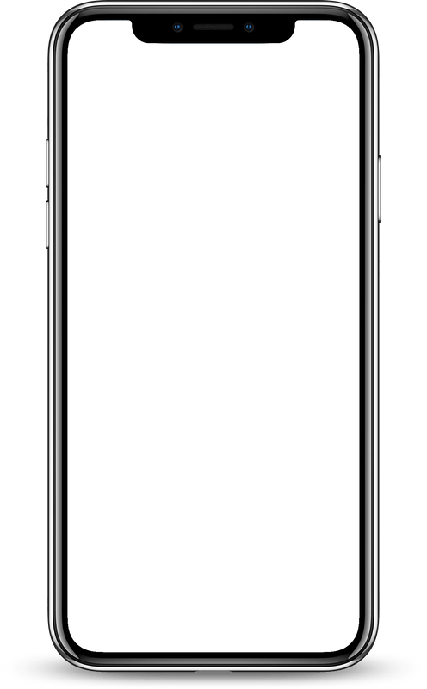
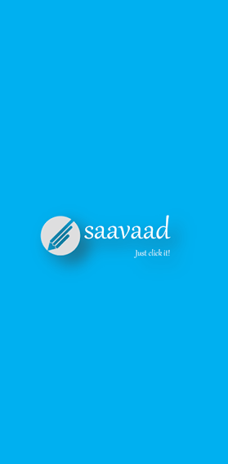
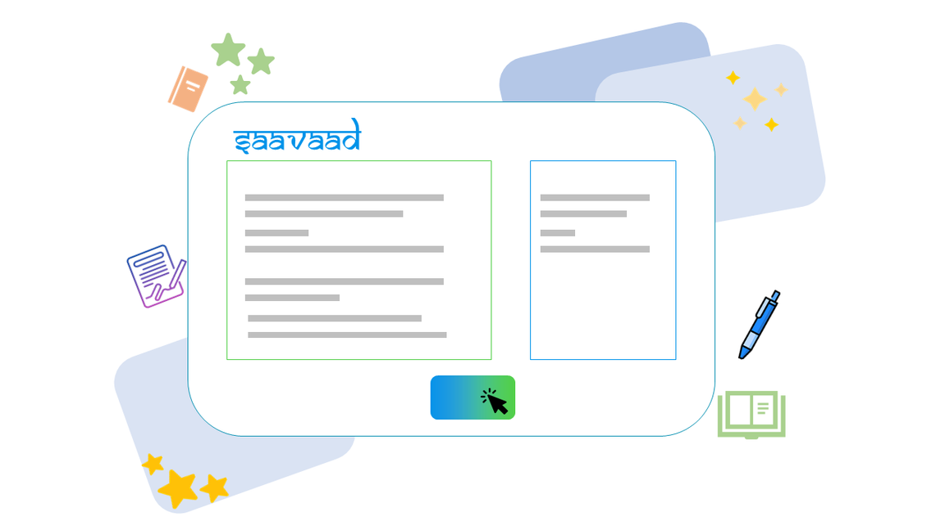
Just click it
SAAVAAD
Group members
Rohith K
Lokesh G
Thilak D
Guided by
Dr. Sampath Lonka

Slide 3
SAAVAAD
System Study
Existing Systems
What's the Current Solution?
What Makes Us Better?
Huge amount of technology existing.
Automation demand.
Reduced workload.
User interface to the technology.
Build efficient systems.
Provide best and unique features of Saavaad within few clicks.
Extended features.

Slide 4
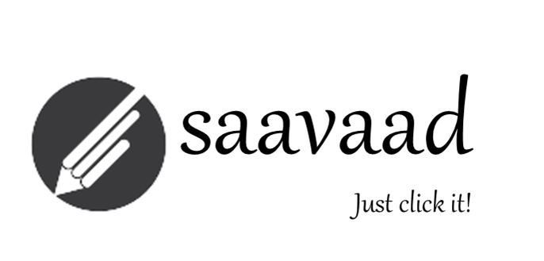
SAAVAAD
What is Saavaad?
01
An application assisting humanity in summarization and translation.
Nomenclature.
Why Saavaad ?
02
Large usage of current technology.
Simplify our tasks.
Help Student Community.

Slide 5







SAAVAAD
Tools used
Webiste
Android App
API
HTML
CSS
React JS
React
React Native Expo
Python
Flask
Serveo.net
MongoDB

Slide 6




SAAVAAD
Contributions
Lokesh Goenka
Thilak D
Kodi Rohith
Web Application designer.
Designed using React.
Android Application designer.
Designed using React Native Expo.
API , Data Storage designer.
Designed using Flask API, Serveo.net, MongoDB and Pymongo.

Slide 7
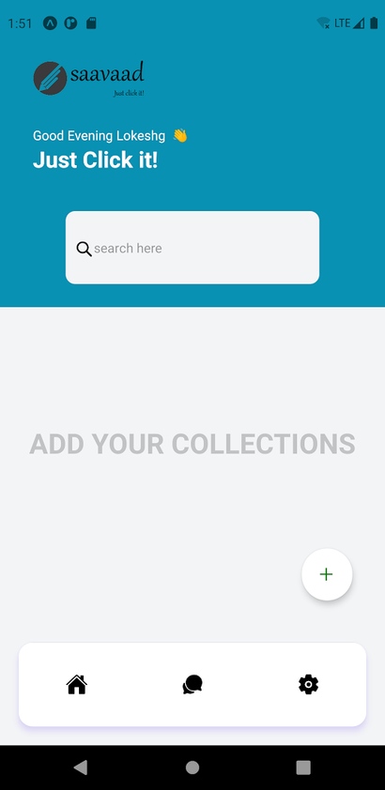
SAAVAAD
01
Benefits
Handier
Save data
Easy to use
The Android App
The Android app provides you the same features as of the website but in a more handy way
02
Features
Summarize
Translate
offline data storage
login & sign in features
themes
sharing data

Slide 8

SAAVAAD
Linking with API
API
Flask API
Serveo.net
Set of protocols for Software Applications.
Integrate with data.
Increased utilisation
Security risks.
Extension of Flask - Web Framework to build web services.
Connections through HTTPS.
Light and flexible.
Limited Functionality.
Opensource service to provide public end-point to our development machine or server.
Port forwarding.
Easy to setup and use.
No control over risk.

Slide 9
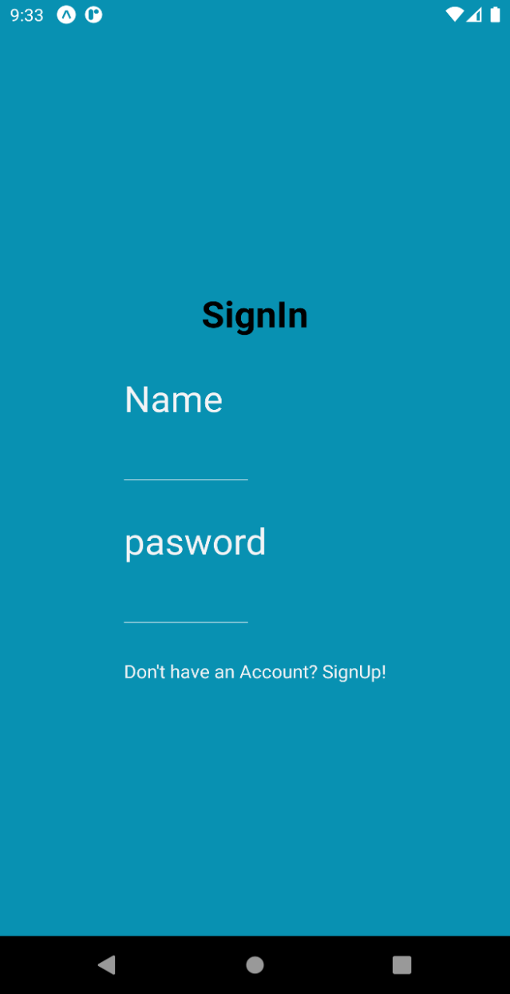
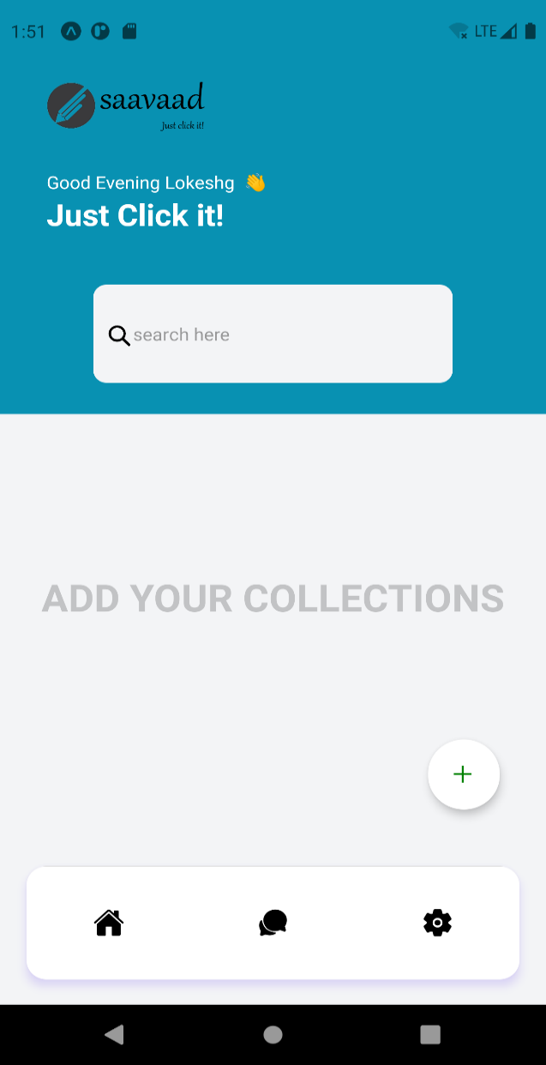
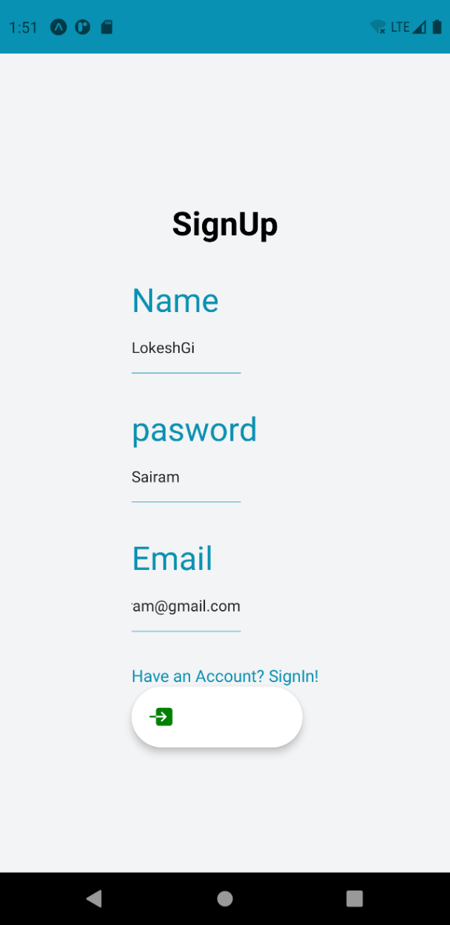
Work Flow

Slide 10

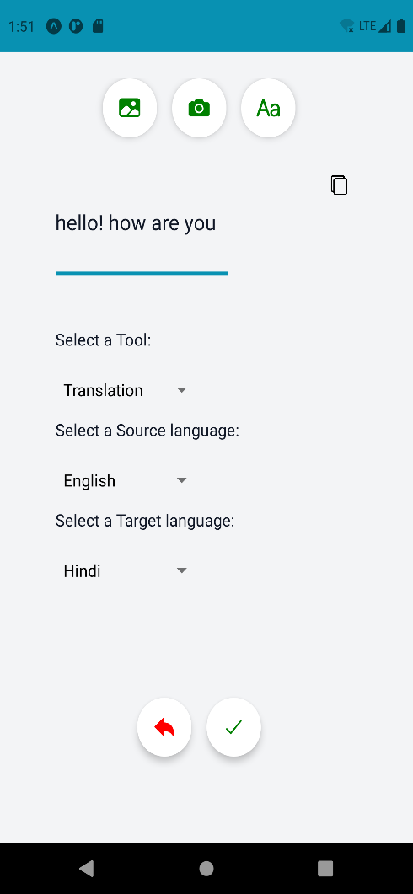
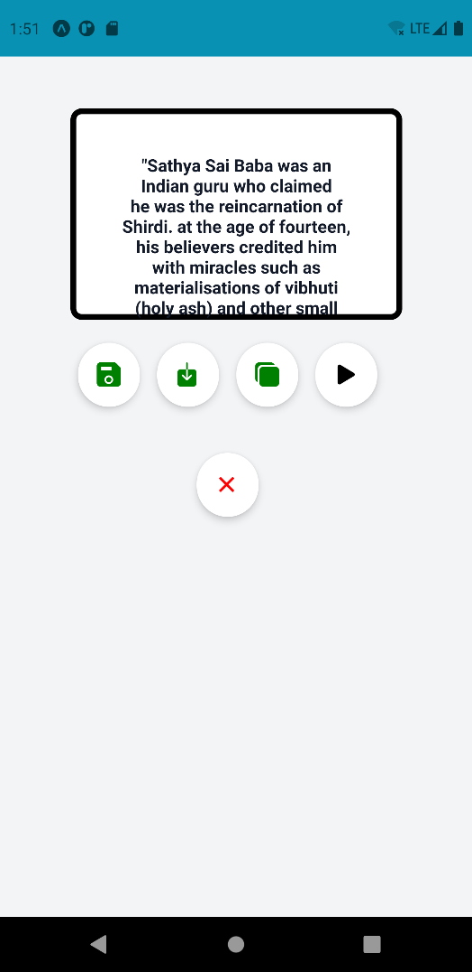
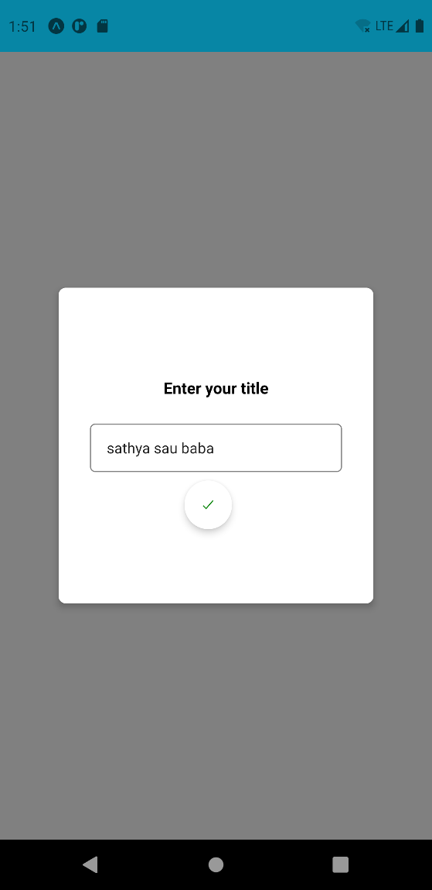
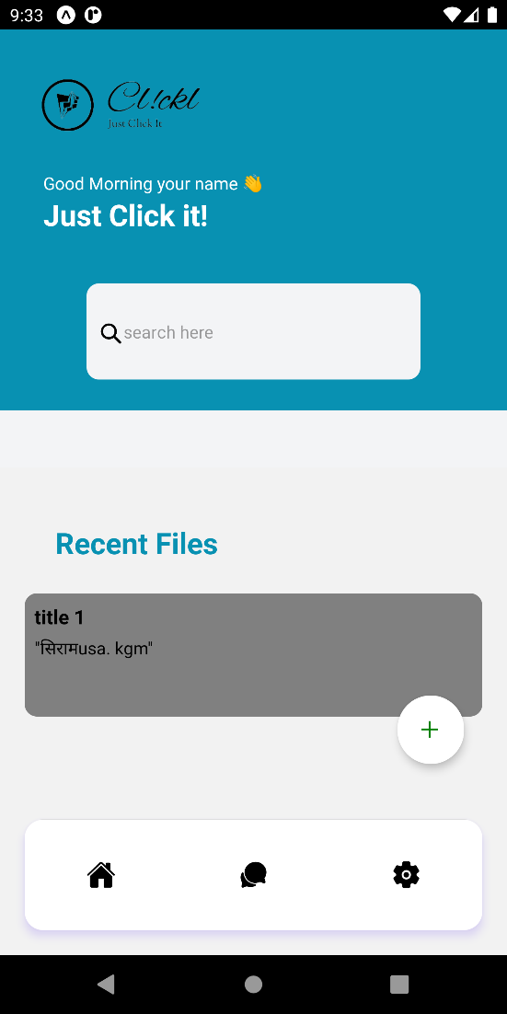

Slide 11

SAAVAAD
Data Storage
MongoDB
Pymongo
Mongo API (via Flask)
NoSQL based document oriented database program.
Handle structed and Non-structed data easily.
Easily store, retrieve, delete, update data.
Python Library, an Interface for MongoDB databases.
Data Handling in python.
Obstacles
Solution
Our Style

Slide 12
SAAVAAD
User
Serveo.net
Data Workflow
API
Request Processing

Slide 13
SAAVAAD
01
Benefits
User Friendly
Simple design
Easy to use
The website
Saavaad website provides you with all the features like
Text Summarisation
Translation
Text To Speech
02
Features
Summarize
Translate
Convert to Audio

Slide 14
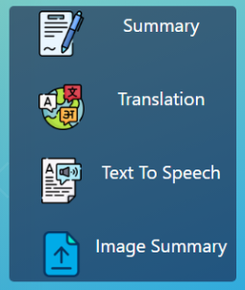
SAAVAAD
website workflow
As soon as you open the website you see the features section of the website where you can choose the required feature.

Slide 15
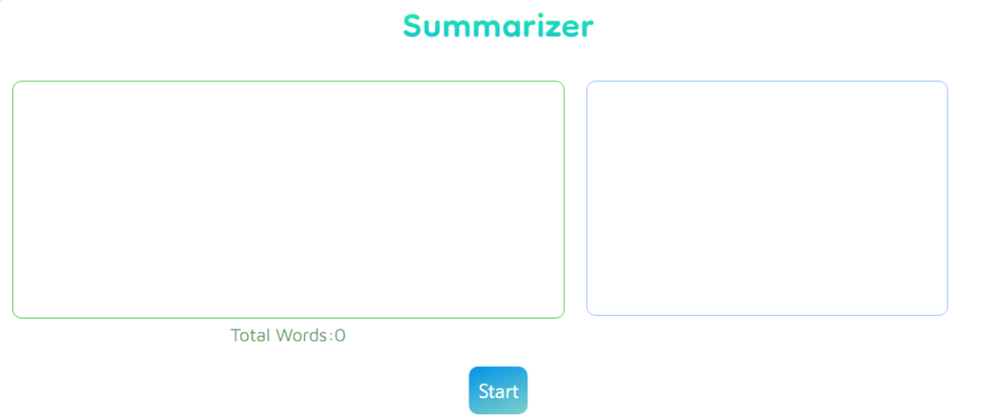
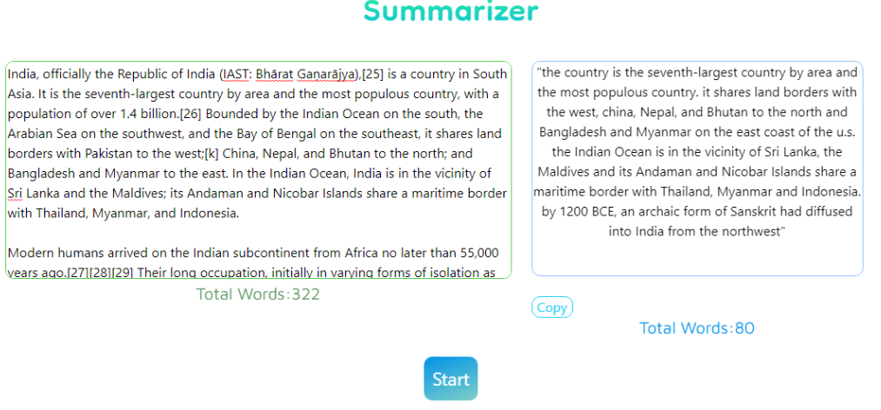

Slide 16
SAAVAAD
User
Serveo.net
API Workflow
API
Request Processing

Slide 17
Computers are now able to see, hear and learn.
Welcome to the Future.
Thank You

