Slide 1
Symulacje i gry decyzyjne 2025.04.09
pczapiewski@pjwstk.edu.pl Czapiewski Paweł

Slide 2

Top 5 Video Game Engines
Source: https://www.vanas.ca/en/blog/top-5-video-game-engines

Slide 3
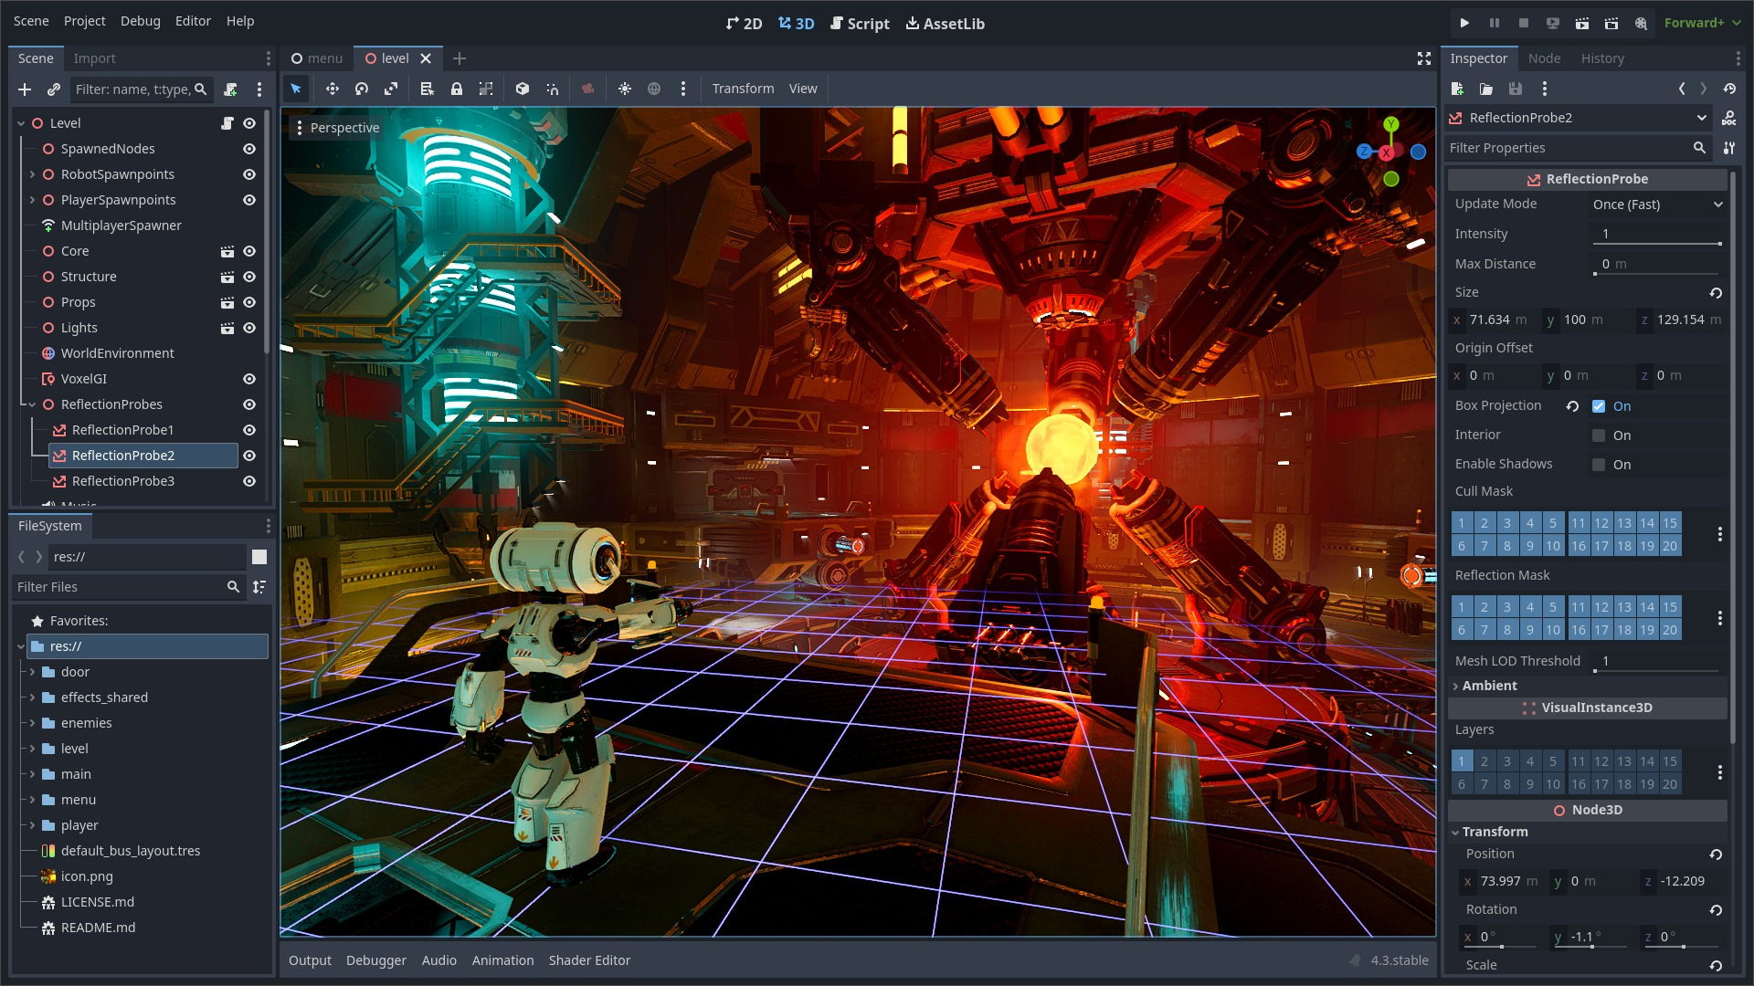
Top 5 Video Game Engines
Source: https://github.com/godotengine/godot

Slide 4
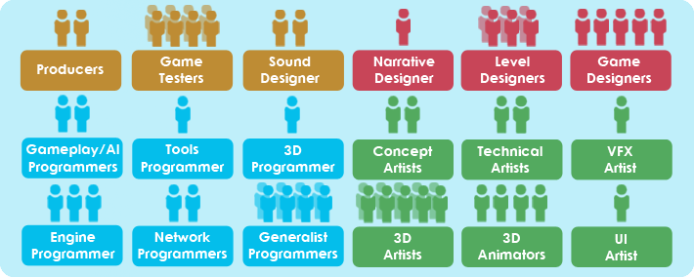
GameDev specializations
Source: https://skillers.tech/blog/gamedev-concepts-prospects-market-review-expert-opinions

Slide 5
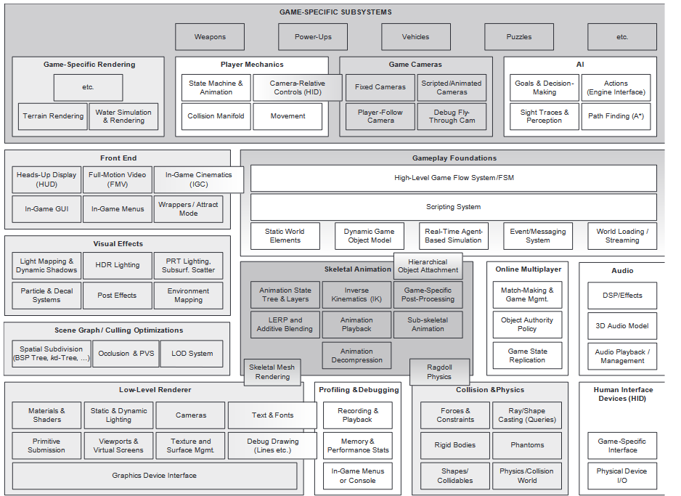

Slide 6
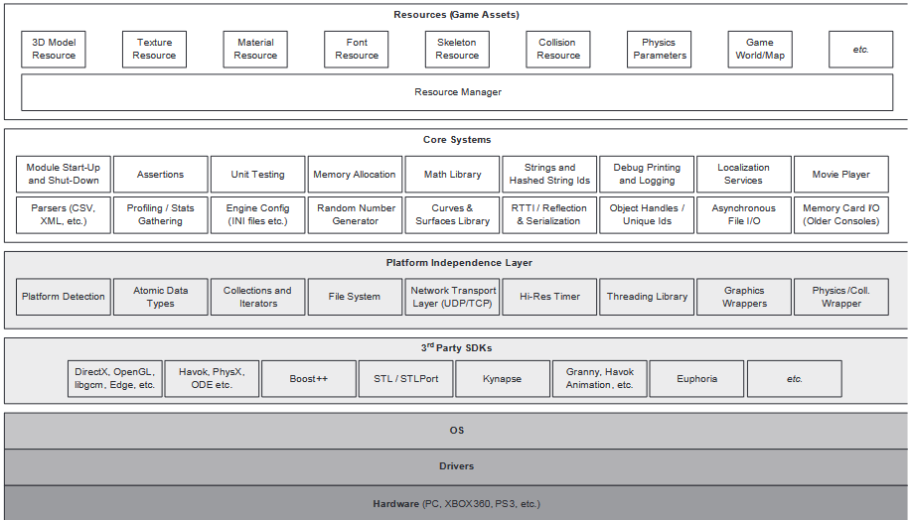
Runtime game engine architecture.

Slide 7

Game loop
Source: http://pygametutorials.wikidot.com/tutorials-basic

Slide 8
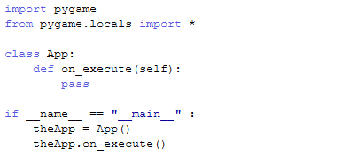
Game loop
Source: http://pygametutorials.wikidot.com/tutorials-basic

Slide 9
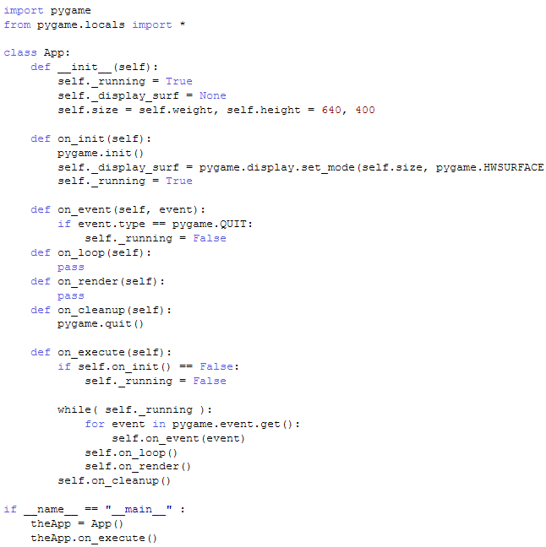
Game loop
Source: http://pygametutorials.wikidot.com/tutorials-basic

