Slide 1
Technical Sales Vault plm Client Extensions
Autodesk on premise PDM solutions, cloud connected
Sven Dickmans
Markus Koechl
Solutions Engineer PDM|PLM
Solutions Engineer PDM|PLM

Slide 2
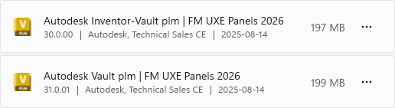
Agenda

Slide 3
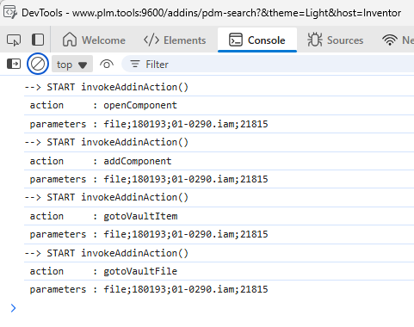
WebMessage Parameters
Source = Vault File
Message format
Action; Source; FileIterationId; Filename.Ext; MasterId
Action Values
openComponent
addComponent
gotoVaultFile
gotoVaultItem
Source Values
file | item | plm-item

Slide 4
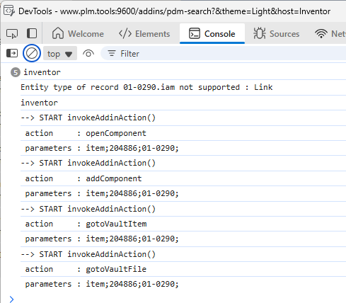
WebMessage Parameters
Source = Vault Item
Message format
Action; Source; ItemRevision(Id); Number
Action Values
openComponent
addComponent
gotoVaultFile
gotoVaultItem
Source Values
file | item | plm-item

Slide 5
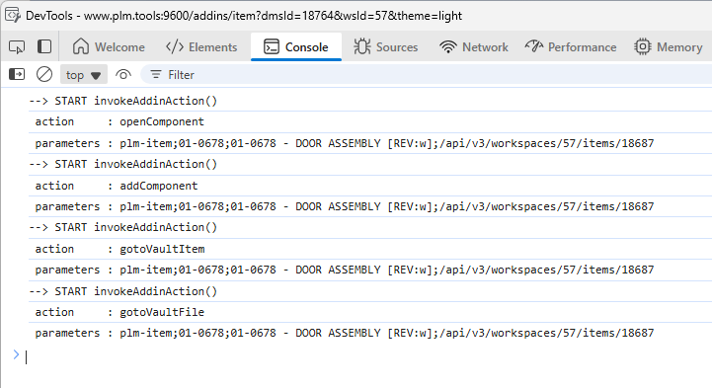
WebMessage Parameters
Source = Fusion Manage Item
Message format
Action; Source; Number; Item Descriptor [Rev]; urn
Action Values
openComponent
addComponent
gotoVaultFile
gotoVaultItem
Source Values
file | item | plm-item

Slide 6
Summary

