Slide 1
Technical Sales Vault plm Client Extensions
Autodesk on premise PDM solutions, cloud connected
Sven Dickmans
Markus Koechl
Solutions Engineer PDM|PLM
Solutions Engineer PDM|PLM

Slide 2
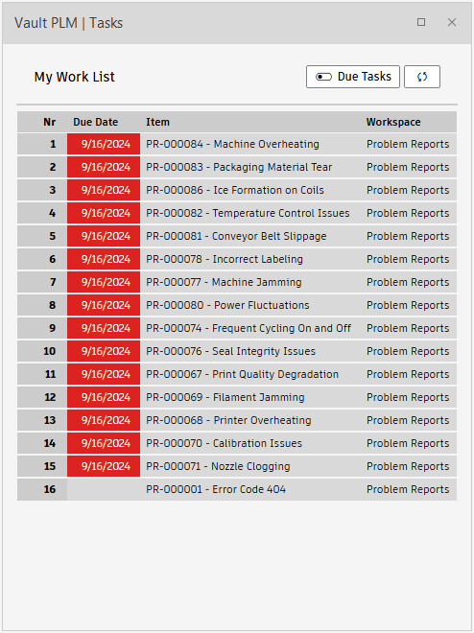
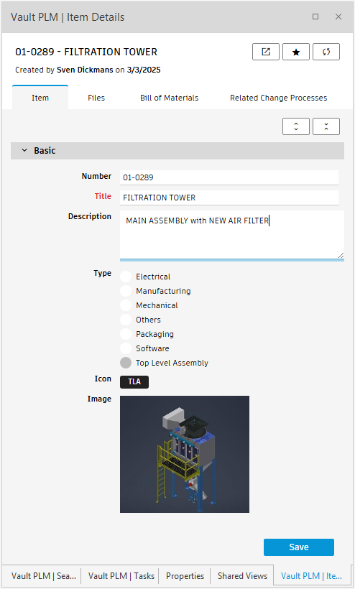
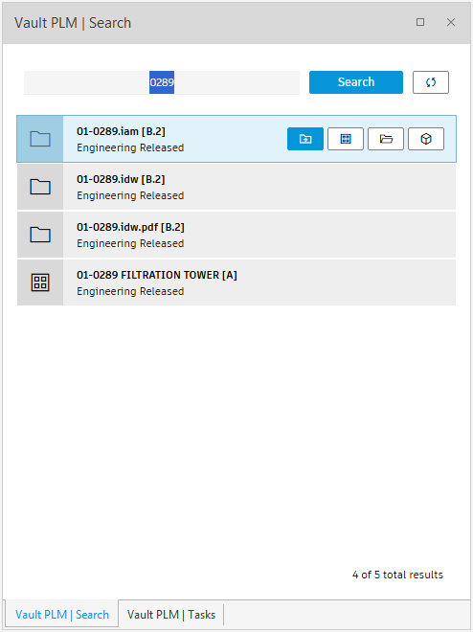
Agenda
Vault plm extensions for Vault and Inventor
Positioning and outcome options
Use case - engineering task sample
PDM-centric workflow option
CAD-centric workflow option
Installation
MSI Installer
Individual configuration settings
Looking behind the scenes

Slide 3
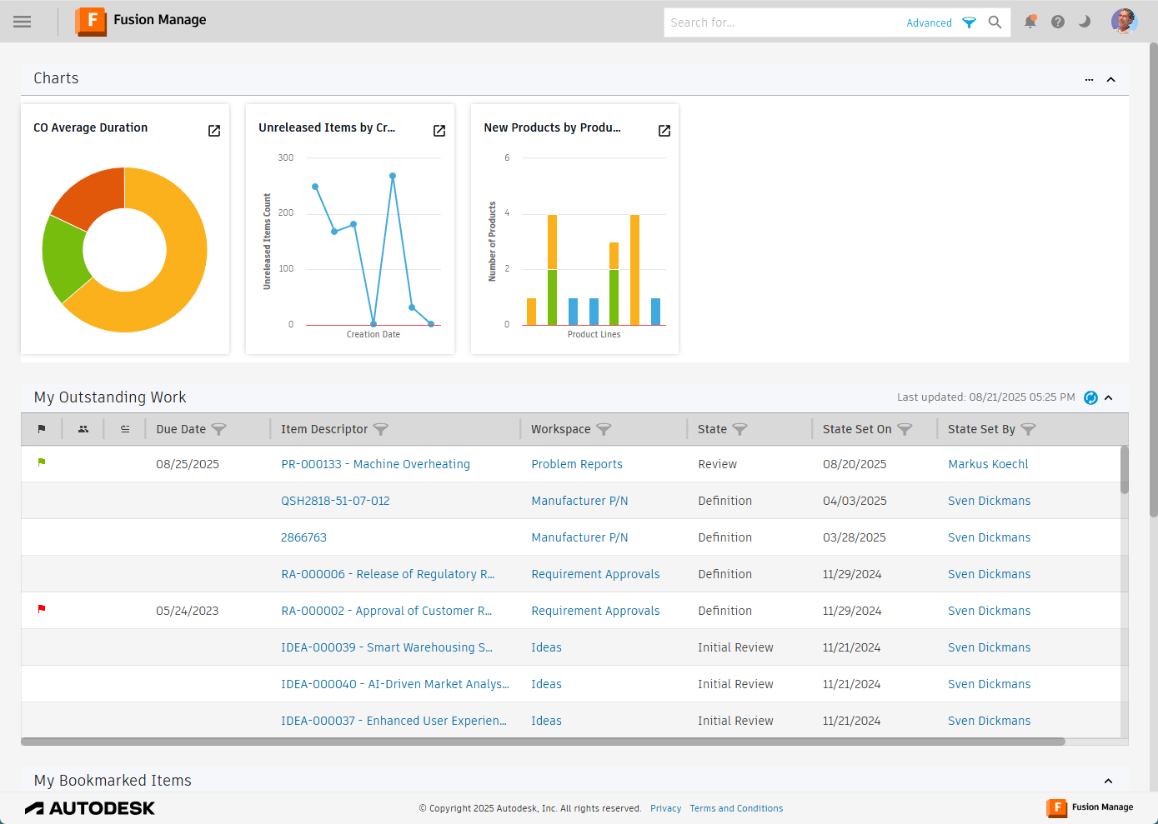
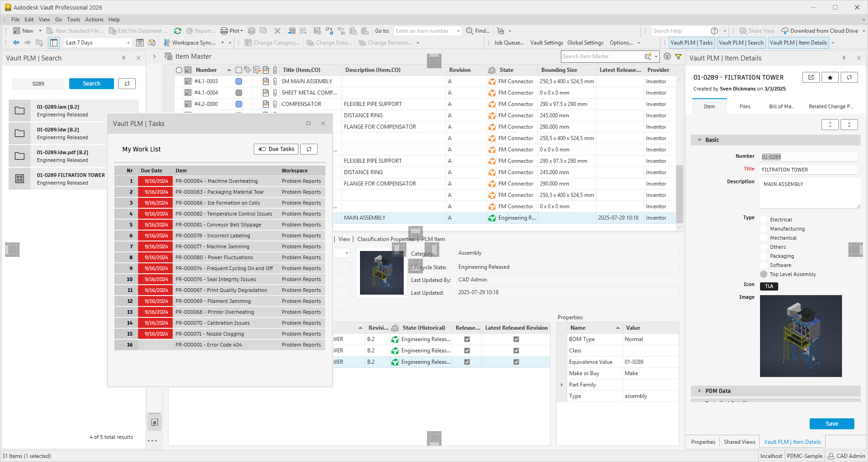
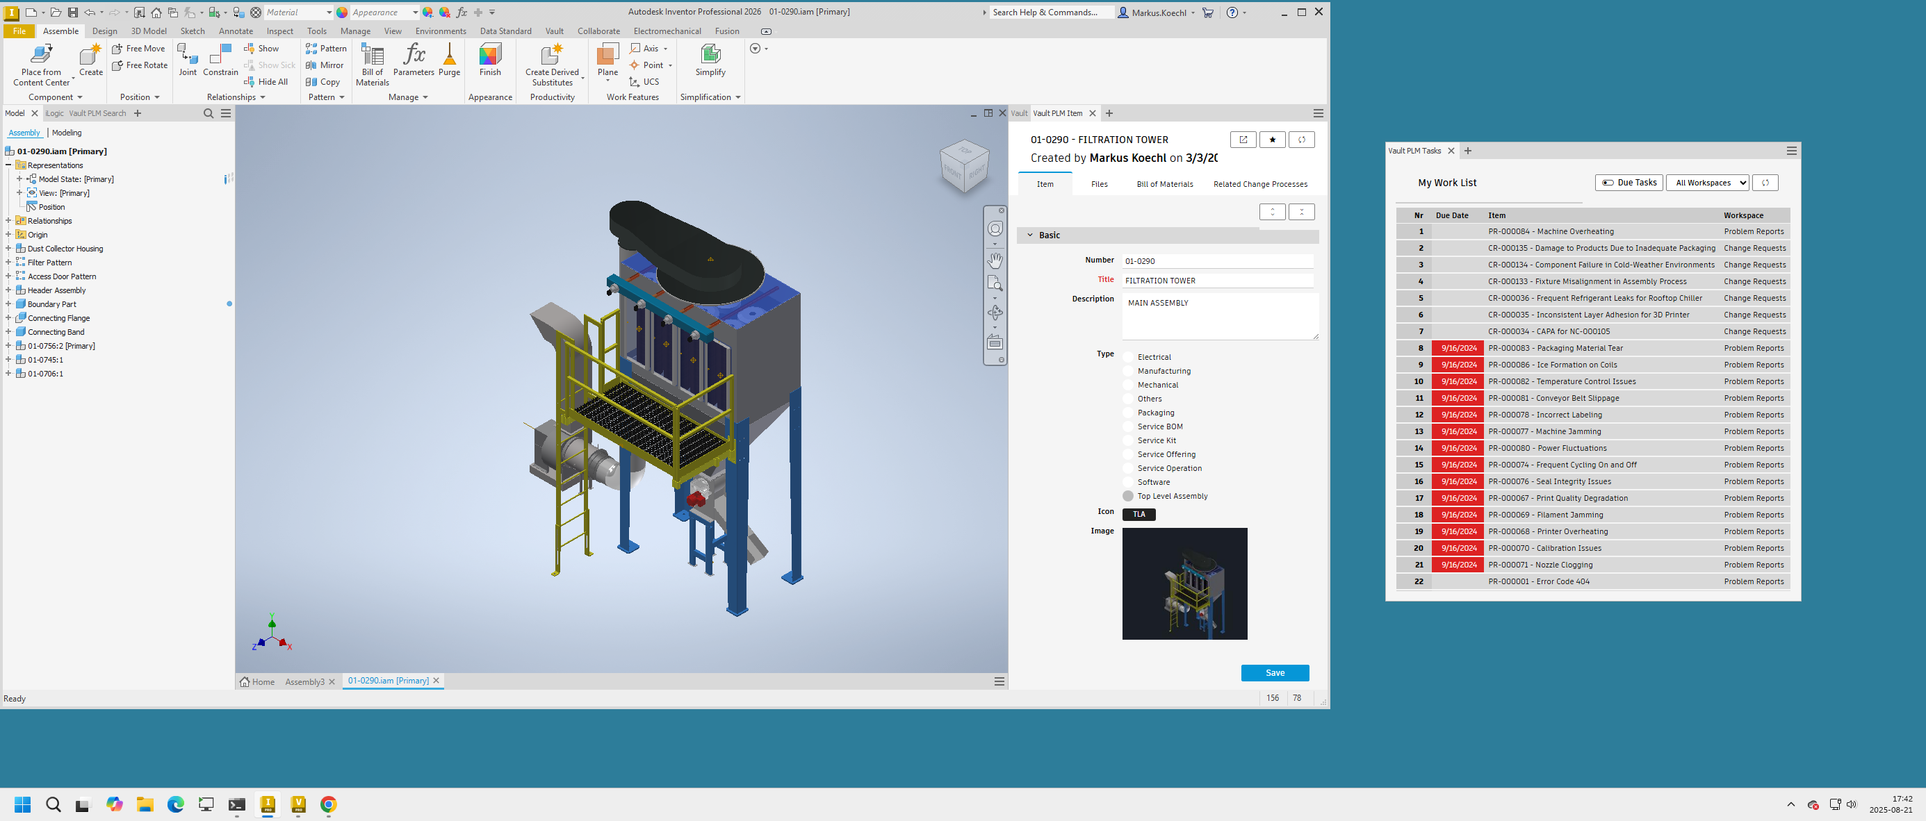
Vault plm Extensions
Positioning and outcome options
The default user interface of the cloud-based PLM system Fusion Manage does not interact with the engineers’ CAD and PDM toolsets. Engineering users want to follow up on their working list of engineering tasks – aka Fusion Manage Dashboard “My Outstanding Work” in the context of their primary tools.
The Technical Sales Vault plm extensions integrate optimized Fusion Manage views into Vault and Inventor clients, providing access to
Engineering tasks
Item Details and Item BOMs
PDM/PLM Search
Product- or Project Workspace(s)
Extended user commands allow completing plm workflows within the CAD/PDM desktop applications

Slide 4
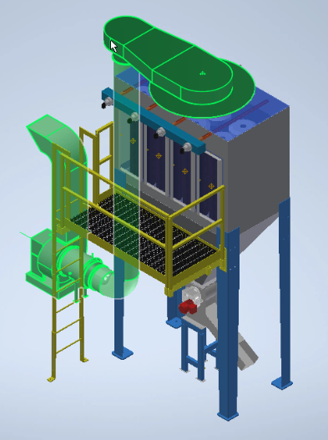
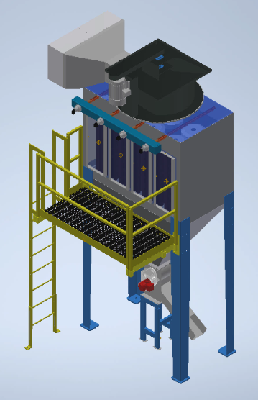
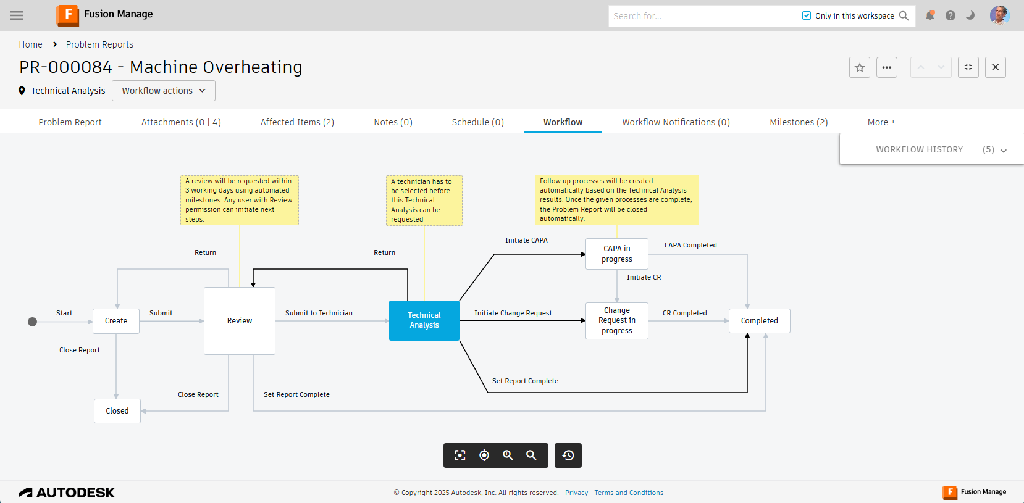
Use Case Sample
Preparing a change evaluation
The engineer drafts a new assembly configuration to prepare extended evaluations on a design change targeting problems in the operational plant.
The engineer’s task is embedded in Fusion Manage processes.
The task linked affected items and suggested a path for the problem resolution.
Real-world scenarios require extended investigations, reviews, and approvals, before a design revision is implemented
The engineer embeds the initial draft into the Fusion Manage workflow

Slide 5
Use Case Demonstration – PDM-centric option

Slide 6
Use Case Demonstration – CAD-centric option

Slide 7
Installation
Prerequisites
Vault Professional 2026 | Inventor 2026
[Recommended]: PDMC-Sample Vault
Fusion Manage tenant with administrative access
Fusion Manage UX Extension server

Slide 8
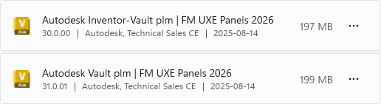
Installation

Slide 10
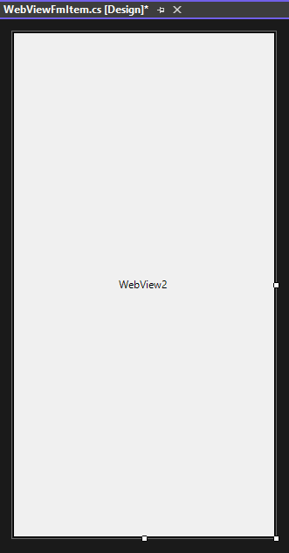

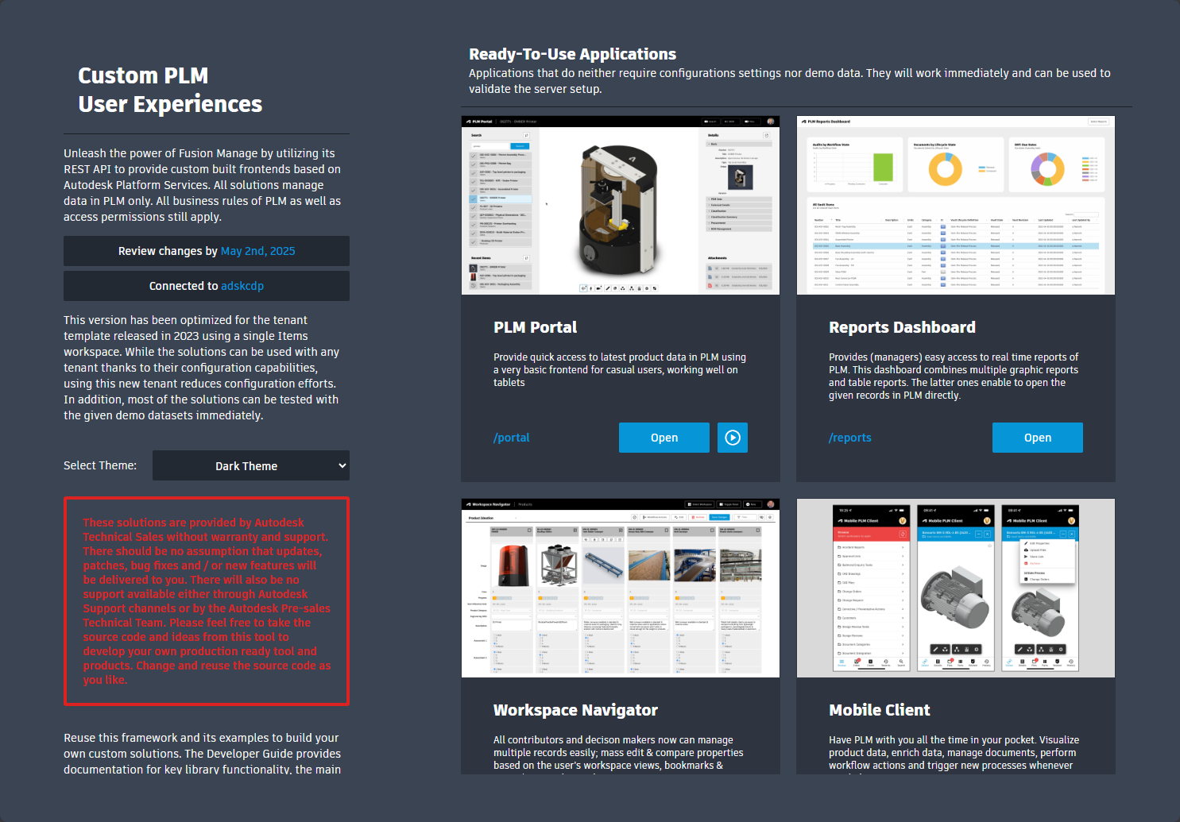

How it works…
Inventor dockable windows | Vault dock-panels = WebView2 controls
WebView2 controls display Fusion Manage UX Extension pages
Optimized layout with host-specific user commands
Messaging for bidirectional host – UXE server communication
Send messages
Call Url
Display
Receive messages
Navigation/Selection Open or Add Component

Slide 11
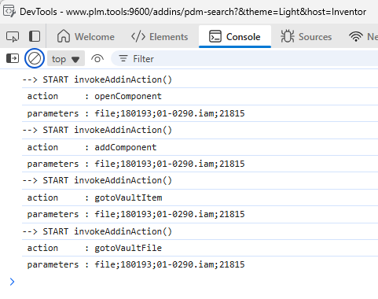
WebMessage Parameters
Source = Vault File
Message format
Action; Source; FileIterationId; Filename.Ext; MasterId
Action Values
openComponent
addComponent
gotoVaultFile
gotoVaultItem
Source Values
file | item | plm-item

Slide 12
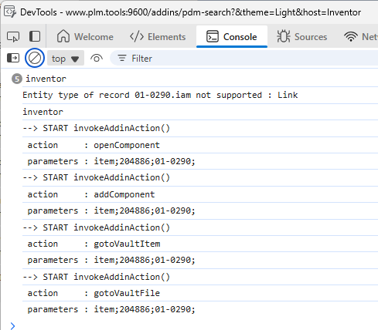
WebMessage Parameters
Source = Vault Item
Message format
Action; Source; ItemRevision(Id); Number
Action Values
openComponent
addComponent
gotoVaultFile
gotoVaultItem
Source Values
file | item | plm-item

Slide 13
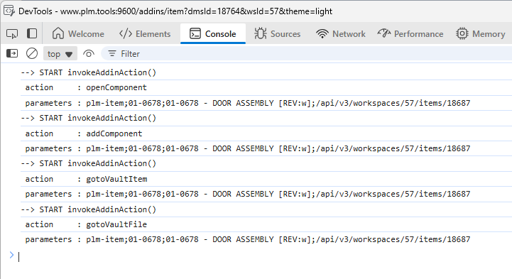
WebMessage Parameters
Source = Fusion Manage Item
Message format
Action; Source; Number; Item Descriptor [Rev]; urn
Action Values
openComponent
addComponent
gotoVaultFile
gotoVaultItem
Source Values
file | item | plm-item

Slide 14
Summary

