Slide 1

DHPoly

Slide 2
Index
Business
Technical Abilities
Quality

Slide 3
Index
Business
Vision
Use Case
Project Methodology
Team Roles
Scope
Technical Abilities
Quality

Slide 4
Our Vision
Monopoly
Online
Chance
Ressources

Slide 5
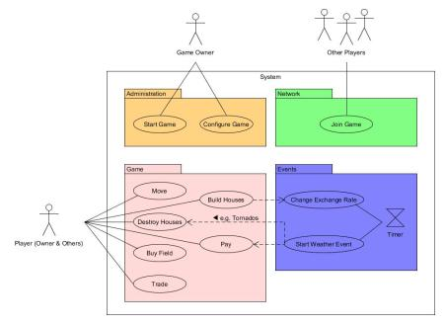
Use Case

Slide 6
Project Methodology
Agile Project
Scrum
GitHub

Slide 7
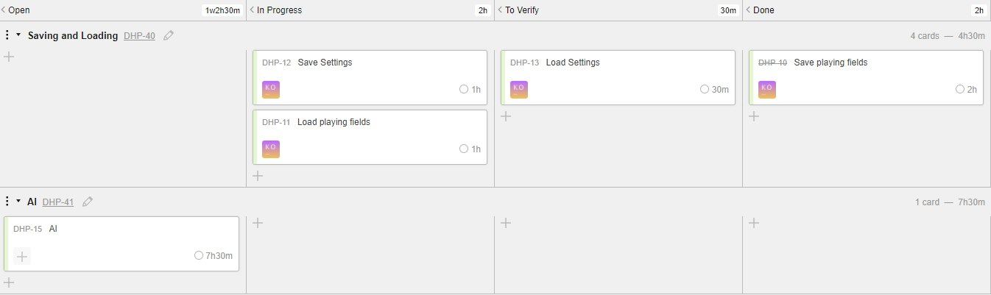
Scrumming

Slide 8
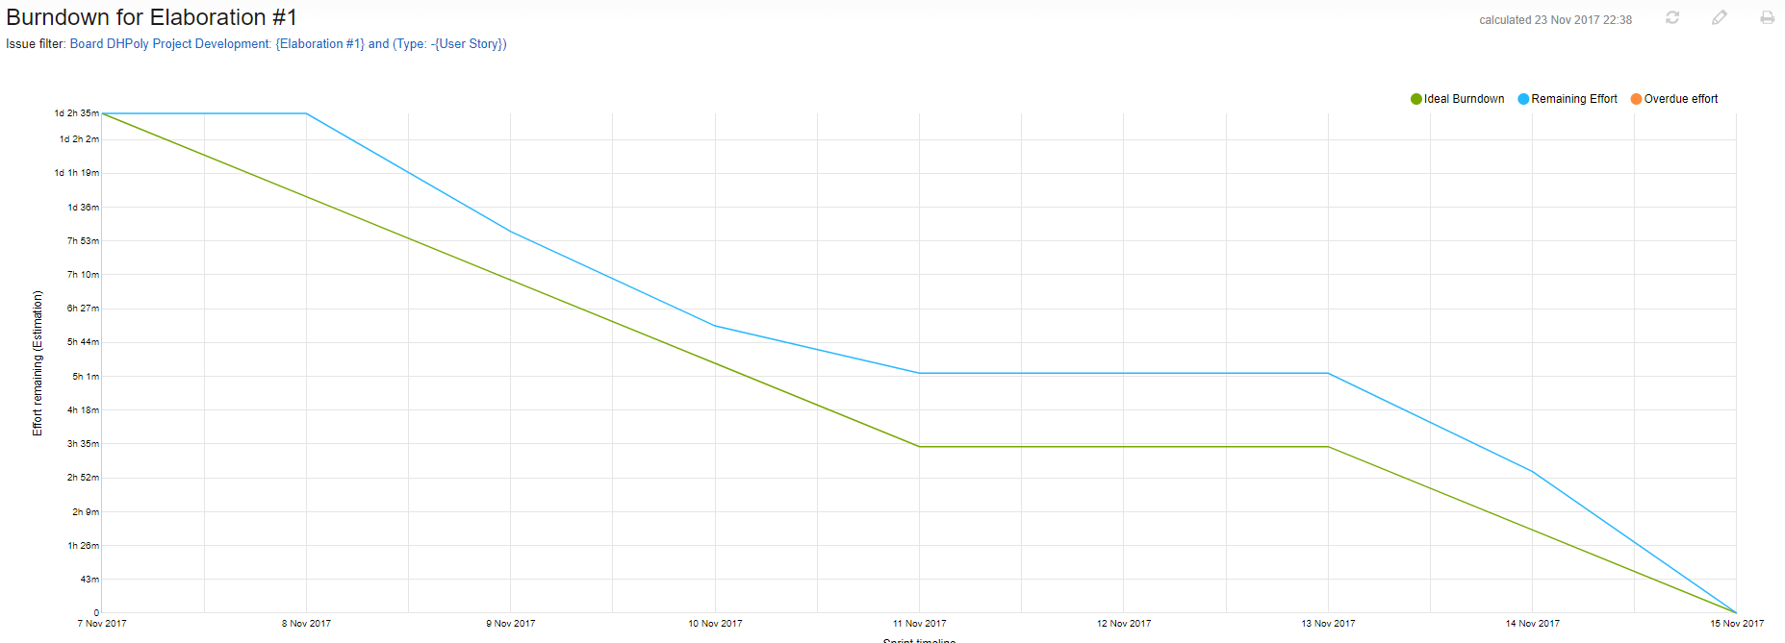
Burndown Chart: Week One

Slide 9
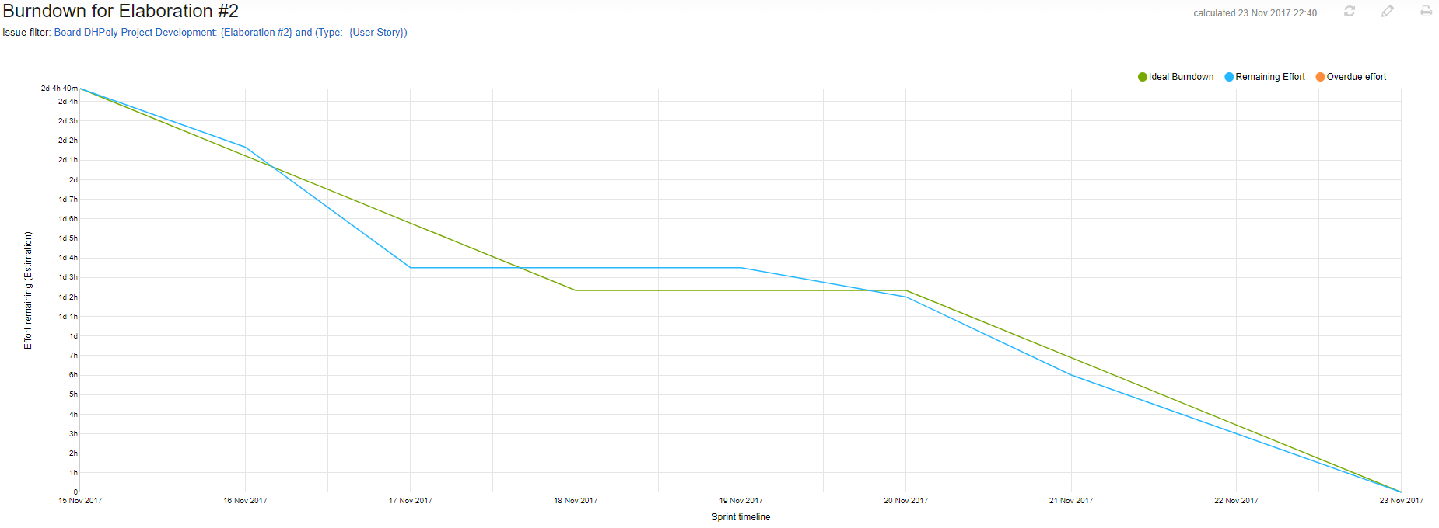
Burndown Chart: Week Two

Slide 10
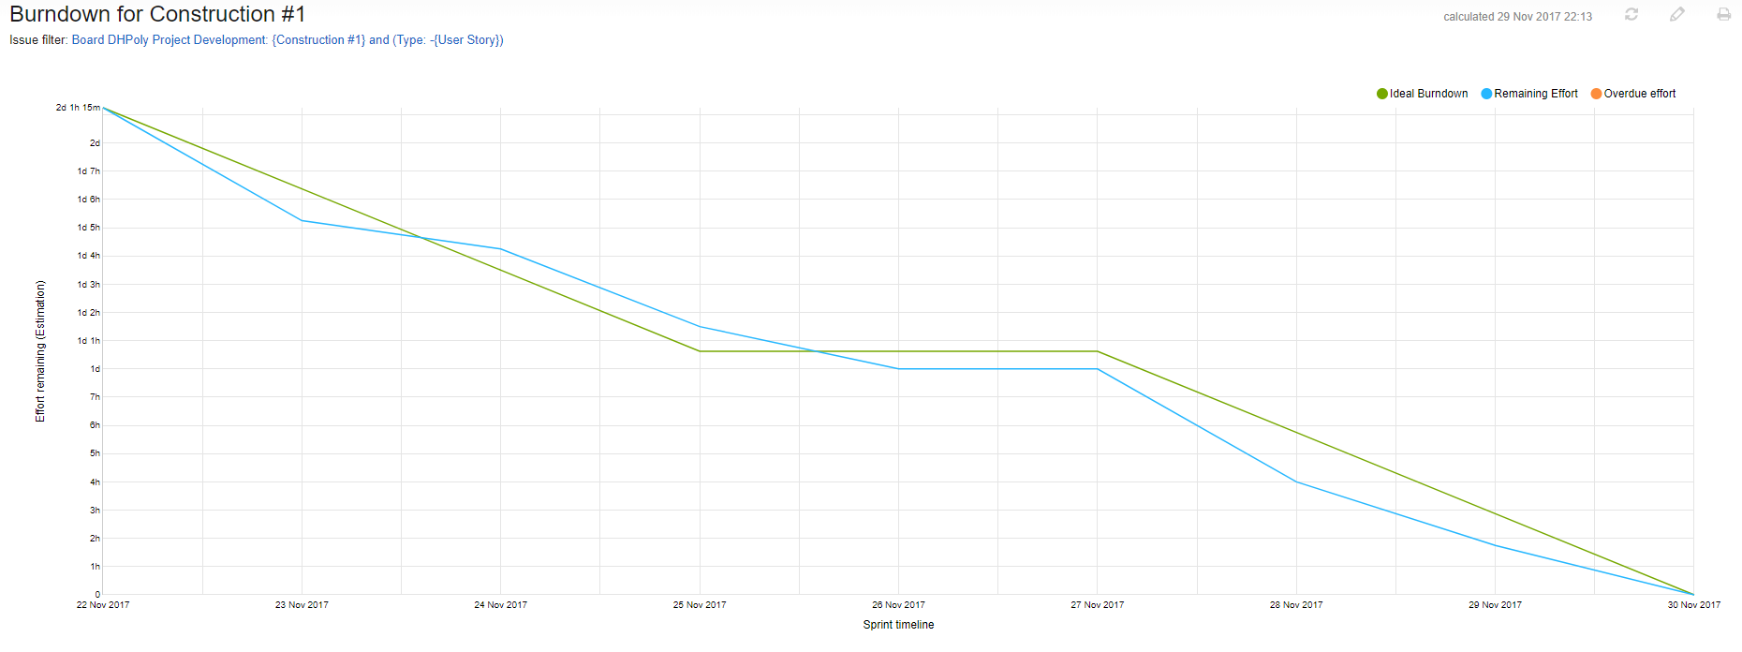
Burndown Chart: Week Three

Slide 11
Team Roles
Alexander:
Project Manager
Designer
Blog Poster
Sven
Tool Specialist
Requirements Specifier
Tester
Rico
Head Implementer / Developer

Slide 12
Scope
Playing Field
Surface
Trading
AI
Events

Slide 13
Index
Business
Technical Abilities
Demo
Use Cases
Class Diagram
Quality

Slide 14
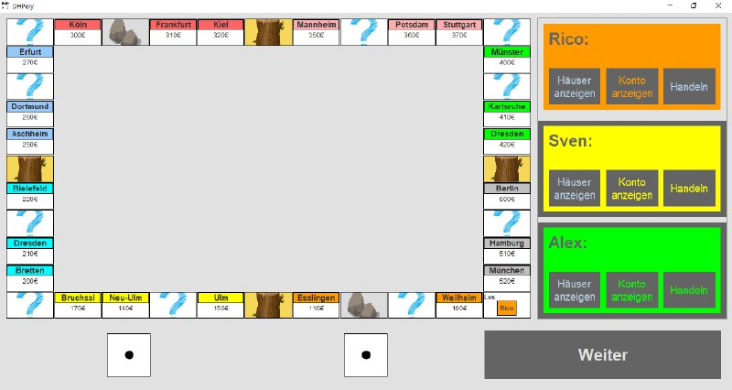
Demo

Slide 15
Use Cases
Withdrawing Money
Trading with other Players
Purchasing a Field
Buying Houses
Moving a Player

Slide 16
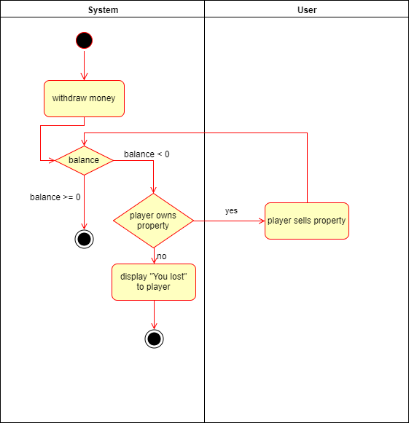
Withdrawing Money

Slide 17
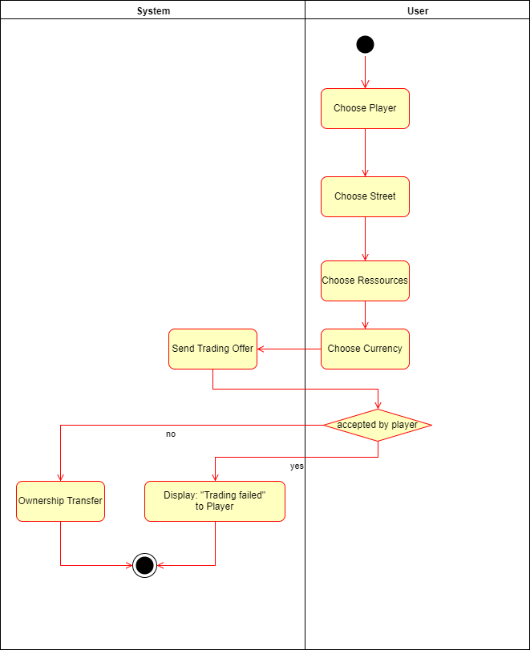
Trading with other Players

Slide 18
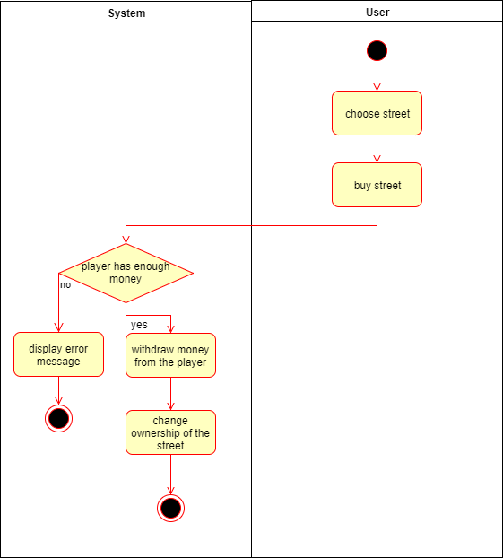
Purchasing a Field

Slide 19
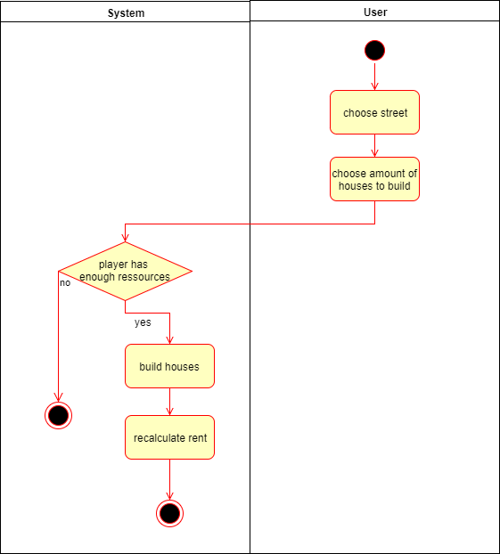
Buying Houses

Slide 20
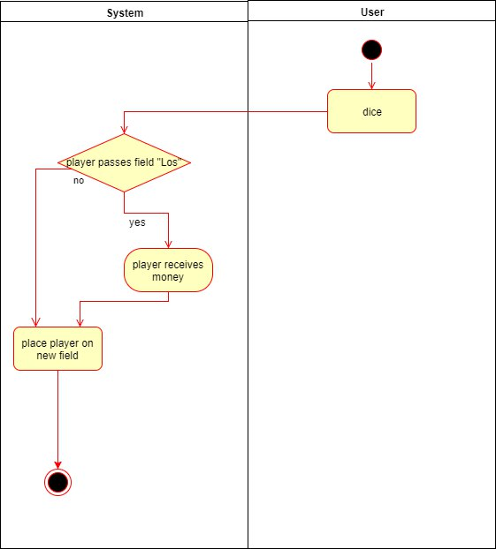
Moving a Player

Slide 21
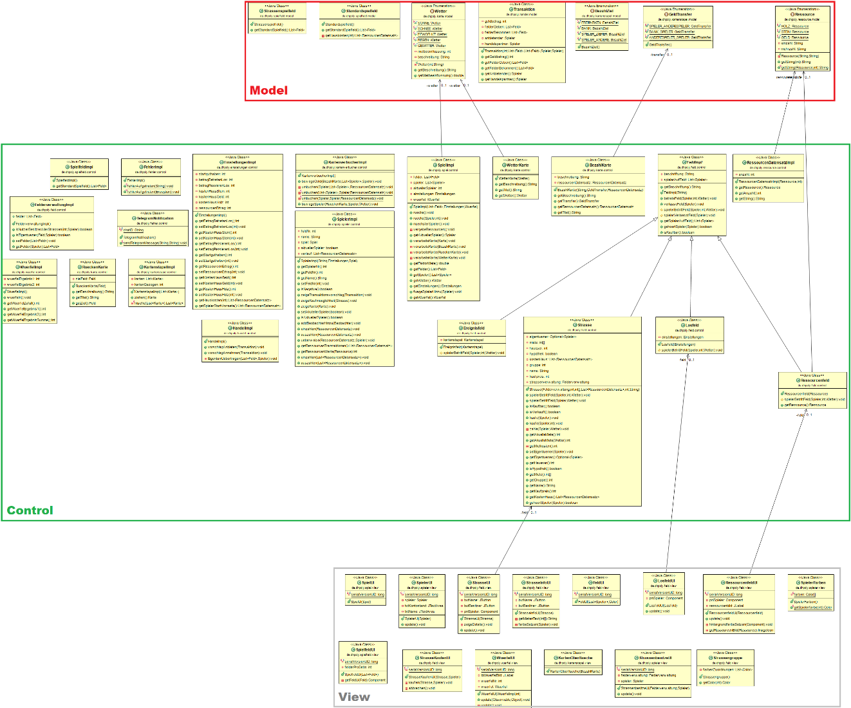
Class Diagram

Slide 22
Index
Business
Technical Abilities
Quality
Architecture
Automation
Testing

Slide 23
Architecture
Model
View
Control

Slide 24
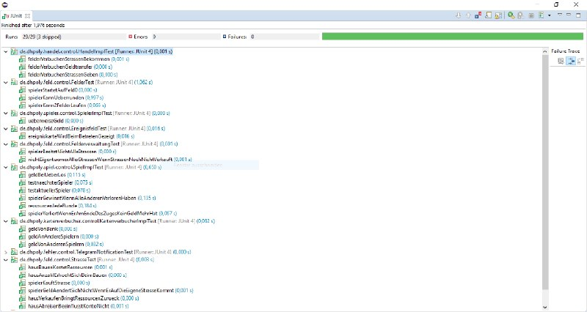
Testing

Slide 25
Thanks for your attention!

