Slide 1

DHPoly

Slide 2
Index
Business
Technical Abilities
Quality

Slide 3
Index
Business
Vision
Use Case Diagram
Project Methodology
Team Roles
Scope
Technical Abilities
Quality

Slide 4
Our Vision
Monopoly
Online
Chance
Ressources

Slide 5
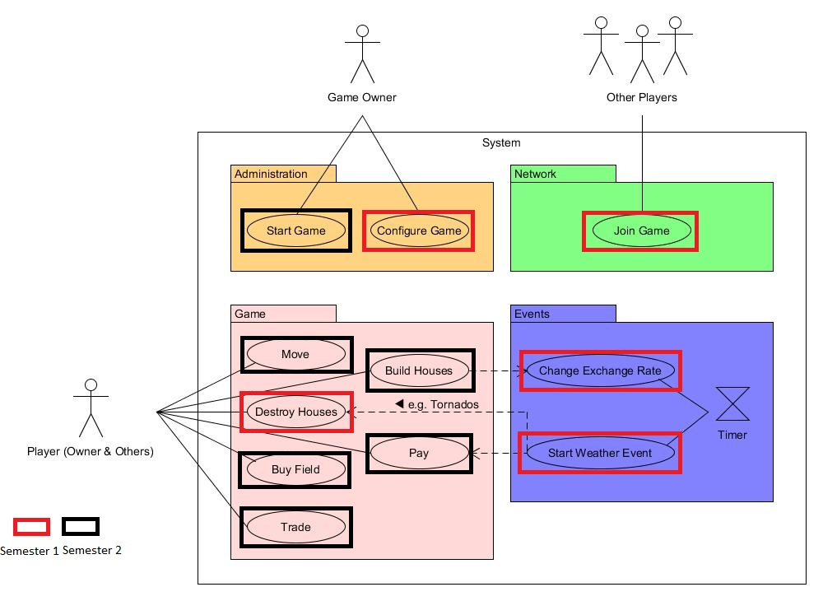
Use Case

Slide 7
Project Methodology
Agile Project
Scrum
GitHub

Slide 8
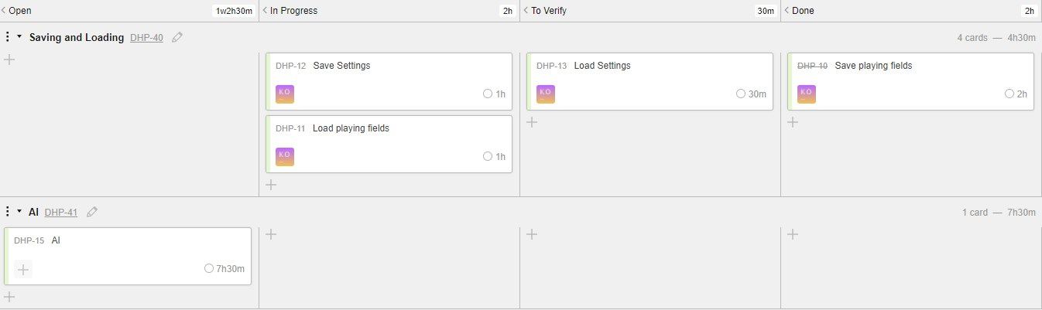
Scrumming

Slide 9
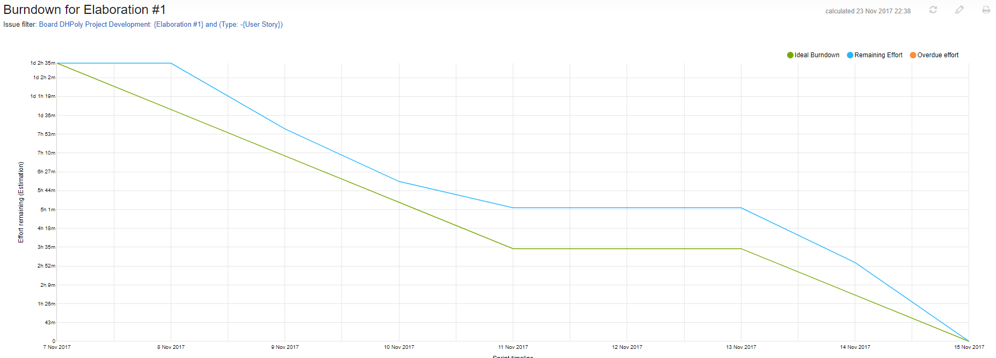
Burndown Chart: Week One

Slide 10
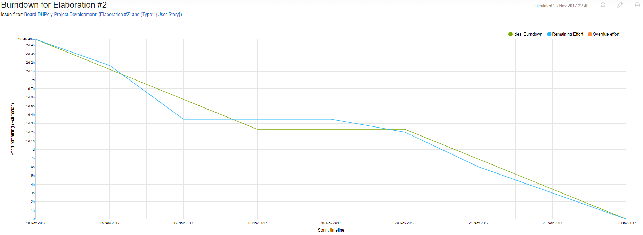
Burndown Chart: Week Two

Slide 11
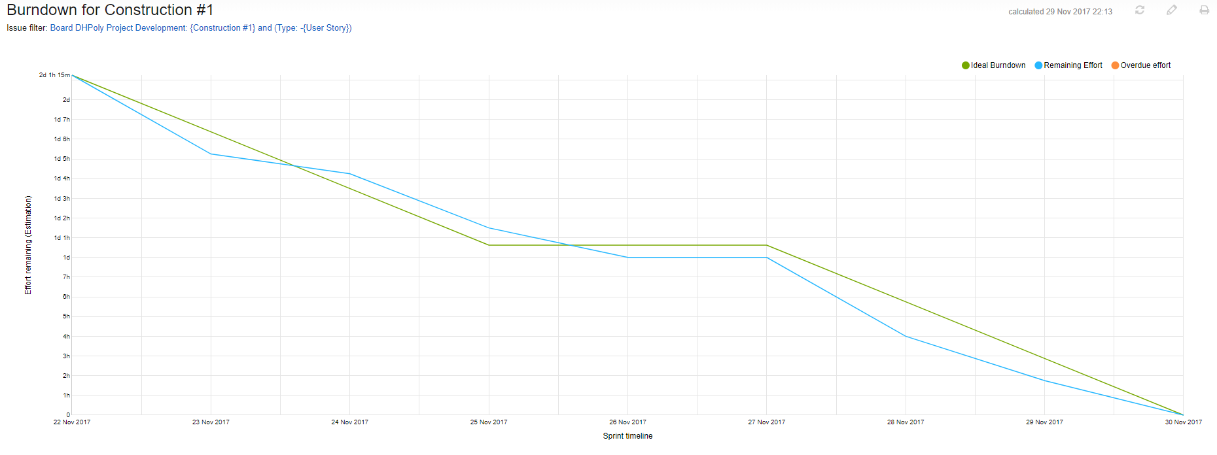
Burndown Chart: Week Three

Slide 12
Team Roles
Alexander:
Project Manager
Designer
Blog Poster
Sven
Tool Specialist
Requirements Specifier
Tester
Rico
Head Implementer / Developer

Slide 13
Scope
Playing Field
Surface
Trading
AI
Events

Slide 14
Index
Business
Technical Abilities
Demo
Use Cases
Class Diagram
Quality

Slide 15
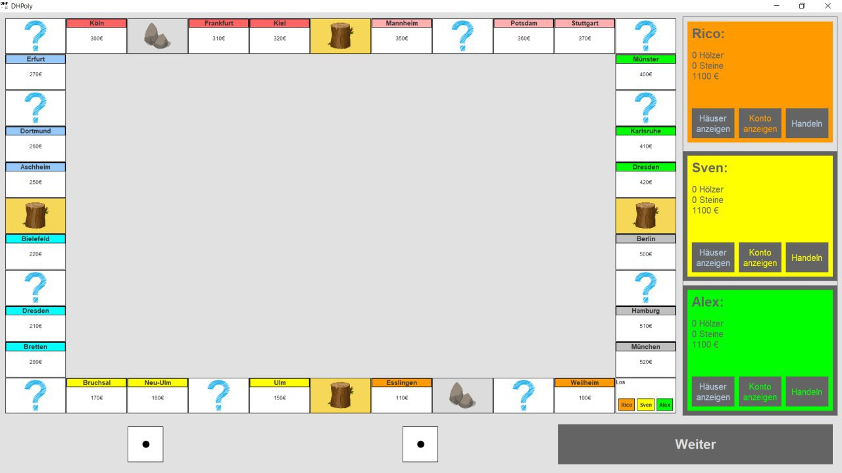
Demo

Slide 16
Use Cases
Withdrawing Money
Trading with other Players
Purchasing a Field
Buying Houses
Moving a Player

Slide 17
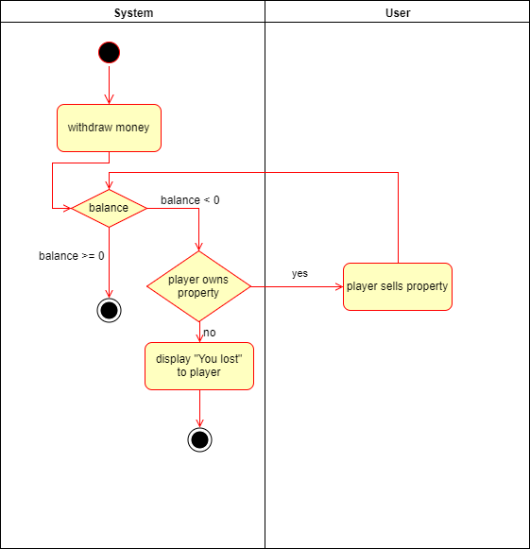
Withdrawing Money

Slide 19
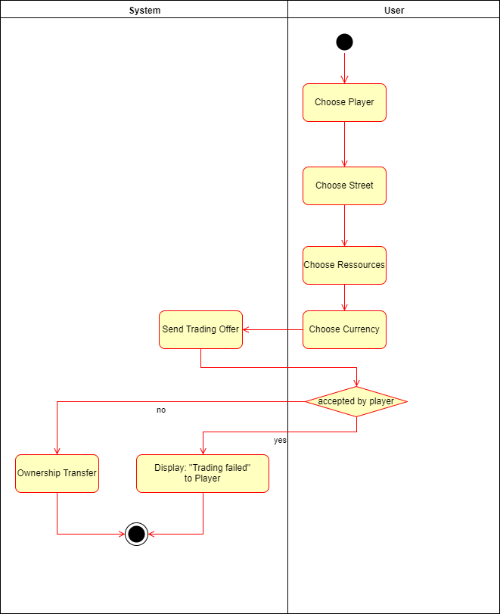
Trading with other Players

Slide 21
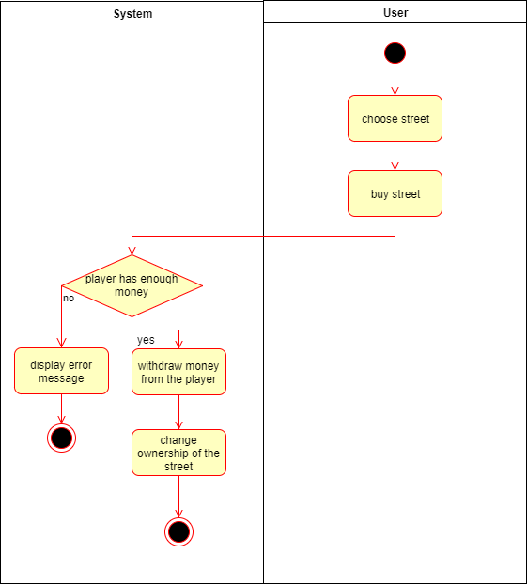
Purchasing a Field

Slide 23
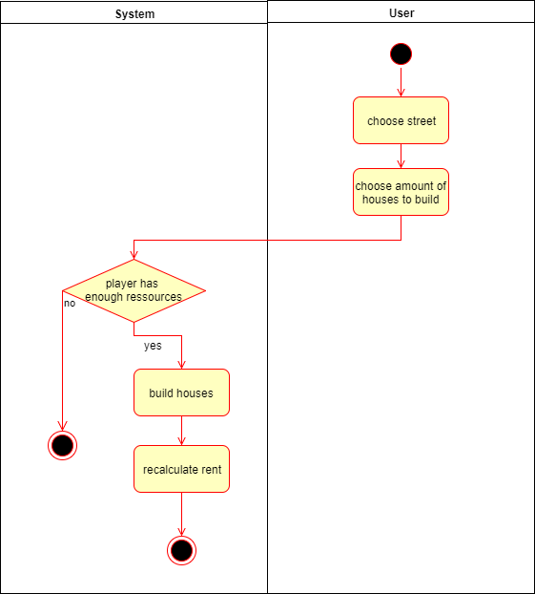
Buying Houses

Slide 26
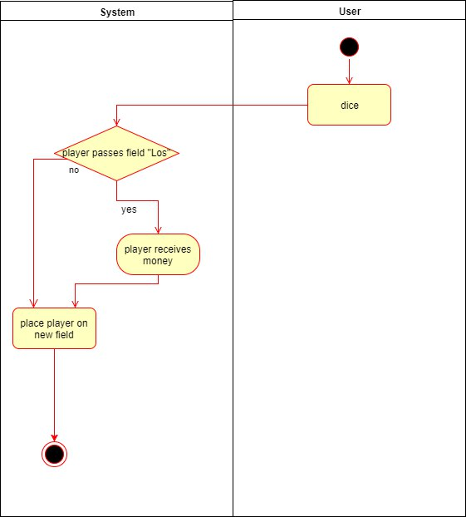
Moving a Player

Slide 28
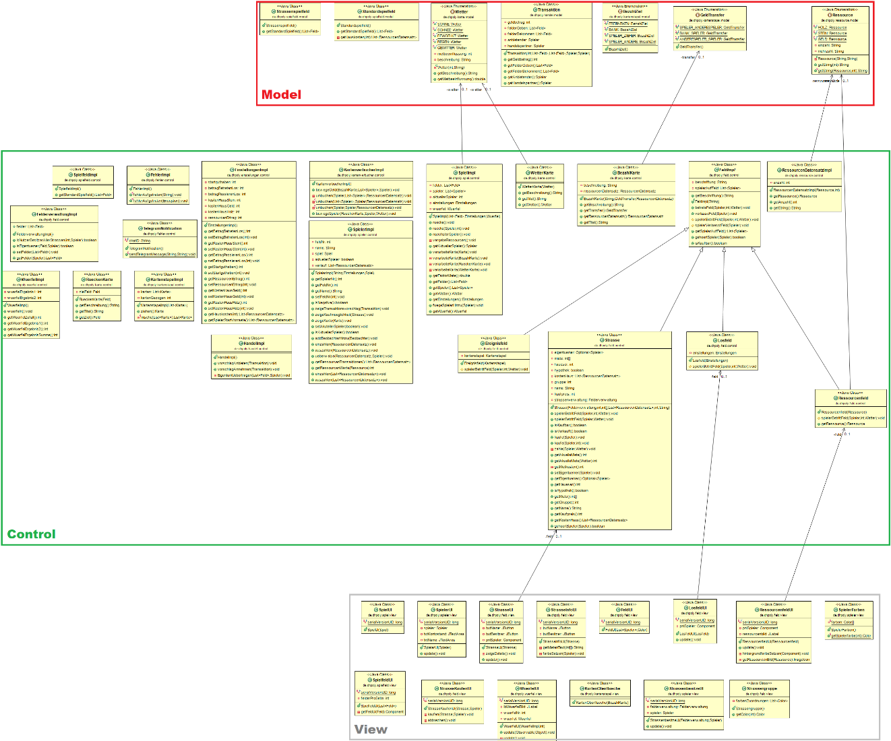
Class Diagram

Slide 29
Index
Business
Technical Abilities
Quality
Architecture
Automation
Testing

Slide 30
Architecture
Model
View
Control

Slide 31
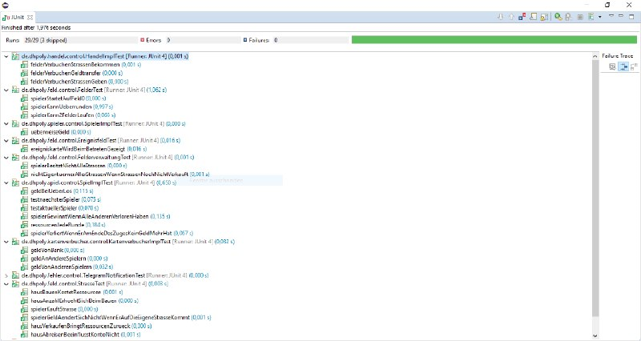
Testing

Slide 32
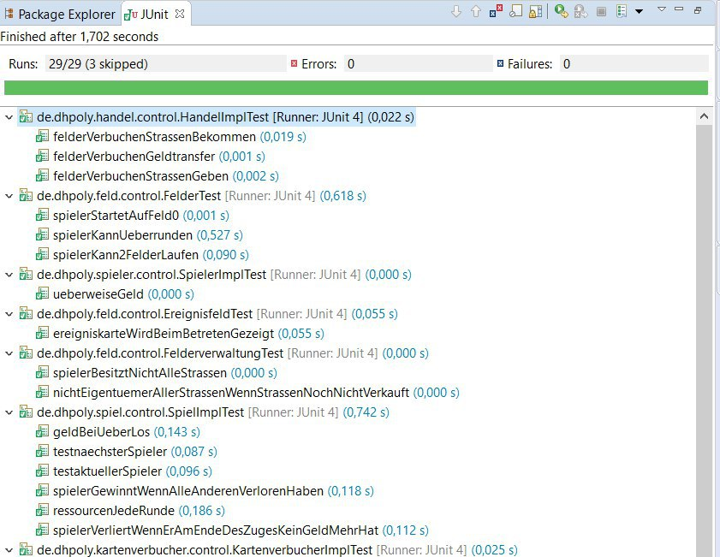

Slide 33

Any Questions?

Slide 34
Thank you for your attention. We hope for good business in the future.

