Slide 1

DHPoly

Slide 2
Index
Business
Technical Abilities
Quality

Slide 3
Index
Business
Introduction
Vision
Use Case
Scope
Scrum
Workflow
Project Methodology
Quality
Technical Abilities

Slide 4
Our Team:
Alexander Busch | Sven Köhler | Rico Kritzer
Project Manager | Tool Specialist | Head Developer

Slide 5
Our Vision
Monopoly
Online
Luck
Ressources

Slide 6
Our Result
Monopoly
Luck
Ressources
Events

Slide 7
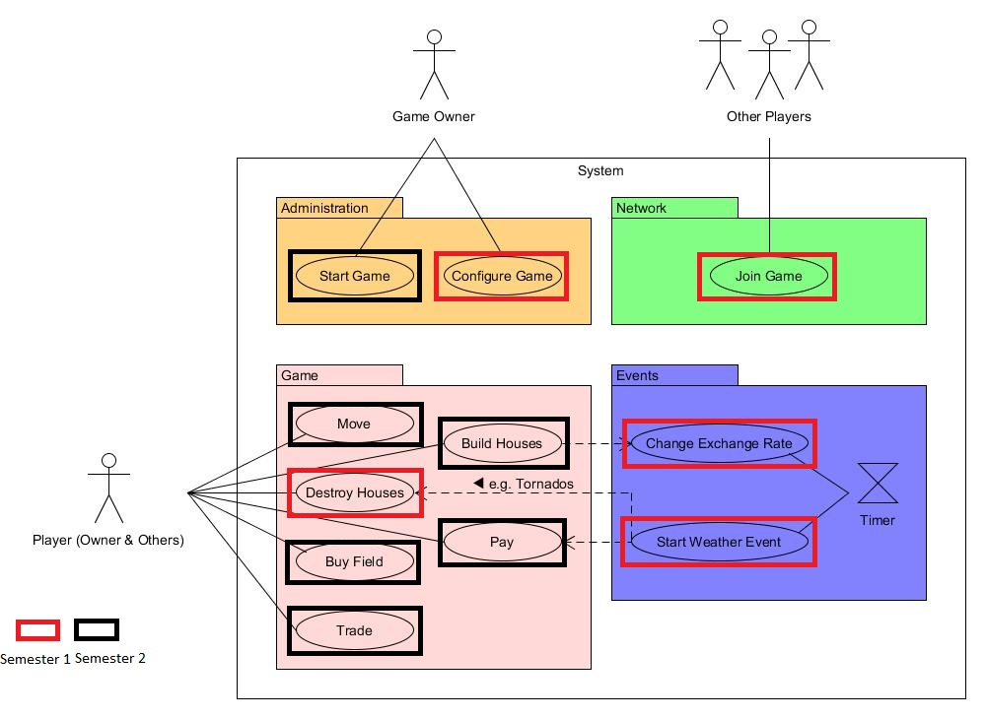
Use Case

Slide 9
Scope
Playing Field
Surface
Trading
AI
Events

Slide 10
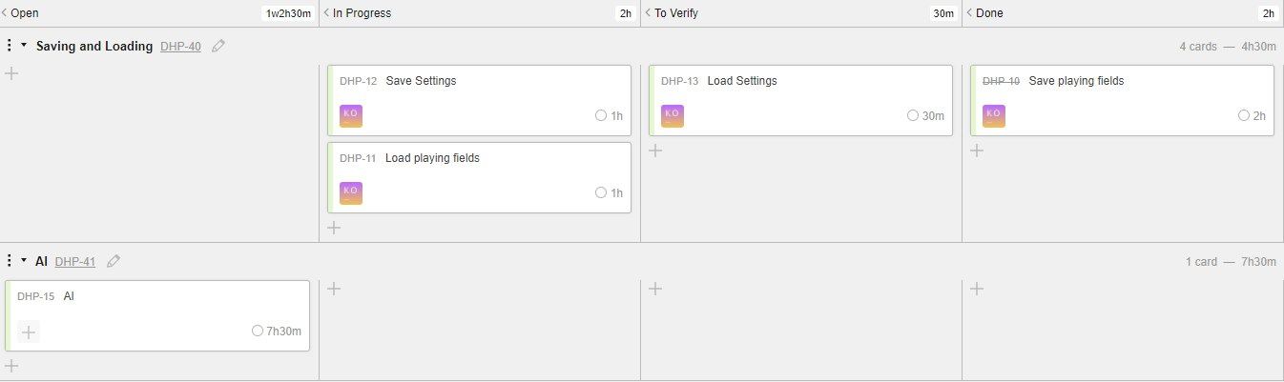
Scrumming

Slide 11
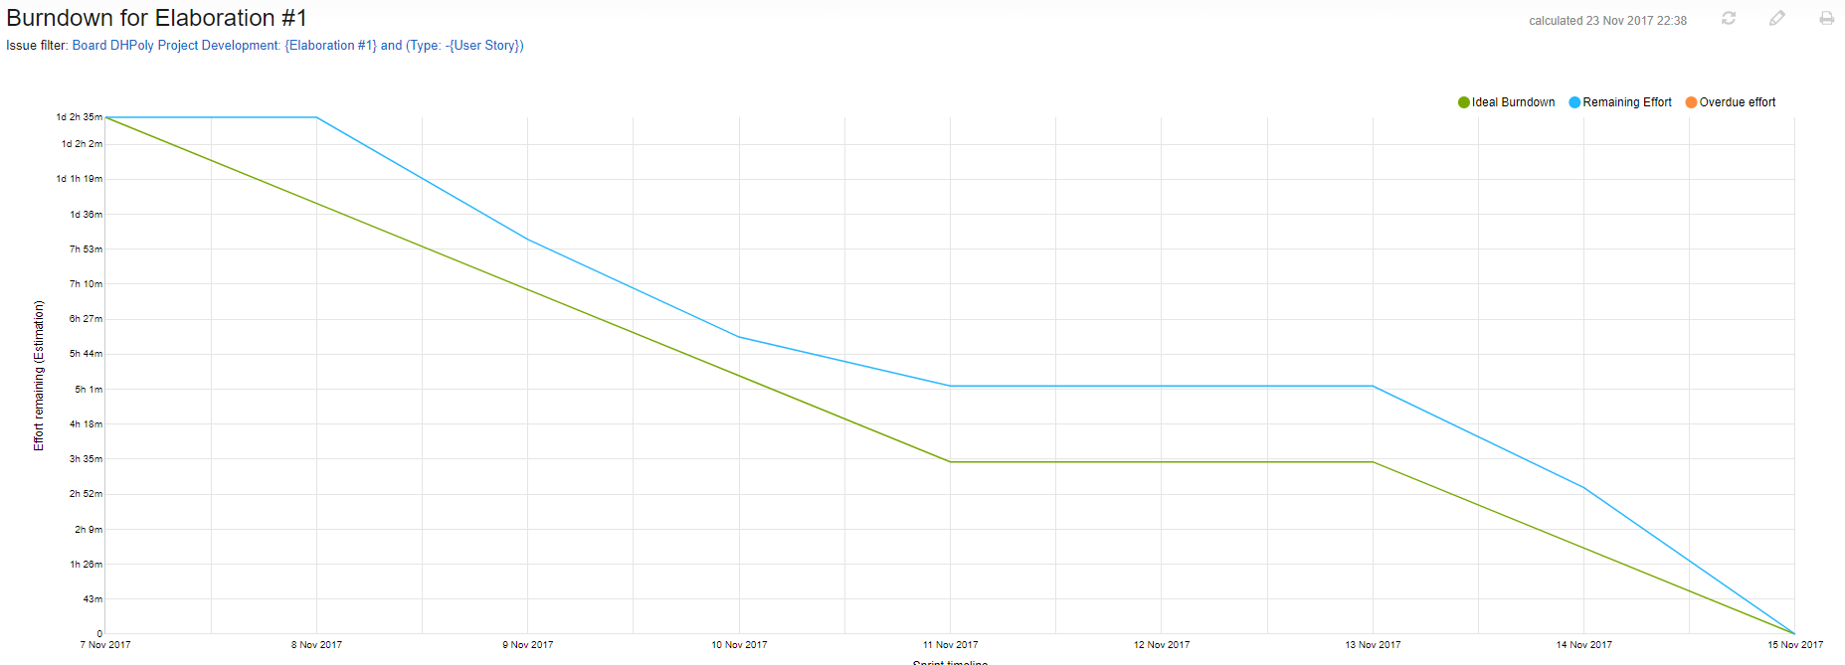
Burndown Chart: Week One

Slide 12
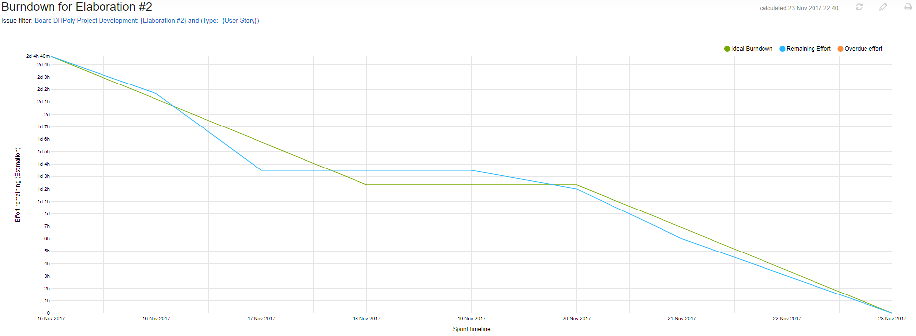
Burndown Chart: Week Two

Slide 13
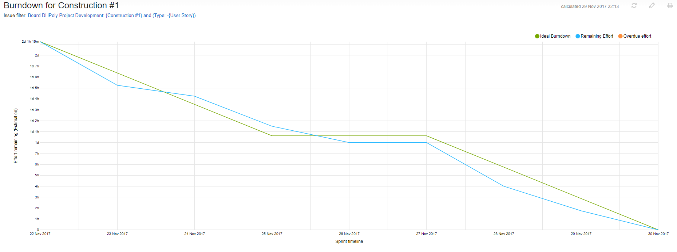
Burndown Chart: Week Three

Slide 14
Project Methodology
Agile Project
Scrum
GitHub

Slide 15
Index
Business
Quality
Archtitecture
Testing
Metrics
Patterns
Technical Abilities

Slide 16
Architecture
Model
View
Control

Slide 17
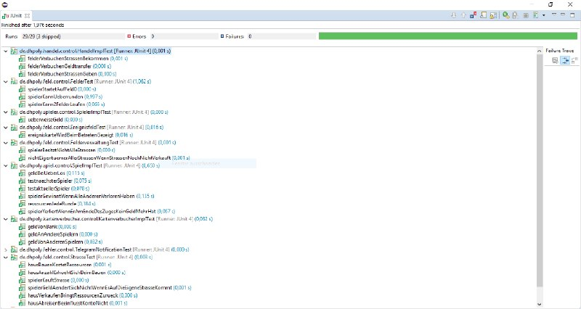
Testing

Slide 18
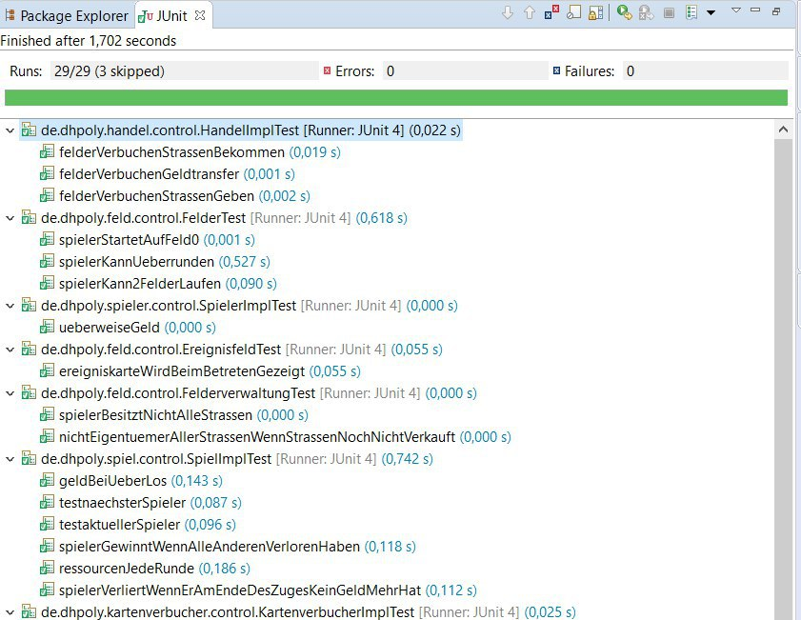

Slide 19
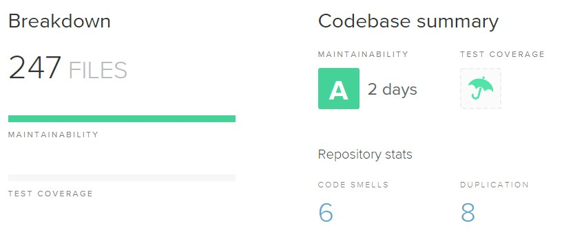
Code Breakdown

Slide 20
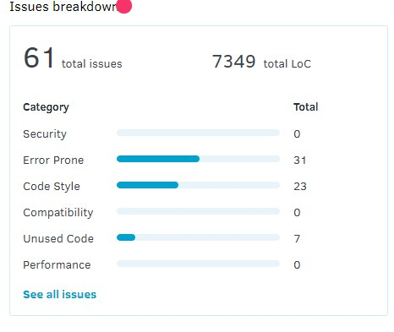
Code Issues

Slide 21
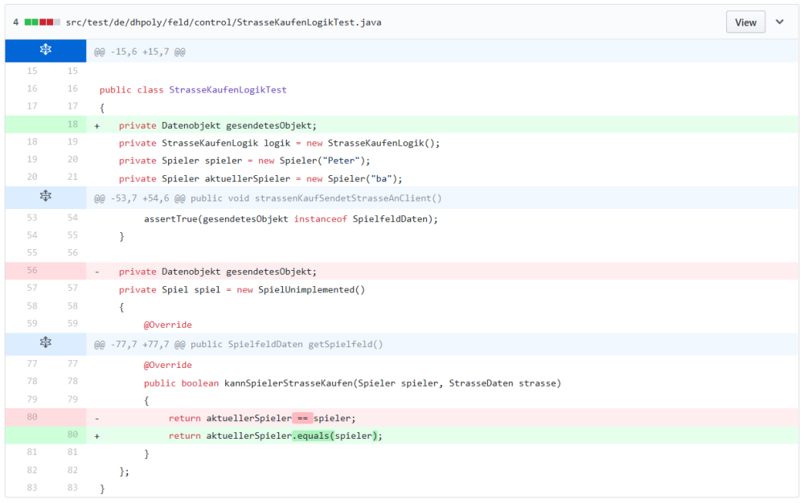
Code Refinement

Slide 22
Pattern
MVC
Factory

Slide 23
Index
Business
Quality
Technical Abilities
Class Diagram
Demo

Slide 24
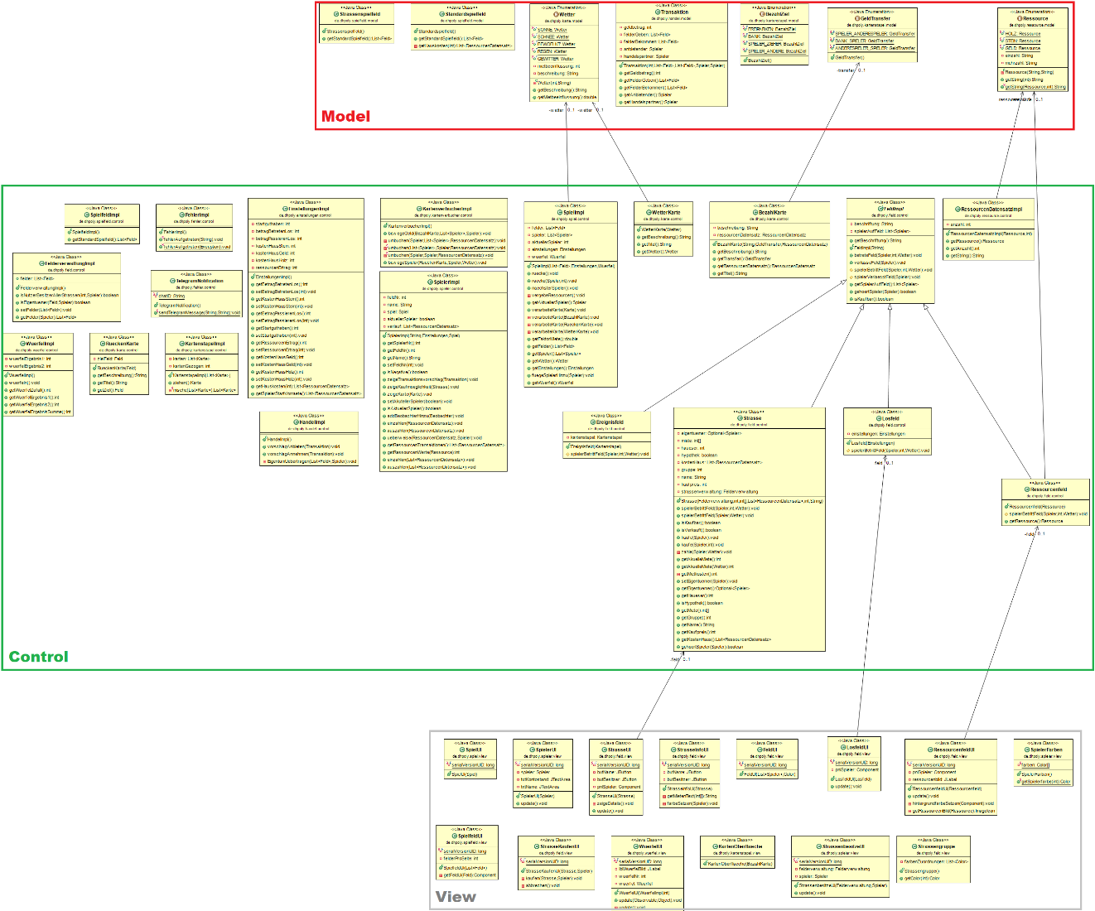
Class Diagram

Slide 25

Any Questions?

Slide 26
Tools
Continuous Integration
Jenkins
Teamcity
Testing
JUnit
Frameworks
Swing

Slide 27
Thank you for your attention. We hope for good business in the future.

