Slide 1

According to “The Guardian ” people aged 18 to 24 spend 13 minutes and 26 seconds in the shower.
http://www.theguardian.com/environment/green-living-blog/2009/sep/04/power-shower-blog

Slide 2

I live in Woodruff North and shower heads there use 2.5 gallons of water per minute.

Slide 3
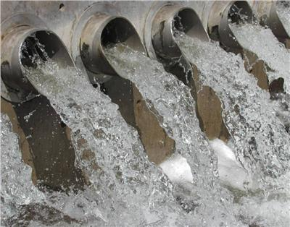
Students use 33.575 gallons of water per shower.
According to our survey, 86% of students take showers once a day, which means 235.025 gallons per week and 3,525.375 gallons of water per semester.

Slide 4

Meet a 1.5 GPM shower head
By doing simple math you can find out that with this device you can save 13.43 gallons of water per one shower.
Which means saving 1410.15 gallons per semester per person.

Slide 5

Here’s another way to save water in dorms.
Toilet tank bank saves up to 0.8 gallons per flush with no loss in performance.

