Slide 1

HOLISTIC SEO
WORKBENCH
Next-Gen SEO Strategy & Content Generation Platform
Dominate Search Results with Semantic SEO

Slide 2

THE SEO STRUGGLE IS REAL
"What content should I write next?"
No clear content strategy or topic prioritization
"Why isn't my content ranking?"
Missing semantic relationships and topical authority
"How do I optimize for featured snippets?"
No systematic approach to SERP features
"AI content feels generic and robotic"
Single-pass generation lacks quality control

Slide 3
INTRODUCING
Holistic SEO Workbench
The only SEO platform that combines:
✓ Semantic Content Strategy (Entity-Attribute-Value Framework)
✓ 9-Pass AI Content Generation with Quality Audits
✓ Featured Snippet Optimization Built-In
✓ Multi-Provider AI Support (OpenAI, Anthropic, Gemini, & more)

Slide 4
RESULTS YOU CAN EXPECT
9
50+
5
10
Optimization Passes
Articles
AI Providers
Audit Rules
Per article
Batch generation
Supported
Quality checks
Save Time
Rank Higher
Scale Content
Automate content strategy & generation
Semantic SEO methodology built-in
Batch generation with quality control

Slide 5

HOW IT WORKS
1
→
2
→
3
→
4
→
5
Define Strategy
Generate Map
Create Briefs
Generate Content
Audit & Export
Set up SEO pillars & semantic triples (EAVs)
AI creates topical map with 50-100+ topics
Generate content briefs with SERP analysis
9-pass optimization for each article
Quality checks & WordPress-ready export
From strategy to published content in one platform

Slide 6
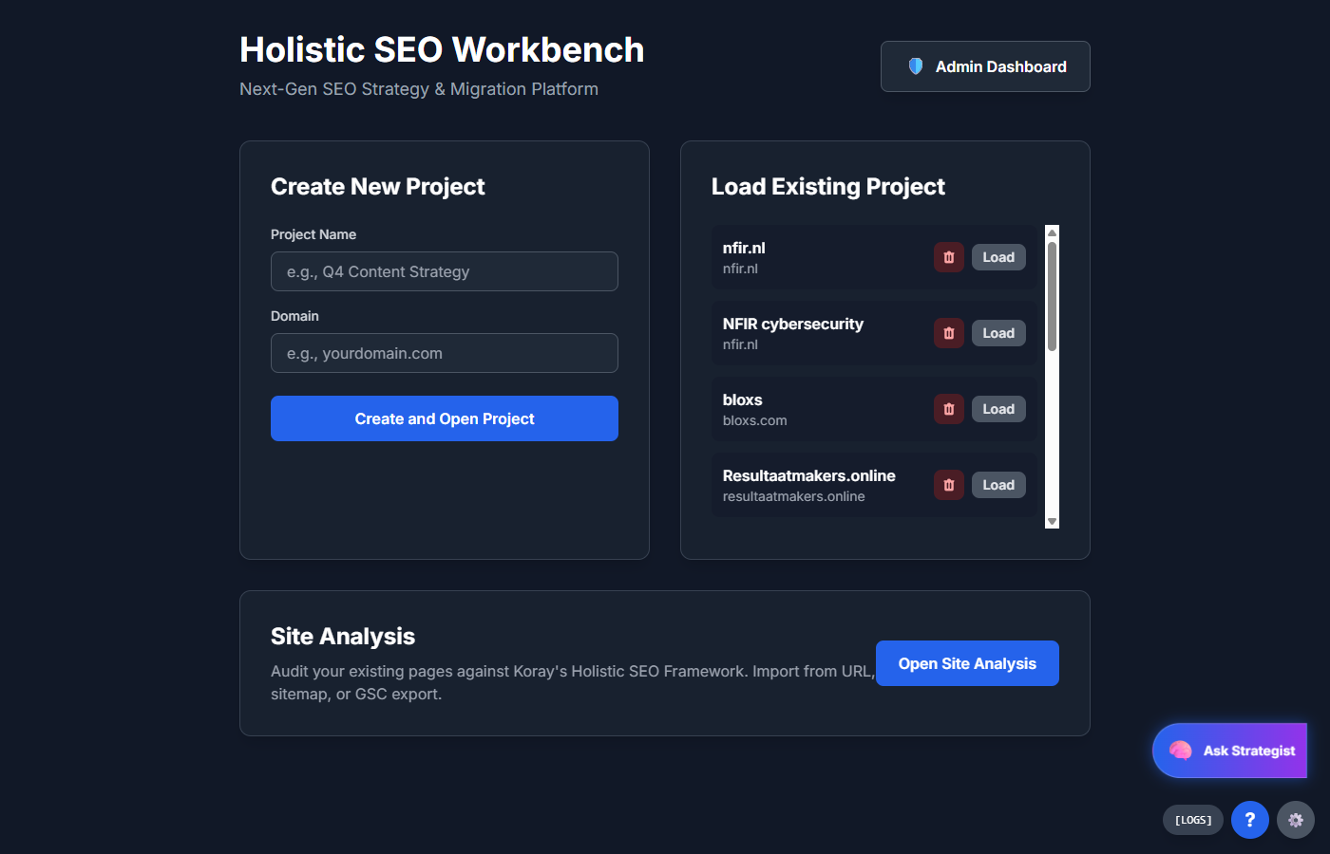
PROJECT MANAGEMENT
Manage multiple SEO projects from one dashboard

Slide 7
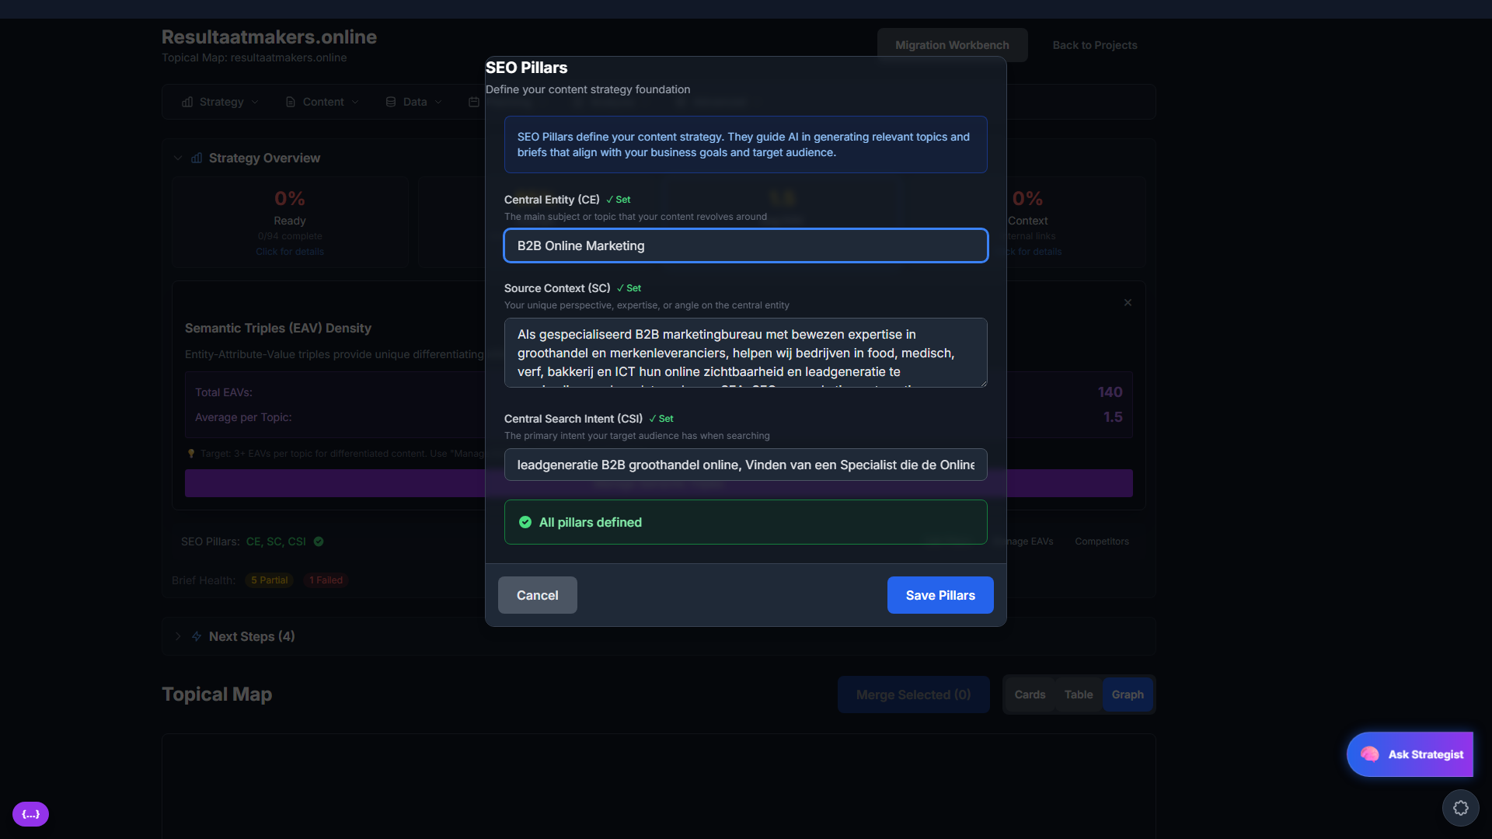
SEO PILLARS
Define your content strategy foundation
• Central Entity (CE) - Your main topic
• Source Context (SC) - Your expertise
• Central Search Intent (CSI) - User goals

Slide 8
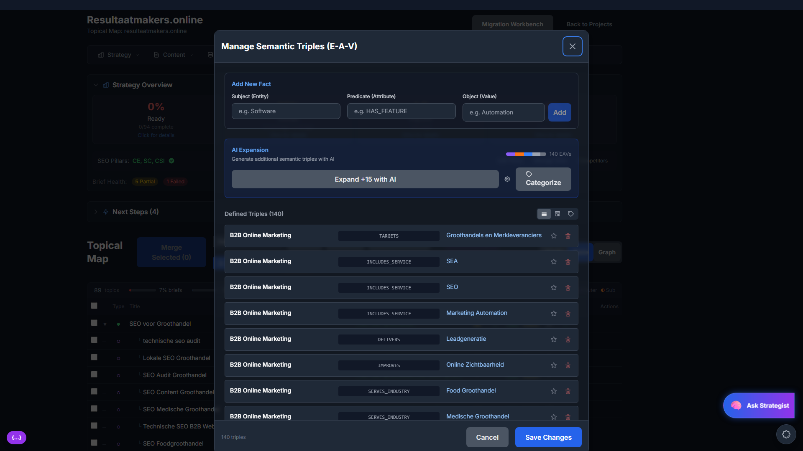
SEMANTIC TRIPLES (E-A-V)
The secret to topical authority - Entity-Attribute-Value framework

Slide 9
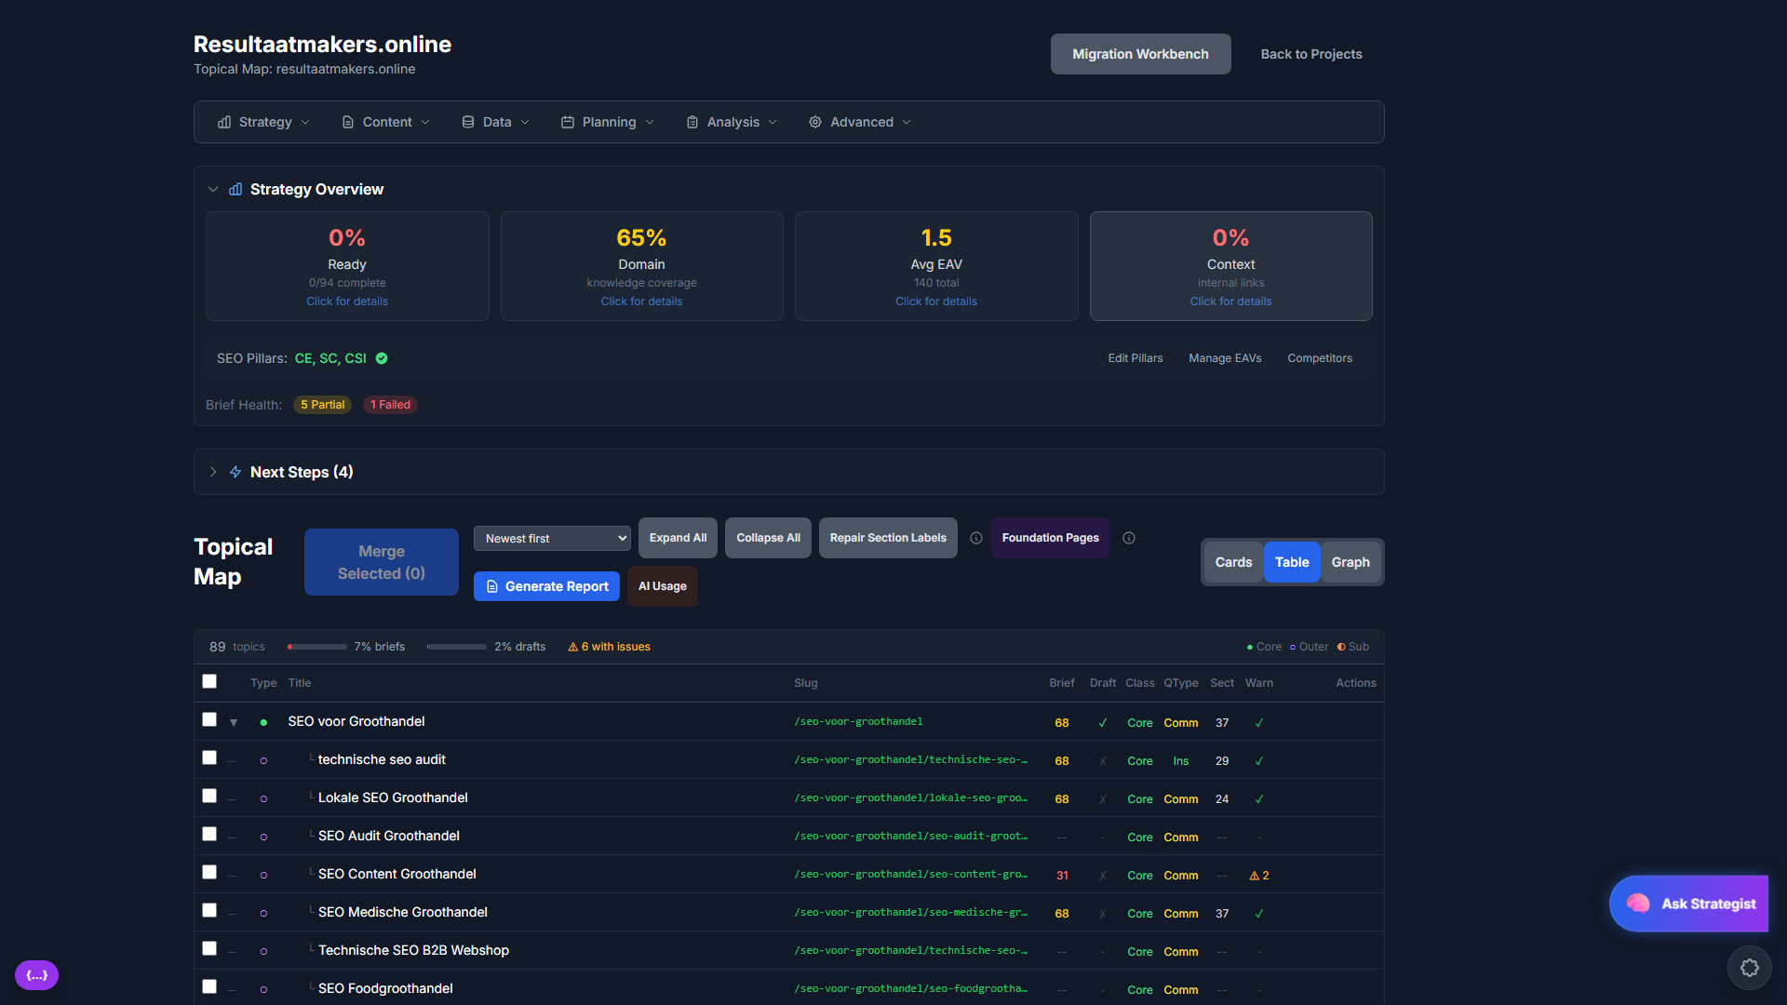
TOPICAL MAP DASHBOARD
Track 89+ topics with briefs, drafts, and metrics at a glance

Slide 10
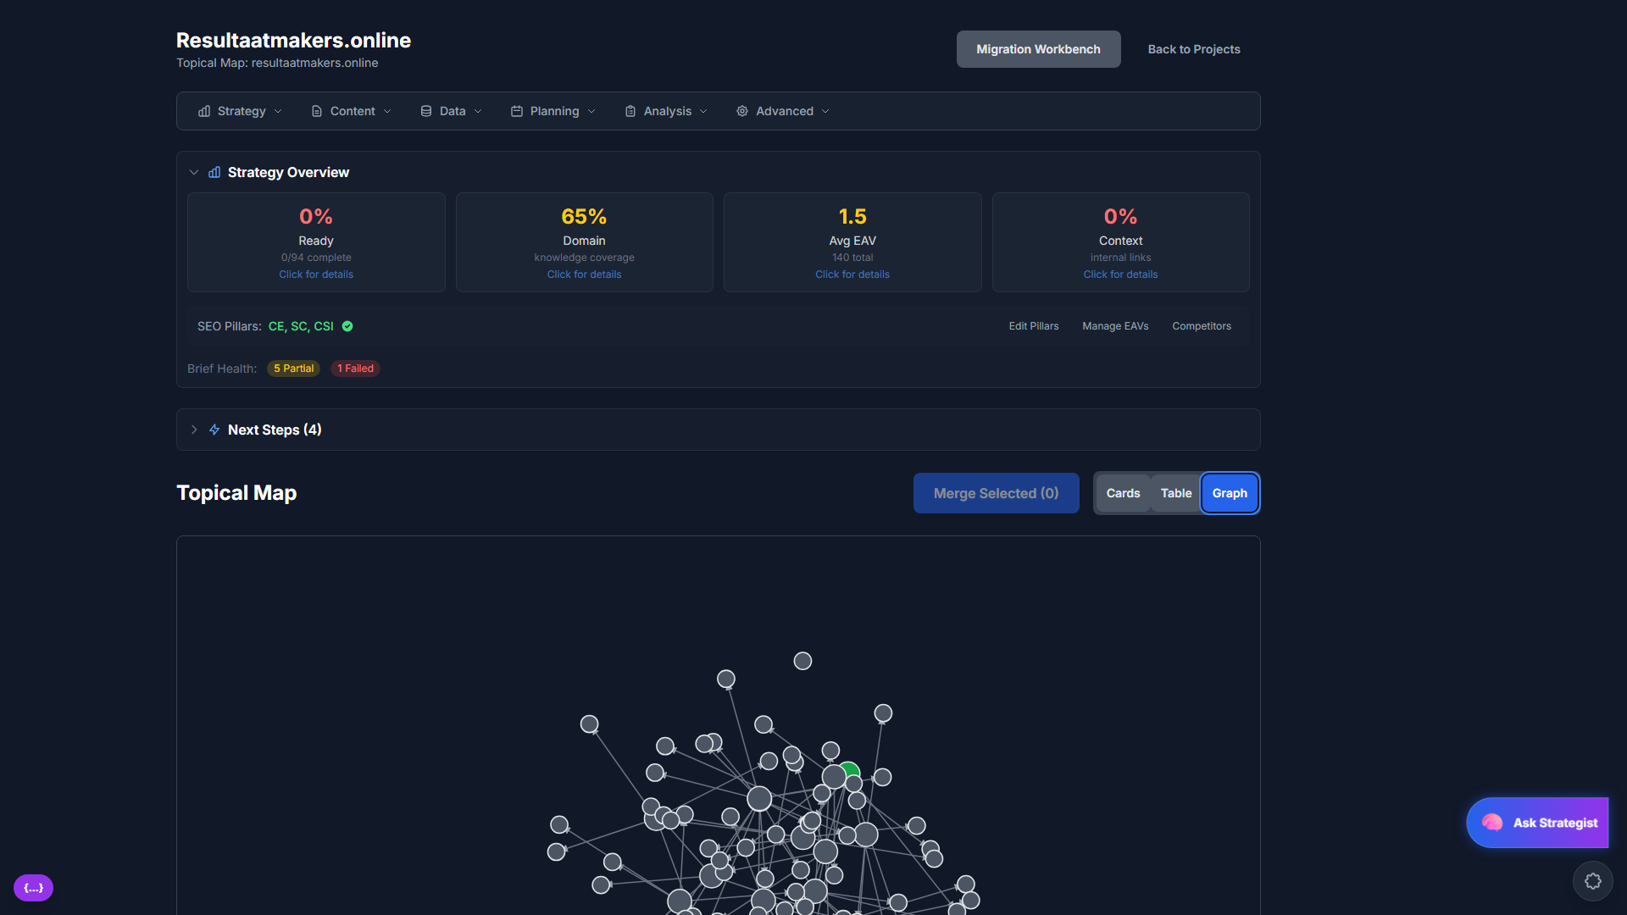
VISUAL TOPIC GRAPH
See your content network and topic relationships

Slide 11
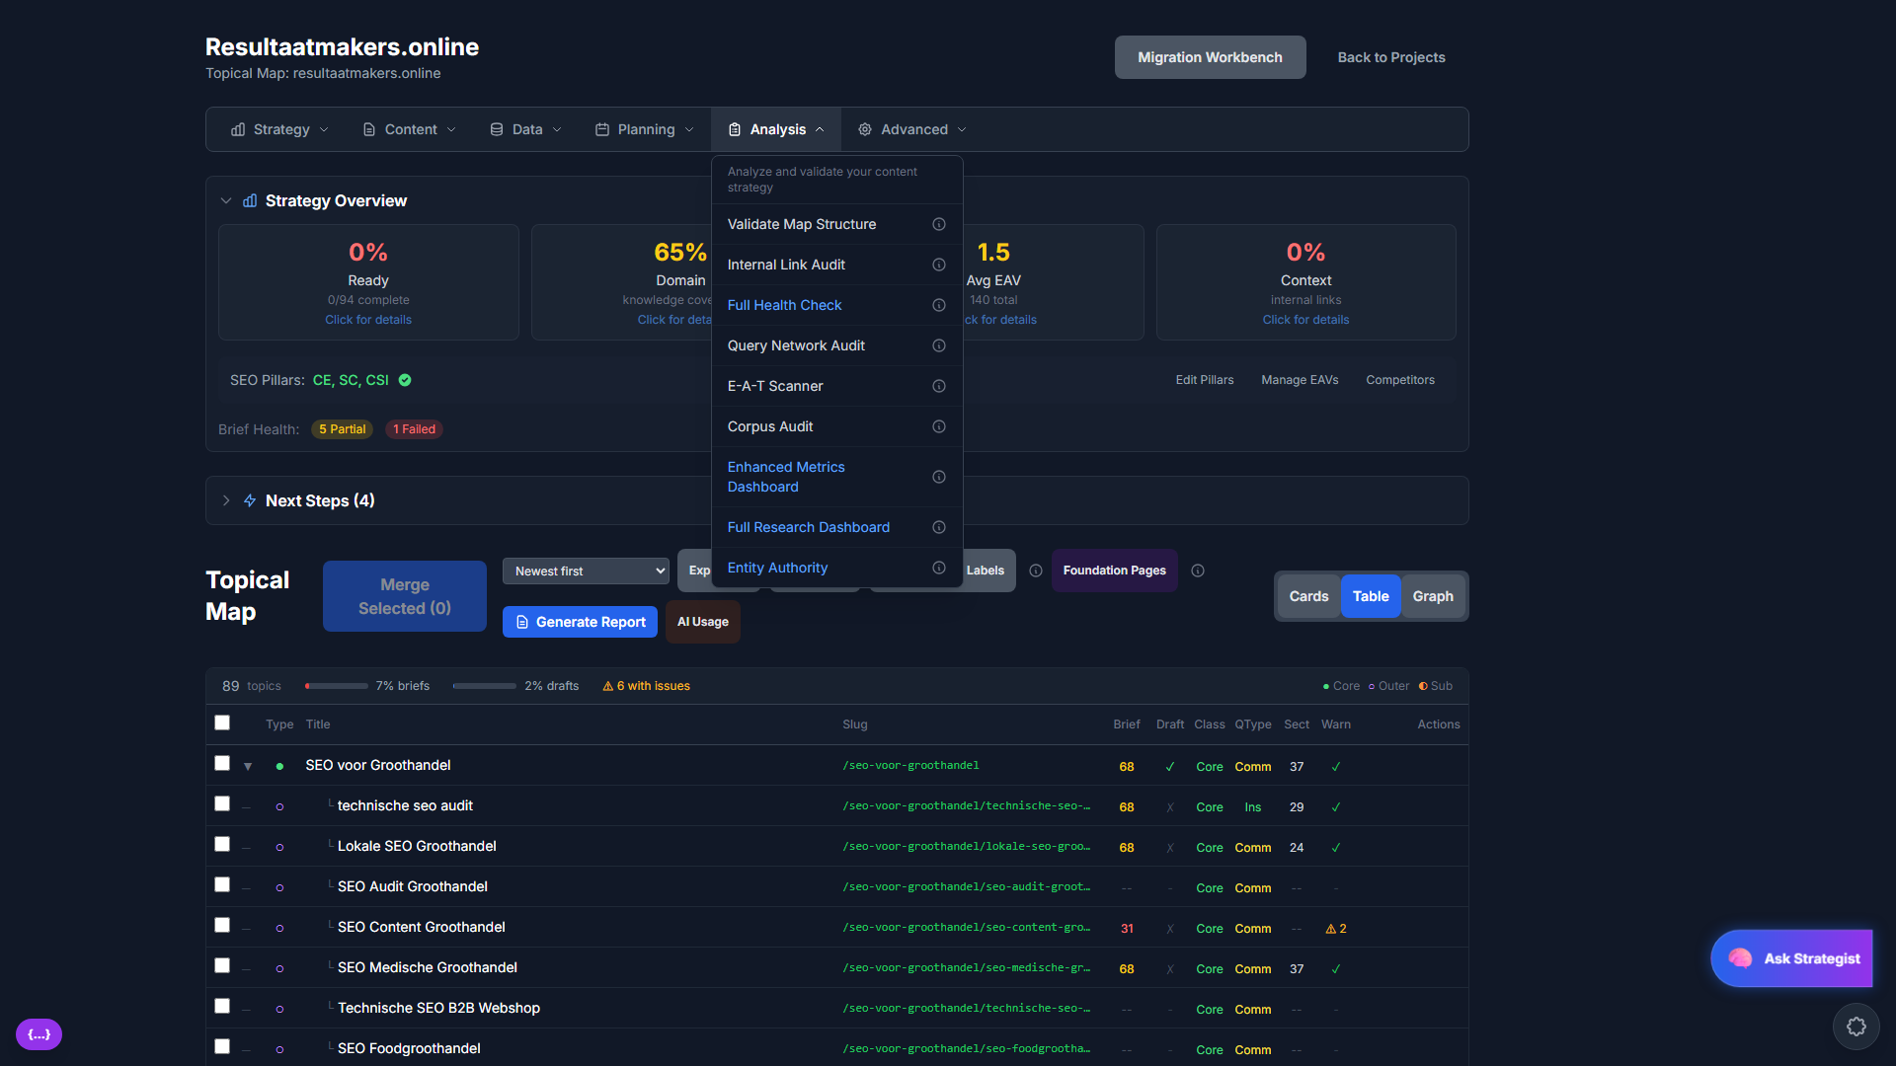
POWERFUL ANALYSIS TOOLS
• Internal Link Audit
• Full Health Check
• Query Network Audit
• E-A-T Scanner
• Corpus Audit
• Enhanced Metrics Dashboard
• Entity Authority Analysis

Slide 12
9-PASS CONTENT GENERATION
Each article goes through 9 specialized optimization passes
1
Draft
2
Headers
3
Intro
Section-by-section content
Heading hierarchy
Centerpiece annotation
4
Lists
5
Flow
6
Micro
Featured snippet ready
Transitions & bridges
Linguistic optimization
7
Visual
8
Audit
9
Schema
Image placeholders
10-rule quality check
JSON-LD generation
Result: Publication-ready content with no AI artifacts

Slide 13
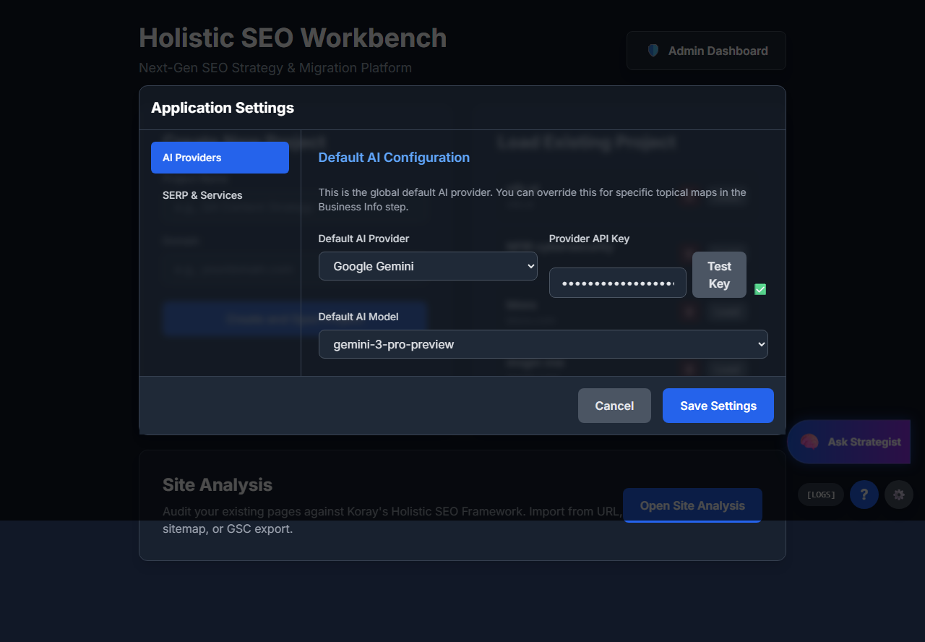
MULTI-PROVIDER AI SUPPORT
Choose your preferred AI provider:
✓ Google Gemini
✓ OpenAI GPT-4
✓ Anthropic Claude
✓ Perplexity
✓ OpenRouter (100+ models)
Bring your own API keys - no markup!

Slide 14
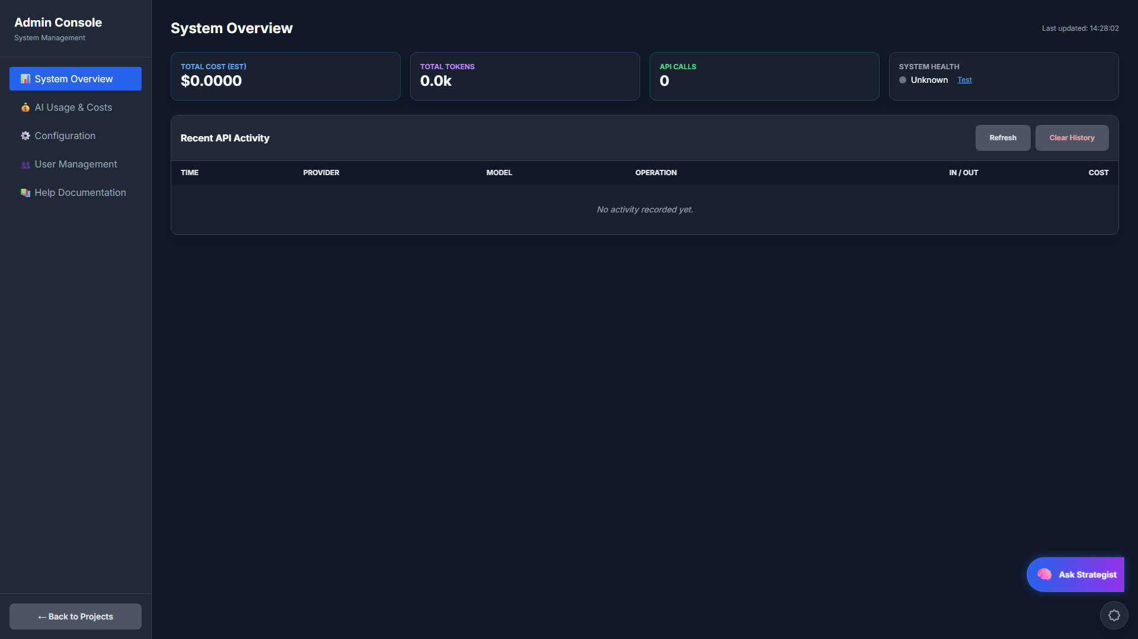
ADMIN CONSOLE
Track AI usage, costs, and system health in real-time

Slide 15
WHAT MAKES US DIFFERENT
Entity-Focused, Not Keyword-Focused
Build topical authority with semantic relationships
9-Pass Quality System
Eliminates AI hallucinations and generic content
Featured Snippet Optimization
Built-in targeting with answer lengths and predicates
Holistic SEO Methodology
Based on proven framework by Koray Tugberk GUBUR

Slide 16
WHO IS THIS FOR?
SEO Agencies
In-House Teams
Content Writers
Scale content production across multiple clients with consistent quality
Build topical authority systematically with data-driven strategy
Get AI assistance that actually understands SEO best practices
Perfect for anyone who wants to dominate search results with quality content

Slide 17
ENTERPRISE-GRADE ARCHITECTURE
React 18 + TypeScript
Supabase Backend
Row Level Security
Modern, type-safe frontend
PostgreSQL + Edge Functions
Enterprise data isolation
Real-time Updates
Encrypted API Keys
Resumable Jobs
Live progress tracking
Secure credential storage
No lost work on interruptions

Slide 18
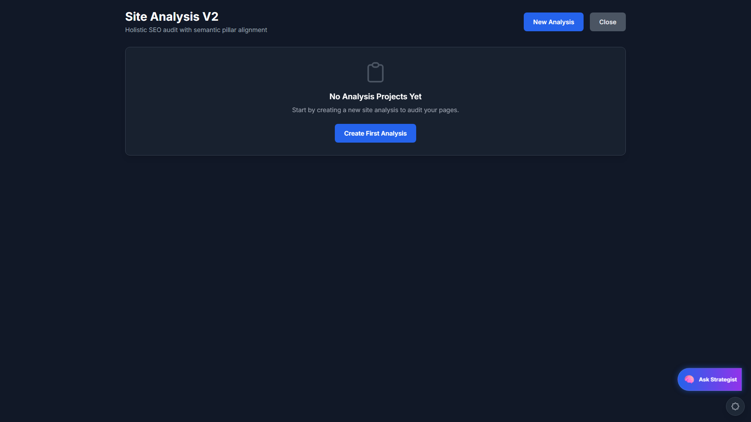
SITE ANALYSIS & MIGRATION
Audit existing pages against Holistic SEO framework

Slide 19
SIMPLE, TRANSPARENT PRICING
Starter
Professional
Enterprise
Free
$49/mo
Custom
✓ 1 Project
✓ Unlimited Projects
✓ Team Collaboration
✓ 10 Topics
✓ Unlimited Topics
✓ Custom Integrations
✓ Basic Briefs
✓ Full 9-Pass System
✓ White-Label Options
✓ Manual Generation
✓ Priority Support
✓ Dedicated Support
Bring your own AI API keys - pay only for what you use!

Slide 20
READY TO DOMINATE
SEARCH RESULTS?
Start building your topical authority today
GET STARTED FREE
holistic-seo-workbench.com

