Slide 1


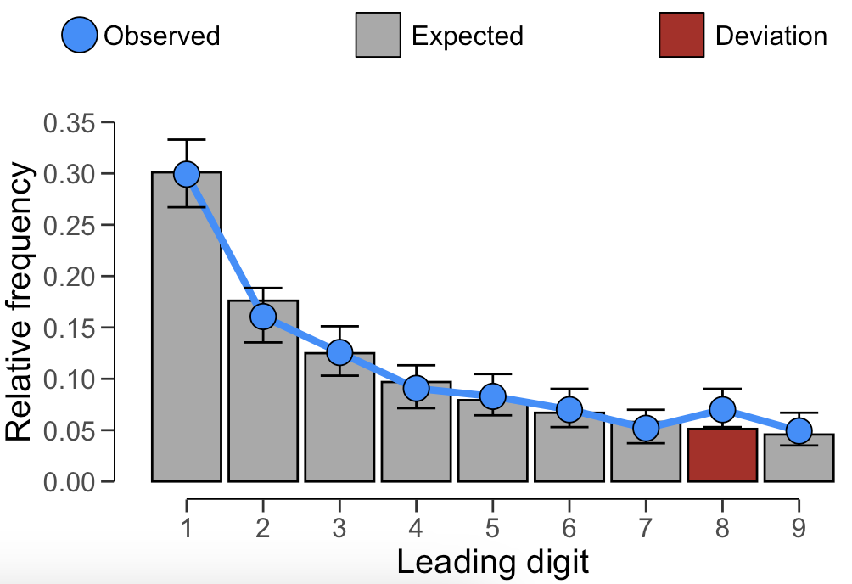
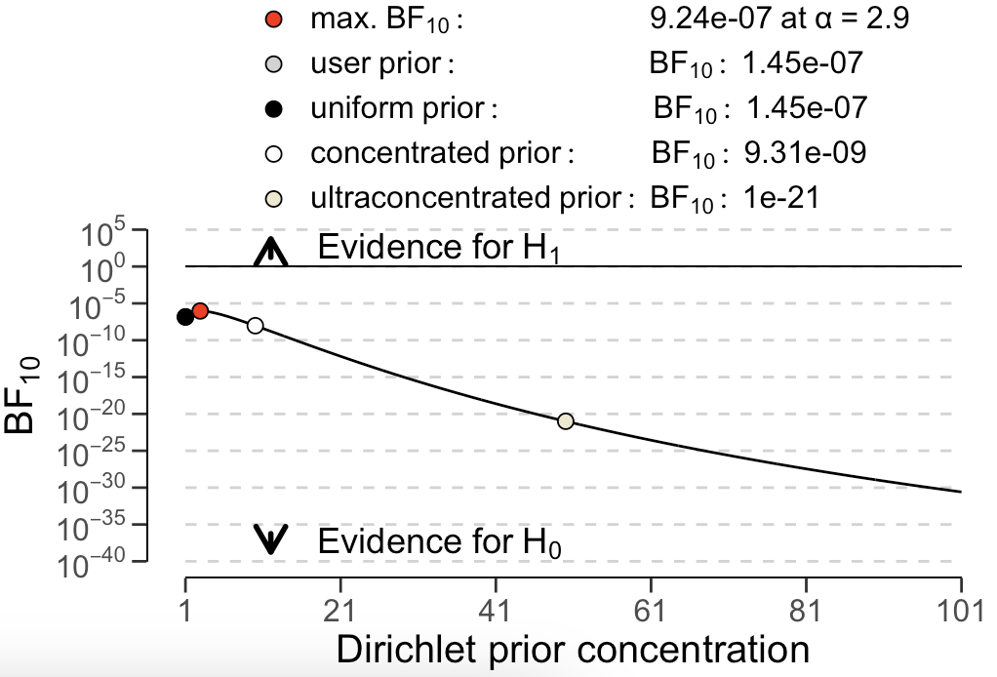
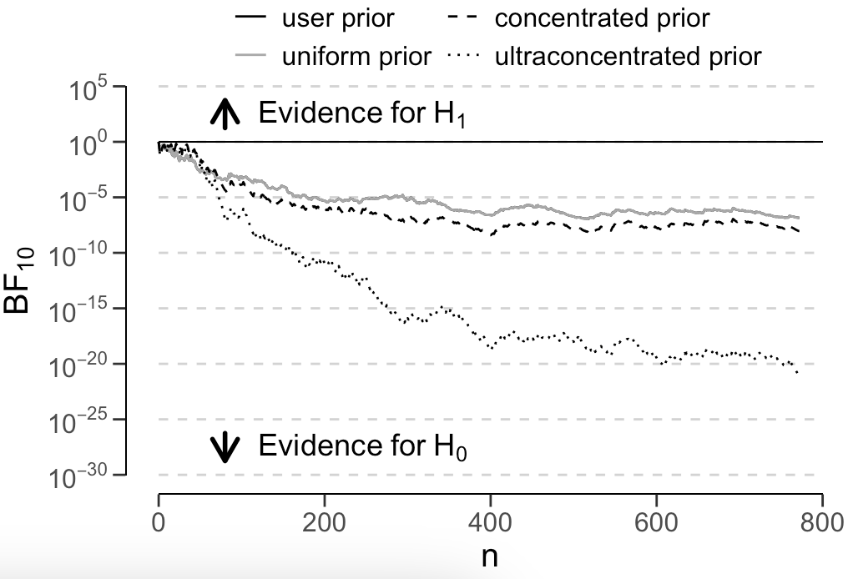
Data auditing with jfa: : CHEAT SHEET
Basics
Test the distribution of leading or last digits against Benford’s law
jfa is an R package that facilitates data auditing.
The package provides two functions that allow users to easily apply Bayesian or classical probability theory in their data audit workflow.
jfa::digit_test()
This function extracts and performs a test of the distribution of leading (two) or last digits in a vector against a reference distribution (e.g., Benford’s law, the uniform distribution or a custom distribution). The prior argument can be used to specify a prior distribution to perform Bayesian inference.
check: Specifies the digits to be checked against the reference distribution.
reference: Specifies the reference distribution to test the digits against.
conf.level: Specifies the confidence level used in the analysis.
prior: Specifies the concentration parameter of the Dirichlet prior distribution.
digit_test(sinoForest$value,
check = 'first',
reference = 'benford',
conf.level = 0.95,
prior = FALSE)
Installation
Installing the package can be done via:
install.packages('jfa')
Loading the package can be done via:
library(jfa)
plot(..., type = 'estimates')
plot(..., type = 'robustness')
plot(..., type = 'sequential')
Example
The blue code blocks next to the function descriptions provide a working example of the intended use.
The data for this example can be loaded via:
data('sinoForest')
Test the frequency of repeated values for unusually high amounts
jfa::repeated_test()
This function analyzes the frequency with which values get repeated within a set of numbers. Unlike Benford's law, and its generalizations, this approach examines the entire number at once, not only the first or last digit(s).
check: Specifies the digits to be shuffled during the analysis.
method: Specifies which statistic is used to quantify the repeated values. Defaults to af for average frequency, but can also be entropy for entropy.
samples: Specifies the number of samples used to bootstrap the p-value.
repeated_test(sinoForest$value,
check = 'last',
method = 'af',
samples = 2000)
RStudio® is a trademark of RStudio, Inc. • CC BY SA Koen Derks • K.Derks@nyenrode.nl • https://koenderks.github.io/jfa • Learn more from the webpage or vignettes • Package version 0.7.2 • Updated: 2023-11

