Slide 1


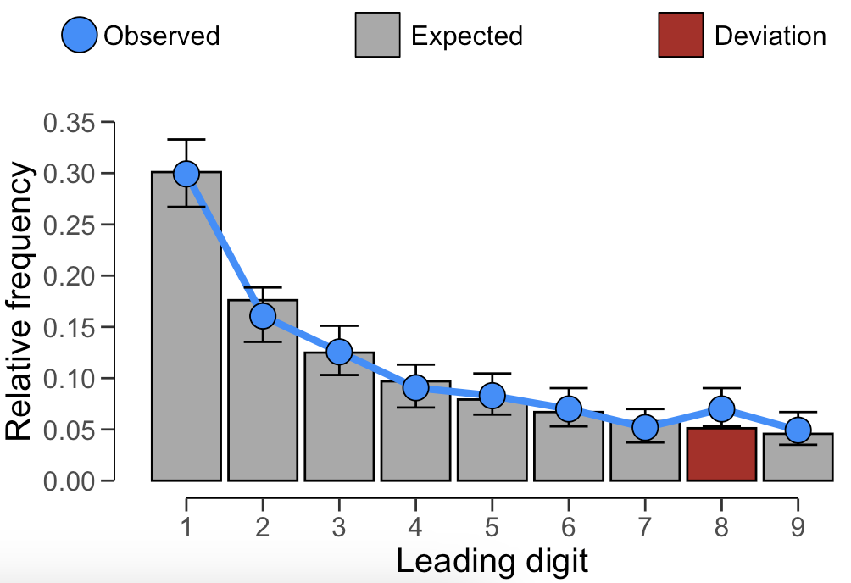
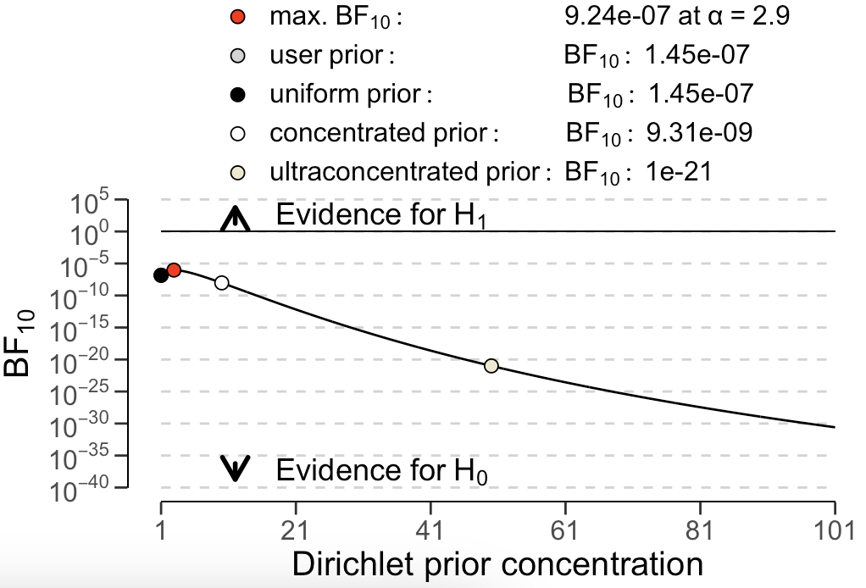
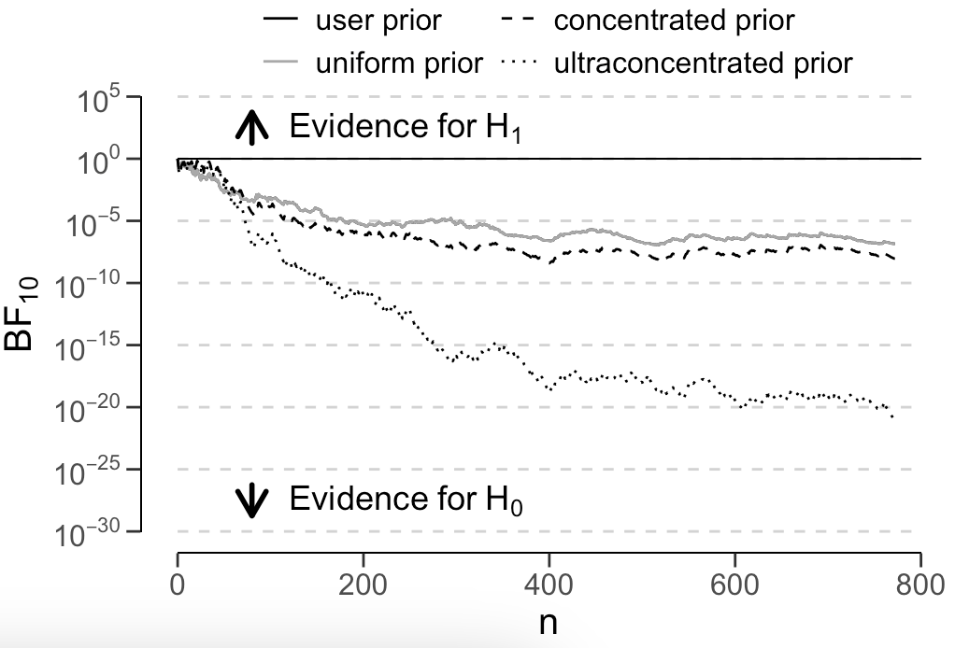
Data auditing with jfa: : CHEAT SHEET
Basics
Test the distribution of leading or last digits against Benford’s law
jfa is an R package that facilitates data auditing. The package also enables users to create a prior probability distribution to perform Bayesian data auditing using these functions.
The package provides two functions that allow users to easily apply Bayesian or classical probability theory in their data audit workflow.
jfa::digit_test()
This function extracts and performs a test of the distribution of leading (two) or last digits in a vector against a reference distribution (e.g., Benford’s law, the uniform distribution or a custom distribution). The prior argument can be used to specify a prior distribution to perform Bayesian inference.
check: Specifies the digits to be checked against the reference distribution.
reference: Specifies the reference distribution to test the digits against.
conf.level: Specifies the confidence level used in the analysis.
prior: Specifies the concentration parameter of the Dirichlet prior distribution.
digit_test(sinoForest$value,
check = 'first',
reference = 'benford',
conf.level = 0.95,
prior = FALSE)
Installation
Installing the package can be done via:
install.packages('jfa')
Loading the package can be done via:
library(jfa)
# does not require 'prior = TRUE'
plot(..., type = 'estimates')
# requires 'prior = TRUE'
plot(..., type = 'robustness')
# requires 'prior = TRUE'
plot(..., type = 'sequential')
Example
The blue code blocks next to the function descriptions provide a working example of the intended use.
The data for this example can be loaded via:
data('sinoForest')
Test the frequency of repeated values for unusually high amounts
jfa::repeated_test()
This function analyzes the frequency with which values get repeated within a set of numbers. Unlike Benford's law, and its generalizations, this approach examines the entire number at once, not only the first or last digit(s).
check: Specifies the digits to be shuffled during the analysis.
method: Specifies which statistic is used to quantify the repeated values. Defaults to af for average
frequency but can also be entropy for entropy.
samples: Specifies the number of samples used to bootstrap the p-value.
repeated_test(sinoForest$value,
check = 'last',
method = 'af',
samples = 2000)
RStudio® is a trademark of RStudio, Inc. • CC BY SA Koen Derks • K.Derks@nyenrode.nl • https://koenderks.github.io/jfa • Learn more from the webpage or vignettes • Package version 0.7.2 • Updated: 2023-11

