Slide 1
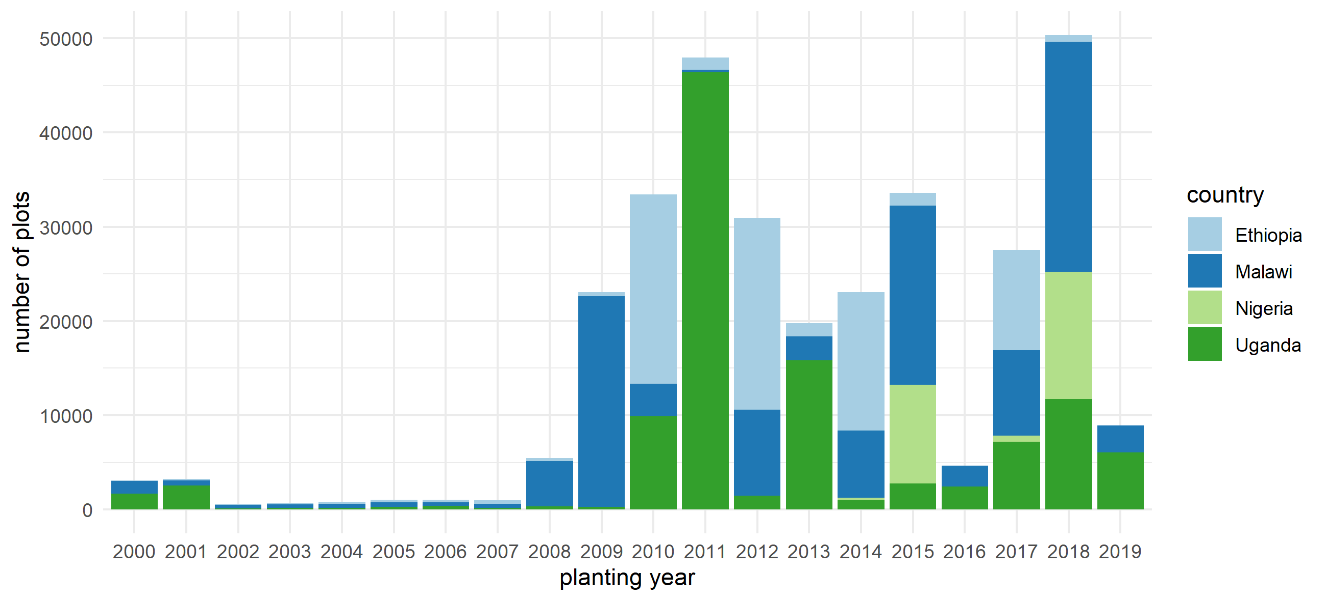
Figure 1 Number of plots with valid planting years from the year 2000 onwards. For users interested in the analysis of temporal trends in growing seasons, plot sizes and crop choice this figure indicates data availability for the six countries included in the dataset. There is no planting year given for Mali and Niger, but they can be partly inferred from the survey year or harvest years.

Slide 2
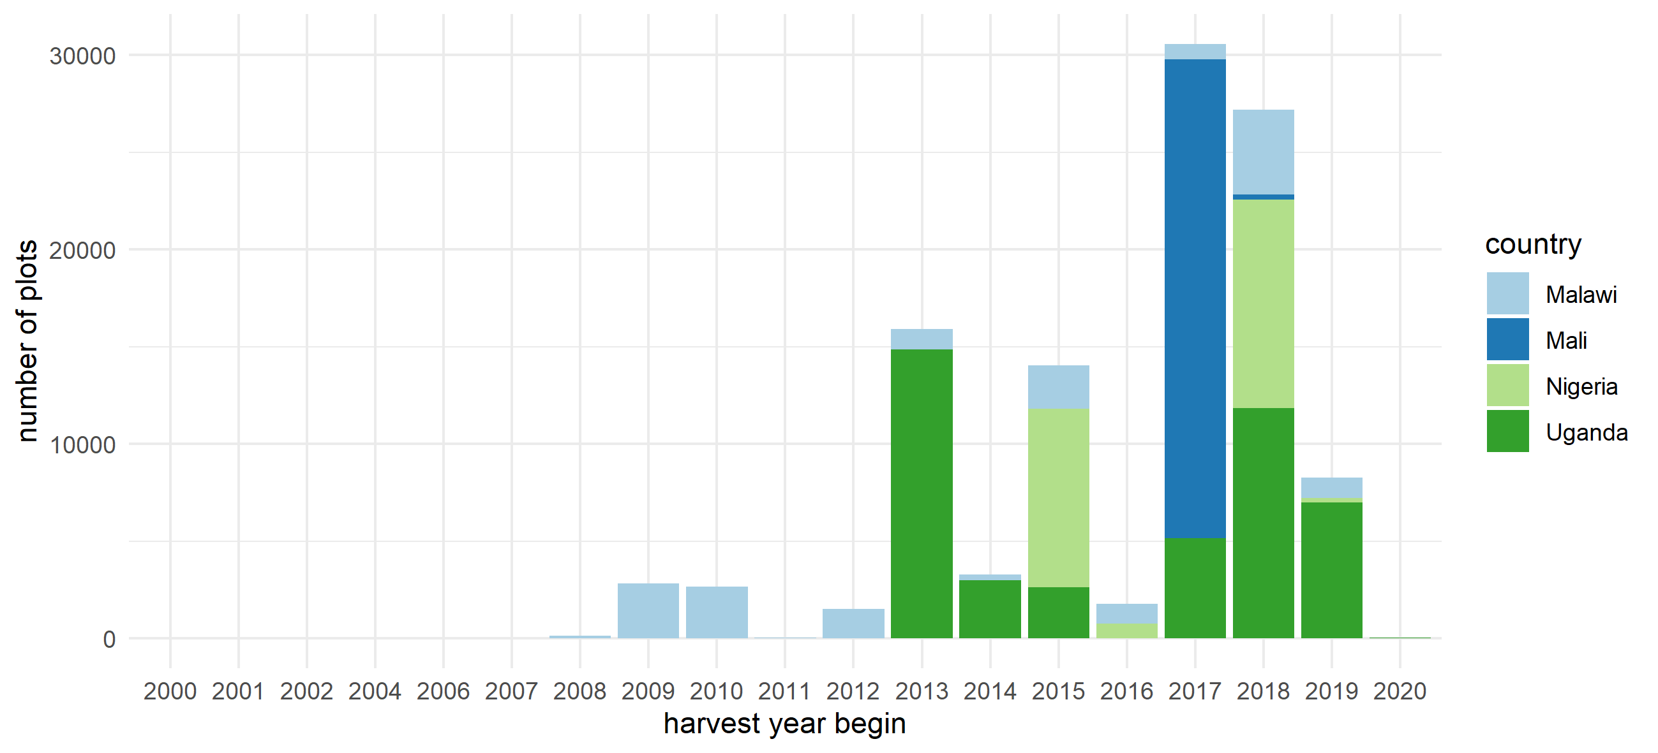
Figure 2 Number of plots with valid harvest years from the year 2000 onwards. For users interested in the analysis of temporal trends in growing seasons, plot sizes and crop choice this figure indicates data availability for the six countries included in the dataset. There is no harvest year given for Niger and Ethiopia but they can be partly inferred from the survey year or planting years.

