Slide 1
SNAP
Predict effect of non-synonymous polymorphisms on function

Slide 2
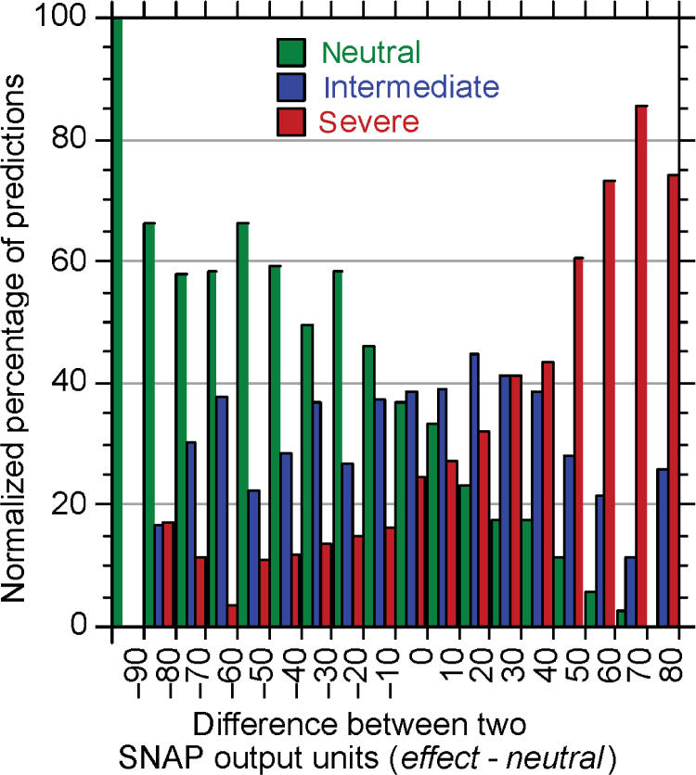
What is SNAP?
Features:
Bio-chemical properties
Sequence information
Transition frequencies
PSI-BLAST profiles
SWISS-PROT annotation
…
Hidden Layer
Input (features) ~ 10
output
-100 0 100
Neutral Effect

Slide 3
Protein features for SNPs predictions in HUMAN (strong high and neutral high)
No differences:
#TM helices (mostly 0)
MetaDisorder
(predicted as disordered)
coiled coil
(motif is present)
Small differences:
RNA binding sites
Strong: 60% with 0 binding sites (up to 25 sites)
Neutral: 90% with 0 binding sites (up to 9 sites)
DNA binding sites
Strong: 40% with 0 binding sites
(up to 24 sites)
Neutral: 90% with 0 binding sites
(up to 14 sites)
more binding sites for strong although “smaller proteins”

Slide 4
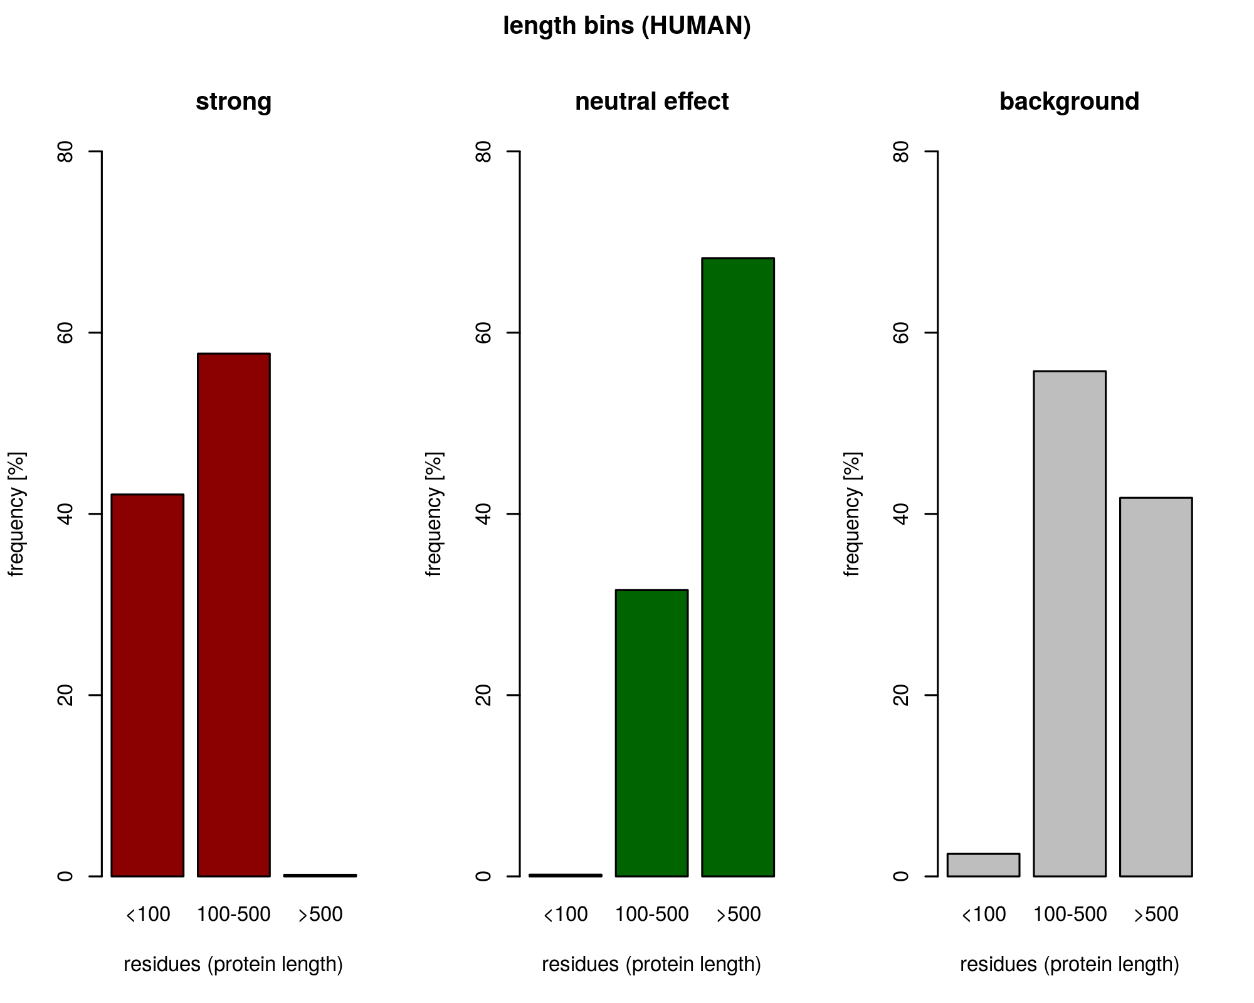
strong set - more short proteins (11-232 residues long)
neutral set - more long proteins (125-5654 residues long)

Slide 5
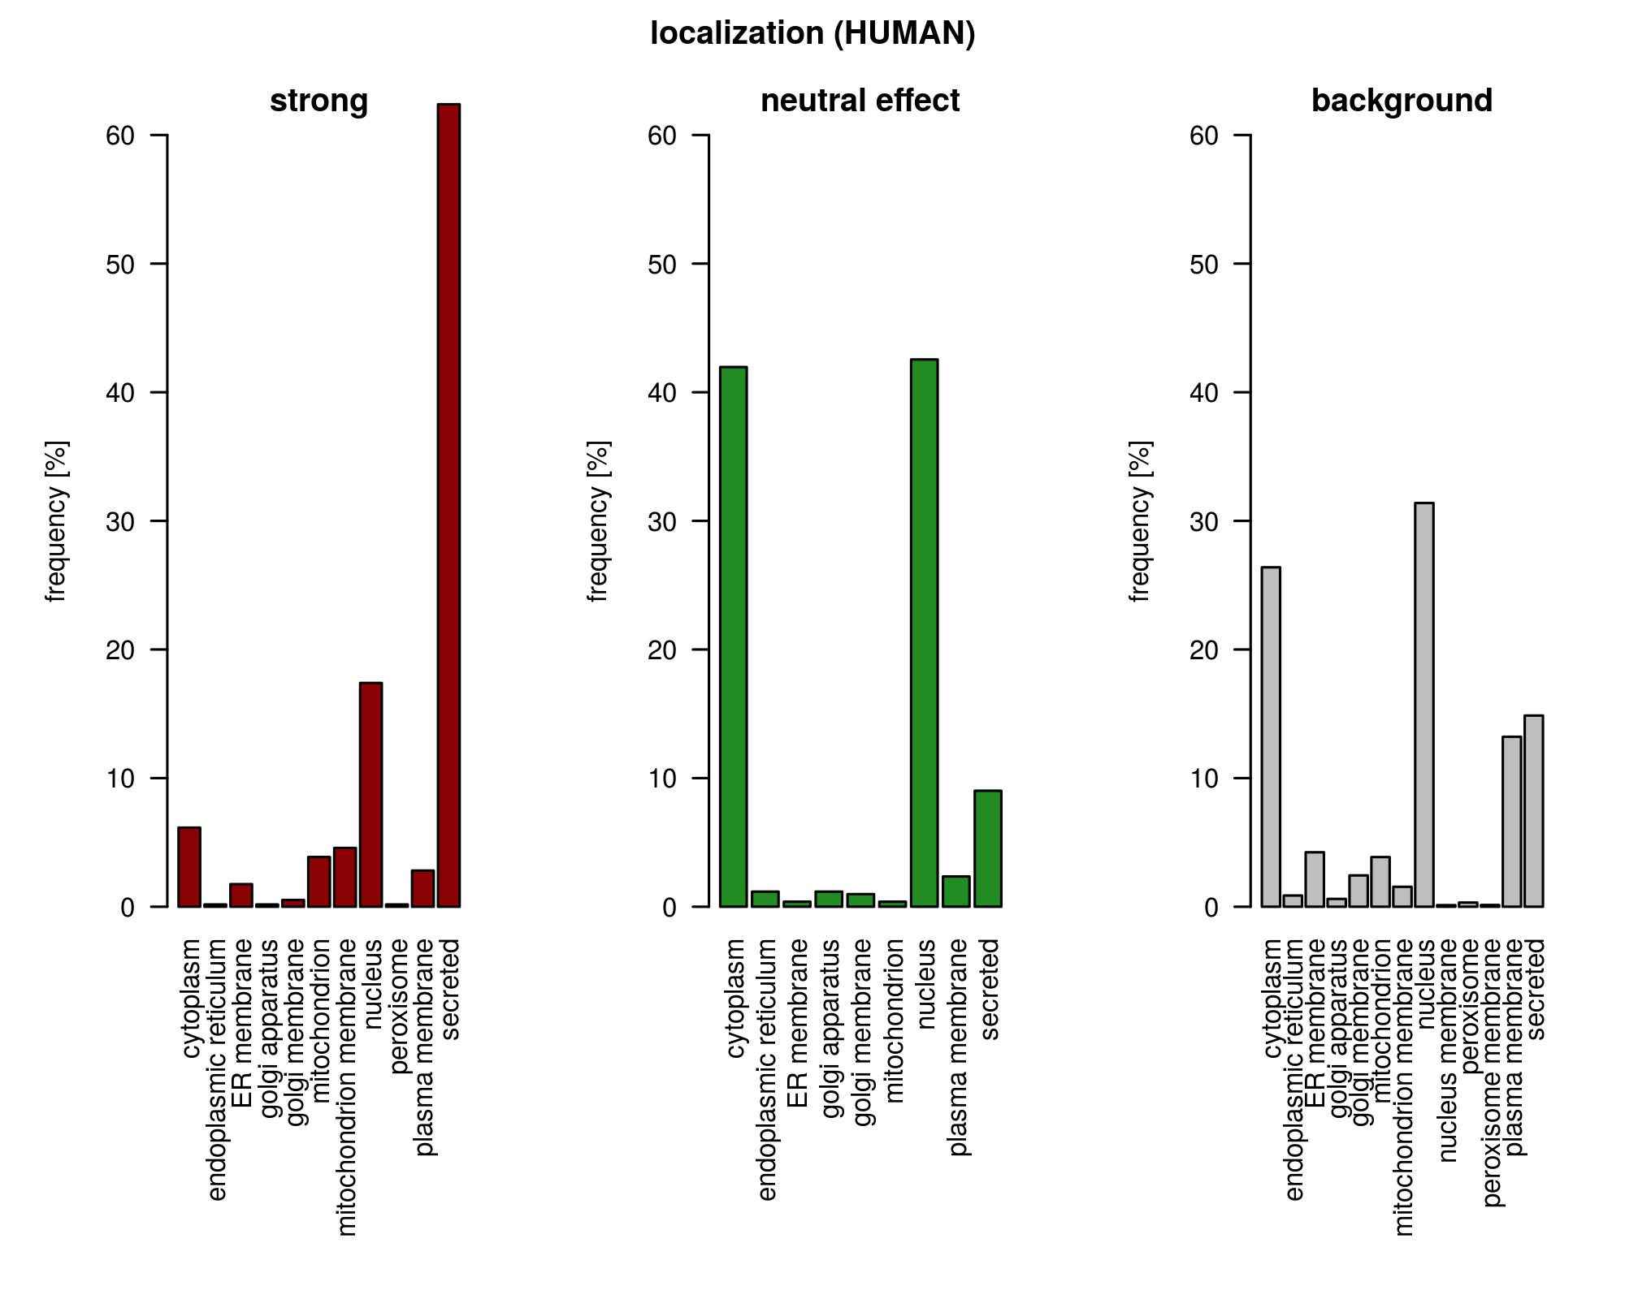
strong set - secreted
neutral set - cytoplasm, nucleus

Slide 6
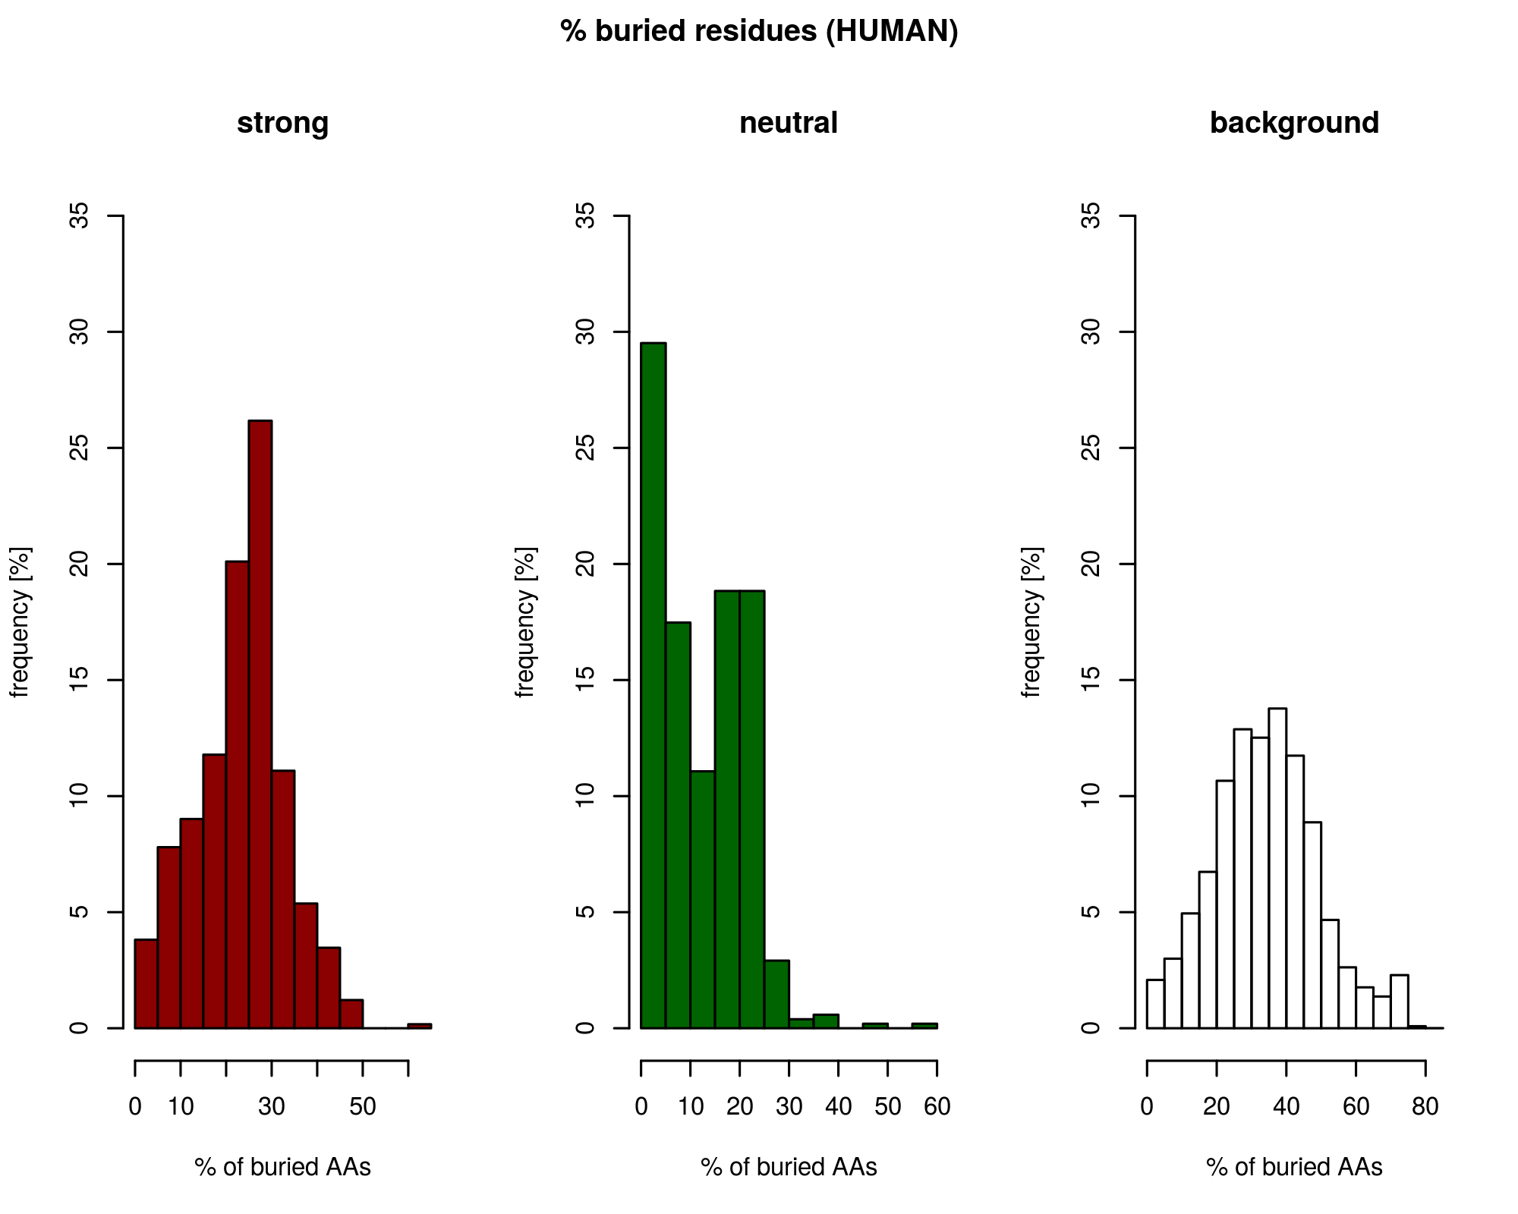
strong set - more buried (10-40%)
neutral set - less buried (0-25%)

Slide 7
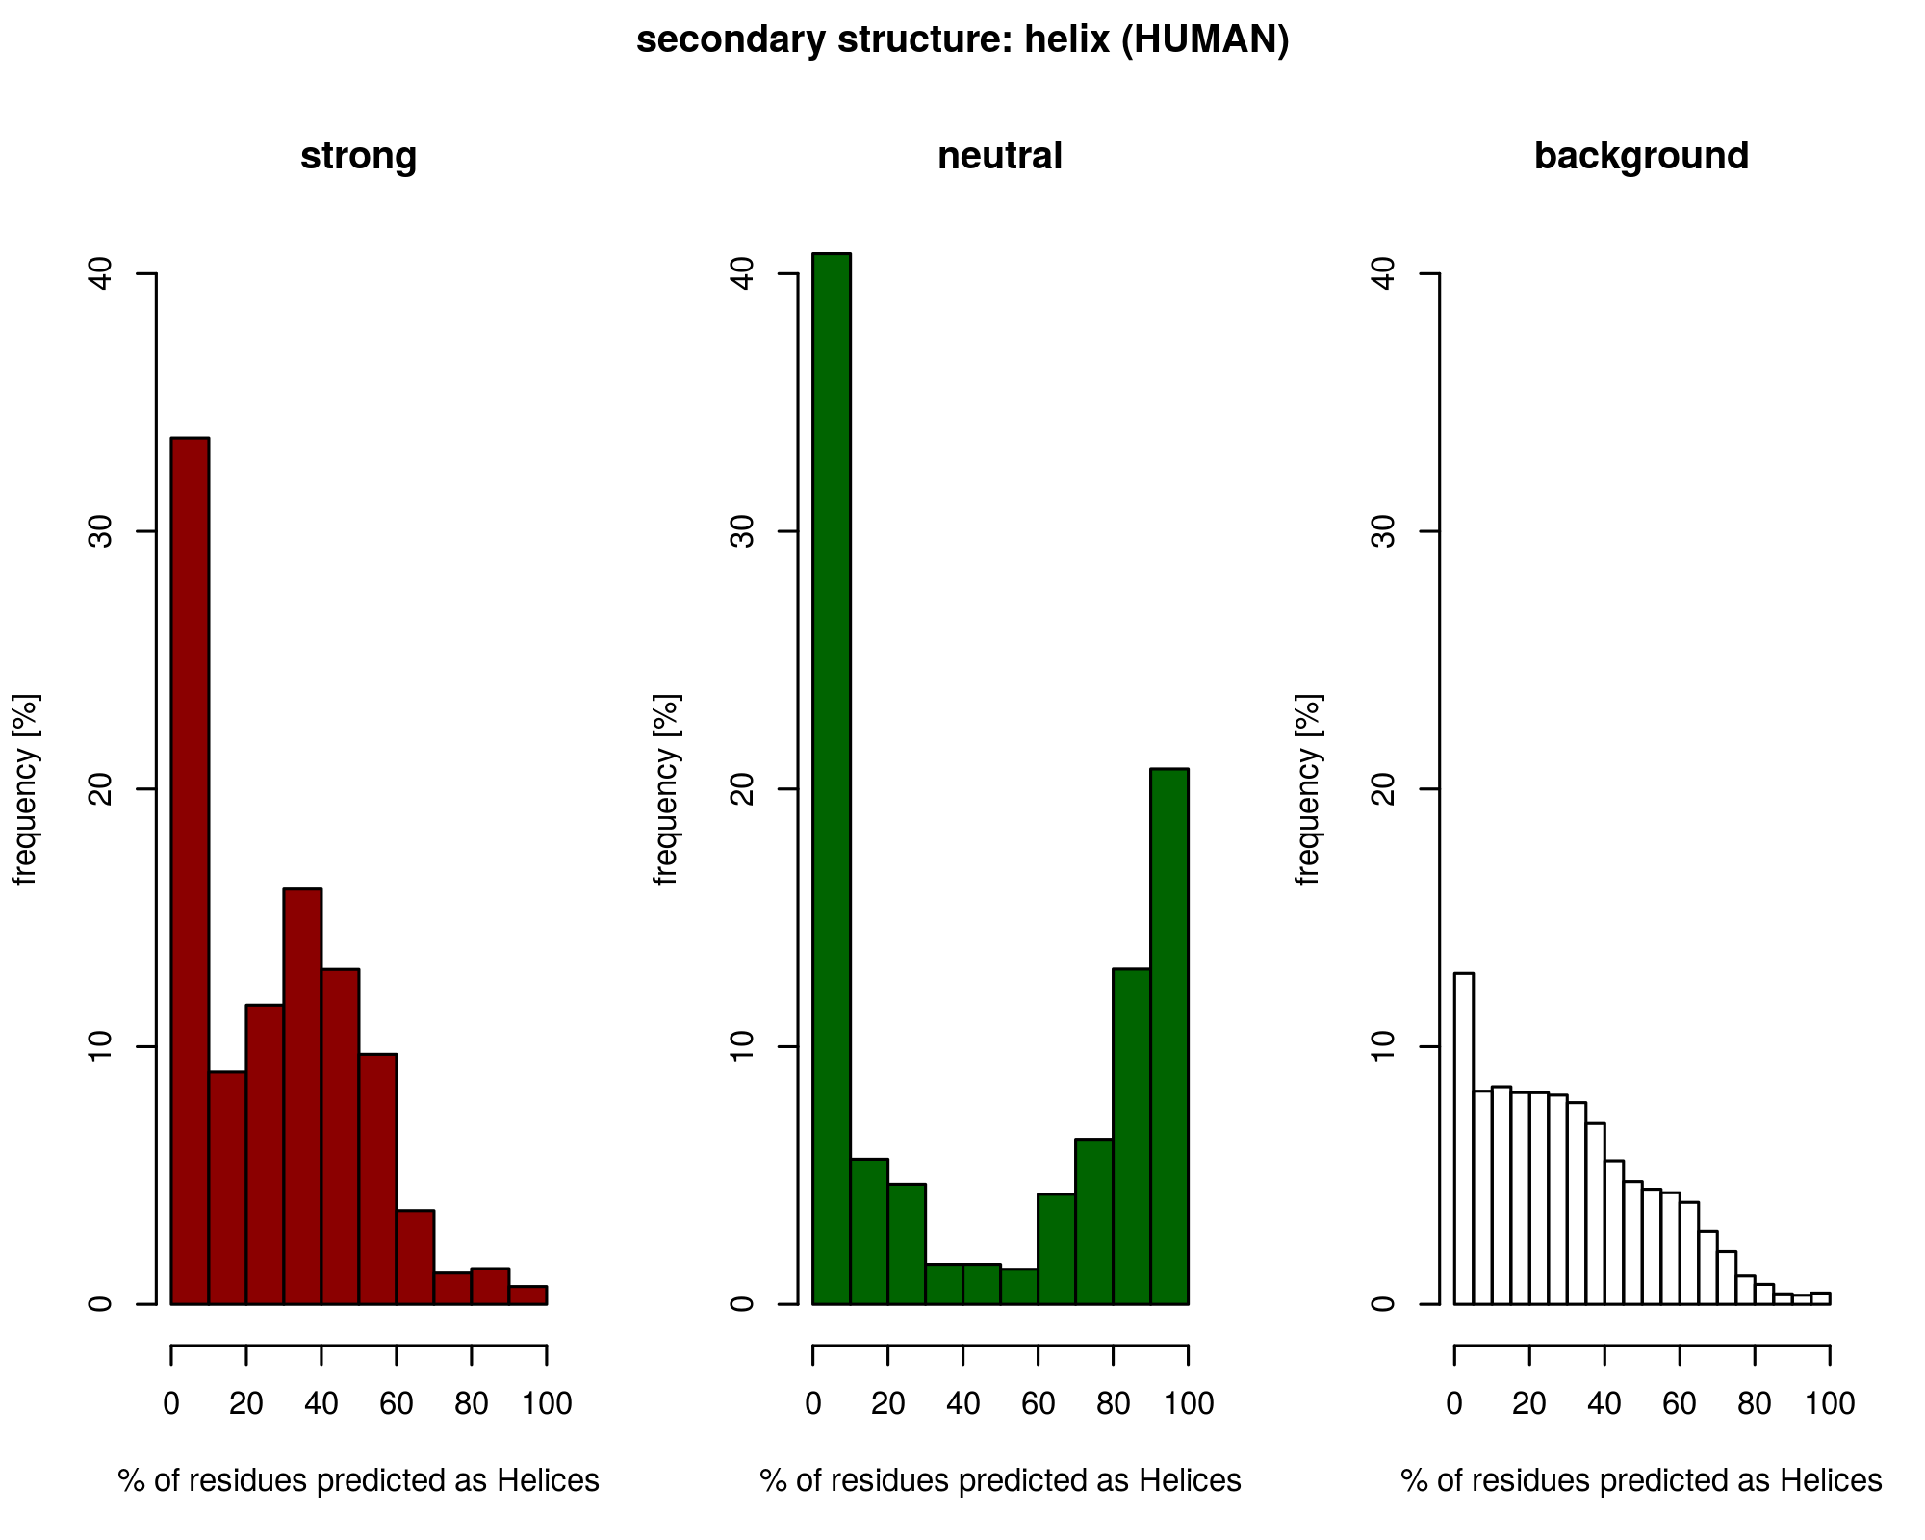
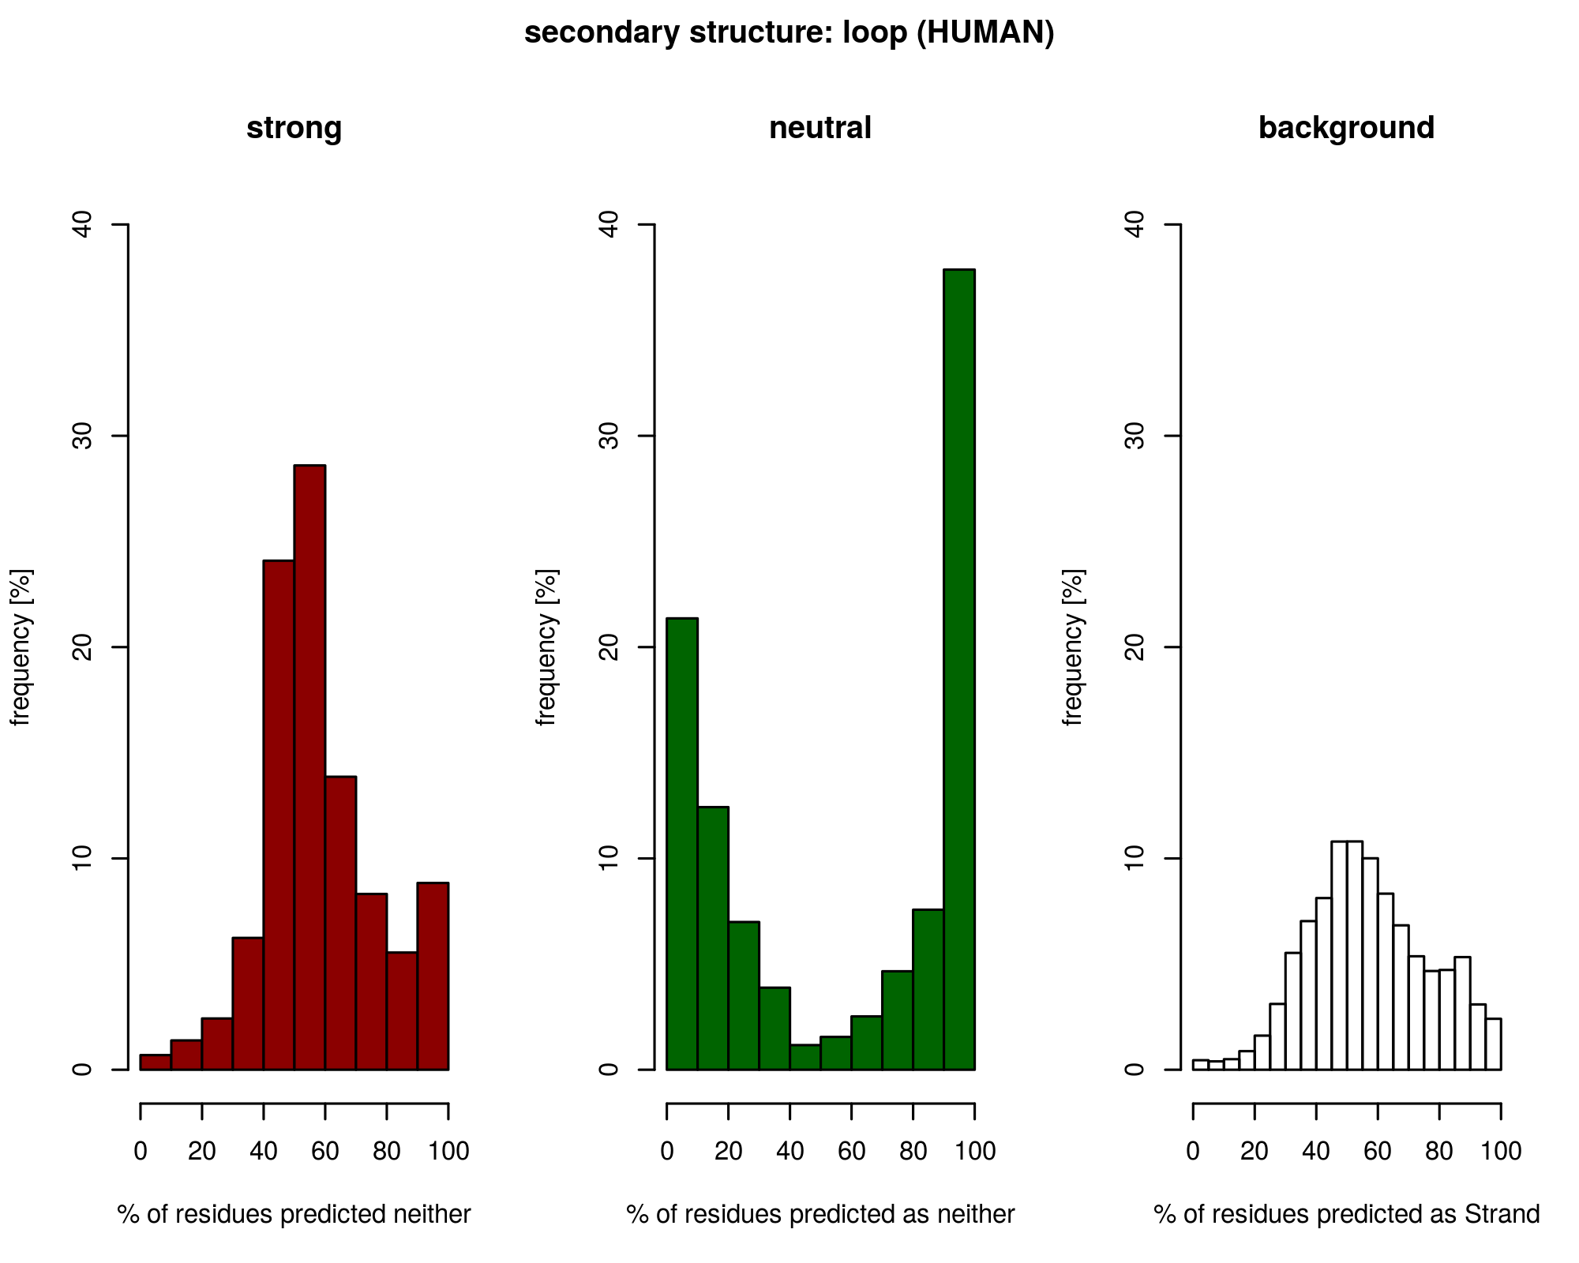
e.g. 40% of proteins from neutral set are predicted as 0% helix
Strong
40% without strands
versatile structure
(mix of loops, helices and strands)
Neutral
70% without strands
“all-or-nothing” loop and helices

Slide 8
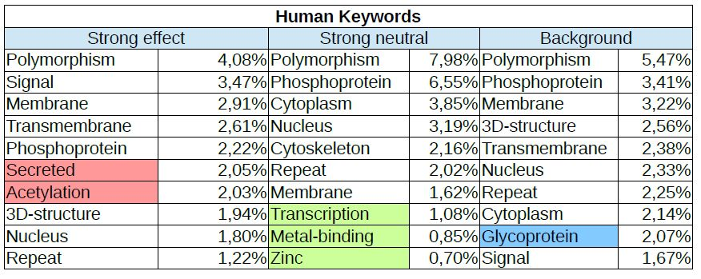
Keywords for SNPs predictions
A. Thaliana | Secreted Antimicrobial Fungicide | DNA-binding Transport Zinc Phosphoprotein | Hydrolase Nucleotide-binding ATP-binding
E. Coli | Ribonucleoprotein DNA-binding Toxin Transcription tRNA-binding | Periplasm | Metal-binding Transferase

Slide 9
Thank you

