Slide 1
Features of proteins in HUMAN sets strong high and neutral high
no differences (strong vs neutral):
number of trans-membrane helices (mostly 0)
MetaDisorder (predicted as disordered)
coiled coil (motif is present)
minor differences:
RNA binding sites
  Strong: 60% with 0 binding sites (up to 25 sites)
  Neutral: 90% with 0 binding sites (up to 9 sites)
DNA binding sites
  Strong: 40% with 0 binding sites (up to 24 sites)
  Neutral: 90% with 0 binding sites (up to 14 sites)
→ strong more binding sites although “smaller proteins”

Slide 2
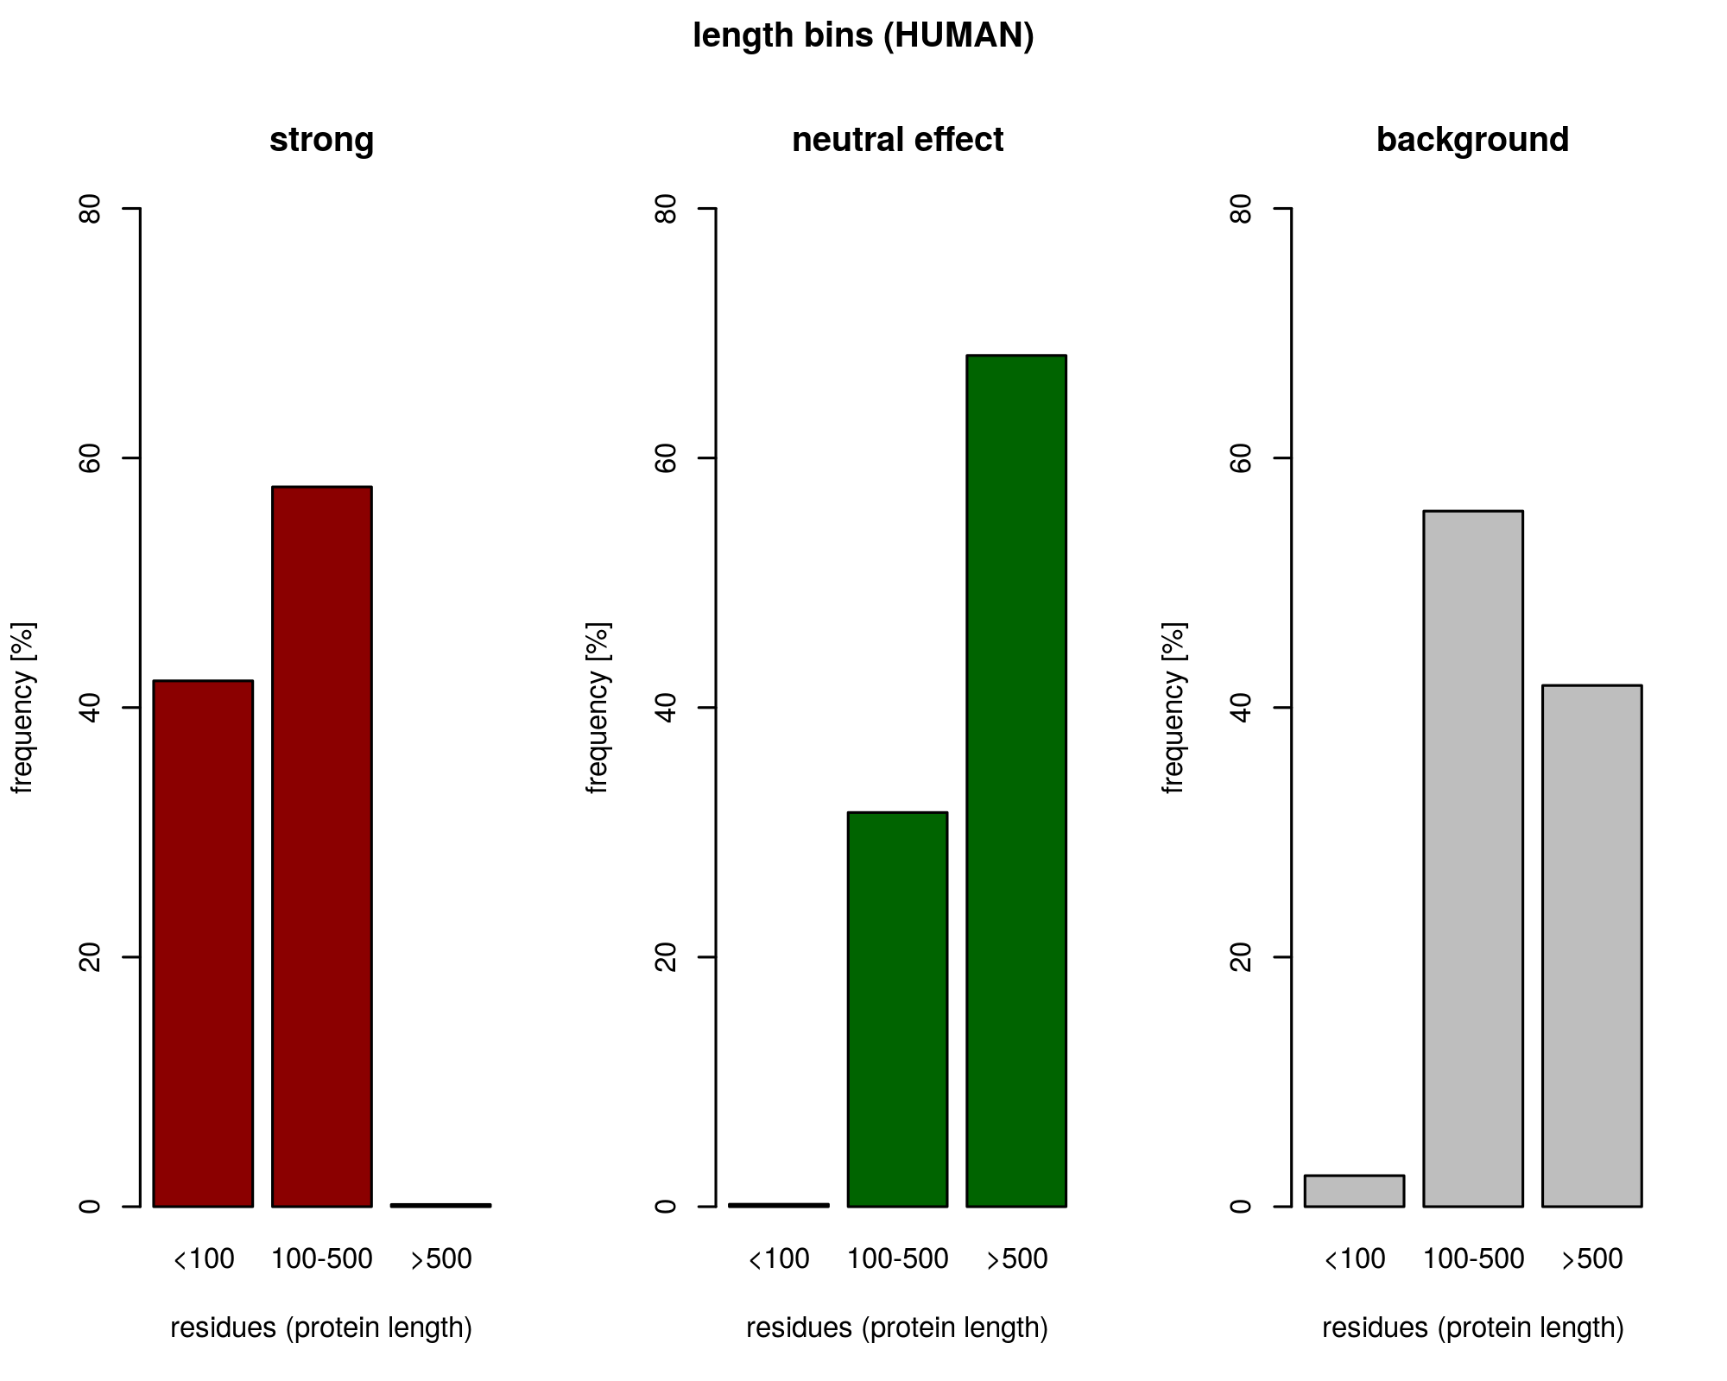
strong set = more short proteins (11-232)
neutral set = more long proteins (125-5654)

Slide 3
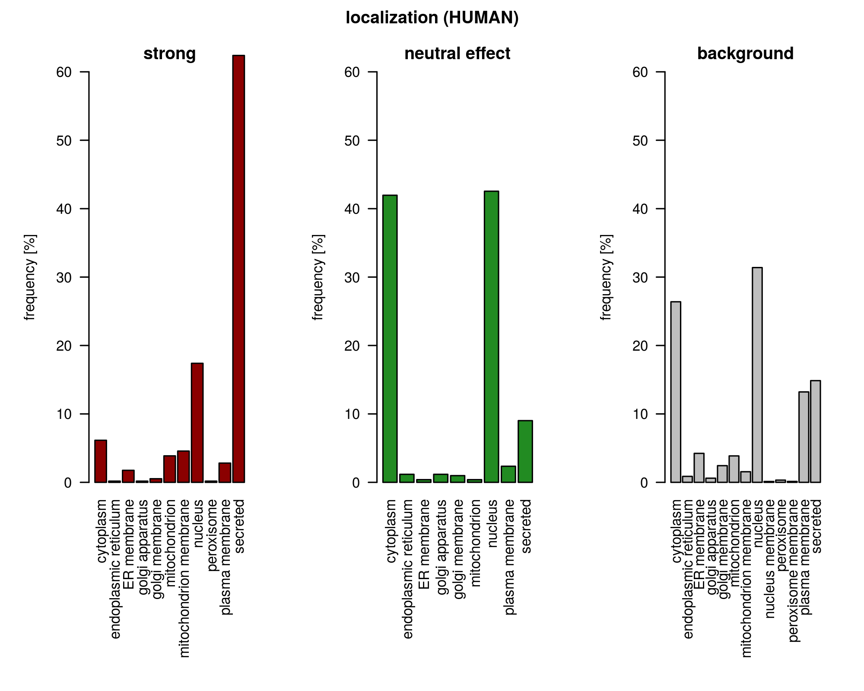
strong set = secreted
neutral set = cytoplasm, nucleus

Slide 4
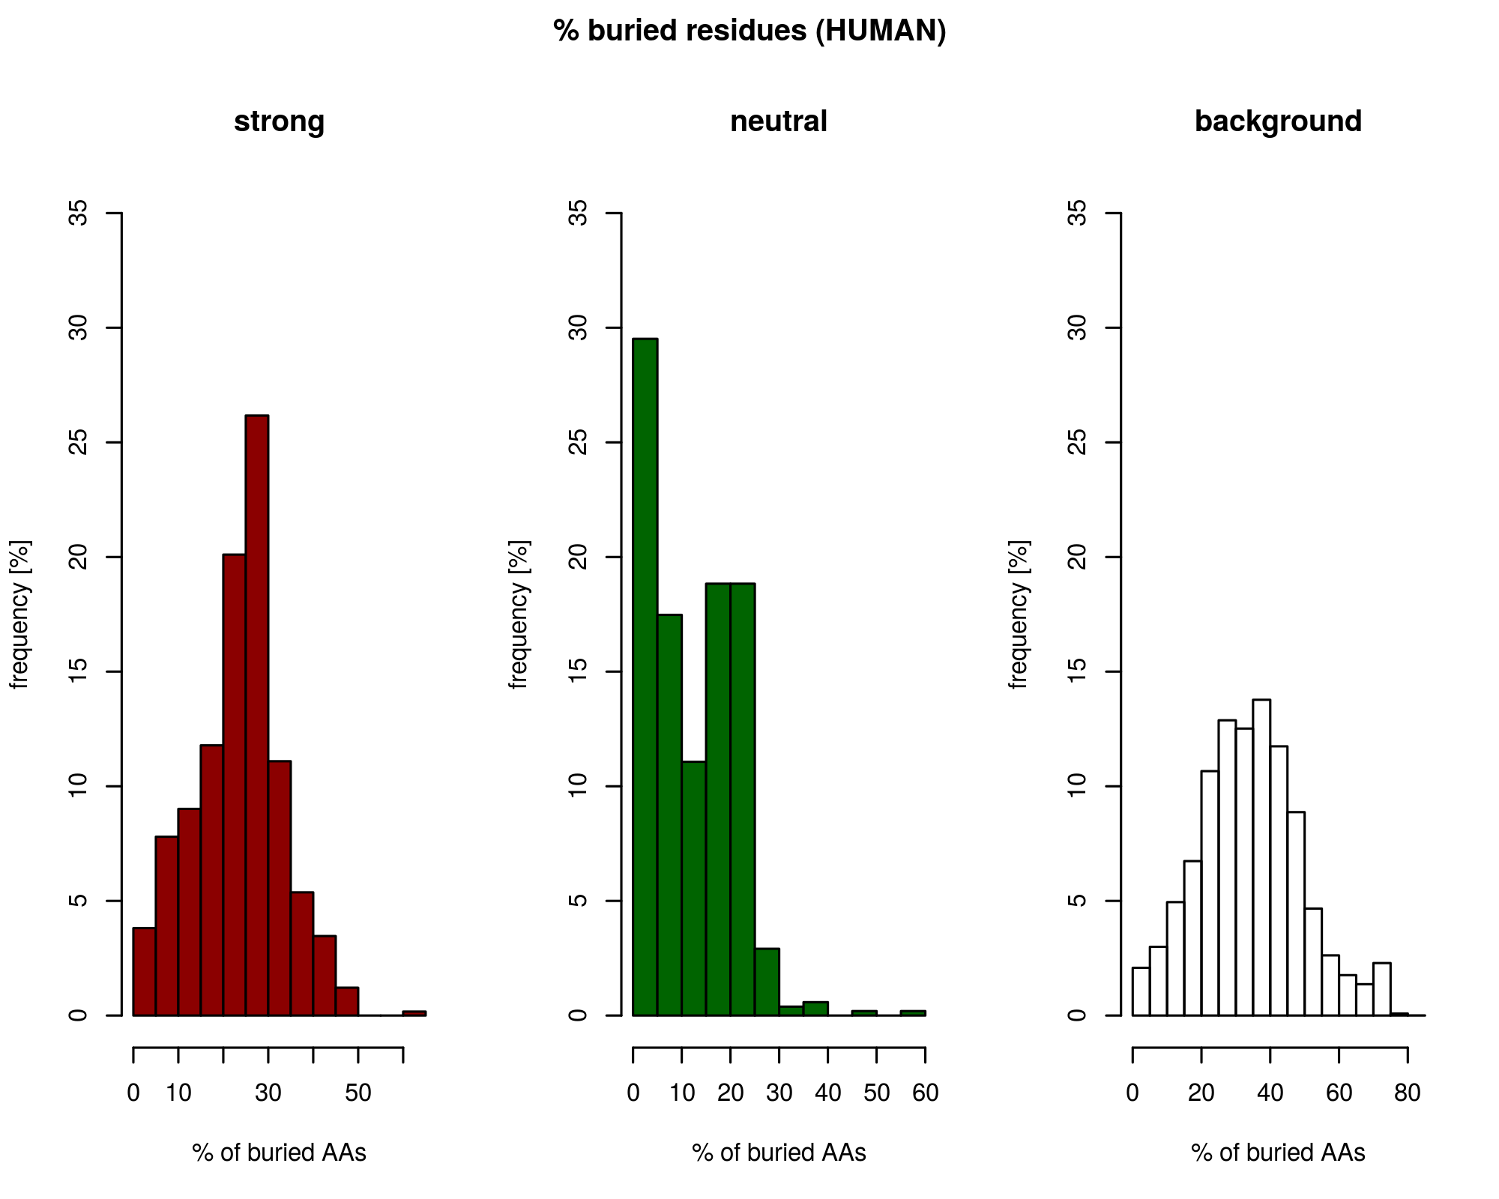
strong set = more buried (10-40%)
neutral set = less buried (0-25%)

Slide 5
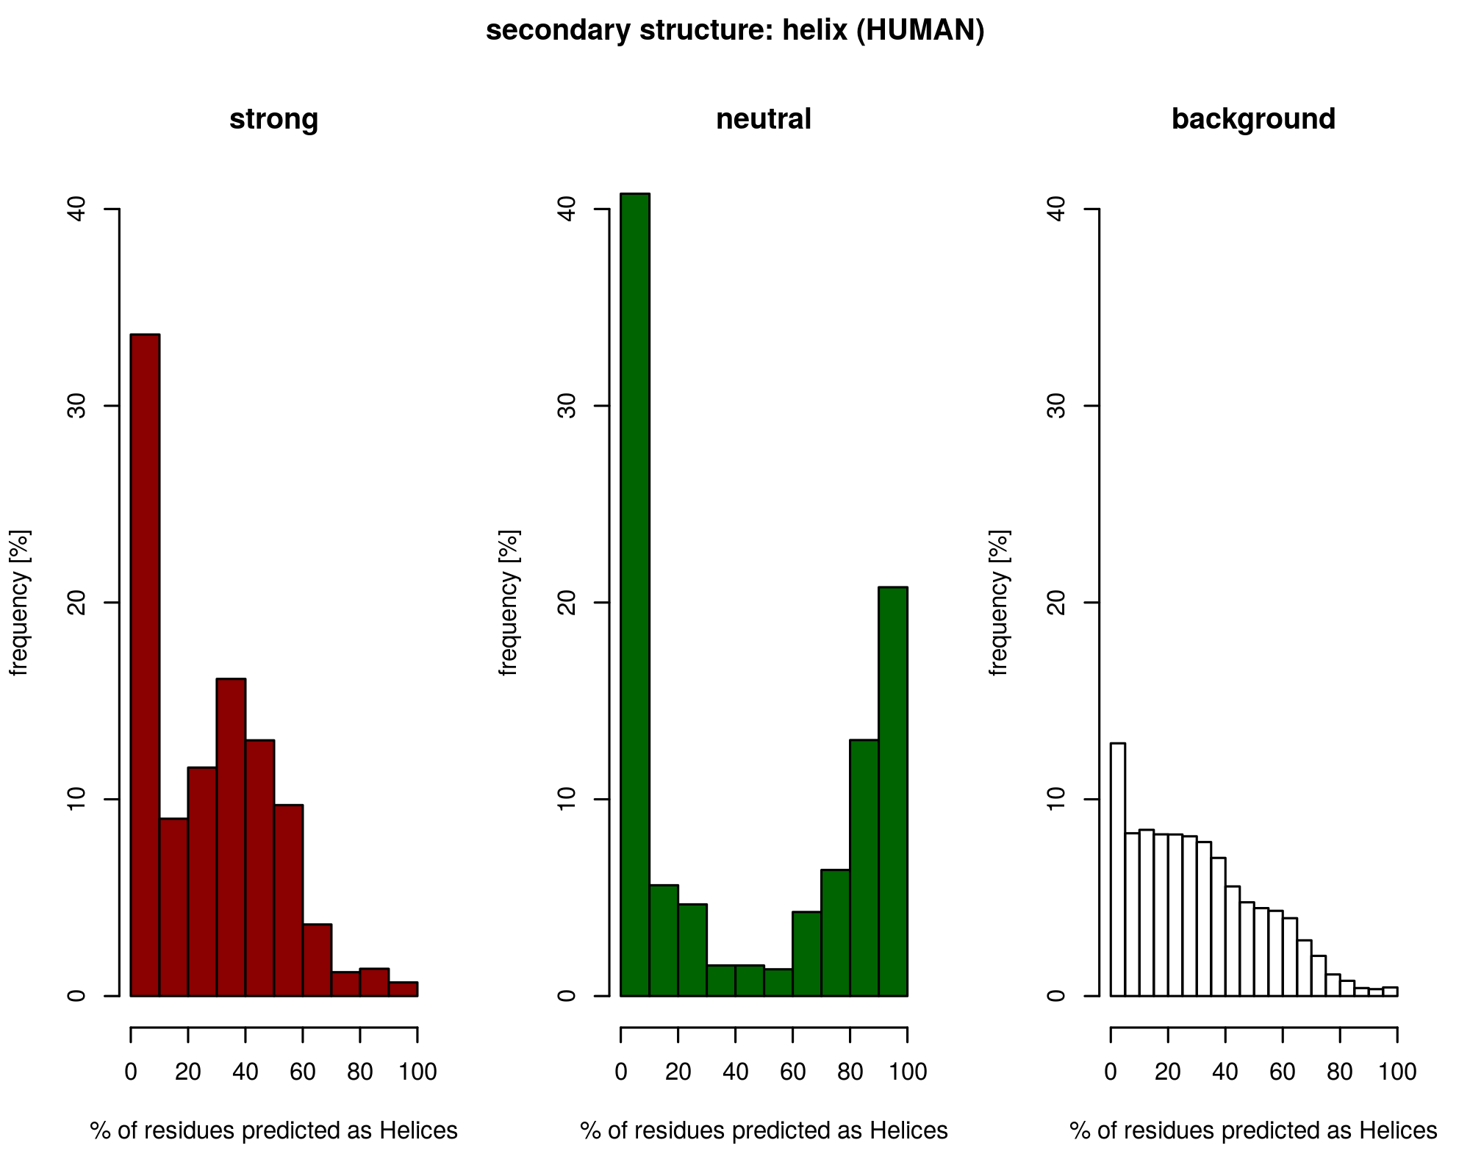
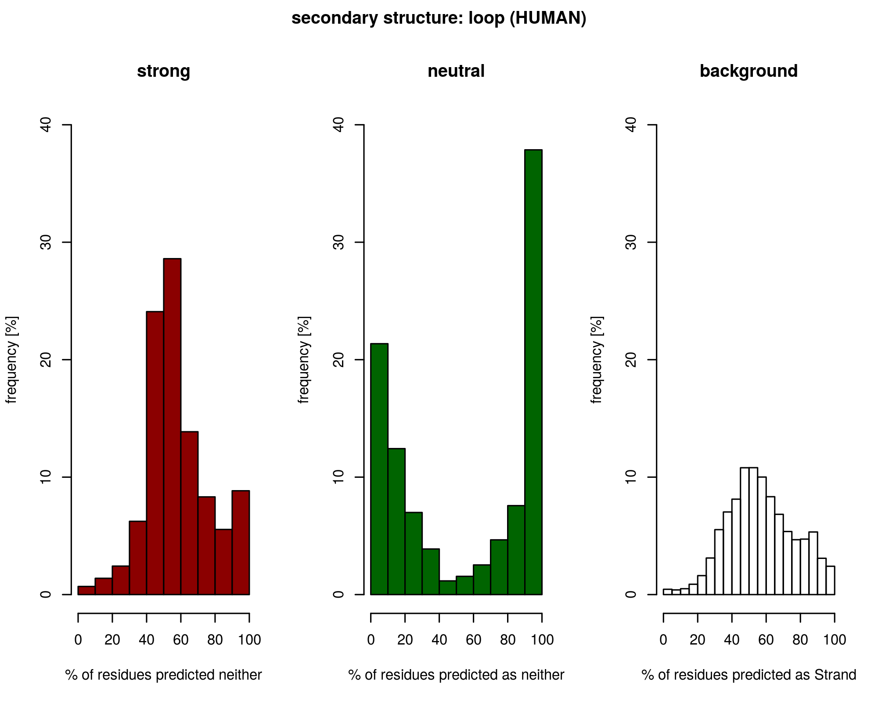
e.g. 40% of proteins from neutral set are predicted as 0% helix
Strong
40% without strands
versatile structure (mix of loops, helices and strands)
Neutral
70% without strands
“all-or-nothing” loop and helices

Slide 6
Thank you!

