Slide 1
SNP's: Analysis of Snap Results
Madalina Giurgiu, Alexander Beratis, Niklas de Andradae Krätzig, Fabian Denbsky

Slide 2
Workflow
Common Dataset of HUMAN sequences
Ran SNAP2
Identified Proteins with large number of strong deleteroius and strong neutral effects
Made plots for that proteins considering features from other predictions

Slide 3
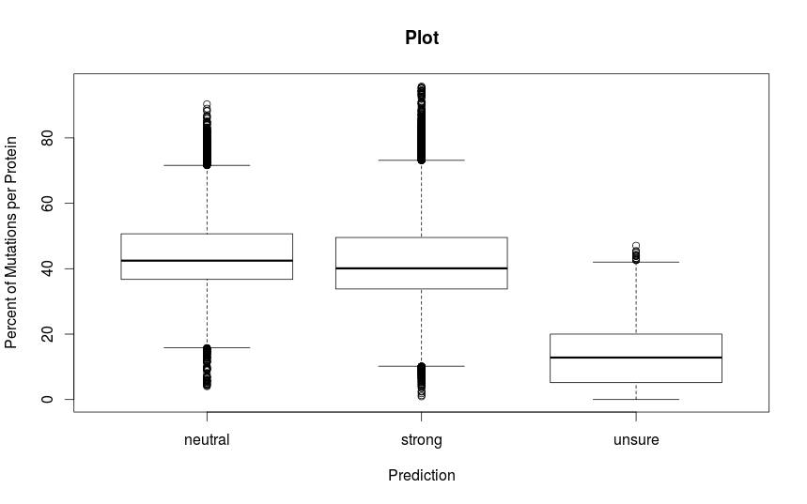

Slide 4
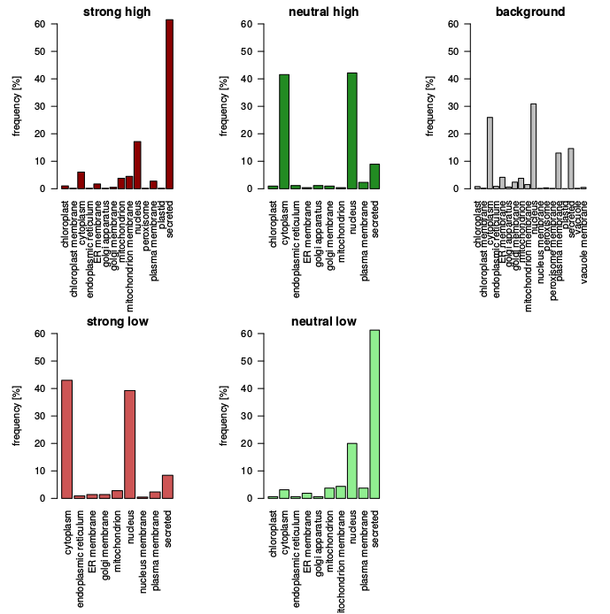

Slide 5
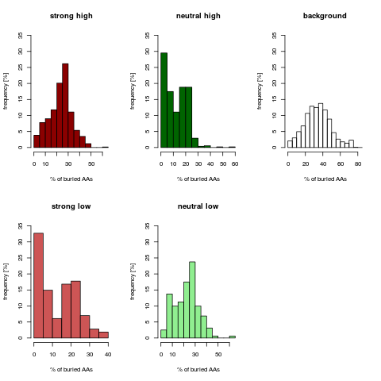

Slide 6
