Slide 1
SESSION 1 OF 4
From Analytics to Machine Learning
On the night of 14-15 April 1912 the Titanic went down; 549 of the 891 passengers on our manifest died. One question for four sessions: could the data have told us who lives? First the ideas, then the manifest.
Machine Learning - Module 2

Slide 2
01
Part 1 - The theory: what learning is
Ideas before code: what a machine actually does when it learns, and why the leap to unseen cases can work at all.
M2 Session 1 - Machine Learning Fundamentals
2

Slide 3
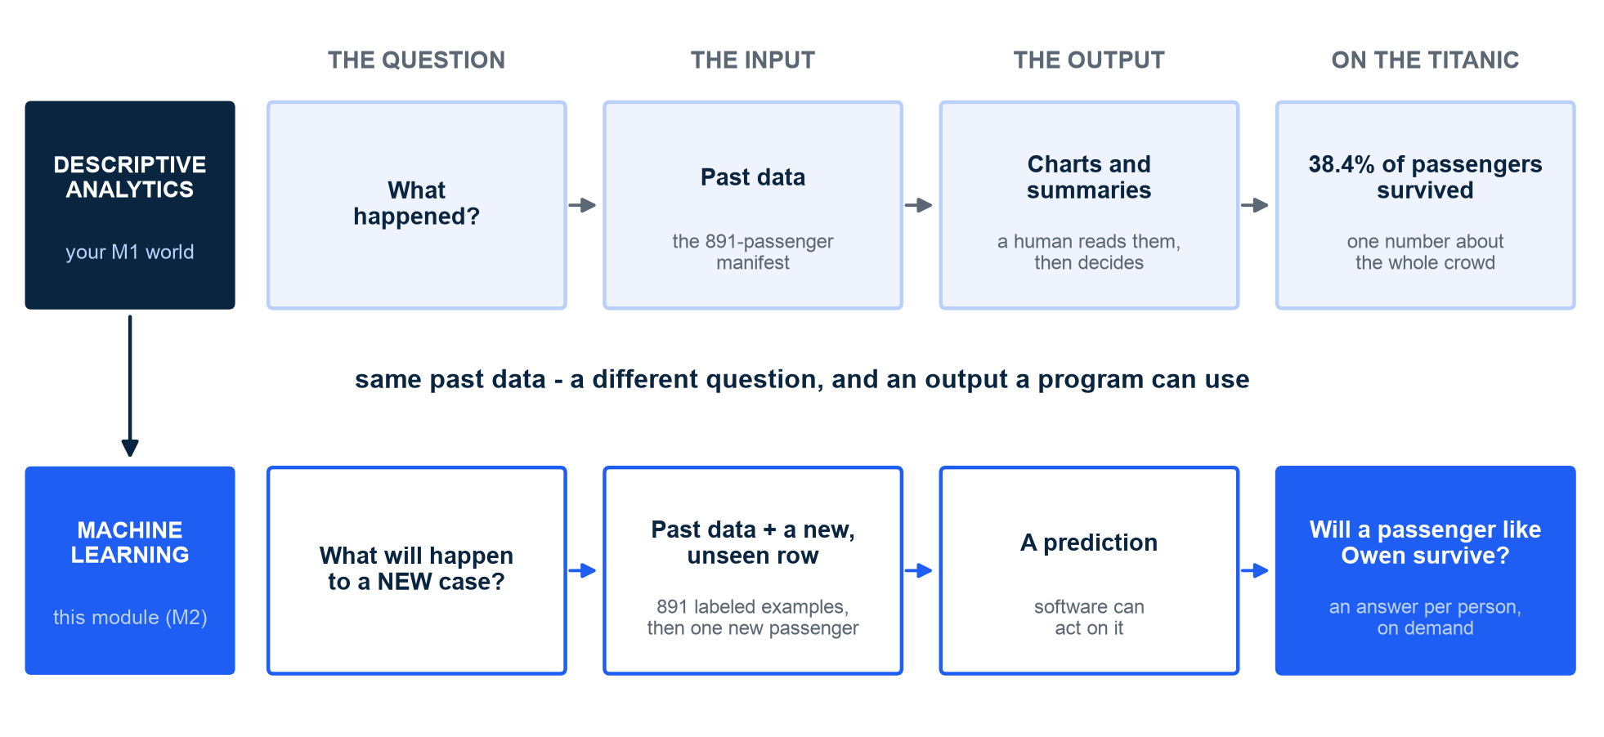
THE BRIDGE FROM M1
Descriptive analytics reads the past - machine learning answers about the future
Same past data - a different question, and an output a program can use. M1 drew the line itself: describing is not predicting. M2 starts exactly there.
M2 Session 1 - Machine Learning Fundamentals
3

Slide 4
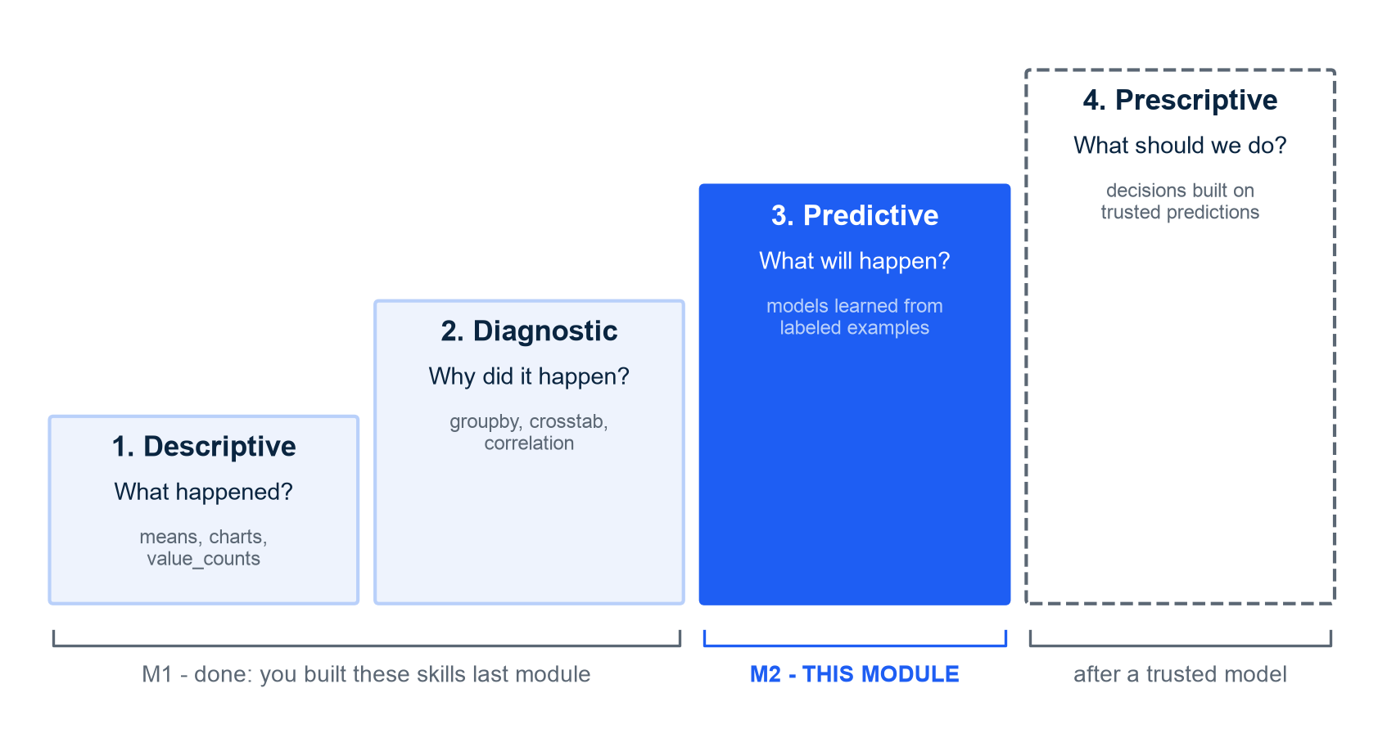
THE ANALYTICS LADDER
Prediction is the next rung on a ladder you are already halfway up
Descriptive and diagnostic: M1. You told what happened and dug into why - groupbys, crosstabs, correlations
Predictive: M2, this module. What will happen to a new, unseen case?
Prescriptive sits on top: what should we do - decisions built on predictions you can trust
Your M1 skills stay load-bearing: 80% of the daily job is still cleaning and describing data
The climb, session by session: S1 what ML is and honest splits; S2 features; S3 the model tournament; S4 tune and ship
MIT draws the same line by goal, not tools: statistics asks 'does the model explain?' - ML asks 'does the prediction hold up?' (MIT 6.390, Intro chapter). Ng, Harvard CS109A and MIT 6.390 all climb this same ladder.
M2 Session 1 - Machine Learning Fundamentals
4

Slide 5
WHAT ML IS
ML learns the rules from examples instead of being told them
Classic programming: a human writes the rules by hand
  A hand-written spam rule list - block 'winner', block ALL CAPS, block unknown senders - never ends, and spammers adapt faster than you can type
Machine learning: you show labeled examples, the algorithm finds the rules
  Arthur Samuel called it the "field of study that gives computers the ability to learn without being explicitly programmed" - his 1950s checkers program beat its own programmer after tens of thousands of self-played games
It is already in your day
  Recommendations predict what you will want next; map arrival times predict a trip nobody has driven in exactly these conditions
The same move on our data: 891 passengers with known outcomes go in; a pattern that predicts new passengers comes out
A model is a function with adjustable knobs (parameters); training turns the knobs until predictions match the examples
Samuel's phrase, quoted by Ng - Machine Learning Specialization C1W1.
M2 Session 1 - Machine Learning Fundamentals
5

Slide 6
TYPES OF MACHINE LEARNING
Machines learn in three ways - this module lives in the first
Supervised learning: the examples include the right answer (the label)
  A spam filter learns from mail already marked spam or not spam - ours: 891 passengers, each labeled Survived, 1 or 0
Unsupervised learning: no labels - find the structure yourself
  Grouping shoppers into segments nobody named in advance: there is no right answer in the data to copy
Reinforcement learning: no examples at all - act, get rewarded or penalized, improve
  Samuel's checkers program improving through wins and losses in self-play is the classic seed of the idea
The families differ in what the data gives you: answers, no answers, or only consequences
This module is supervised classification end to end - the other two families are a later course
Supervised learning comes first because it covers most ML used in industry today - Ng, Machine Learning Specialization C1W1.
M2 Session 1 - Machine Learning Fundamentals
6

Slide 7
FRAMING
Every supervised problem is a table: features X in, target y out
Features X = the inputs
Target y = the answer to learn
The columns that describe each passenger
Age, Sex, Pclass, Fare, SibSp, Parch, Embarked
In code: X = everything except the answer
Also called predictors or covariates - the whole table is n observations x p predictors
One column: Survived, 1 or 0
Predicting a category -> classification
Predicting a number -> regression
Survived is a category, so this module is a classification problem
Same table, different y: predicting the Fare a passenger paid would make this a regression problem instead. Vocabulary: Harvard CS109A / ISLR ch. 2.
M2 Session 1 - Machine Learning Fundamentals
7

Slide 8
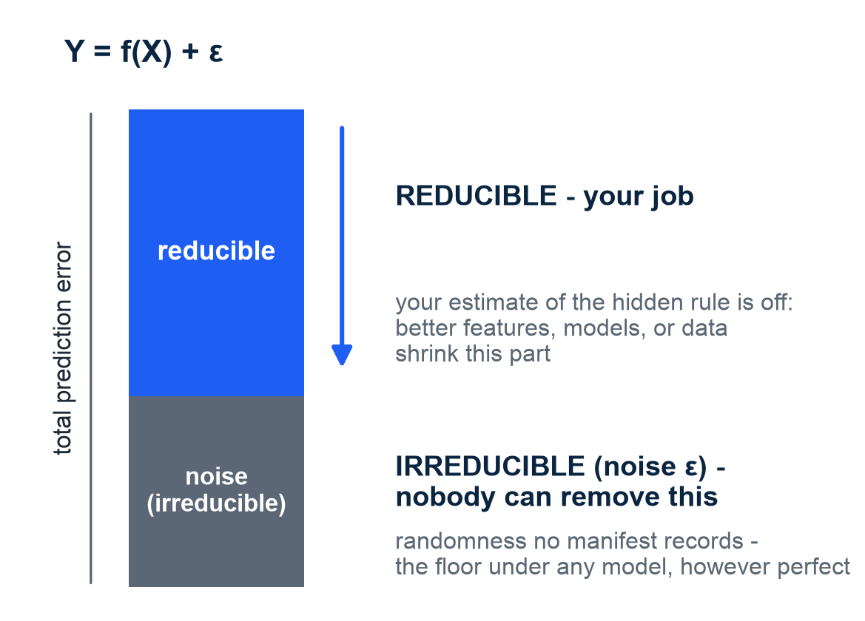
THE HIDDEN RULE AND THE NOISE
Every outcome is a hidden rule plus noise - only the rule part is learnable
The outcome is a hidden rule plus noise: Y = f(X) + ε. Learning estimates the rule; nothing can predict the noise. Error you can shrink is reducible; the noise floor is irreducible.
On the Titanic: survival = some true, unknown rule of class, sex, age... plus randomness no manifest records
A model is an estimate f-hat of the hidden rule - learning = estimating f from noisy samples
Better features, models, or data shrink reducible error; ε - chaos on a sinking ship - yields to no model, however perfect
This is why 100% accuracy is not the goal and never will be - Session 3 pays this off
Schematic illustration - no course numbers on this chart. Harvard CS109A / ISLR ch. 2.
M2 Session 1 - Machine Learning Fundamentals
8

Slide 9
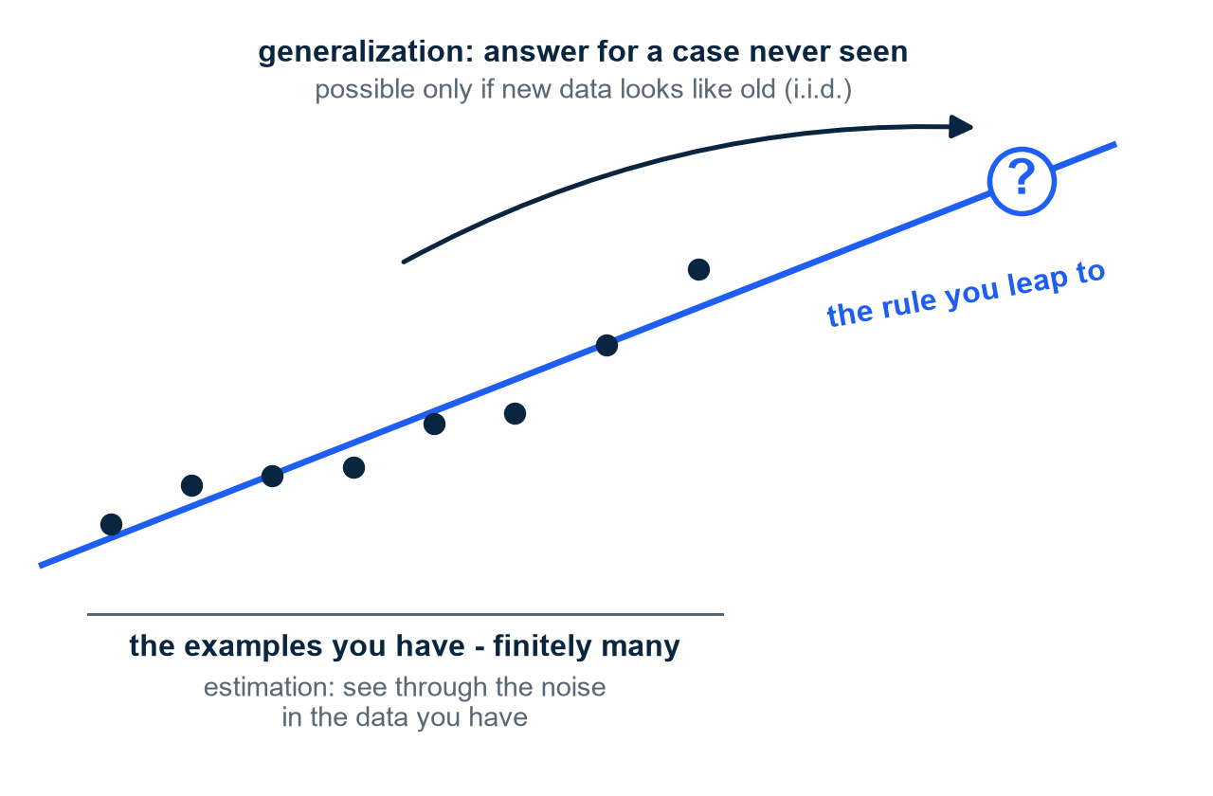
THE INDUCTION PROBLEM
Learning is a leap from a few examples to cases never seen - one assumption makes it work
Every learner makes the same leap: finitely many examples in, a rule that must answer for cases nobody has seen yet
Philosophers call it the problem of induction: nothing logically guarantees the future resembles the past
MIT splits the difficulty in two: estimation - see through the noise in the data you have - and generalization - say something about inputs you never saw
The bridge is an assumption, not a proof: new data is drawn from the same world as the old (i.i.d.) - no assumption, no generalization
Part 2 builds exactly this leap: 712 passengers teach a rule that 179 unseen ones will judge
Illustration - synthetic data. MIT 6.390, Intro chapter ('the problem of induction').
M2 Session 1 - Machine Learning Fundamentals
9

Slide 10
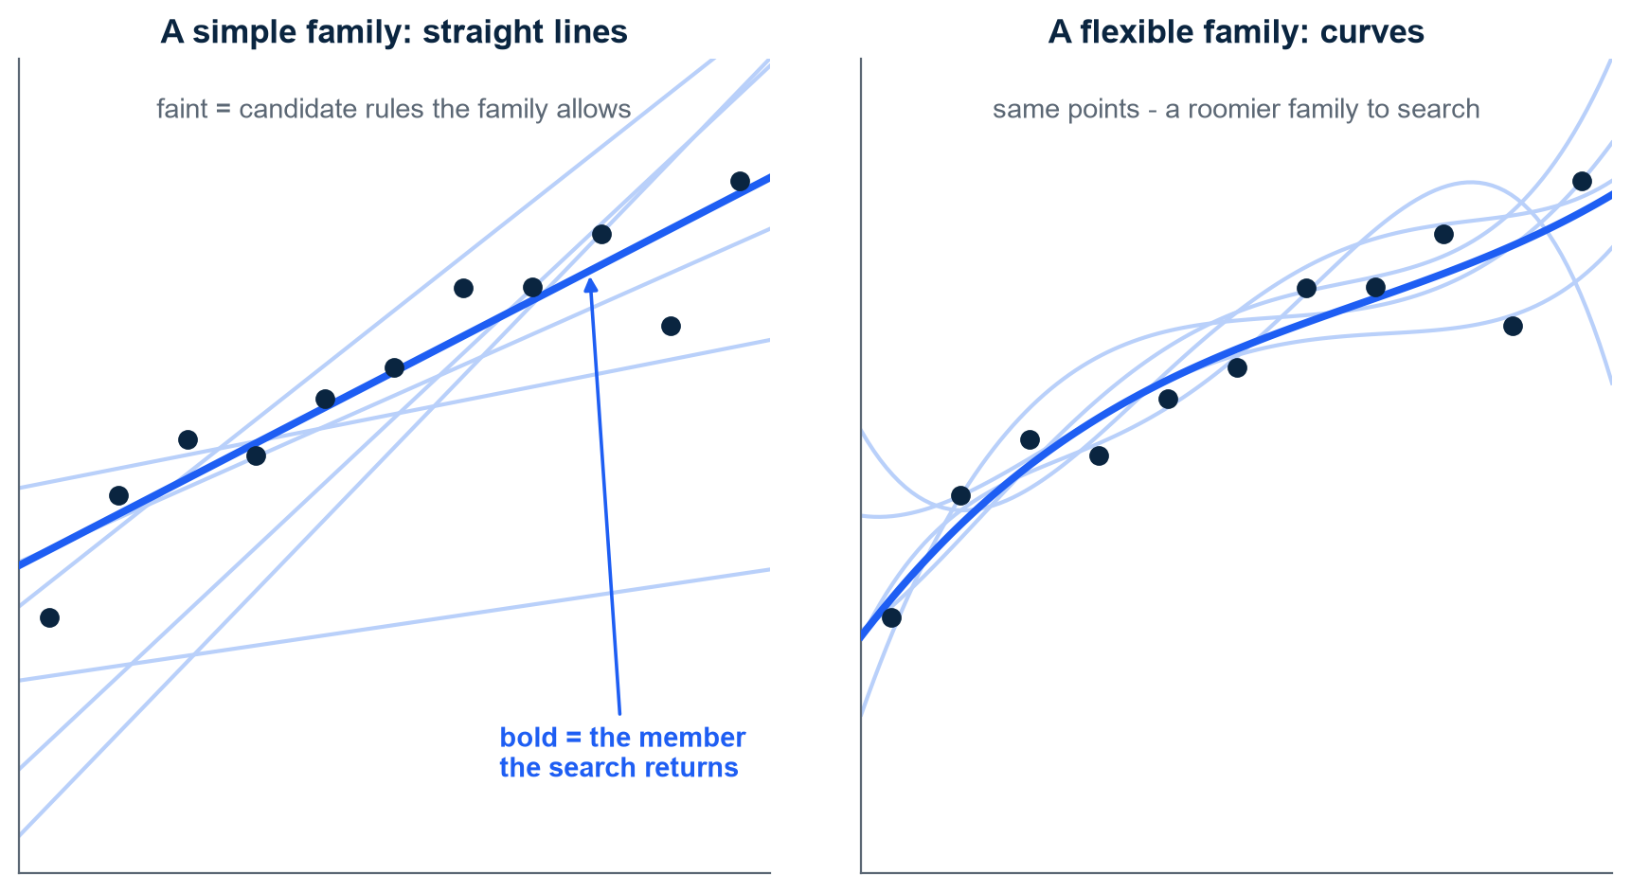
THE HYPOTHESIS CLASS
You choose the space of candidate rules - the algorithm only finds its best member
A hypothesis is one concrete rule with its numbers filled in; the hypothesis class is the whole family of rules of that shape
Learning is a SEARCH: the algorithm scans the family and returns the member that fits the examples best
Which family to search is YOUR design decision, made before any data is touched: straight lines, or flexible curves?
Flexibility cuts both ways: a roomier family can follow the pattern more closely - and can follow the noise too
MIT separates model selection (choose the class) from model fitting (find the member) - Session 3 turns exactly this dial
Illustration - synthetic data. MIT 6.390, Intro chapter.
M2 Session 1 - Machine Learning Fundamentals
10

Slide 11
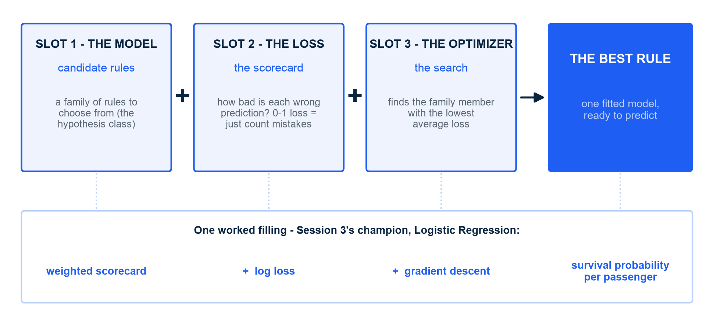
THE THREE-SLOT RECIPE
Every learner you will meet is the same recipe: candidate rules + a score + a search
Every supervised learner is the same three-slot recipe: a set of candidate rules (the model), a score for how wrong a prediction is (the loss), and a search that finds the best-scoring rule (the optimizer).
Slot 1 is the hypothesis class you just met - choosing it stays YOUR call, made before any data is touched
Different ML methods = different fillings of the same three slots
Session 3 refills slot 1 six times; Session 4 tunes the knobs around the recipe
One recipe, every method in this module. MIT 6.390, Intro chapter & Appendix C 'Supervised learning in a nutshell'.
M2 Session 1 - Machine Learning Fundamentals
11

Slide 12
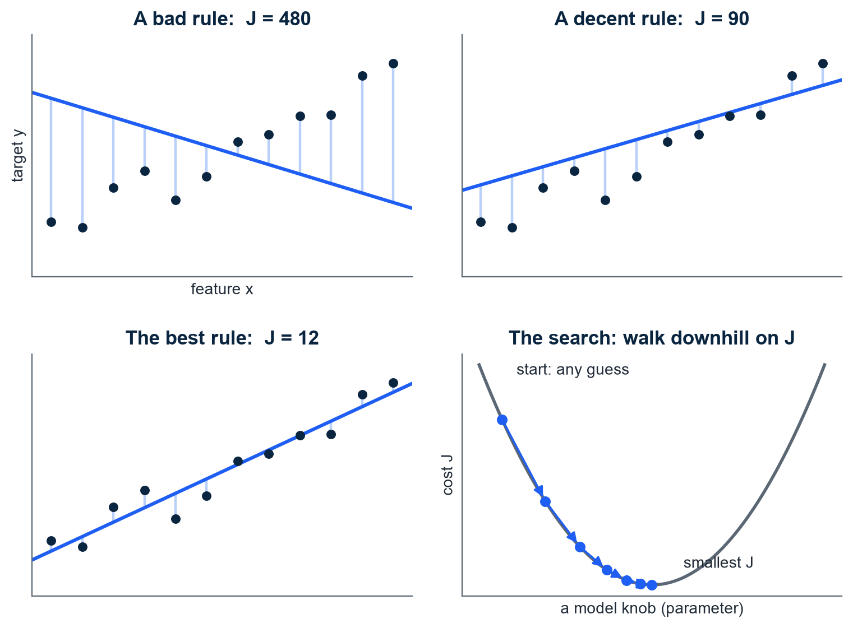
HOW TRAINING WORKS
Training is nothing mystical: make one number - the average miss - small
Every candidate rule makes errors on the 891 labeled examples; average them into one number J - the cost
J scores how badly a rule fits ALL the data at once - training = searching for the rule with the smallest J
The search walks downhill: from any starting guess, nudge the knobs in the direction that lowers J fastest - a hillside descent in fog
Step size matters: too small crawls, too large overshoots the valley
The same downhill walk trains Session 3's scorecard - no magic anywhere in this module
Illustration - synthetic data; illustrative J values, not course results. Method: Ng, Machine Learning Specialization C1 / Stanford CS229 notes.
M2 Session 1 - Machine Learning Fundamentals
12

Slide 13
02
Part 2 - Practice: the Titanic manifest
The ideas land on 891 real passengers: one dataset, one honest split, and a floor every model must beat.
M2 Session 1 - Machine Learning Fundamentals
13

Slide 14
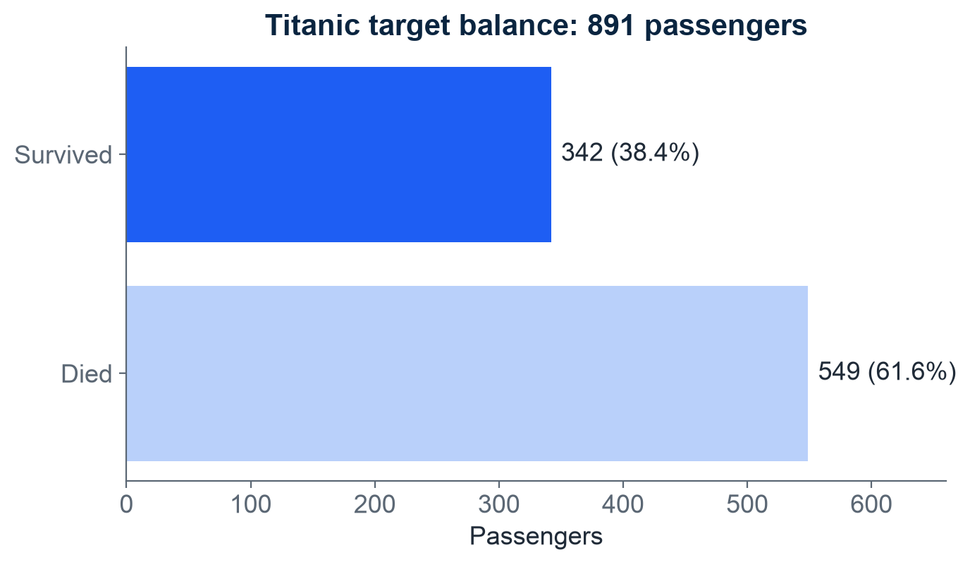
THE DATASET
One dataset carries every concept: 891 passengers, 38.4% survived
891 rows x 12 columns - small enough to read, real enough to be messy
549 died, 342 survived: imbalanced, but not extremely
Missing values are real: Age 177, Cabin 687, Embarked 2
One worked example carrying every new concept is Andrew Ng's teaching pattern - we reuse the Titanic the same way
Class balance in the full dataset. Source: Module 2, notebook 01, section 2.
M2 Session 1 - Machine Learning Fundamentals
14

Slide 15
THE MANIFEST
Three real rows put faces on the data - they return every session
Passenger (as listed) | Class | Age | Family aboard | Fare | Boarded | Outcome
Braund, Mr. Owen Harris | 3rd | 22 | 1 (SibSp 1) | 7.25 | Southampton | Died
Cumings, Mrs. John Bradley (Florence Briggs Thayer) | 1st | 38 | 1 (SibSp 1) | 71.2833 | Cherbourg | Survived
Goldsmith, Master. Frank John William "Frankie" | 3rd | 9 | 2 (Parch 2) | 20.525 | Southampton | Survived
PassengerId 1, 2 and 166 of the dataset, fields verbatim. Owen, Florence and Frankie carry the whole module: their gaps in Session 2, their odds in Sessions 3-4.
M2 Session 1 - Machine Learning Fundamentals
15

Slide 16
FEATURE VERDICT
Not every column becomes a feature - identifiers and free text sit out
Column | Verdict | Why
Pclass, Sex, Fare, SibSp, Parch | Feature | Numbers or clean categories, nearly complete
Age | Feature | 177 missing (19.9%) - we will impute, not drop
Embarked | Feature | Only 2 missing (0.2%)
Cabin | Drop | 687 missing (77.1%) - mostly gaps
Name | Drop, for now | Free text - Session 2 mines a Title feature from it
Ticket | Drop | Arbitrary codes with no consistent meaning
PassengerId | Drop | An identifier - a row number predicts nothing about survival
Rule of thumb: identifiers out, mostly-missing columns out, free text out until you can engineer something from it.
M2 Session 1 - Machine Learning Fundamentals
16

Slide 17
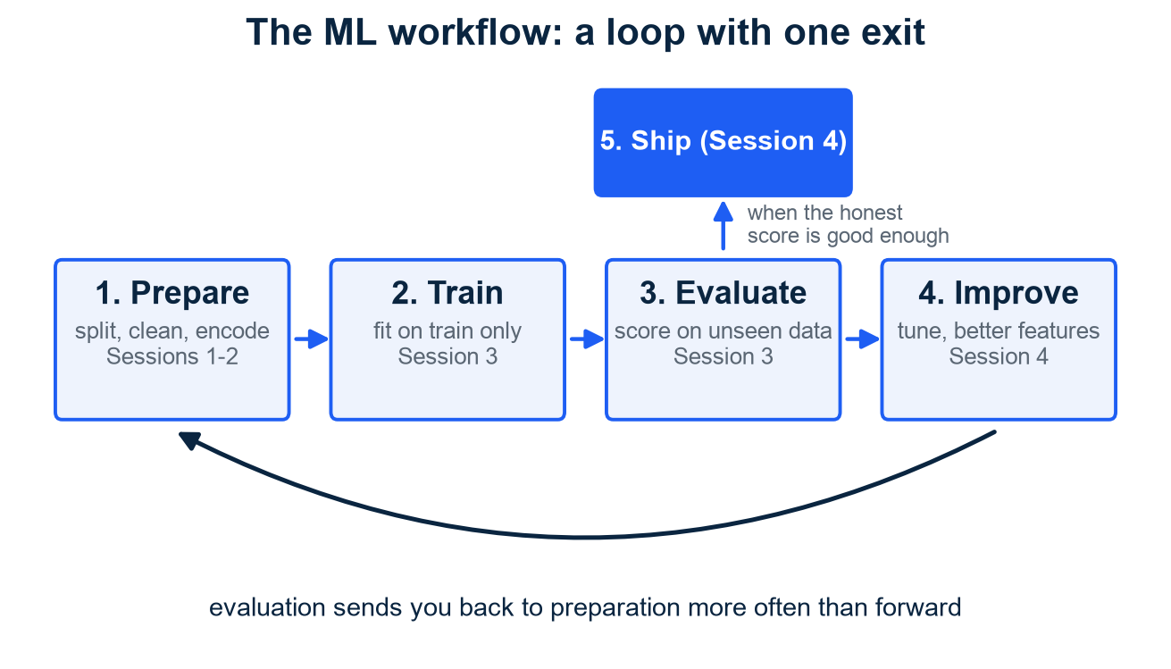
THE WORKFLOW
The ML workflow is a loop, not a line - you will walk it all module
Prepare: split, clean, encode, scale (Sessions 1-2) - today you started it on the 891-row manifest
Train: fit models on the training set only (Session 3)
Evaluate: score on data the model has never seen (Session 3)
Improve, then ship: tune, engineer, deploy (Session 4)
Evaluation sends you back to preparation more often than forward
Harvard teaches it as a five-stage loop - ask, get, explore, model, communicate: modeling is one box of five, and answers routinely send you back a stage
Harvard CS109A teaches the same shape: one workflow revisited all semester on messy real data. Source: Harvard CS109A, Lecture 1 (the data science process).
M2 Session 1 - Machine Learning Fundamentals
17

Slide 18
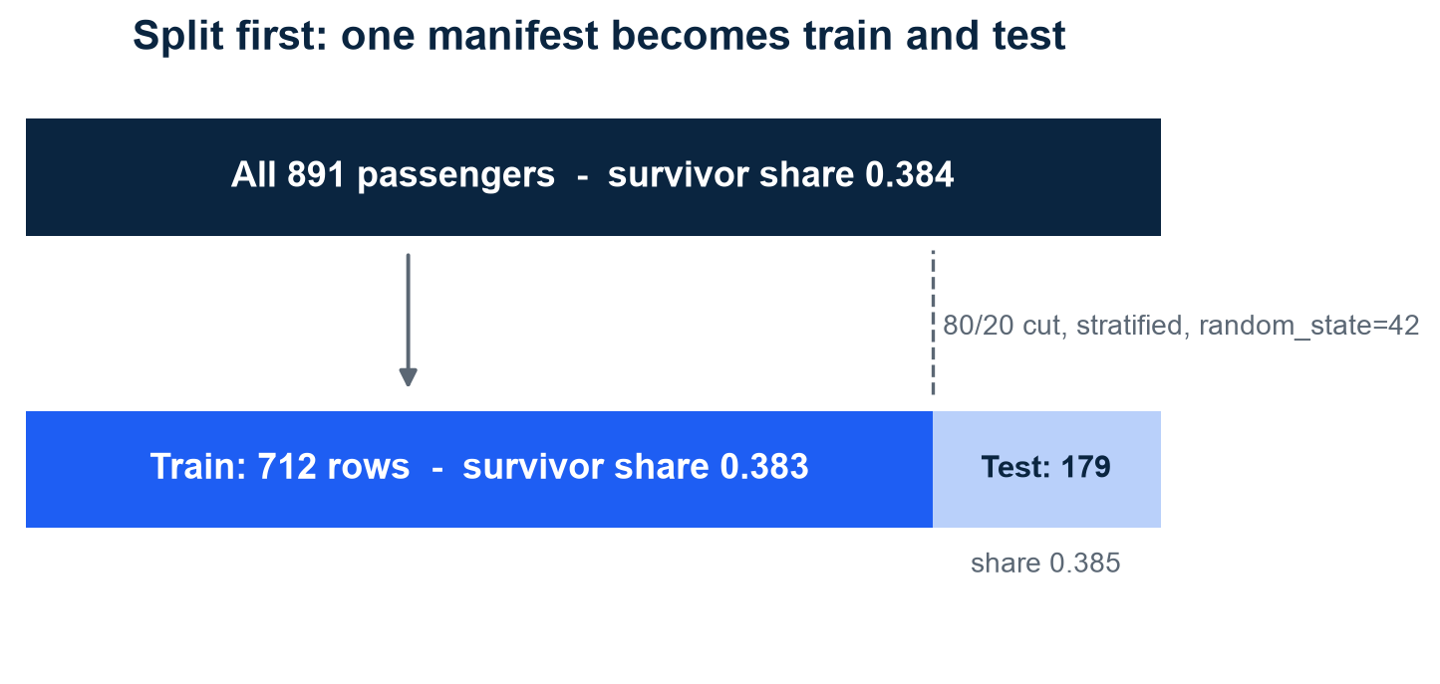
THE GOLDEN RULE
Split before you prepare - even an innocent average can leak
80/20 split first: 712 training rows, 179 test rows (seed 42)
Data leakage = test-set information sneaking into training - even 'fill missing ages with the average' leaks if that average used all rows
Analogy: the test set is the final exam - seeing the questions while studying inflates your score and proves nothing
stratify=y keeps the survivor share equal in both halves
Leakage bites professionals: KDD Cup 2008 teams found 'Patient ID' predicted breast cancer - the ID encoded which hospital, not the tumor
A feature that works suspiciously well deserves suspicion, not celebration
The split and the preserved survivor share. Source: Module 2, notebook 01, section 3. Leakage story: Kaufman, Rosset & Perlich, 'Leakage in Data Mining', KDD 2011.
M2 Session 1 - Machine Learning Fundamentals
18

Slide 19
HONEST EVALUATION PREVIEW
In this module, 'good' means a number - and the floor is 0.617
0.617
Accuracy of a model that always predicts 'died' - the baseline floor every real model must beat
Dummy classifier, 5-fold cross-validation on the training set. Source: Module 2, notebook 02. Beating the floor is the entry ticket, not the goal. Accuracy is 0-1 loss in disguise - the simplest filling of the recipe's loss slot (MIT 6.390, Intro chapter).
M2 Session 1 - Machine Learning Fundamentals
19

Slide 20
You now predict, not describe - and every claim gets a number
Part 1, the ideas: ML learns rules from labeled examples - a leap from seen cases to unseen ones, licensed by one assumption (new data looks like old)
You choose the hypothesis class; every learner = model + loss + optimizer, and training = making one number (the cost J) small
Y = f(X) + ε: we estimate the hidden rule, we never beat the noise
Part 2, the manifest: 891 passengers, split first - 712 train / 179 test, stratified; the test set is the exam you take once
Every claim gets a number, and the floor is 0.617
Practice now, zero setup: open notebook 01 in Colab (badge click), Runtime > Run all, work sections 1-3 - exercises at the end, solutions included, attempt them first
Machine Learning - Module 2
M2 Session 1 - Machine Learning Fundamentals
20

