Slide 1
SESSION 2 OF 4
Data Preparation and Feature Engineering
The manifest - the ship's passenger list - is messy: 177 missing ages, titles buried inside names, scales that disagree. Today we turn passengers into signals - without cheating.
Machine Learning - Module 2

Slide 2
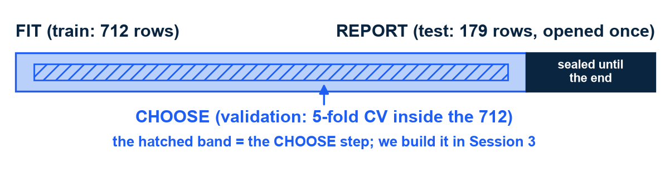
RECAP AND ROADMAP
One bar rules the module: FIT on train, CHOOSE by validation, REPORT on test - once
Last time: 891 passenger rows, split 80/20 - 712 train, 179 test (stratified, seed 42)
How to read the bar: pale band = the 712 training rows; dark block = the 179 test rows, sealed
The hatched stripe sits INSIDE training: validation - practice tests, built in Session 3
Exam terms: study on train, pick your strategy with practice tests, sit the final once
Anything learned FROM data - a fill-in value, a scaler - is part of the model
So it must never see the test rows. Today lives entirely in the FIT band
The bar every session returns to. Harvard CS109A / ISLR ch. 5 (model selection vs model assessment).
M2 Session 2 - Data Prep and Feature Engineering
2
Notes:
Teach the bar itself before the rules: the pale band is the 712 training rows, the dark block is the 179 test rows kept sealed, and the hatched stripe inside training is validation - the practice tests we build in Session 3. Then the exam metaphor: study on train, pick your strategy with practice tests, sit the final once. Today never leaves the study material - every value we compute comes from the 712 training rows. Ask the class: why does even an average count as 'part of the model'?

Slide 3
01
Part 1 - The theory: turning passengers into rows of numbers
A row of numbers is called a vector. Before any code: the model only sees the numbers you construct - gaps, encodings, scales, and new columns are design decisions, not chores
M2 Session 2 - Data Prep and Feature Engineering
3

Slide 4
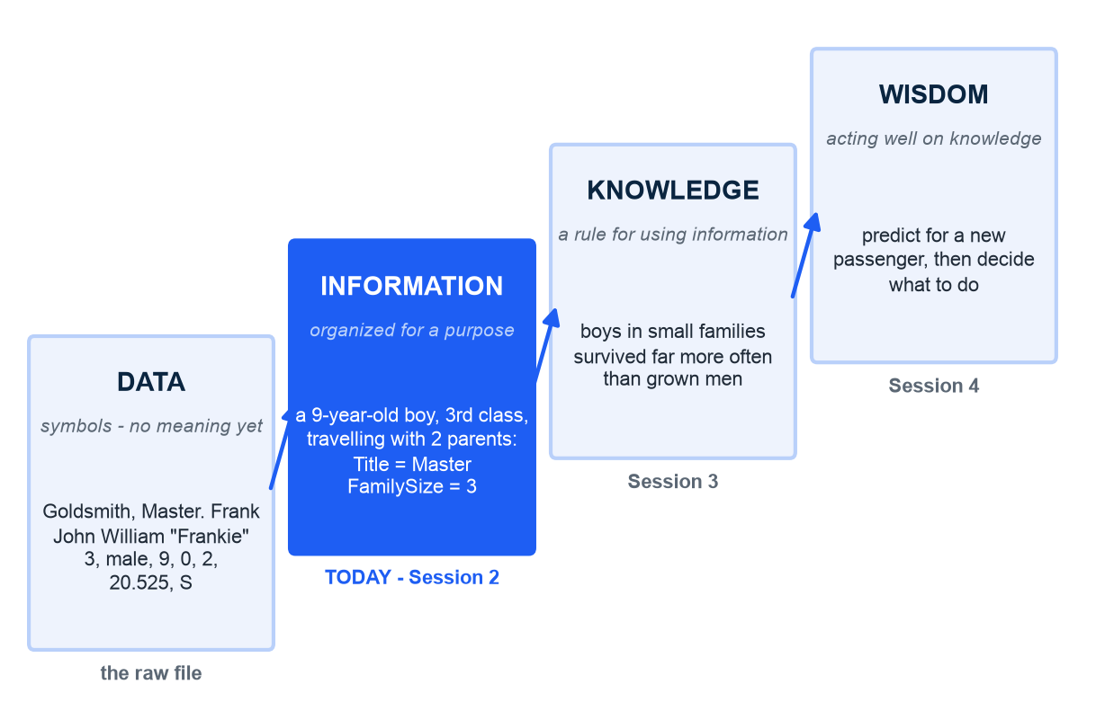
DATA, INFORMATION, KNOWLEDGE
Preparation is the step from data to information - the model cannot take it for you
How to read it: four rising boxes, one real passenger climbing them; the blue box is today
Data, in plain words: symbols with no meaning yet - '3, male, 9, 0, 2, 20.525, S'
Information: the same symbols organized for a purpose - a 9-year-old boy travelling with two parents
Knowledge: a rule for using information - Session 3 learns it; wisdom: acting well on it - Session 4 ships it
Kitchen terms: raw ingredients, prepared ingredients, the recipe, the meal served
Today's whole job is step one to step two - and no algorithm does it for you
Illustration - the data-information-knowledge-wisdom ladder. Ackoff, 'From Data to Wisdom', Journal of Applied Systems Analysis, 1989. Passenger: PassengerId 166, fields verbatim.
M2 Session 2 - Data Prep and Feature Engineering
4
Notes:
Start from the raw row and read it aloud as symbols: 3, male, 9, 0, 2, 20.525, S - it means nothing until you know what each position is. Organize it for a purpose and it becomes information: a nine-year-old boy in third class travelling with two parents - Title Master, FamilySize 3. A rule for using that information is knowledge - Session 3's model learns it; acting well on the rule is wisdom - Session 4's app. Kitchen line: raw ingredients, prepared ingredients, recipe, meal. Ask the class: which step did M1's dashboards stop at?

Slide 5
WHY THIS SESSION EXISTS
Skimping on this step is the most common way real ML projects fail
92%
of AI practitioners in a Google study had lived through at least one 'data cascade' - a data flaw that surfaced late, as a model failure
In plain words: a cascade is a small data problem that grows as it flows downstream - a typo in a recipe's first line. 53 practitioners interviewed; 45% reported two or more per project. Sambasivan et al., 'Everyone wants to do the model work, not the data work', CHI 2021. Time budget: loading and cleaning data take about 45% of a data scientist's day (Anaconda, State of Data Science 2020).
M2 Session 2 - Data Prep and Feature Engineering
5
Notes:
The number first: 92 out of 100 practitioners in a Google Research study had lived through a data cascade - a small data flaw that surfaced late and expensively as a model failure. The paper's title says the rest: everyone wants to do the model work, not the data work. Then the time budget: about 45% of a data scientist's day goes to loading and cleaning. Today is that 45%. Ask the class: name one gap in the manifest that could become a cascade if we ignored it.

Slide 6
DATA QUALITY: THE THEORY
Data quality is more than accuracy - each manifest column fails a different dimension
Dimension (in plain words) | On the manifest | What we do today
Completeness - are the values there? | Age blank in 177 rows; Cabin blank in 687 of 891 | Impute Age from train; drop Cabin
Accuracy - are they right? | 18 ages end in .5 - the file's mark for an estimated age; 15 fares read 0.00 | Keep, but remember Session 1's noise floor
Consistent representation - same thing, same form? | Embarked is letters C/Q/S, Sex is words, Fare is numbers | One-hot the letters, scale the numbers
Relevance - does it bear on the question? | PassengerId and Ticket carry no signal about survival | Drop them
Appropriate amount - the right level of detail? | Name is raw text; 14 different titles hide inside it | Mine Name for Title, group 14 into 5 buckets
Believability - would you trust it? | A fare of 0.00 - free ticket, staff perk, or missing? | Flag it and ask someone who knows the domain
Dimensions from Wang & Strong, 'Beyond Accuracy: What Data Quality Means to Data Consumers', J. of Management Information Systems, 1996. Counts computed on the full 891-row file; the .5 rule is the dataset's own convention for estimated ages.
M2 Session 2 - Data Prep and Feature Engineering
6
Notes:
Kitchen line: inspect the ingredients before you cook. Read one row at a time and say the dimension in plain words first - is the value there, is it right, is it in the same form, does it matter, is it the right level of detail, would you trust it. Every Titanic column fails a different one, and every failure maps to one of today's moves. Ask the class: 15 fares read 0.00 - which dimension is that, and what would you do before imputing?

Slide 7
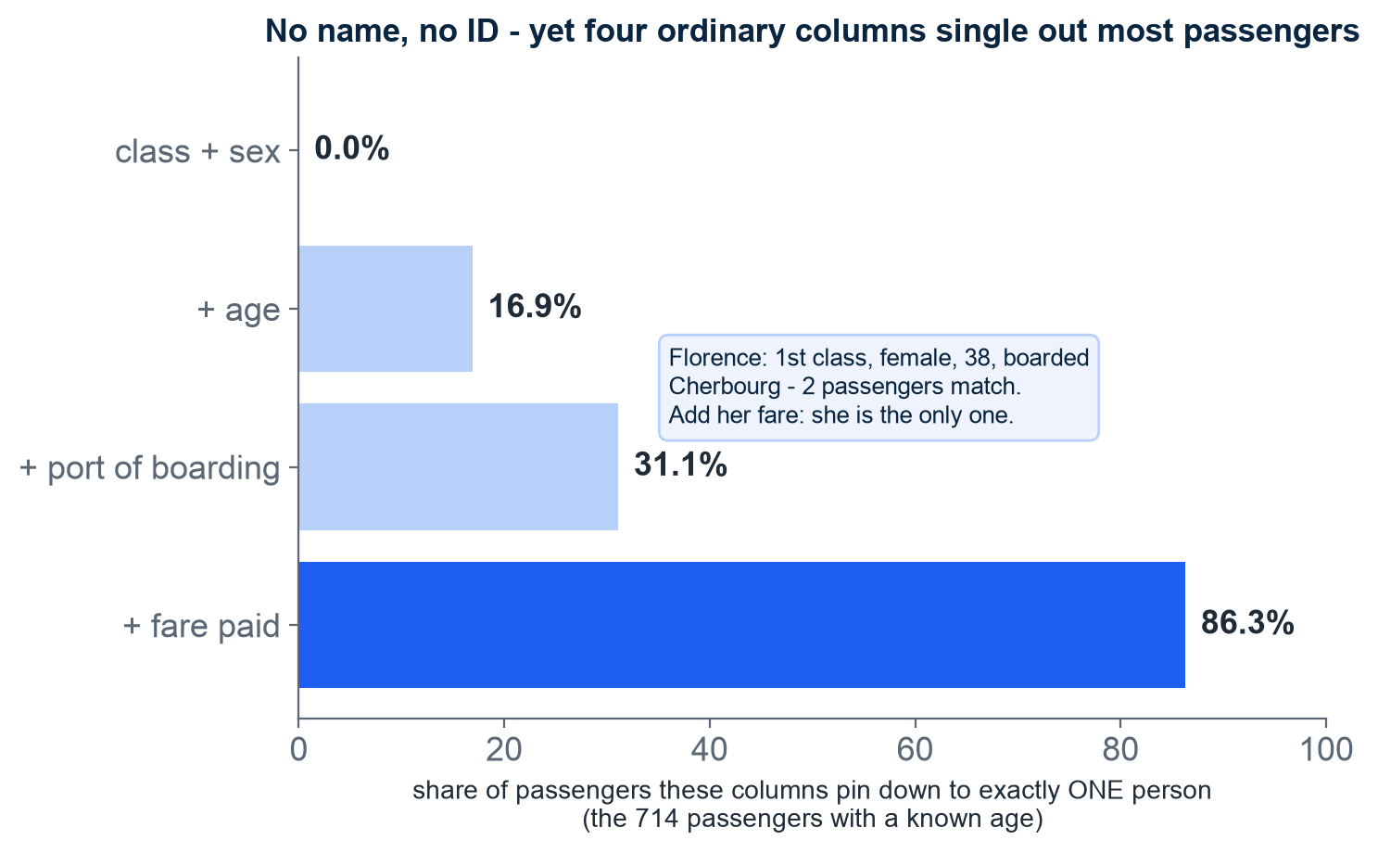
DATA YOU MUST HANDLE WITH CARE
Dropping the Name column is not anonymisation - four ordinary columns single out 86% of passengers
We drop Name and PassengerId today - the model does not need them
How to read it: each bar adds one column; bar length = share of passengers left standing alone
Class + sex + age + port already pins down 31%; add the fare paid, 86%
In plain words: quasi-identifiers are columns that are not names but together point at one person
Sweeney (2000): ZIP code + birth date + sex uniquely identify 87% of Americans
The Titanic is public history; your customers' tables are not - keep only the columns the question needs
Counts computed on the course dataset (714 passengers with a known age). Sweeney, 'Simple Demographics Often Identify People Uniquely', Carnegie Mellon, 2000.
M2 Session 2 - Data Prep and Feature Engineering
7
Notes:
Ground it in a name they know: Florence Cumings. Drop her name and ID, keep class, sex, age and port - only two passengers on the whole ship match her; add her fare and she is alone. Read the bars: each adds one ordinary column, and the share of passengers standing alone jumps from 0 to 86%. Sweeney showed the same for Americans with ZIP code, birth date and sex. The Titanic is public history, so this is a lesson, not a leak; their future customer tables are different. Ask the class: which of today's engineered columns makes a passenger easier to single out?

Slide 8
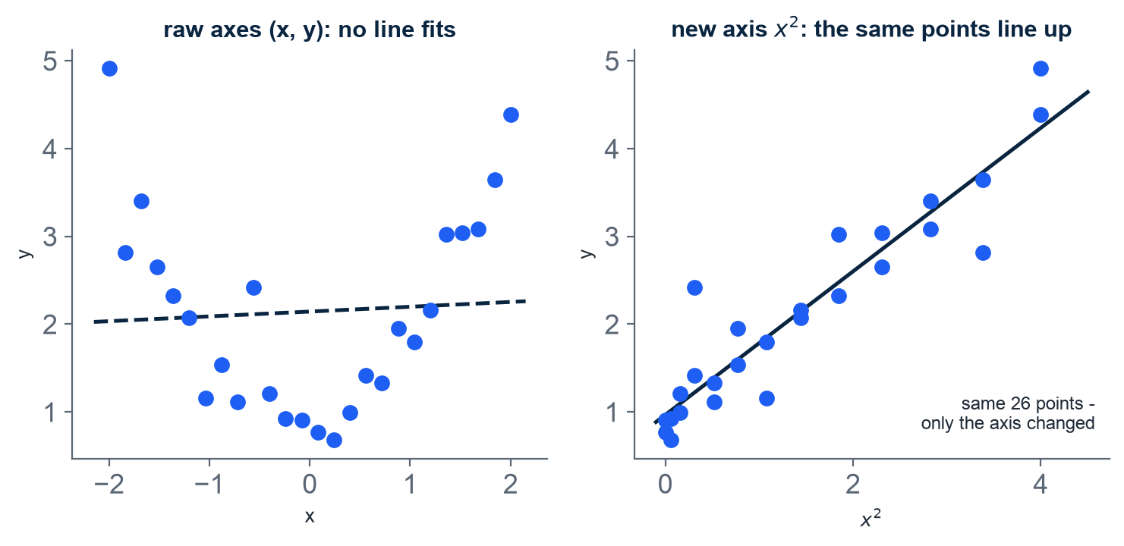
FEATURE REPRESENTATION
The model only sees the numbers you construct - representation comes first
The model never meets a passenger - it meets a row of numbers built to stand for one
That row is the representation: the numbers you choose to describe each passenger
How to read the charts: each dot is one example; the line is the best straight line
Left: plotted against x, no straight line fits the dots
Right: the SAME dots against x squared - now they line up
The dots never move; only the axis changes - good columns beat fancy algorithms
Same 26 synthetic dots in both panels; only the horizontal axis changes. MIT 6.390, ch. 5 "Feature representation".
M2 Session 2 - Data Prep and Feature Engineering
8
Notes:
The model never meets Frankie - it meets the row of numbers you built to stand for him, and that row is its entire world. Point at the two panels: the dots never move, only the axis changes, and suddenly a straight line fits. That is the whole chapter in one picture. Ask the class: if the model only sees the numbers, who is responsible when it sees the world wrongly?

Slide 9
WHY PREPARATION EXISTS
Models are picky eaters: they want numbers only, no gaps, sensible scales
The model demands | Raw Titanic reality | The fix
Numbers only | Sex is "male"/"female"; Embarked is C/Q/S; Name is free text | Encoding: turn categories into 0/1 columns
No gaps | Age missing in 177 of 891 rows (19.9%); Embarked missing in 2 | Imputation: fill gaps with a value learned from train
Sensible scales | Age runs 0 to 80 while Fare runs 0 to 512 - Fare shouts, Age whispers | Scaling: put features on a comparable ruler
Why so picky? A model sees each passenger as a point in space, one axis per column - words and gaps have no place on an axis. Impute = fill a gap with a learned substitute. Counts: Module 2, notebook 1.
M2 Session 2 - Data Prep and Feature Engineering
9
Notes:
The kitchen line: models are picky eaters - they only eat numbers, refuse plates with gaps, and complain when portions are on wildly different scales. Each row of the table is one complaint and its fix: encoding, imputation, scaling. Ask the class: what would the model make of the word 'Southampton' if we fed it raw?

Slide 10
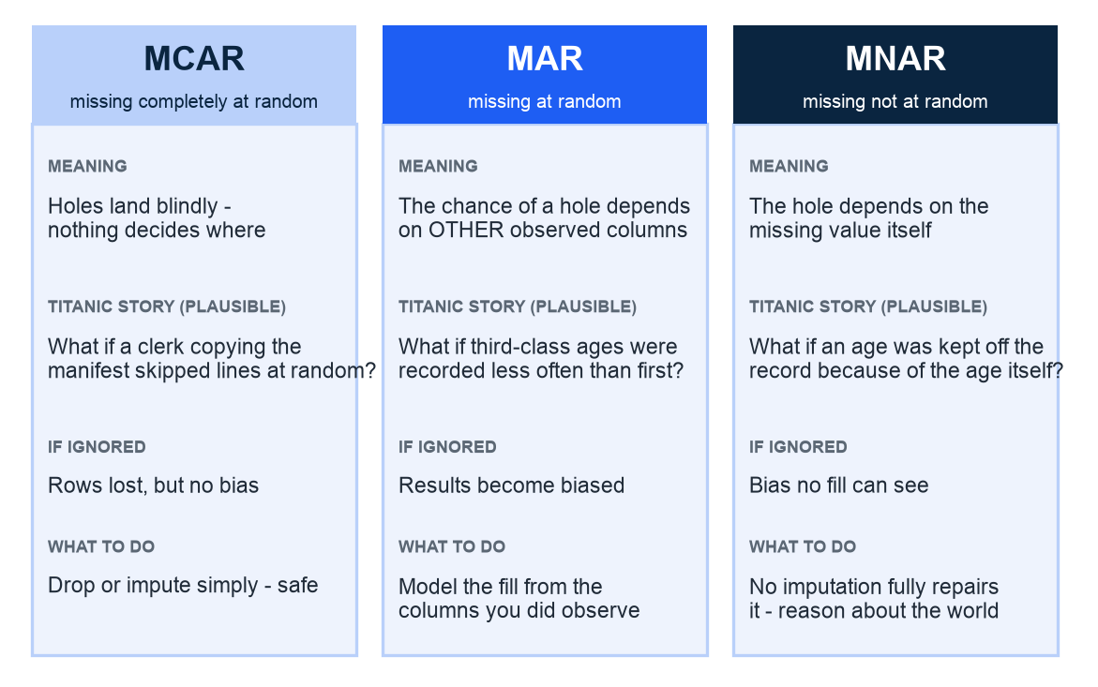
MISSING VALUES: THE THEORY
Missing values come in three species - and the data cannot tell you which
Our table is missing 177 of 891 ages. WHY a hole exists matters
How to read: one card per species - meaning, a Titanic story, the risk, the fix
MCAR: holes poked blindfolded - nothing decides where they land
MAR: holes cluster by ANOTHER column you can see (class, say)
MNAR: the hidden value itself caused the hole - the nastiest kind
The data alone cannot tell you which. Discuss: which are our 177?
Each Titanic story is plausible, not asserted. Harvard CS109A, Missing Data lecture (2020, L19).
M2 Session 2 - Data Prep and Feature Engineering
10
Notes:
Ground it first: 177 of our 891 ages are simply blank - the question is WHY. Walk the cards left to right; each card gives the meaning, a plausible Titanic story, the risk, the fix. Harvard's device: MCAR is poking holes in the table blindfolded - annoying but fair. MAR holes cluster where another visible column points, so ignoring them biases you. MNAR holes are caused by the very value that is missing - no fill can see that. The deciding information is missing by definition, so the table cannot settle it. Run the discussion: which species are our 177 missing ages? Any argued answer beats a certain one.

Slide 11
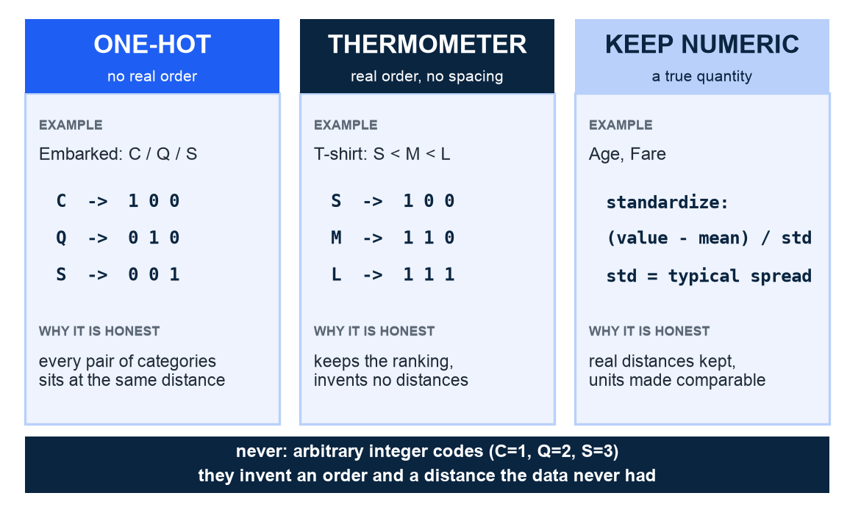
ENCODING: THE THEORY
Three honest encodings: one-hot labels, thermometer ranks, standardized numbers
The manifest says Embarked = S. The model needs numbers, not letters
Encoding = translating categories into numbers, without inventing facts
How to read: one card per code - when it applies, the translation, why it is honest
One-hot (no real order): each category gets its own 0/1 column
Thermometer (order, no spacing): keeps the ranking S < M < L, nothing more
Keep-numeric (true quantities): Age and Fare stay numbers
The navy strip is the trap: C=1, Q=2, S=3 claims S is three times C
Illustration - the encoding menu. MIT 6.390, ch. 5, sec. 5.3 "Hand-constructing features".
M2 Session 2 - Data Prep and Feature Engineering
11
Notes:
Start concrete: the manifest literally says 'S' in the Embarked column, and the model cannot eat letters. Walk the three cards left to right, then the navy strip at the bottom - the forbidden move. Frame encoding as translation into the only language the model speaks - numbers - and honesty as translating without adding claims. Coding red=1, blue=2 quietly tells the model blue is twice red; it will believe you. One-hot claims nothing, the thermometer claims only order, keeping a real number claims real distances. Ask the class: is T-shirt size S/M/L more like Embarked or more like Age?

Slide 12
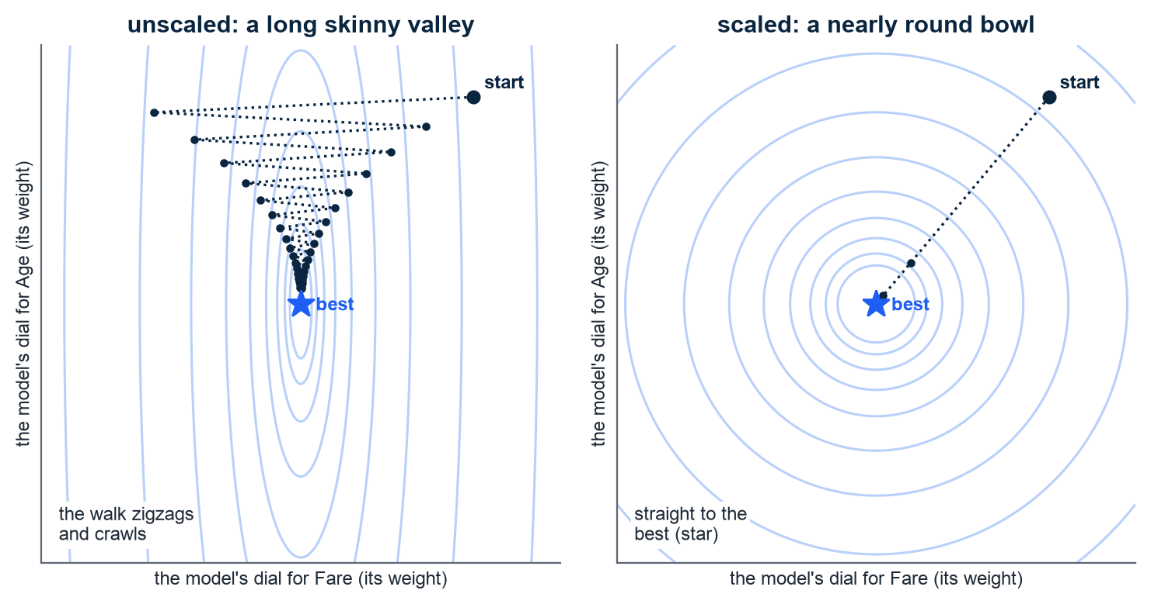
FEATURE SCALING: THE WHY
Scaling does not change the destination - it straightens the road to it
Fare runs 0 to 512, Age 0 to 80 - to the model, Fare shouts and Age whispers
Each picture is a map of the search for the best settings: every ring = settings scoring the same; the star = the best; the dots = training's steps
Unscaled: the map is a long skinny valley - the search zigzags and crawls
Scaled: the map turns round - the search walks straight to the star
Scaling never changes the answer - only how fast and surely you find it
Illustration - a schematic map of the search, not course data. Ng, Machine Learning Specialization C1W2.
M2 Session 2 - Data Prep and Feature Engineering
12
Notes:
Ground it first: Fare runs 0-512 and Age 0-80, so to the model Fare shouts and Age whispers. Then teach the picture before the moral: each panel is a map of the search for the best settings - one ring joins settings that score the same, the star is the best setting, the dotted trail is training's steps from the 'start' marker. Unscaled, the map is a skinny valley: the walk zigzags and crawls. Scaled, it is a round bowl: straight to the star. The destination never moves - only the trip changes. Ask the class: which of our columns stretches the valley worst?

Slide 13
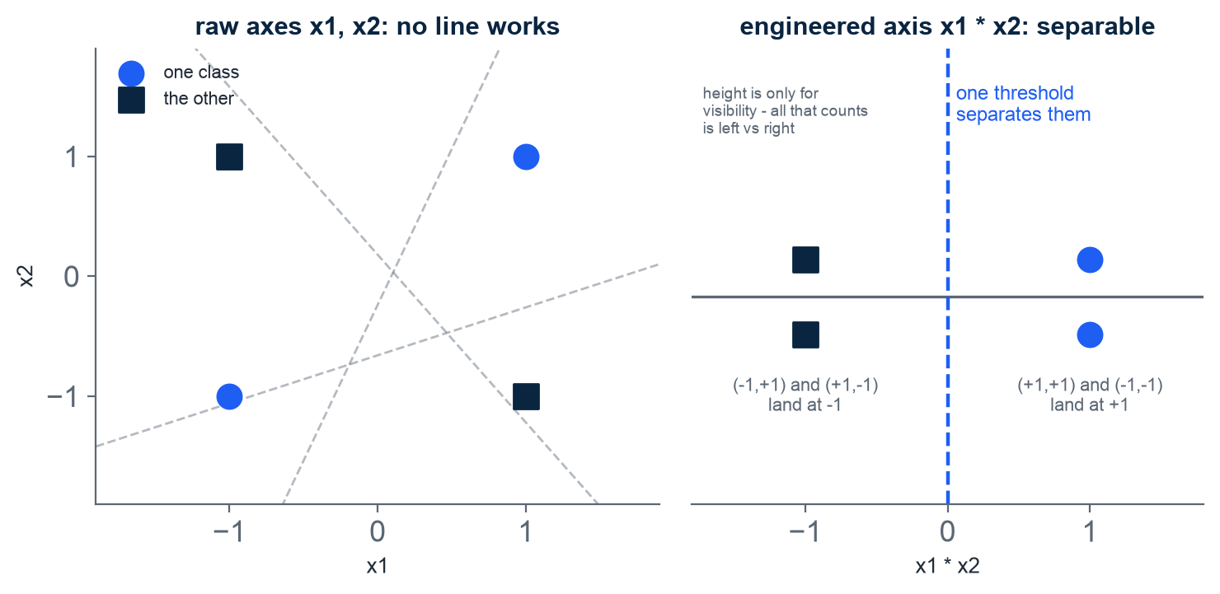
FEATURE ENGINEERING: THE GEOMETRY
One engineered column, x1 times x2, splits four points no line ever could
Four points, two facts each (x1, x2) - every value +1 or -1
How to read: blue circles = one class, dark squares = the other
Left: the gray dashed lines are failed tries - no straight line can split circles from squares
Right: re-plot each point by ONE new number, x1 times x2, on a number line
Circles land at +1, squares at -1 - one cut separates them
We never changed the model - we changed the space it looks at
Part 2 repeats the move on the manifest: Title and FamilySize
Illustration - the classic XOR construction. MIT 6.390, ch. 5.
M2 Session 2 - Data Prep and Feature Engineering
13
Notes:
Walk the picture slowly: four corner points - blue circles are one class, dark squares the other - and diagonal corners share a class, so no straight line will ever split them; let students try (the gray dashed lines are failed tries). Then multiply the two coordinates into one new column and the four points sort themselves onto two spots a single threshold separates. We never touched the model - we changed what it looks at. Ask the class: did the model get smarter, or did the world get simpler?

Slide 14
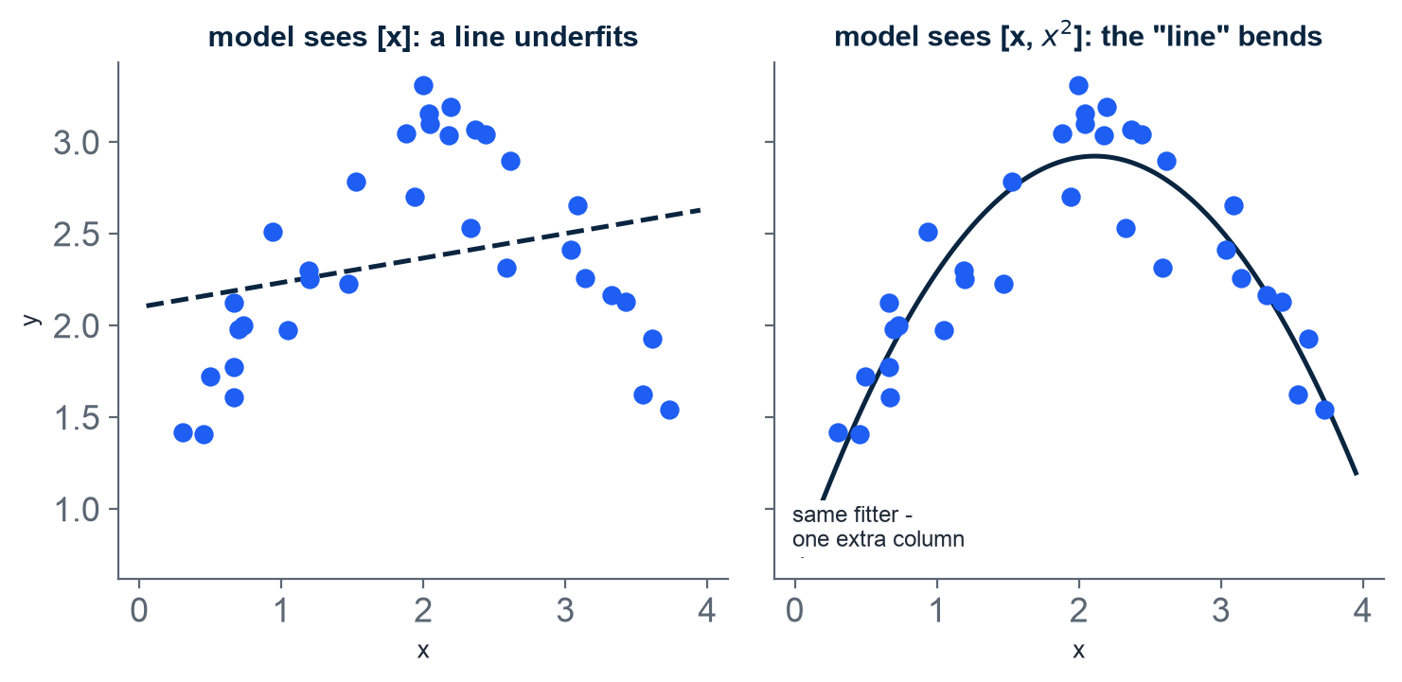
BASIS EXPANSION
Add an x-squared column and the straight line learns to curve
These dots rise, then fall - one straight line cannot follow that
How to read: the same dots in both panels; left, the model sees only the column x
Right: append ONE new column, x squared - the same fitter now bends
Kitchen terms: same cook, one extra ingredient - now it can cook curves
This is basis expansion: add powers and products of columns you already have (XOR's x1 times x2 is the same family)
The price: every extra column can chase noise - Session 3 counts that cost
Illustration - one fitter, two feature tables, synthetic points. Harvard CS109A, Lecture 4 "Polynomial Regression" / ISLR.
M2 Session 2 - Data Prep and Feature Engineering
14
Notes:
Point at the dots first: they rise and then fall, and a ruler cannot follow that - the dashed line on the left proves it. Then the kitchen: the line is the cook, the columns are the ingredients. Hand the cook x squared as one more ingredient and the same recipe starts producing curves - no new cook, no new technique. But every extra ingredient is also freedom to cook nonsense that matches noise; Session 3 puts a price on that. Ask the class: what column would you hand the line so it could bend twice?

Slide 15
02
Part 2 - Practice: preparing the manifest
The theory applied to 891 passengers: fit on the 712 training rows only, engineer Title and FamilySize, and wire every step into one leak-proof pipeline
M2 Session 2 - Data Prep and Feature Engineering
15

Slide 16
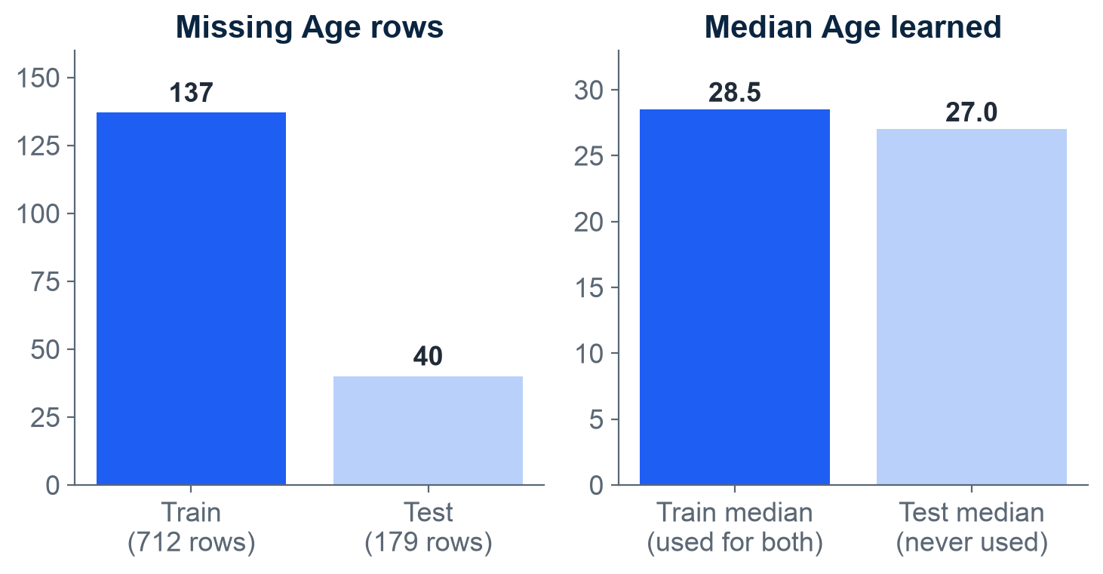
MISSING VALUES THE ML WAY
Fill gaps with a value learned from train only - the test median stays untouched
Age is blank in 137 train rows and 40 test rows (left chart)
Median = the middle value. The 712 train rows say: median Age 28.5
That one number, 28.5, fills every gap - in train AND in test
The test-only median, 27.0, is "exactly the information we refuse to use"
In code: SimpleImputer(strategy="median") - fit on train, transform both
Embarked, 2 gaps: strategy="most_frequent" learns "S" from train
Left: rows with Age blank. Right: each half's median - only train's is ever used. Module 2, notebook 1.
M2 Session 2 - Data Prep and Feature Engineering
16
Notes:
Ground it in the chart: 137 blank ages in train, 40 in test. The median is just the middle value, and only the 712 training rows may vote: they say 28.5, and that one number fills every gap in both halves. The test rows' own median, 27.0, is exactly the information we refuse to use - the test set is the future, and you cannot compute statistics on data you have not seen yet. Same rule for Embarked's 2 gaps: most_frequent learns 'S' from train. Ask the class: what would be wrong with filling test gaps with 27.0?

Slide 17
ENCODING CATEGORICAL FEATURES
One-hot gives each category its own 0/1 column - and the training set fixes the columns once
Passenger | Embarked | Embarked_C | Embarked_Q | Embarked_S
1 | S | 0 | 0 | 1
2 | C | 1 | 0 | 0
3 | Q | 0 | 1 | 0
4 | S | 0 | 0 | 1
Read one row: Passenger 2 boarded at C, so Embarked_C is 1 and the other two are 0 - exactly one column is 'hot' per row
fit(train) fixes the column layout once; transform(test) always reproduces those same columns
handle_unknown="ignore": an unseen category becomes all zeros - no crash
pd.get_dummies instead builds columns from whatever it happens to see - train and test drift apart (the notebook demo misaligns them)
Part 1's menu chose for us: Embarked has no real order, so one-hot - never C=1, Q=2, S=3. Module 2, notebook 1.
M2 Session 2 - Data Prep and Feature Engineering
17
Notes:
Read one row of the table aloud: Passenger 2 boarded at C, so the C column gets the 1 and the others get 0 - that lone 1 is why it is called one-hot. No order, no distance is invented; Part 1's menu chose this because Embarked has no real order. Then the trap: pd.get_dummies rebuilds columns from whatever data it sees, so train and test can drift apart; the sklearn encoder fixes the layout at fit(train) and reproduces it forever. Ask the class: what should happen to a port the training set never saw?

Slide 18
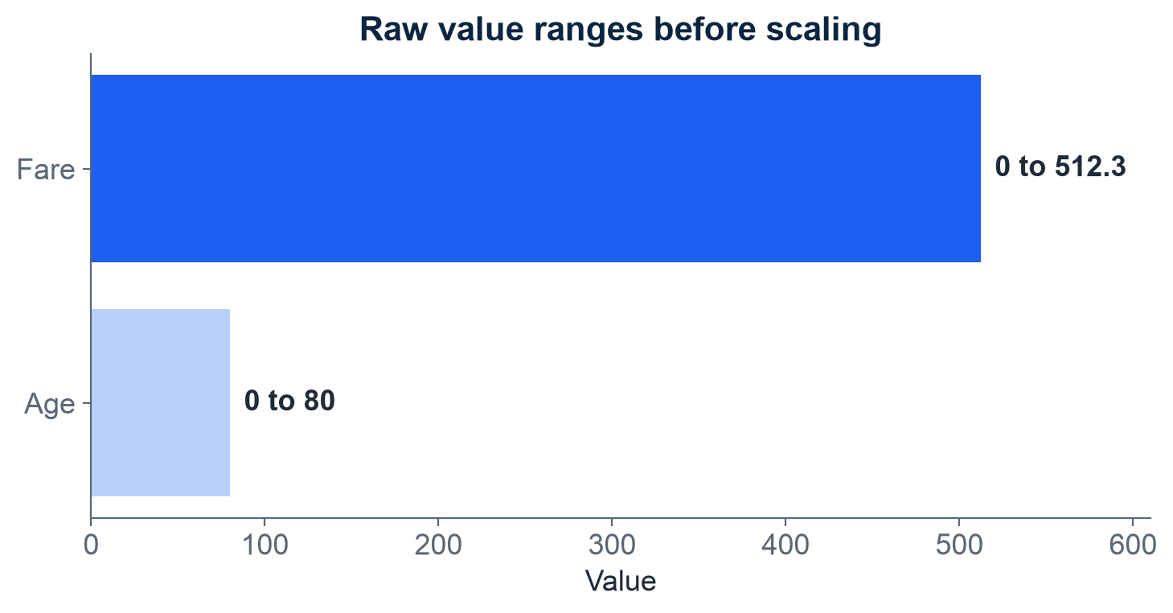
FEATURE SCALING
Scaling re-labels the ruler: distance models care, trees never notice
Look right: Fare runs 0 to 512, Age 0 to 80 - Fare shouts, Age whispers
Distance and equation models (KNN, Logistic Regression) hear only the shouting axis: raw Fare gaps drown out Age gaps
Trees only ask yes/no questions - "is Fare > 30?" - so scale never matters to them
StandardScaler re-expresses values as 'how far from average': Fare becomes mean -0.00, std 1.00
MinMaxScaler instead squeezes Fare into 0.0 to 1.0
The histogram's shape never changes - scaling only re-labels the ruler
Each bar = one column's raw range in the training set. Module 2, notebook 1.
M2 Session 2 - Data Prep and Feature Engineering
18
Notes:
Same grounding as Part 1: Fare shouts (0-512), Age whispers (0-80) - the chart makes the mismatch physical. Models that measure distances or weigh sums (KNN, Logistic Regression) hear only the loud axis; trees just ask yes/no questions like 'is Fare > 30?', so they never notice. StandardScaler re-expresses each value as 'how far from average' - the mean and standard deviation from M1 are exactly the two numbers it learns from train; MinMaxScaler squeezes into 0-1. Either way the histogram's shape is untouched - only the ruler's labels change. Ask the class: which of our six models from the next session will care?

Slide 19
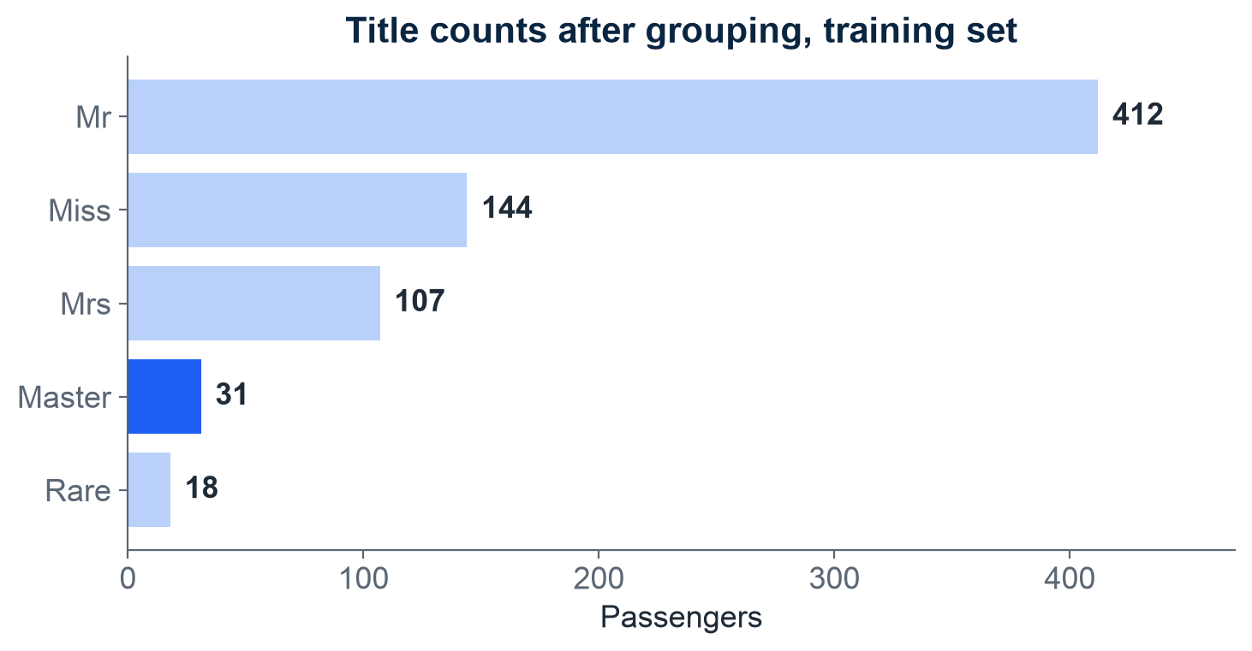
FEATURE ENGINEERING: TITLE
Title packs sex, age, and status into one column - and finds the boys
Every Name hides a title: "Cumings, Mrs. John Bradley" contains Mrs
Name is unstructured text inside a structured table - free text has no column until you build one
A regex (a text-search pattern), " ([A-Za-z]+)\.", grabs the word before the period
14 raw titles group into 5 buckets: Mr, Miss, Mrs, Master, Rare - the chart counts them
Frankie, age 9, is a "Master" - the old title for a young boy
Sex alone calls Owen (22) and Frankie (9) both male - Title tells the man from the boy
Signal check: Mrs and Miss survived far more often than Mr; Master sits well above adult men
Grouped Title counts, training set (712 rows). Master highlighted: the boys the Sex column hides. Module 2, notebook 1.
M2 Session 2 - Data Prep and Feature Engineering
19
Notes:
Start from a real name: 'Cumings, Mrs. John Bradley' - the title Mrs is sitting right there in the text. The regex just grabs the word before the period; 14 raw titles collapse into five buckets. The payoff is Master, the old-fashioned title for a young boy: to the Sex column, Owen (22) and Frankie (9) are both simply 'male', but Title tells the man from the boy - which mattered a lot on a sinking ship. Signal check before keeping any new column: Mrs and Miss survived far more often than Mr, and Master sits well above adult men.

Slide 20
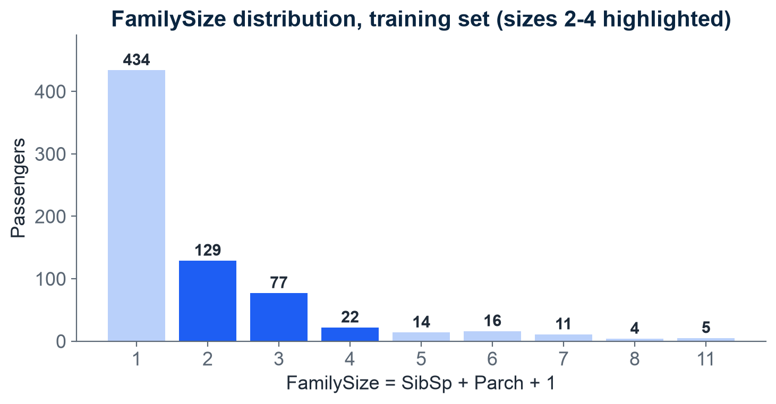
FEATURE ENGINEERING: FAMILYSIZE
FamilySize = SibSp + Parch + 1 - small families of 2 to 4 fared best
FamilySize = SibSp (siblings/spouses) + Parch (parents/children) + 1: you count yourself
Owen: 1 + 0 + himself = 2. Frankie: 0 + 2 + himself = 3
IsAlone = 1 when FamilySize is 1 - true for 434 of 712 training passengers
Chart: one bar per family size, counting passengers; the blue bars are sizes 2 to 4
Those small families fared best; solo travelers and very large families fared badly
More features is not automatically better - always check for signal
FamilySize distribution, training set. Blue bars: the sizes that fared best. Module 2, notebook 1.
M2 Session 2 - Data Prep and Feature Engineering
20
Notes:
One addition, one new column: siblings/spouses plus parents/children plus yourself. Work the two passengers: Owen has a sibling aboard, so 1+0+1 = 2; Frankie has two parents aboard, so 0+2+1 = 3. IsAlone flags the 434 solo travelers - more than half the training set. On the chart, the blue bars (sizes 2-4) are the families that fared best; solo travelers and the very large families fared badly. Close with the discipline: a new column earns its place only if it carries signal.

Slide 21
FEATURE ENGINEERING, ATTRIBUTED
Multiply two weak columns and you can get one strong feature - Ng's area example
Andrew Ng - Machine Learning Specialization
The same move on the Titanic
A house lot has a street-facing width (x1, the 'frontage') and a depth (x2)
New feature: x3 = x1 * x2 = the lot's area
Exactly Part 1's x1 * x2 move, in Ng's own example
Area often predicts price better than width or depth alone
One multiplication - no new data collected
SibSp + Parch + 1 = FamilySize: one column beats two
Name -> Title: sex, age, and status compressed into one
Master = young boy: a signal Sex and Age only hint at
Good features often improve a model more than a fancier algorithm
Ng's rule for inventing features, paraphrased: use knowledge or intuition about the problem to design new columns. Ng, Machine Learning Specialization.
M2 Session 2 - Data Prep and Feature Engineering
21
Notes:
Ng's own example, in plain terms: a house lot has a width facing the street (the 'frontage') and a depth. Multiply them and you get the area - one new column, often more predictive than either raw one, and no new data collected. Then mirror it on the Titanic: SibSp + Parch + 1 became FamilySize, and Name became Title. Same rule both times: use knowledge about the problem to design new columns. Ask the class: what other Titanic column pair might multiply into something useful?

Slide 22
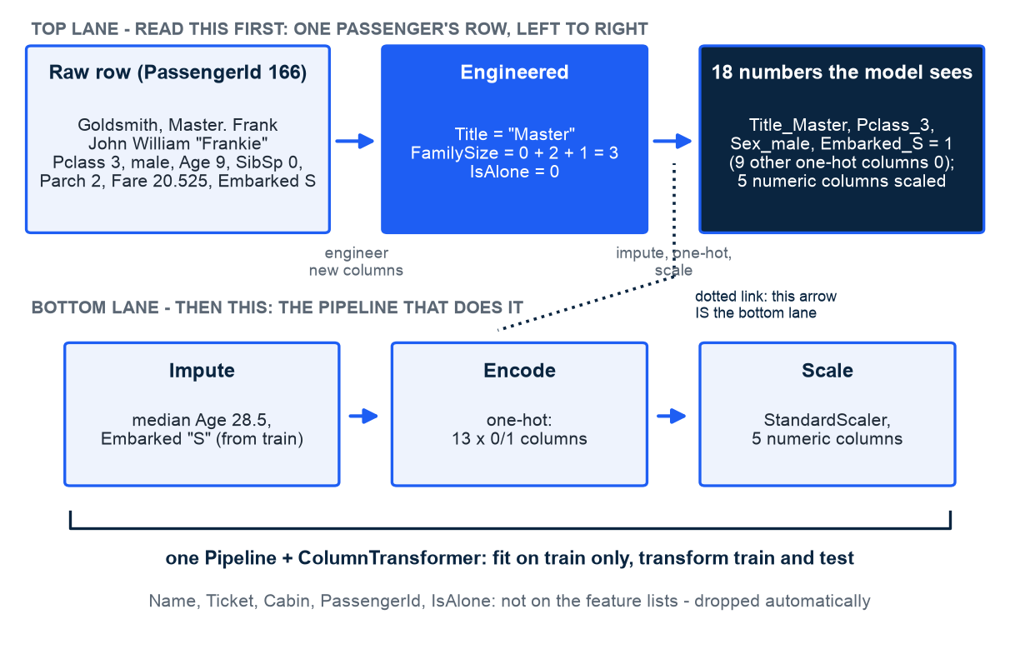
PUTTING IT ALL TOGETHER
Frankie walks the pipeline: raw row in, 18 leak-proof numbers out
Read the top lane first: Frankie's one raw row becomes 18 numbers, left to right
Then the bottom lane: the machinery - impute gaps, encode categories, scale numbers
The dotted link: the top lane's last arrow IS the bottom lane
fit_transform(train) learns every step's values; transform(test) only applies them
Engineers call this shape ETL - extract, transform, load; one Pipeline, no leakage, nothing forgotten
IsAlone is computed but not on the feature lists - the ColumnTransformer drops it
PassengerId 166, raw fields verbatim from the dataset. The canonical prep, reused verbatim by Sessions 3 and 4. Module 2, notebook 1.
M2 Session 2 - Data Prep and Feature Engineering
22
Notes:
Give the reading order out loud: top lane first - one real boy, Frankie, PassengerId 166, raw row on the left, 18 numbers on the right. Then the bottom lane: the three machines that do it - impute, encode, scale - and the dotted link showing the top lane's last arrow IS that machinery. Hammer the verbs once more: fit_transform on train learns the values, transform on test only applies them. One Pipeline means no leakage, no forgotten steps, and the whole thing travels as a single object - Sessions 3 and 4 reuse it verbatim. Note IsAlone: computed, but dropped by the ColumnTransformer.

Slide 23
Two parts, three golden rules
Part 1: preparation turns data into information (Ackoff) - the model sees only the numbers you build
Quality has dimensions; missing values have species (MCAR, MAR, MNAR) the data cannot tell apart
Features change the geometry - Ng's area, MIT's XOR, Harvard's x-squared: good columns beat fancy models
Anonymous is not unidentifiable: four ordinary columns single out 86% of passengers
Part 2: split first (80/20, seed 42, stratified); fit on train only; Pipelines always
Proof: Logistic Regression scores 0.838 on the 179 unseen passengers, 0.829 on train - no memorization gap
Session 3 chooses the model. Practice now: notebook 01-data-prep-and-feature-engineering in Colab
Machine Learning - Module 2
M2 Session 2 - Data Prep and Feature Engineering
23

