Slide 1
SESSION 3 OF 4
Choosing a Model You Can Trust
Six models compete to predict who survived the Titanic, one fair referee keeps them honest - and there is a floor every contestant must beat.
Machine Learning - Module 2

Slide 2
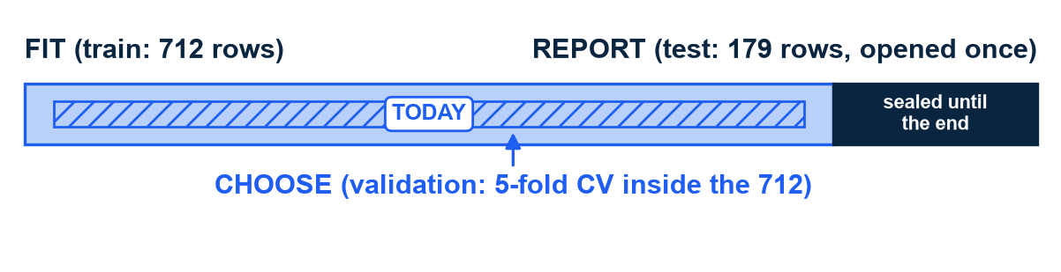
THE MAP FOR TODAY
Today we live in the CHOOSE band: selection and assessment are different jobs
Where we stand: a model-ready Titanic table - 712 training rows, 179 test rows, 18 features.
Six algorithms could predict who survived. Picking by name or fashion is guessing.
How to read the bar: all 891 passengers, split once. Light left = 712 training rows; dark right = 179 test rows, sealed.
Model SELECTION = practice tests: try many models, always inside the training rows (the CHOOSE band).
Model ASSESSMENT = the final exam: grade the winner once, on the sealed test rows (REPORT).
Today: Part 1, the theory of judging honestly; Part 2, the tournament that puts it to work.
The one bar that rules Module 2 (it returns in every session). Harvard CS109A / ISLR ch. 5 (model selection vs model assessment).
M2 Session 3 - Model Selection and Evaluation
2
Notes:
Re-say the exam metaphor before the theory: practice tests choose your strategy - you can take as many as you like; the final exam grades it - and you sit it once. Selection is the practice-test job, assessment is the final. Ask the class: what would go wrong if you picked your strategy based on the final's questions?

Slide 3
01
Part 1 - The theory: how to judge a learner honestly
Seven ideas that explain every chart you will see in Part 2: what training really does, why it flatters itself, and how to measure without fooling yourself.
M2 Session 3 - Model Selection and Evaluation
3

Slide 4
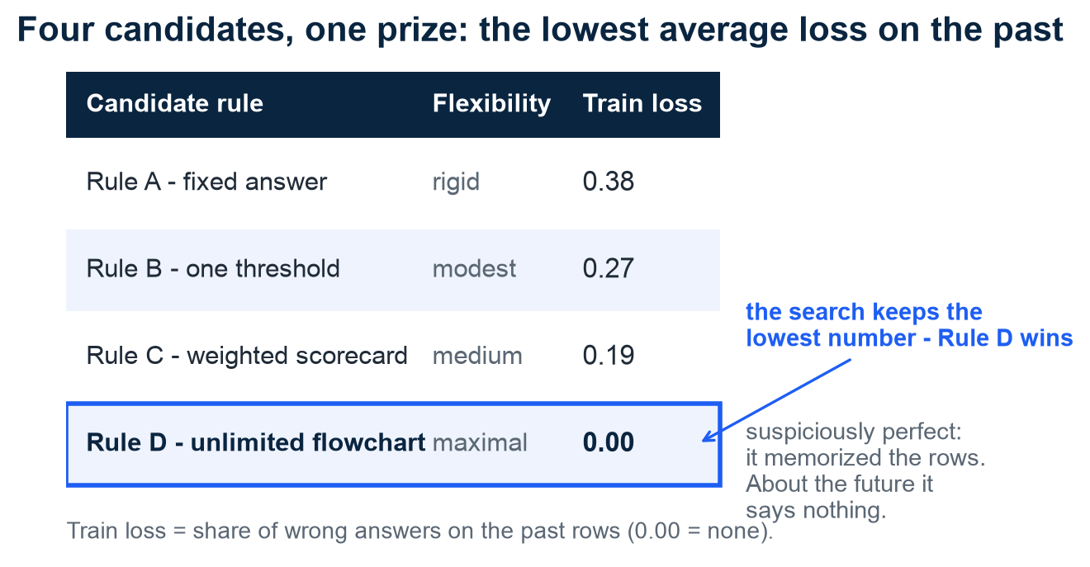
EMPIRICAL RISK MINIMIZATION
Training just minimizes average loss on the past - and a flexible rule can always ace the past
Empirical risk minimization - in plain words: pick the rule with the fewest mistakes on past exams.
Loss = how wrong a prediction is. 'Empirical' = measured on the rows we already HAVE.
That is all training does: scan a family of candidate rules, keep the lowest average loss.
How to read the table: four candidate rules, ranked by train loss - their mistakes on the past.
The catch: a flexible enough rule memorizes the answer sheet. Rule D scores a perfect 0.00.
A perfect training score proves nothing about tomorrow. The rest of Part 1 closes that gap.
Illustration - invented rules and loss values. MIT 6.390, ch. 1 and appendix C (empirical risk minimization).
M2 Session 3 - Model Selection and Evaluation
4
Notes:
Strip the Latin off the term: empirical risk minimization is studying from past exams - pick whatever strategy made the fewest mistakes on the old exams. The catch sits in the table: Rule D scores a perfect zero because it memorized the answer sheet, and it says nothing about tomorrow. Ask the class: which classmate is Rule D - and how do they do on a fresh exam?

Slide 5
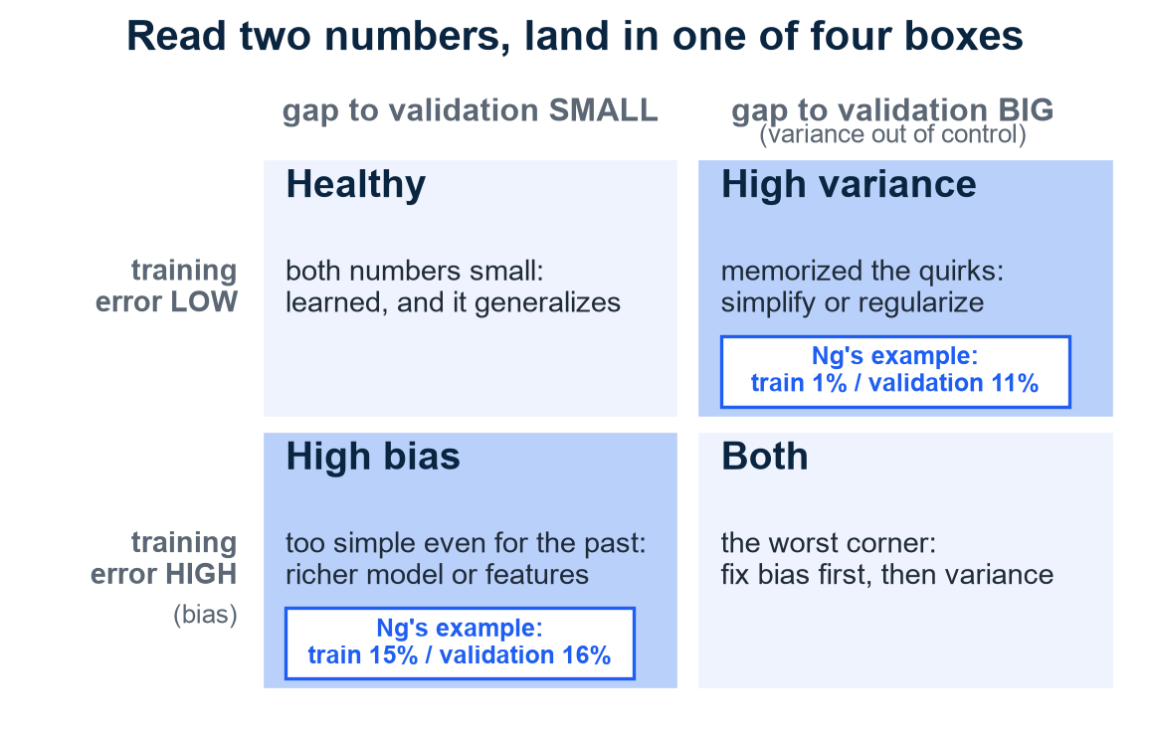
GENERALIZATION
Two numbers diagnose any model: the training error and the gap to the honest score
Generalization - in plain words: doing well on rows the model has never seen. Only that counts.
Validation score = a practice test: held-back rows the model did not train on.
Ng's diagnostic: read TWO numbers - the training error, and the gap to the validation error.
Training error too high = bias: too simple even for the past it studied.
Gap too wide = variance: it memorized quirks that do not travel to new rows.
How to read the grid: your two numbers pick one box - each box has a different cure. Bottom-right is worst.
Ng's examples: train 1% / validation 11% = variance; train 15% / validation 16% = bias.
Grid cards: Ng's teaching examples, not course numbers. Ng, Machine Learning Yearning chs. 20-21.
M2 Session 3 - Model Selection and Evaluation
5
Notes:
Two numbers, one diagnosis: how wrong on the material it studied (bias), and how much worse on the practice test (variance). If students read Ng later: he calls the validation set the 'dev set' - same thing. Walk the two example cards into their grid cells before naming the cures. Ask the class: train 2%, validation 3% - which box, and do you change anything?

Slide 6
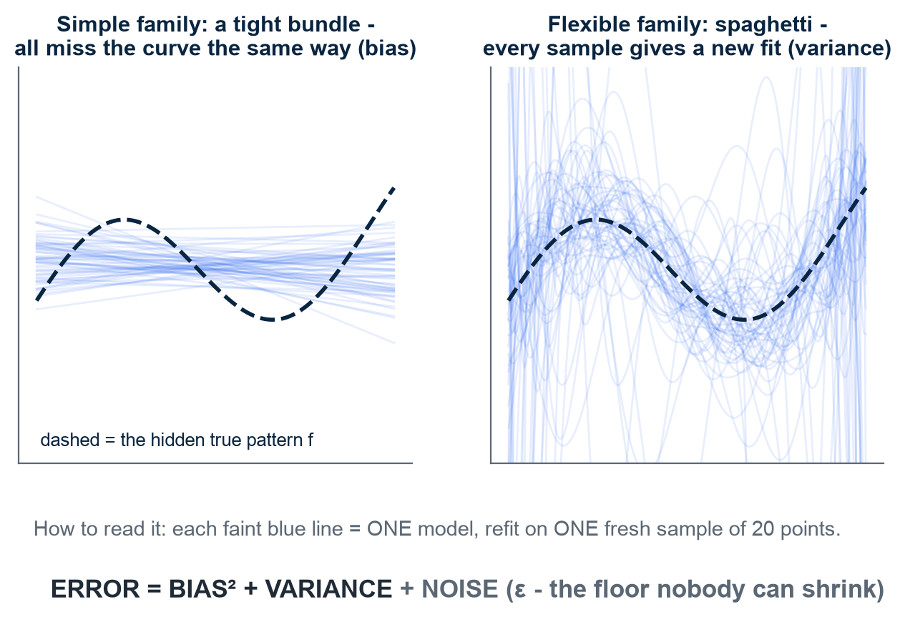
BIAS-VARIANCE DECOMPOSITION
Refit on fresh samples and watch: simple models miss together, flexible models scatter
Bias - in plain words: the same miss every time. Variance: a different answer every time.
Thought experiment: refit the same model on many fresh samples - parallel universes - and watch.
How to read it: one faint line = one model, fit on one fresh sample. Dashed = the true pattern.
Left, the simple family: a tight bundle - all miss the curve the same way. That shared miss is bias.
Right, the flexible family: spaghetti - a new fit for every sample. That instability is variance.
Total error = bias² + variance + noise. The noise floor ε never shrinks - your work lives in the other two.
Hold this image: later, five cross-validation folds act as five mini-universes.
Illustration - synthetic data, 60 refits per panel. Device from Harvard CS109A L6 / ISLR §2.2.
M2 Session 3 - Model Selection and Evaluation
6
Notes:
Give them the two plain words before the picture: bias means it misses the same way every time; variance means it gives a different answer every time you retrain it. Then let the panels do the work - tight bundle versus spaghetti, same hidden dashed rule behind both. Ask the class: which panel would you rather ship, and what would change your mind?

Slide 7
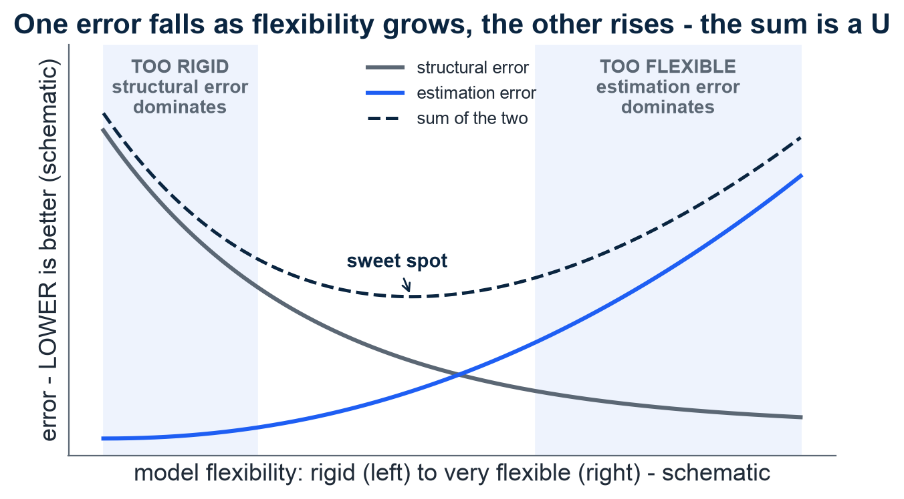
STRUCTURAL VS ESTIMATION ERROR
Name the two errors: a family too rigid, or too little data to find its best member
Structural error - in plain words: shopping in the wrong shoe aisle. No shoe there fits, however long you look.
That is underfitting: the true rule is not in your family of shapes, so even its best member misses.
Estimation error: the right aisle, too little time to try pairs - you walk out with the wrong shoe.
That is overfitting: the family is so flexible that 712 rows cannot point at its best member.
How to read it: x = flexibility; y = ERROR, so LOWER is better. Grey falls, blue rises.
Their dashed sum is a U - the sweet spot is its LOW point. In Part 2 a real tree draws this U.
Illustration - schematic curves, no real data. MIT 6.390, ch. 2 and ch. 5 (structural vs estimation error).
M2 Session 3 - Model Selection and Evaluation
7
Notes:
Use the shoe shop: structural error is shopping in the wrong aisle - no shoe there fits, no matter how carefully you search. Estimation error is the right aisle but too little time to try pairs - you grab the wrong shoe. Bigger aisle helps the first problem and worsens the second; that tension is the U. Ask the class: which error does more data fix - the aisle or the time?

Slide 8
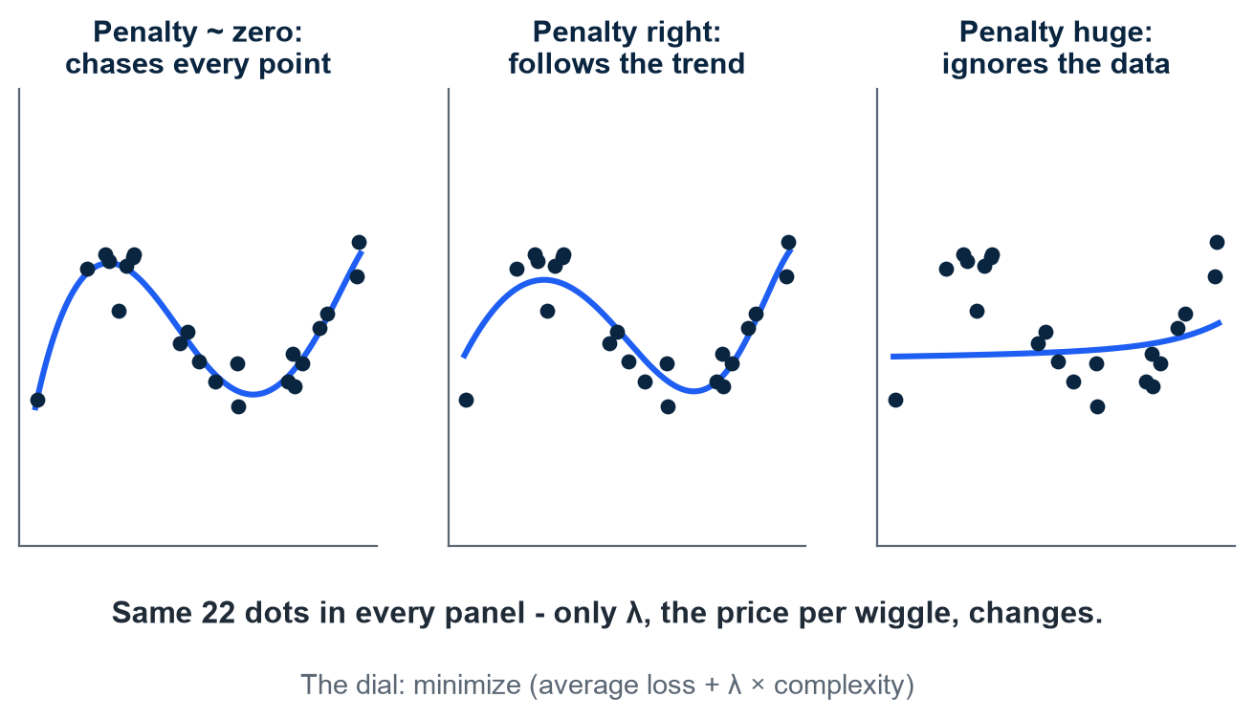
COMPLEXITY ON A LEASH
Don't choose simple-or-flexible once: take the flexible family and make complexity pay
Regularization - in plain words: every extra wiggle costs points. Flexibility on a budget.
How to read it: same 22 dots in all three panels. Only the penalty λ changes; the blue curve is the fit.
The new training goal: minimize (average loss + λ × complexity). λ (lambda) = the price per wiggle.
λ near zero: wiggles free - memorizing allowed. λ huge: wiggles unaffordable - the data is ignored.
The right λ (middle panel) follows the trend and lets the noise go.
Ridge regression is this idea for scorecard models: a penalty on big weights.
Foreshadow: Session 4's tree knobs (like max_depth) ARE this dial. A shallow tree is a short leash.
Illustration - synthetic points, same data in all panels. MIT 6.390 ch. 2 (penalty framing); Harvard CS109A / ISLR ch. 6 (ridge).
M2 Session 3 - Model Selection and Evaluation
8
Notes:
One sentence carries the slide: every extra wiggle costs points. The model may still buy wiggles - it just has to be worth the price, and lambda sets the price. Walk the three panels: free wiggles chase every point, fair-priced wiggles follow the trend, unaffordable wiggles ignore the data. Ask the class: which panel is the memorizing classmate from the ERM slide?

Slide 9
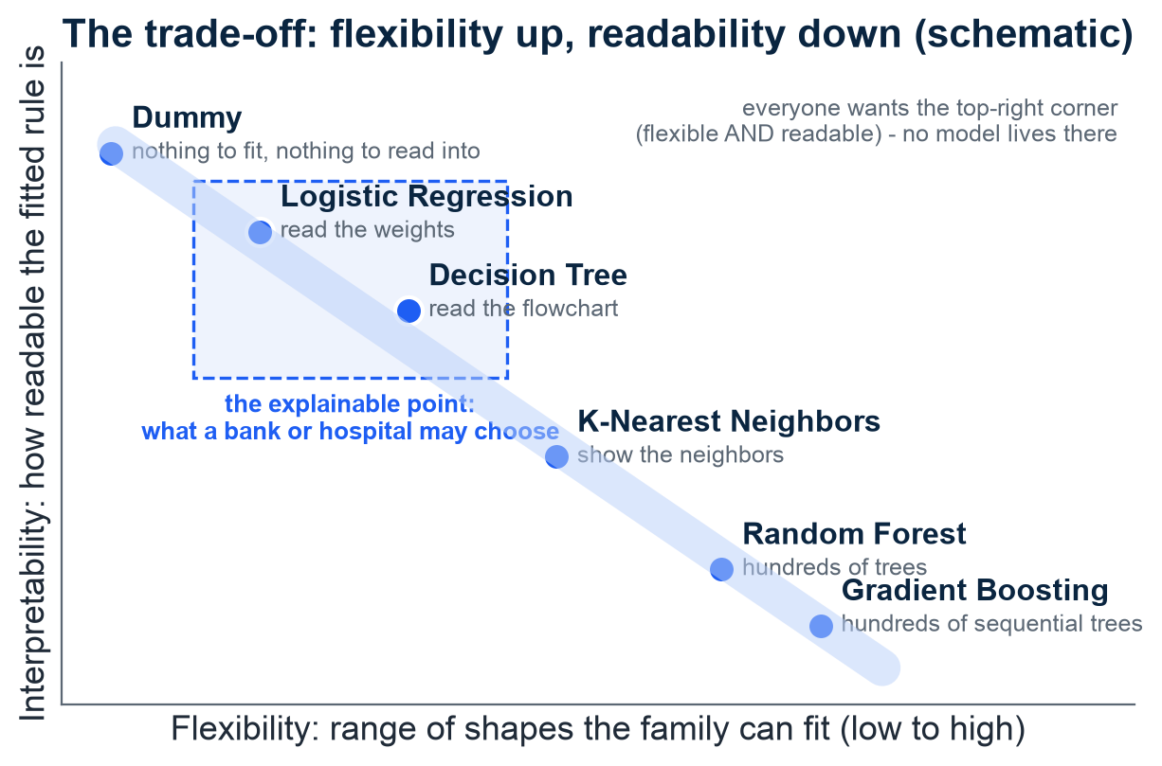
THE TRADE-OFF CHART
Flexibility costs readability - and a bank or hospital may choose the explainable point
The trade-off - in plain words: the more shapes a family can fit, the harder its fitted rule is to read.
How to read it: each dot = one of today's six contestants. Right = more flexible; up = easier to read.
Everyone wants the top-right corner - flexible AND readable. No model lives there; you must trade.
Flexible is not automatically better: it needs more data and overfits more easily - the wrong-shoe trap.
A bank explaining a rejected loan, a hospital a triage call: the explainable point wins, even at some accuracy cost.
Schematic - our six models placed as a teaching judgment. Device from ISLR fig. 2.7.
M2 Session 3 - Model Selection and Evaluation
9
Notes:
The axis trade: moving right buys shapes, moving down loses readability - you cannot have both ends. Make it concrete: a scorecard's weights can be read to a customer; a committee of 500 trees cannot. Ask the class: your loan is rejected by a model nobody can read - what do you want the bank to be able to tell you?

Slide 10
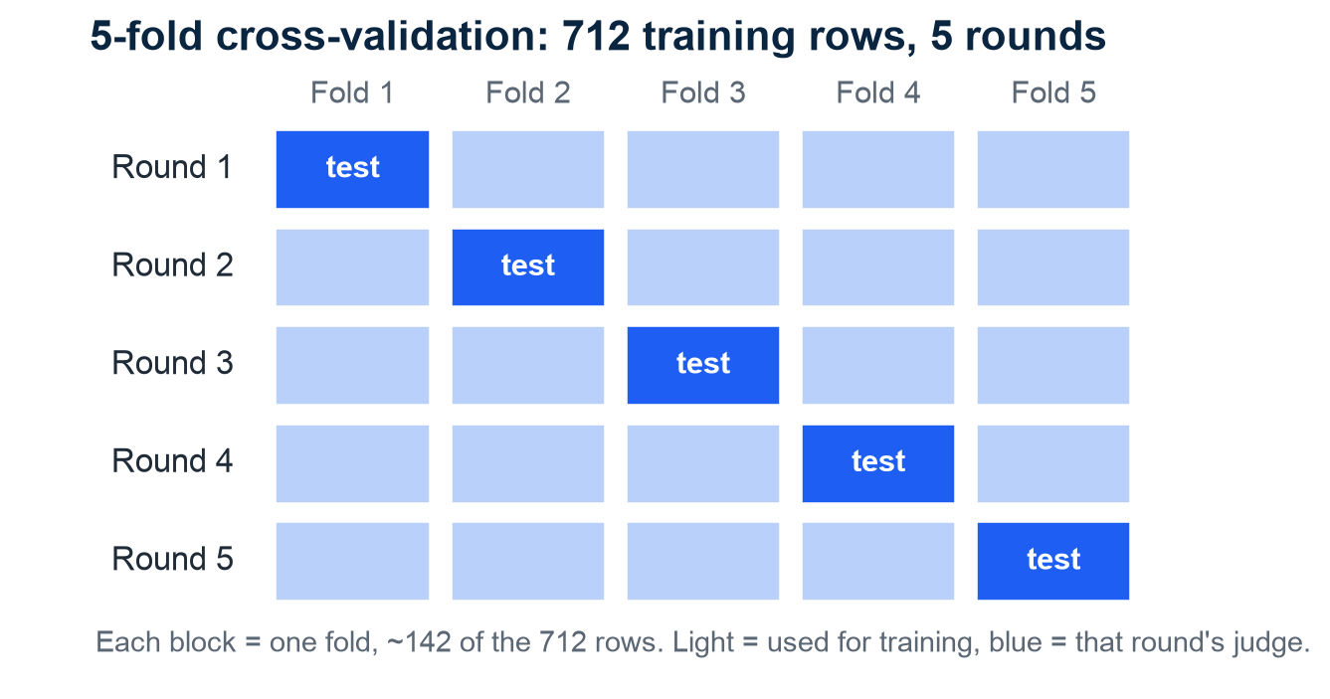
ESTIMATING THE TRUE ERROR
Cross-validation gives every row a turn at being the test
Cross-validation - in plain words: five practice tests instead of one.
How to read it: each row is one round; each block one fold, ~142 of the 712 training rows.
The blue block sits out as that round's judge - every row judges exactly once.
Five honest scores give a mean AND a wobble (the spread) - stability becomes visible.
Subtle but crucial: CV scores the recipe (algorithm + settings), not one baked cake.
Why 5 folds? Fewer starve training; leave-one-out is noisy - 5 or 10 is the sweet spot.
The real 179 test rows are never touched - CV lives entirely inside the CHOOSE band.
5-fold cross-validation, the referee used throughout Part 2. MIT 6.390, Appendix C; Harvard CS109A / ISLR §5.1.
M2 Session 3 - Model Selection and Evaluation
10
Notes:
Exam family again: cross-validation is five practice tests instead of one, and every row gets one turn as the judge. Then MIT's line students always miss: CV scores the recipe, not the cake - it rates the way of building models, not one finished model. Ask the class: why is an average of five practice tests harder to fool than the best of five?

Slide 11
02
Part 2 - Practice: the tournament
Six contestants, one fair referee, one locked test set - Part 1's theory, run for real on the Titanic manifest.
M2 Session 3 - Model Selection and Evaluation
11

Slide 12
THE MODEL ZOO
Six contestants enter, from a deliberately dumb floor to committees of trees
Model | Intuition in one line | Needs scaling | Interpretability
Dummy | Ignores the data, always predicts "died" - our floor | No | Nothing to read
Logistic Regression | A weighted scorecard summed into a probability | Yes | High - read the weights
K-Nearest Neighbors | Ask the 5 most similar passengers, then let them vote | Yes | Medium - show the neighbors
Decision Tree | A flowchart of yes/no questions | No | High - read the flowchart
Random Forest | Hundreds of trees voting; the vote averages mistakes away | No | Low - too many trees to read
Gradient Boosting | Trees that learn from the previous tree's mistakes | No | Low
One recipe, six fillings: only the MODEL changes - the data prep, the loss (mistake counter) and the referee stay identical for all six. (MIT 6.390, Appendix C)
A model = a function with adjustable knobs ("parameters"). "Needs scaling" = wants all features on one ruler first: Fare runs 0-512, Age 0-80 - Fare would shout, Age whisper.
M2 Session 3 - Model Selection and Evaluation
12

Slide 13
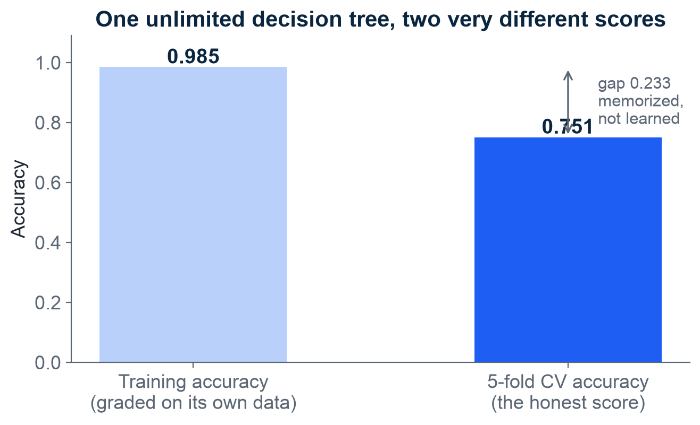
PART 1'S WARNING, LIVE
Training accuracy lies: an unlimited tree scores 0.985 on itself, 0.751 honestly
Let a decision tree grow with no depth limit, then grade it twice.
Graded on its own training data: 0.985. Graded on five honest practice tests: 0.751.
It memorized the answers - like grading students on the exact questions they practiced at home.
This is Rule D from the ERM table, caught in the act.
On Ng's grid: training error low, gap 0.233 wide - the high-variance box.
That is why the tournament's referee is cross-validation, never training accuracy.
Unlimited decision tree, training vs 5-fold CV accuracy. Module 2, notebook 2.
M2 Session 3 - Model Selection and Evaluation
13
Notes:
Part 1's warning caught on camera: grade the tree on the exact questions it studied and it scores 0.985; grade it on practice tests it never saw and it drops to 0.751. The 0.233 gap is memorization, not learning - the student who copied the answer sheet. Ask the class: which of the two bars would you show your boss, and why is the other one a lie?

Slide 14
BASELINE FIRST
Beat the floor first: always saying "died" already scores 0.617
0.617
Dummy baseline, 5-fold CV accuracy (+/- 0.003). It always predicts "died" - and 61.7% of training passengers did die, so it is right 61.7% of the time.
Any model that cannot clearly beat this floor is useless, no matter how fancy its name. Andrew Ng's doctrine: build your first system quickly, then iterate (Machine Learning Yearning, ch. 13).
M2 Session 3 - Model Selection and Evaluation
14

Slide 15
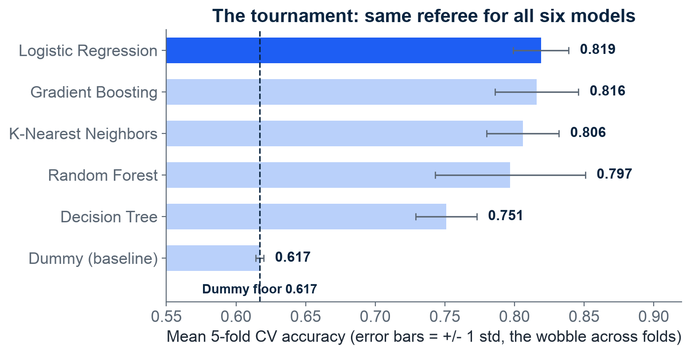
SIX MODELS, ONE REFEREE
The tournament verdict: the humble scorecard wins at 0.819
How to read it: each bar = one model's average score over the 5 practice tests.
The whisker = the wobble across those 5 tests. Dashed line = the Dummy floor.
Fair referee: preprocessing re-fit inside every fold, so no fold can leak.
Logistic Regression leads at 0.819; Gradient Boosting is a close second at 0.816.
Whiskers are Part 1's spaghetti, measured: Random Forest wobbles most (+/- 0.054), the scorecard least (+/- 0.020).
All five real models clear the floor. The Dummy's F1 (a stricter metric, two slides on) is 0.000: it never says "survived".
The surprise: the humble scorecard wins - fancy does not automatically mean better.
Mean 5-fold CV accuracy, +/- 1 std; axis starts at 0.55 to magnify the differences. Module 2, notebook 2.
M2 Session 3 - Model Selection and Evaluation
15

Slide 16
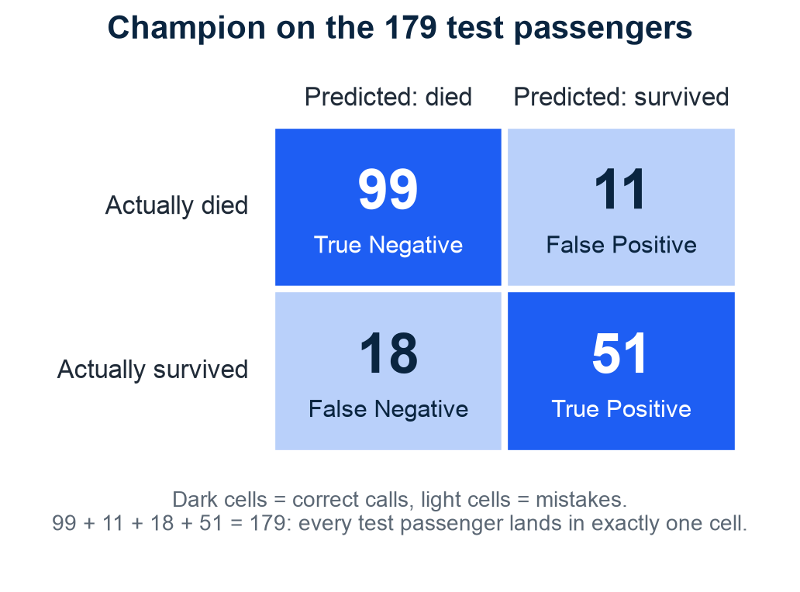
THE 99% TRAP
Accuracy can hide the mistakes that matter - the confusion matrix shows all four
The trap: a disease hits 1 in 100. "Always say no disease" is 99% accurate - and worthless.
Confusion matrix = the four ways a prediction can go right or wrong, counted.
How to read it: rows = what really happened, columns = the model's call. Dark cells = correct.
Champion on the 179 test passengers: 99 correct "died" (TN), 51 correct "survived" (TP).
The mistakes: 11 false alarms (said survived, died) and 18 missed survivors (said died, survived).
One number became four. Every metric you will ever meet is arithmetic on these four counts.
Logistic Regression, confusion matrix on the test set. Module 2, notebook 2. Harvard CS109A, Classification Metrics lecture.
M2 Session 3 - Model Selection and Evaluation
16
Notes:
Open with the 99% trap: a disease hits 1 in 100, so 'always say no disease' is 99% accurate and completely useless. The confusion matrix fixes that by splitting one number into four honest counts: right two ways, wrong two ways. Every metric they will ever meet is arithmetic on these four cells. Ask the class: which of our two mistake cells - 11 false alarms or 18 missed survivors - would matter more if this were a rescue list?

Slide 17
TWO KINDS OF MISTAKES
Precision and recall answer different questions - pick the one your problem asks
Precision 0.823 - trust our alarms
Recall 0.739 - catch them all
"Of everyone we said survives, how many actually did?"
TP / (TP + FP) = 51 / (51 + 11) = 0.823
High precision = few false alarms.
Spam filter: a false alarm buries real mail. Precision first.
"Of everyone who actually survived, how many did we catch?"
TP / (TP + FN) = 51 / (51 + 18) = 0.739
High recall = few missed cases.
Cancer screening: a missed case is the disaster. Recall first.
TP, FP, FN are the confusion-matrix cells from the last slide. F1 = a strict average (harmonic mean) of precision and recall = 0.779 - high only when both are decent. Metric pairing after Ng's ML Specialization (C2, W3).
M2 Session 3 - Model Selection and Evaluation
17
Notes:
Two questions, not one: precision asks 'when we raise an alarm, how often is it real?'; recall asks 'of the real cases, how many did we catch?'. The problem picks the metric - spam filters fear false alarms, cancer screening fears missed cases. F1 is a strict average of the two that a useless side drags down. Ask the class: for airport security screening, precision first or recall first?

Slide 18
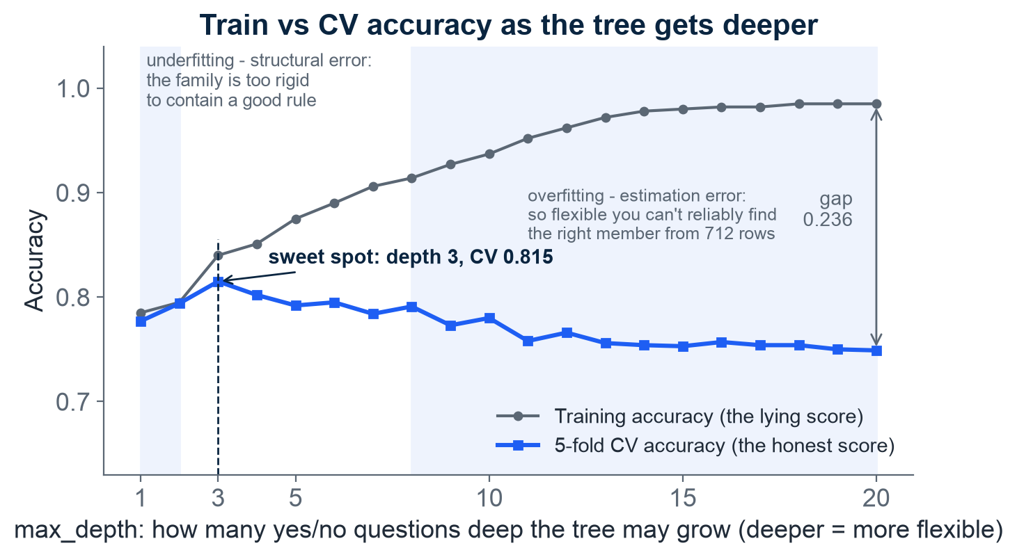
THE U-CURVE, FOR REAL
Overfitting made visible: past depth 3, the tree memorizes instead of learning
How to read it: x = tree depth (deeper = more flexible); y = accuracy, so HIGHER is better.
Grey = score on its own training data: climbs to 0.985 and never looks back.
Blue = the honest CV score: peaks at 0.815 at depth 3, then slides.
The gap between the curves is memorization. At depth 20 it is 0.236.
This is Part 1's U on real data, flipped: y is accuracy, so the sweet spot is a PEAK.
Left of depth 3: too rigid (structural error). Right of it: memorizing (estimation error).
Why peak at 0.815, not 1.00? The outcome is rule plus noise, Y = f(X) + ε - and nothing can predict ε.
Decision tree, max_depth 1-20, train vs 5-fold CV accuracy. Module 2, notebook 2. MIT 6.390, ch. 2 & ch. 5; Harvard CS109A / ISLR ch. 2.
M2 Session 3 - Model Selection and Evaluation
18
Notes:
This is the theory chapter drawn by real data. Depth is the aisle-size dial: too shallow and the family cannot hold a good rule (wrong aisle); past depth 3 the tree starts memorizing the 712 training rows (right aisle, wrong shoe). The grey line only climbs because memorizing always improves the score on the questions you studied. Ask the class: the honest peak is 0.815, not 1.00 - which part of the outcome can no model ever predict? (The noise term ε on the slide.)

Slide 19
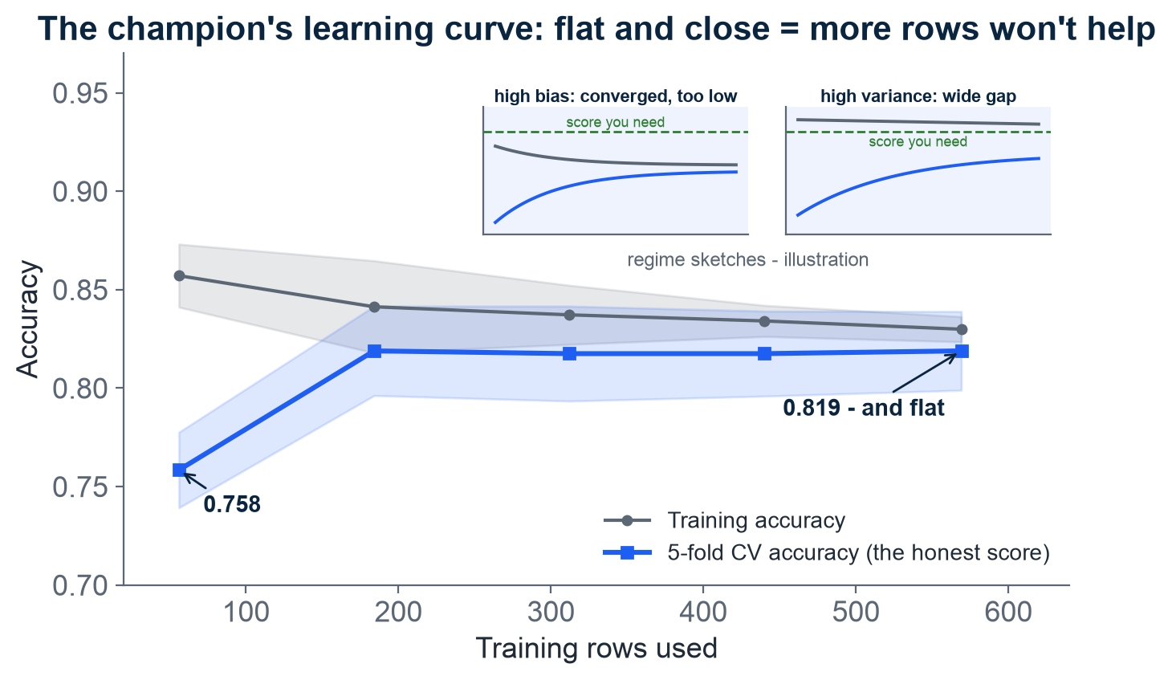
WOULD MORE DATA HELP?
The learning curve answers "would more data help?" - for us: no
How to read it: x = how many rows we trained on; y = accuracy; shaded band = wobble across folds.
Grey = score on its own training data; blue = the honest CV score.
Ours climbs from 0.758 (56 rows) to 0.819 (569 rows) - then goes flat.
Insets, high bias: the two curves meet BELOW the score you need - more rows cannot fix that.
Insets, high variance: a wide gap still separates the curves - more data plausibly helps.
Our verdict: flat and close, so more passengers buy little. Better settings are the lever - Session 4's job.
Main panel: real curve, Module 2, notebook 2. Insets: regime sketches - illustration. Ng, Machine Learning Yearning chs. 28-32.
M2 Session 3 - Model Selection and Evaluation
19
Notes:
The learning curve answers one question managers always ask: would more data help? Read the shape - if the honest score has flattened and sits close to the training score, more rows buy almost nothing; if a wide gap remains, more data plausibly helps. Ours is flat and close, so the lever is better features or settings - which is Session 4. Ask the class: your boss offers 10,000 more passenger records - based on this chart, do you take the deal?

Slide 20
DECISION AND NEXT STEP
The verdict: the simplest model that beats the floor on the right metric - the scorecard
The checklist
Verdict & handoff
Beats the baseline clearly? The floor is 0.617 - if not, stop.
Metric matches the problem? Accuracy, precision, recall, or F1 - decide before you rank.
Simple first: if the scorecard is within a hair of the forest, ship the scorecard.
Stable across folds? A model that wobbles (Random Forest: +/- 0.054) is harder to trust.
Champion by CV: Logistic Regression, 0.819 (+/- 0.020).
One look at the locked test set: accuracy 0.838.
Precision 0.823, recall 0.739, F1 0.779 on "survived".
AUC 0.878 = chance a random survivor ranks above a random non-survivor.
Random Forest finished 0.797 but has the most knobs - Session 4 tunes it, then ships it.
Why interpretability is on the checklist: a real pneumonia model learned "asthma lowers risk" - true in the data (asthmatics were rushed to intensive care), fatal if acted on; caught only because the model was readable. Source: Caruana et al., KDD 2015.
M2 Session 3 - Model Selection and Evaluation
20

Slide 21
The referee, the floor, and the right question
Part 1: training only minimizes loss on the past (ERM) - never trust the training score alone.
Read two numbers: high training error = bias; a wide gap to the honest score = variance.
Too rigid (structural error) vs too flexible (estimation error) trade off - that is the U-curve.
Regularization is the leash, cross-validation the honest referee - and readability is a feature, not a bonus.
Part 2: the floor was 0.617, the humble scorecard won at 0.819, the sealed test set was opened once: 0.838.
The real U peaked at depth 3; the learning curve said more rows won't save us - better settings might (Session 4).
Accuracy is one question of many. Precision, recall, and F1 ask sharper ones.
Practice now: notebook 02-model-selection in Colab.
Machine Learning - Module 2
M2 Session 3 - Model Selection and Evaluation
21

