Slide 1
SESSION 4 OF 4
Tuning and Shipping the Model
The forest gets tuned, the test set gets its one look, and the model leaves the notebook: a public app anyone can ask about a passenger like Owen or Florence.
Machine Learning - Module 2

Slide 2
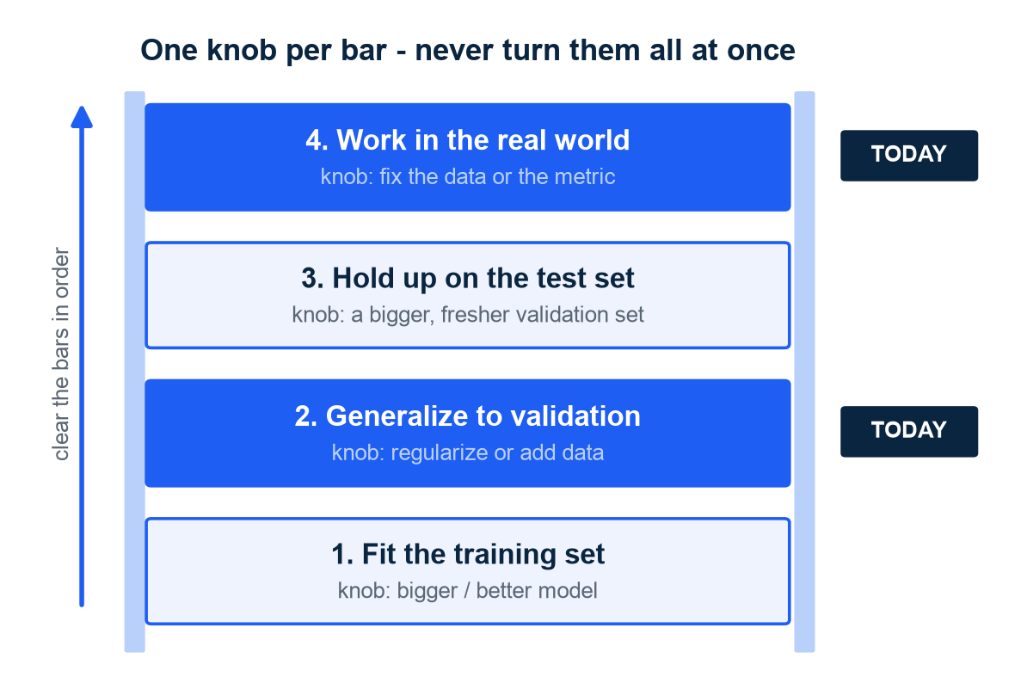
WHERE WE ARE - NG'S ORTHOGONALIZATION
Tune one knob per problem: four bars, each with its own dials
Where we are: leak-proof pipeline (712/179, 18 features); LogReg champion CV 0.819 / test 0.838, no knobs left; Random Forest 0.797 has the most knobs - today's candidate.
Ng's tuning philosophy: clear four bars in order - fit the training set, generalize to validation, hold up on test, work in the real world - and each bar has its OWN knobs.
Failing training: bigger/better model. Failing validation: regularize (= penalize complexity) or add data. Failing test: your validation was over-tuned. Failing the world: your data or metric misses reality.
Diagnose WHICH bar you are failing (Session 3's two numbers) before touching any knob - turning random knobs at once is an untunable radio.
Today: the validation bar's knobs, then the world bar.
Ng's orthogonalization ladder: one job per knob. Ng, Deep Learning Specialization C3 "Structuring ML Projects".
M2 Session 4 - Optimization and Deployment
2

Slide 3
01
Squeeze more from the forest
Search the settings honestly - the referee stays 5-fold cross-validation, and the test set stays sealed.
M2 Session 4 - Optimization and Deployment
3

Slide 4
TUNING - TWO KINDS OF SETTINGS
The model learns its parameters - you set the hyperparameters before training
Parameters: the model learns them
Hyperparameters: you choose them
Learned from the data during training - fit() finds them.
Example: the split rules inside every tree of the forest.
There are thousands; you never set one by hand.
Chosen by you before training starts.
Examples: n_estimators (how many trees), max_depth (how deep).
Tuning = try different knob positions, keep the best result.
MIT's sharper cut: hyperparameters are settings of the ALGORITHM itself - knobs OUTSIDE Session 1's three slots (model + loss + optimizer); they define the game the learner plays.
The same algorithm with two settings is best thought of as two different algorithms. MIT 6.390, Appendix C.
Baking analogy: the oven temperature is a hyperparameter you set; how the ingredients turn into cake is the parameters.
M2 Session 4 - Optimization and Deployment
4

Slide 5
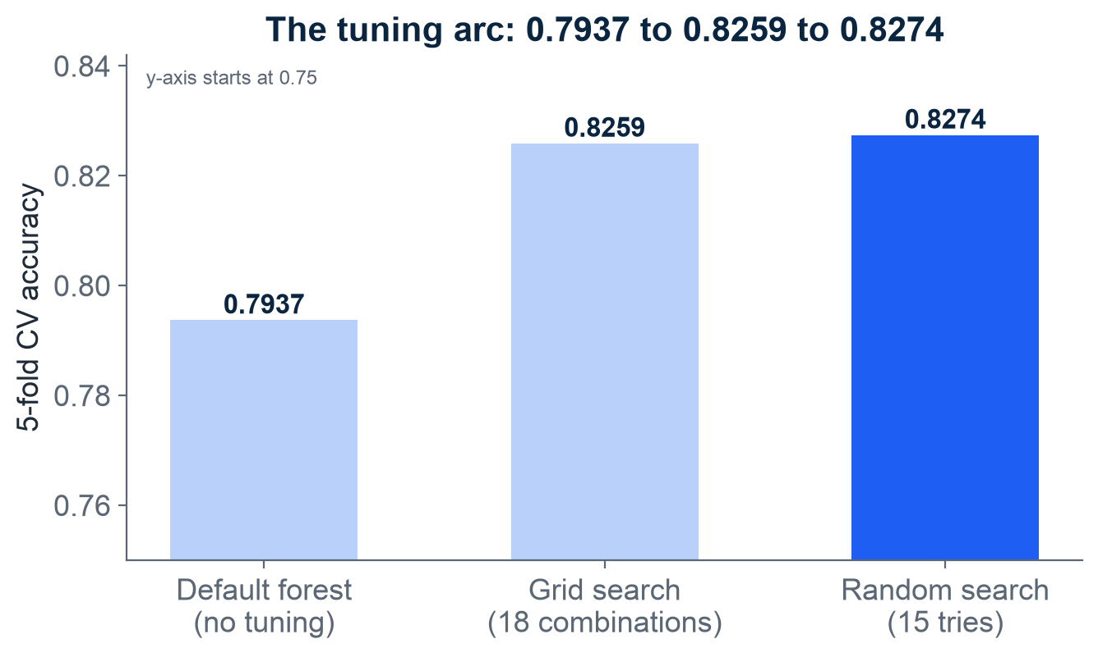
TUNING - GRID AND RANDOM SEARCH
Tuning is Session 3's tournament again - every setting is a contestant, CV is the referee
Grid search = CV plus nested for-loops, no magic: 2x3x3 = 18 combos x 5 folds = 90 trainings. Best (max_depth 4, min_samples_leaf 5, 100 trees): CV 0.8259, +0.0322 over the 0.7937 default.
Grids explode: 5 knobs x 6 values = 7,776 combos - nearly 39,000 trainings. 15 random draws instead test up to 15 distinct values of every knob: CV 0.8274, beating the grid with fewer tries.
MIT's reframe: picking a hyperparameter value IS comparing learning algorithms - same referee, same rules; the contestants are settings instead of model families.
Read the winning knobs: capped depth and bigger leaves are complexity BRAKES - regularization by another name: a little bias buys a big drop in variance. Session 3's U-curve, found automatically.
Random Forest 5-fold CV accuracy at each tuning stage. Module 2, notebook 3. MIT 6.390, Appendix C.
M2 Session 4 - Optimization and Deployment
5

Slide 6
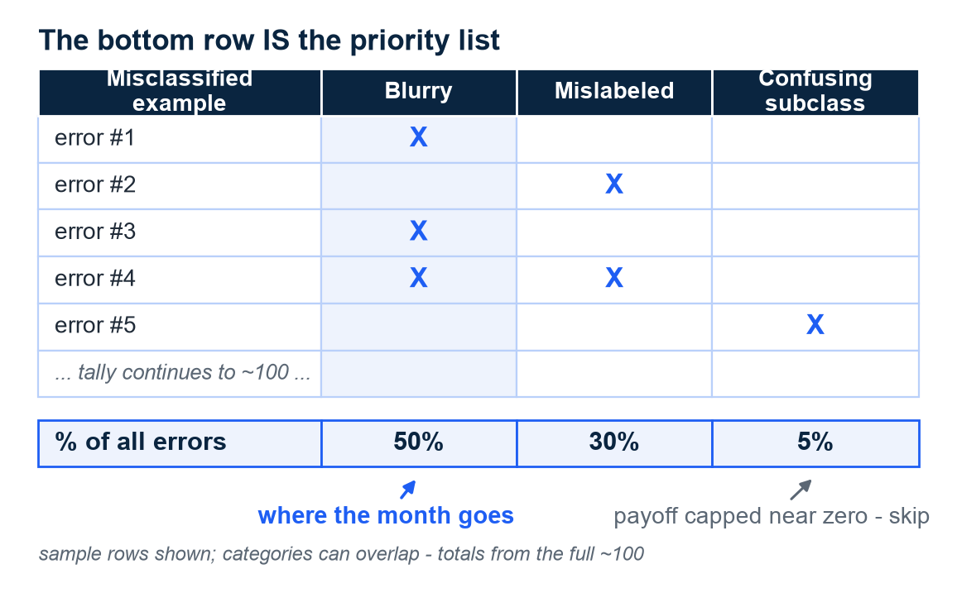
TUNING - ERROR ANALYSIS
Before turning more knobs, read the mistakes - an hour of counting beats a week of guessing
Pull the misclassified validation examples and look at them by hand - about 100 when you have them.
Tally them into categories in a spreadsheet; add new categories as they emerge.
The bottom row of percentages IS your priority list: a category worth 5% of errors caps its payoff at almost nothing; one worth 50% is where the month goes.
Guard: split a large validation set into an "Eyeball" part you inspect and a "Blackbox" part you never look at - you will overfit whatever you stare at.
Exercise: pull our champion's misclassified test-set passengers in the notebook and tally your own categories (family size? fare band? title?) - no fixing allowed before the counting.
The method, on Ng's classic image-classifier example - illustration, not our data. Ng, Machine Learning Yearning chs. 14-19.
M2 Session 4 - Optimization and Deployment
6

Slide 7
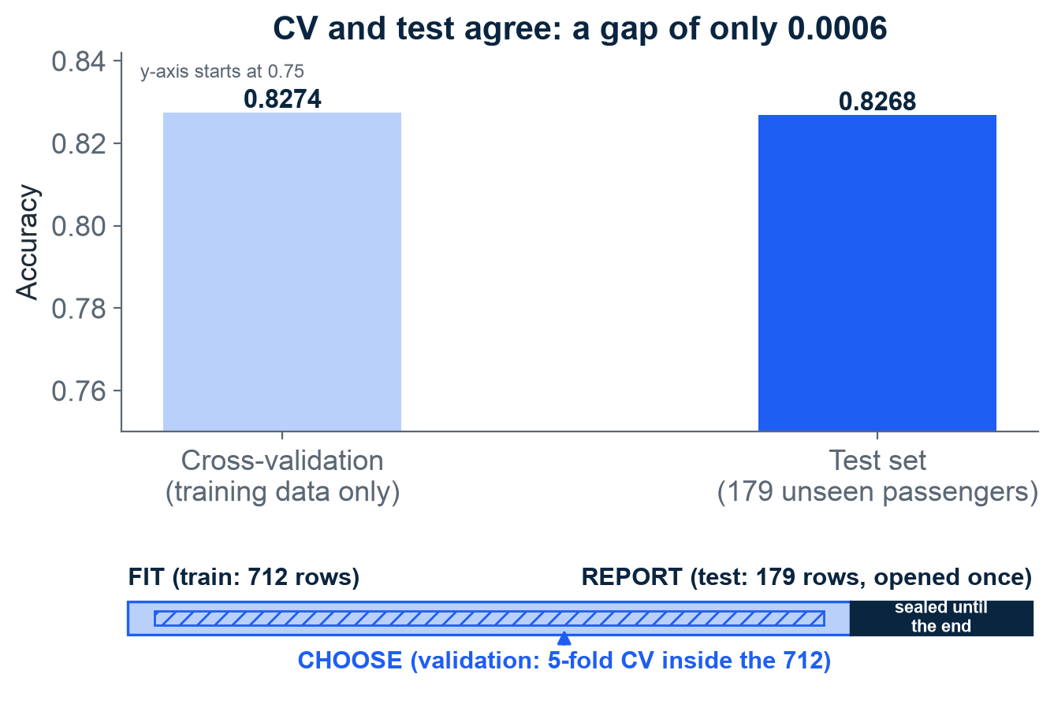
THE HONEST FINAL EXAM
The test set is used exactly once - tune against it and it becomes training data
Final exam: 179 passengers the model has never seen, scored one time: accuracy 0.8268, F1 0.7597.
Test is close to CV (0.8274): the tuning did not fool itself.
Peeking at test scores while tuning silently turns the test set into training data.
Honest expectation: tuning buys a percentage point or two, not miracles.
The bar closes: we FIT on 712 rows, CHOSE by CV inside them - the REPORT band opens now, exactly once, and its score (0.8268) is the only forecast of real-world performance we own.
Tuned forest: CV score vs the single test-set look. Module 2, notebook 3. Harvard CS109A / ISLR ch. 5 (model selection vs model assessment).
M2 Session 4 - Optimization and Deployment
7

Slide 8
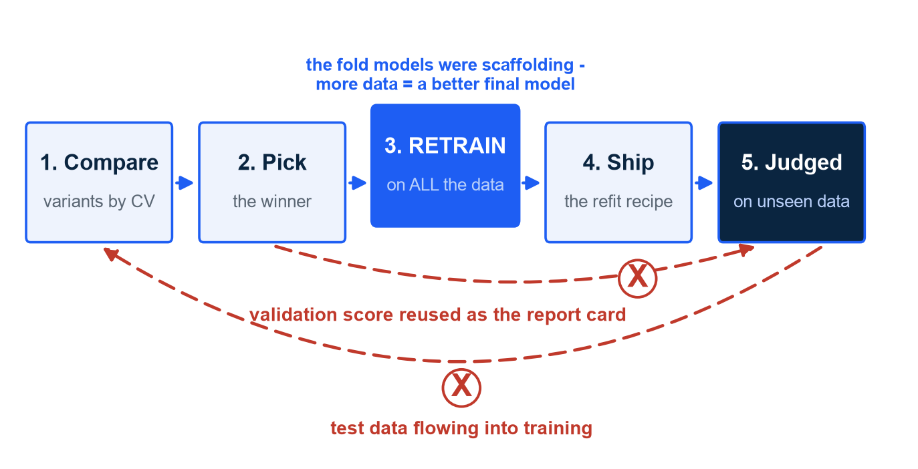
THE LAST STEP BEFORE SHIPPING
You don't ship the CV copy: after choosing, retrain the winning recipe on all the data
MIT's five steps: compare variants by CV, pick the winner, RETRAIN the winning recipe on all available data, ship, and be judged on data nobody at the table has seen.
Step 3 surprises beginners: the fold models were scaffolding; more data = a better final model, so refit everything.
sklearn already does the training-set version: refit=True retrains the best settings on all 712 rows automatically - that is the model we saved.
Once the single test look is spent, the recipe - not the score - is what you trust: retraining it on all 891 rows before shipping is legitimate; re-scoring it is not, because no honest data remains.
Two contamination arrows are forever forbidden: test data into training, and validation scores reused as the final report card.
MIT's end-to-end evaluation pipeline - the two red arrows are never allowed. MIT 6.390, Appendix C.
M2 Session 4 - Optimization and Deployment
8

Slide 9
02
Ship it
A model in a notebook helps nobody - ship it where anyone can ask about a passenger like Owen or Florence.
M2 Session 4 - Optimization and Deployment
9

Slide 10
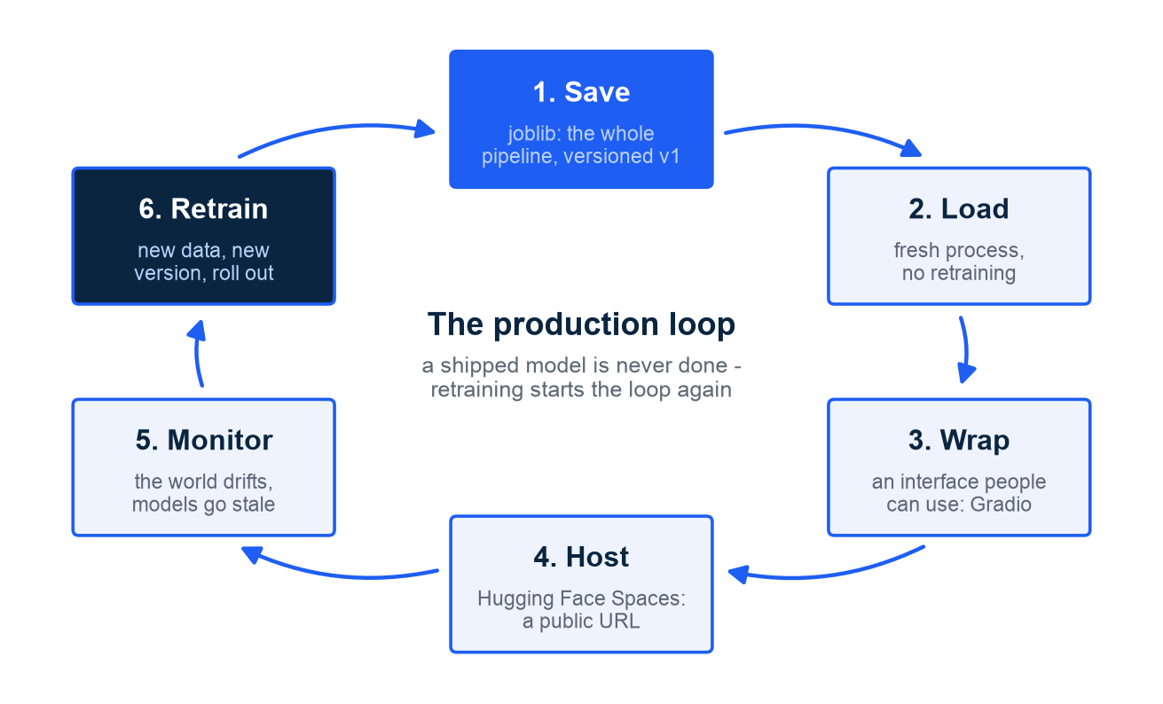
FROM NOTEBOOK TO PRODUCTION
Production is a loop, not a finish line - the model runs where real users can reach it
Save the WHOLE pipeline: titanic_model_v1.joblib, 2,599 KB - raw data in, prediction out; re-coding the prep by hand invites silently wrong predictions
Load in a fresh process: no retraining, no notebook required
Version the file name (v1) so you always know what is running - and can roll back
Ng's rollout ladder for steps 4-5: SHADOW mode (model runs beside the human, predictions logged but unused), then CANARY (~5% of real traffic, watch, ramp), then full swap with a rollback path - deployment is a dial, not a switch
Monitoring closes the loop: drift detected means retrain and reship
The production loop: save, load, wrap, host, monitor, retrain. Module 2, notebook 3. Ng, Machine Learning Engineering for Production C1.
M2 Session 4 - Optimization and Deployment
10

Slide 11
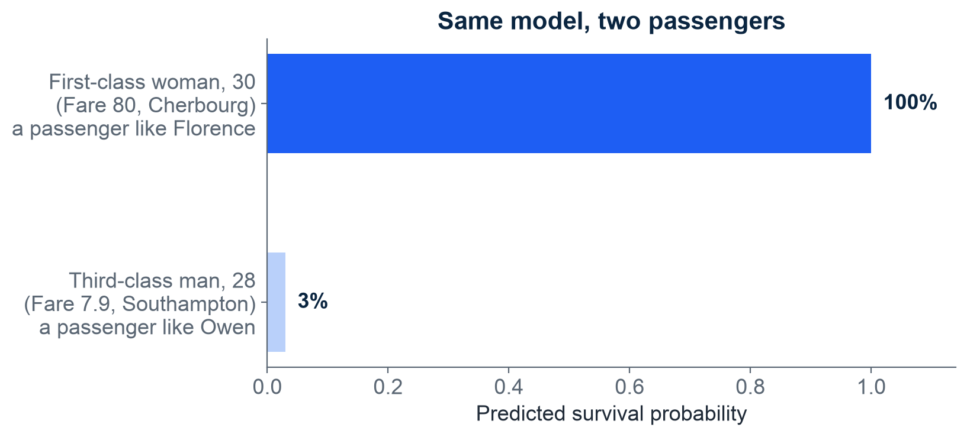
SANITY CHECK ON TWO PASSENGERS
The loaded pipeline answers a real question - a survival gap of 100% vs 3%
Loaded from disk, no retraining: raw passenger details in, verdict out.
An invented first-class woman, 30 (Fare 80, Cherbourg) - a passenger like Florence: survives, 100%.
An invented third-class man, 28 (Fare 7.9, Southampton) - a passenger like Owen: does not survive, 3%.
A probability is confidence, not a guarantee about one individual.
The gap reflects the Titanic's reality: class and sex decided lifeboat seats.
Two invented sanity-check passengers, scored by the saved pipeline. Module 2, notebook 3.
M2 Session 4 - Optimization and Deployment
11

Slide 12
FROM MODEL TO APP
A few lines of Gradio turn the pipeline into a web app anyone can use
Gradio: a function becomes a web form
Hugging Face Spaces: free hosting
Write a normal Python function: inputs in, answer out.
Gradio renders it as sliders, dropdowns and a text box.
Title is derived by rule (boys under 13 Master, men Mr).
On Colab, launch() gives a shareable temporary link.
Four files: app.py, the model, requirements.txt, README.md.
Pin the scikit-learn version in requirements.txt.
Upload the files in the browser - that is the whole deploy.
No tokens or keys in code, ever - uploads stay in the browser.
Result: a public URL anyone can open.
M2 Session 4 - Optimization and Deployment
12

Slide 13
AFTER LAUNCH
After launch, reality bites: models go stale and accuracy alone does not ship
The $1M Netflix Prize ensemble (about 800 models, a 10% RMSE gain) was never put into production.
  Engineering cost outweighed the accuracy gain, and the business had moved to streaming. Netflix tech blog, 2012.
Two kinds of drift: DATA drift - the inputs change (different passengers start arriving); CONCEPT drift - the hidden rule f itself moves.
  Same inputs, new outcomes: Session 1's Y = f(X) + ε, with f no longer standing still. Monitor inputs and outputs separately.
Google Flu Trends overestimated flu by more than 50% in 2011-13.
  It once claimed about 11% of the US had flu; CDC data said about 6%.
  It was essentially never retrained after 2009. Lazer et al., Science, 2014.
Version every saved model (model_v1, model_2026_09_06) so you can always roll back.
Retrain on a schedule and re-score; monitoring is step 5 of the loop, not an afterthought.
M2 Session 4 - Optimization and Deployment
13

Slide 14
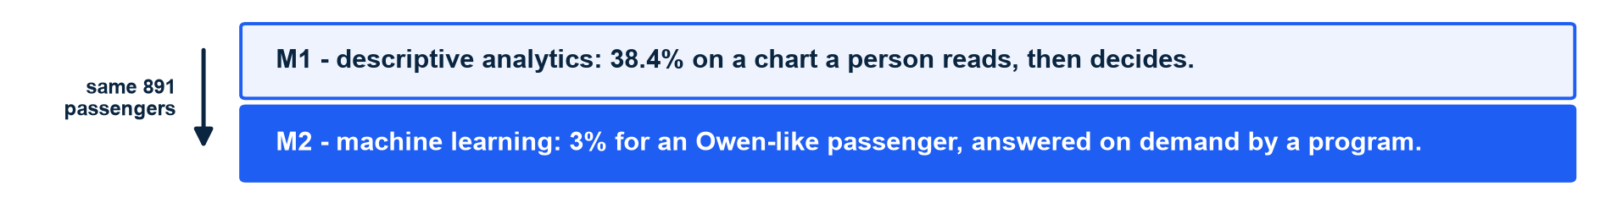
MODULE 2 IN ONE SLIDE
M1 dashboards inform people - M2 models act inside products: the whole module in one table
Stage | What you built | The rule
Prep (NB1) | Split 80/20 first; impute, encode, scale; Title + FamilySize; one Pipeline | Split first. Fit on train only. Pipelines always.
Select (NB2) | Six-model tournament, 5-fold CV; Dummy floor 0.617; LogReg wins 0.819 | Baseline first; pick the metric that fits the problem.
Tune (NB3) | Grid + random search: 0.7937 to 0.8274; one test look: 0.8268 | Search honestly; the test set is used exactly once.
Ship (NB3) | joblib save; Gradio app; Hugging Face Spaces; versioned v1 | Save the whole pipeline; monitor - models go stale.
M1 described the past for people to read; M2 learned from it so software can answer about the future. Module 3 adds the next layer: cloud ML APIs - consuming models other people have trained and deployed.
M2 Session 4 - Optimization and Deployment
14

Slide 15
Session 4 - what to remember
Hyperparameters are the algorithm's own settings - tune them with CV, never the test set; every setting is a different algorithm.
Diagnose the failing bar before turning any knob; when knobs stall, count your errors before guessing.
Random search reached CV 0.8274; the one test look said 0.8268 - the tuning did not fool itself.
Ship the recipe retrained on everything, then the loop: save, load, wrap, host, monitor - and watch for data drift AND concept drift.
The manifest's last word: Survived = 0 for Owen, 1 for Florence, 1 for Frankie. The odds were never abstract.
Practice now: notebook 03-model-optimization-and-deployment in Colab.
Machine Learning - Module 2
M2 Session 4 - Optimization and Deployment
15

