Slide 1

ML Project - House Prices: Advanced Regression Techniques
Koeun Lim, Ph.D.

Slide 2
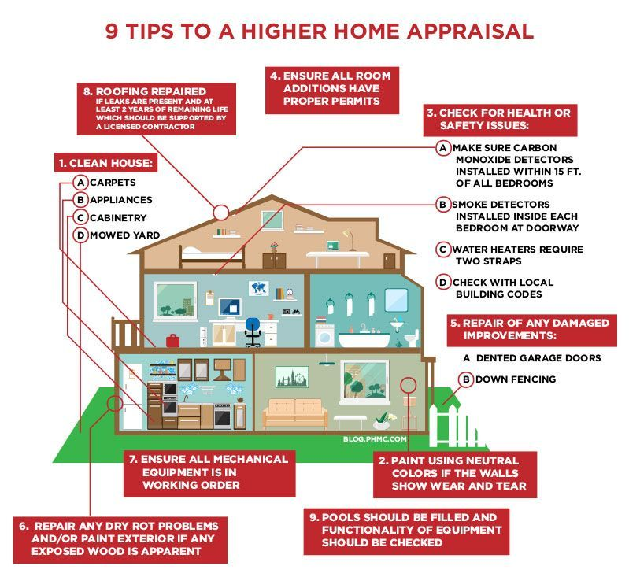
What is a “good house”?
Houses are inspected and appraised to determine their values.
“Good” houses get appraised with higher price.

Slide 3
What features contribute to house values?
High-dimensional data : 79 Features
36 Numerical features
23 Ordinal categorical features – label encode
Hierarchical features ranging desirable (e.g. excellent) to undesirable (e.g. poor) qualities.
20 Nominal categorical features – dummify
No specific relationships between the levels.
➔ Total 203 features

Slide 4
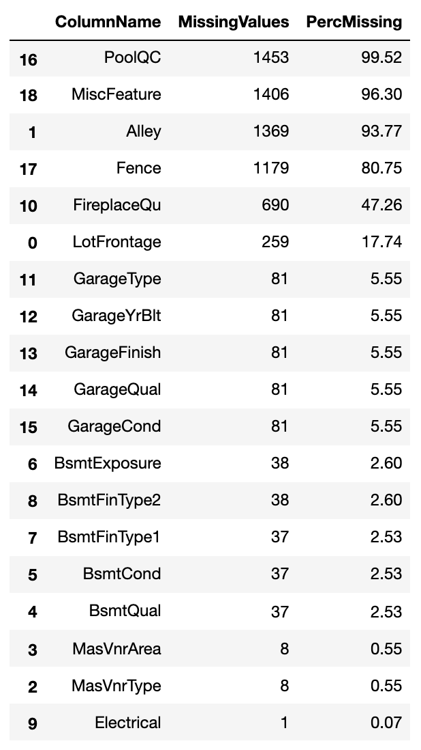
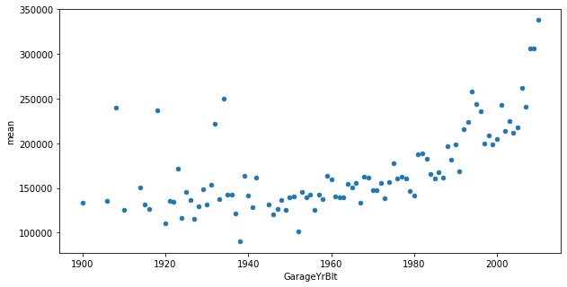
Missing value inspection & Imputation
Categorical missing values due to non-existent mother features (i.e. no pool, no basement, etc.)
➔ ‘NotAvail’
Numerical missing values due to non-existent mother feature (GarageYrBlt)
➔ Oldest – 10
Missing values due to missing entries (LotFrontage, MsVnrArea, MsVnrType, Electrical)
➔ KNN imputation

Slide 5
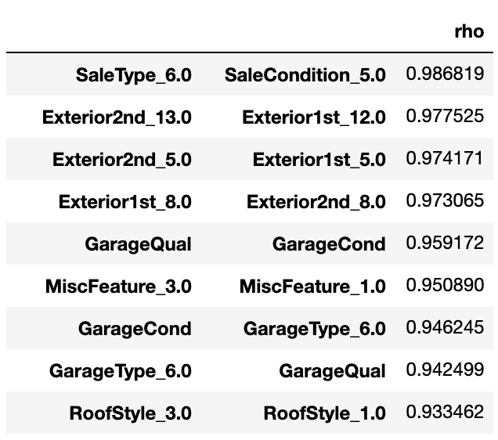
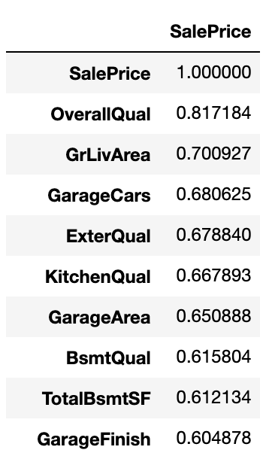
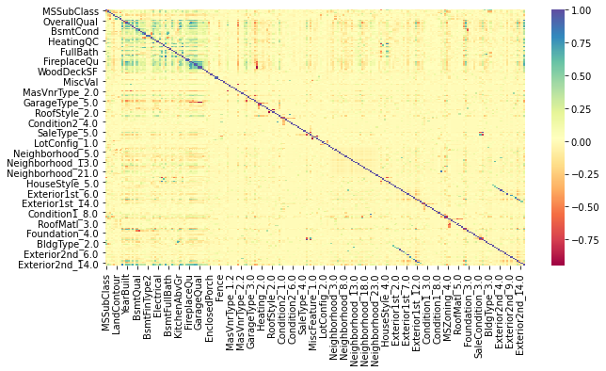

Severe multicollinearity
Correlation Matrix of 203 Features
Features with high correlations (rho)

Slide 6
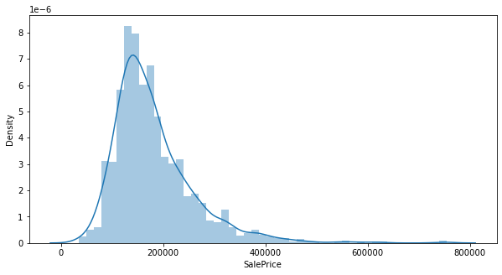
Sale price distribution is non-normal.

Slide 7
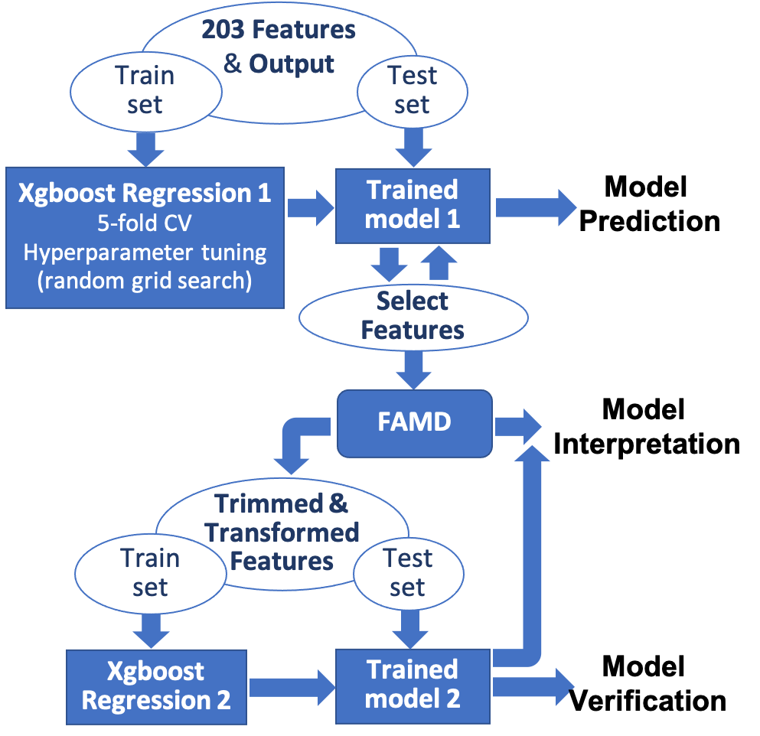
Modeling : xgboost + FAMD
While non-normal distribution of the house prices can be mitigated through log-transformation, severe multicollinearity make the modeling result difficult to interpret.
Gradient boosting model (xgboost) is chosen because:
GBM is insensitive to non-normal outcome distribution
State-of-the-art ML technique
Can be used for feature selection – select a subset of features that can attain R2>=0.9 for the test set
Factor analysis for mixed data (FAMD) was chosen to address multicollinearity
FAMD was performed on the surviving features from the xgboost to extract components (some combination of the features) that are orthogonal to each other
Each components show interrelationships between the features
Reran xgboost regression using FAMD components to verify and observe which component is most relevant

Slide 8
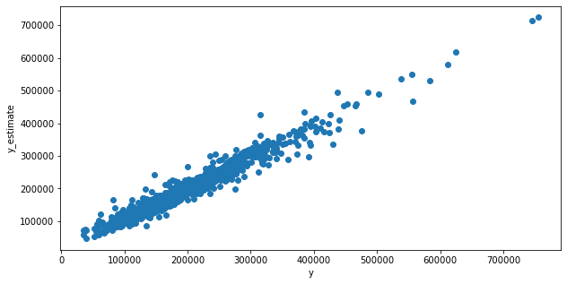
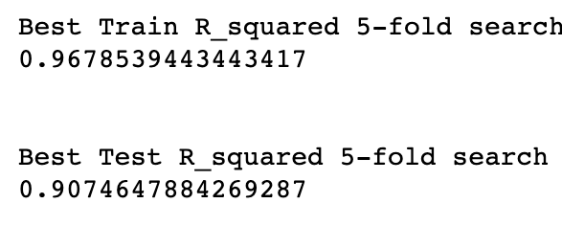
Modeling : Feature selection through xgboost
Random grid search with 5-fold CV
28 features remaining
SalePrice Prediction
SalePrice

Slide 9
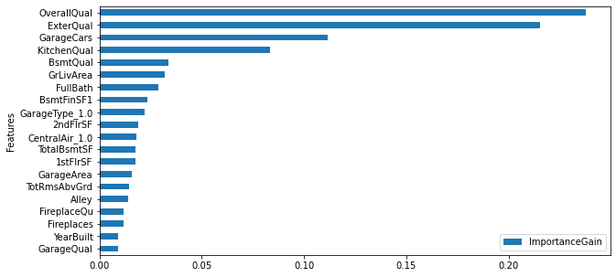
Modeling : Feature selection through xgboost
Feature importance shows that OverallQual has the highest gain along with ExternalQual, but feature importance does not show the direction of covariance between the output and features.

Slide 10
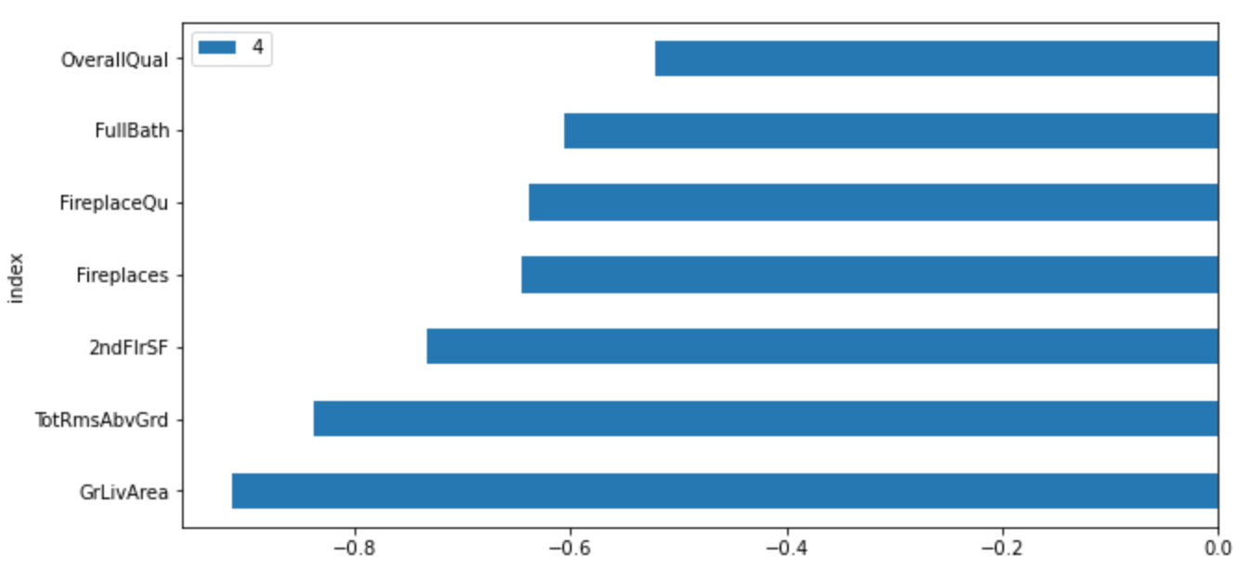
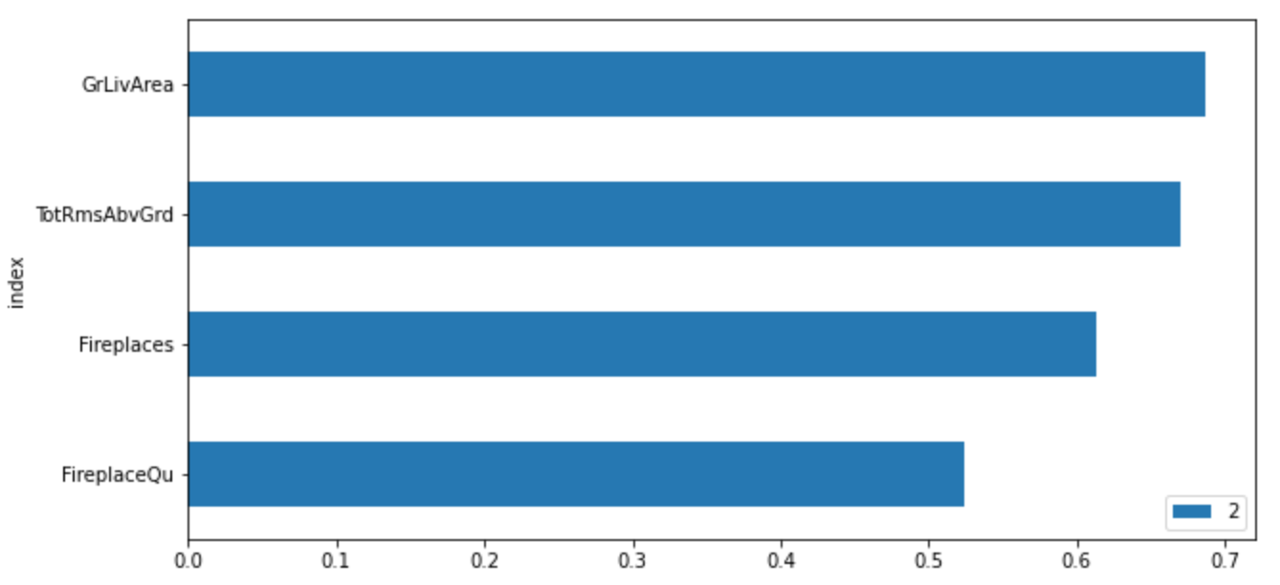
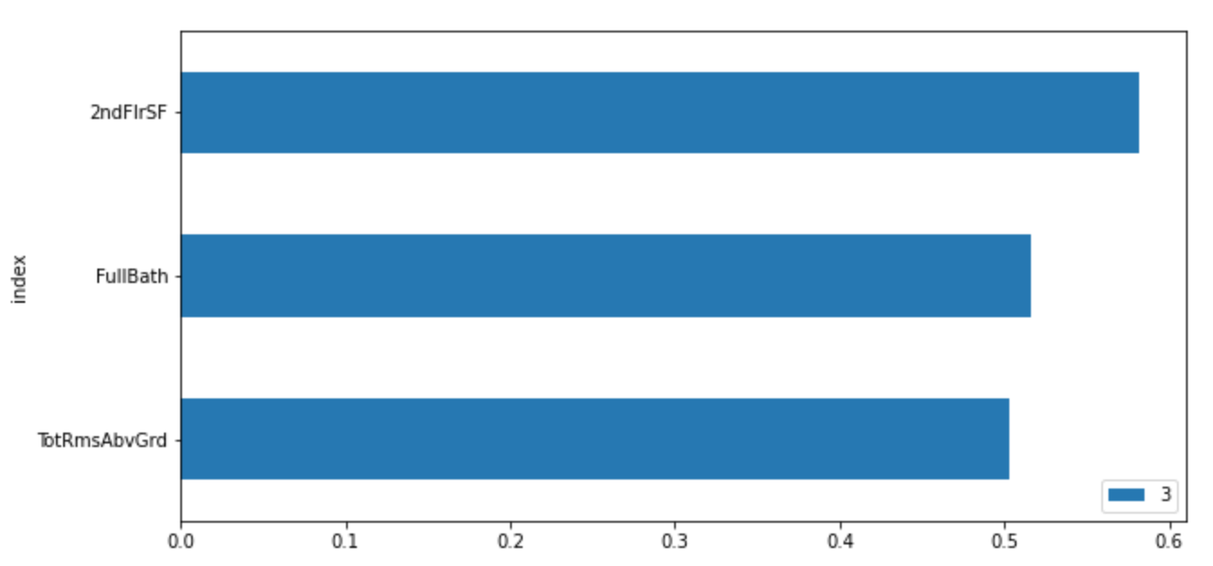
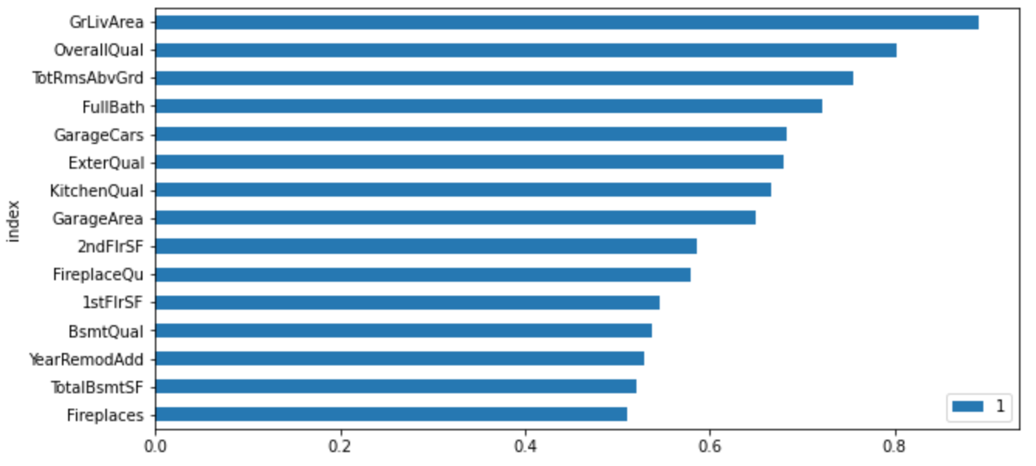
Modeling: Dimension reduction through FAMD
 | ExplaineInertia | EigenValues | CummExplaineInertia
0 | 0.266627 | 9.234815e-04 | 0.266627
1 | 0.110392 | 3.823509e-04 | 0.377019
2 | 0.080337 | 2.782520e-04 | 0.457356
3 | 0.072814 | 2.521968e-04 | 0.530170
4 | 0.063646 | 2.204412e-04 | 0.593816
5 | 0.058533 | 2.027322e-04 | 0.652349
6 | 0.044824 | 1.552496e-04 | 0.697172
7 | 0.037982 | 1.315533e-04 | 0.735154
8 | 0.035035 | 1.213469e-04 | 0.770190
9 | 0.032418 | 1.122821e-04 | 0.802608
10 | 0.027354 | 9.474319e-05 | 0.829962
11 | 0.024351 | 8.434152e-05 | 0.854313
12 | 0.022042 | 7.634319e-05 | 0.876355
13 | 0.020469 | 7.089434e-05 | 0.896823
14 | 0.017805 | 6.166997e-05 | 0.914629
15 | 0.014497 | 5.021169e-05 | 0.929126
16 | 0.012403 | 4.295891e-05 | 0.941529
17 | 0.011403 | 3.949343e-05 | 0.952931
18 | 0.009148 | 3.168335e-05 | 0.962079
19 | 0.008283 | 2.868869e-05 | 0.970362
20 | 0.006762 | 2.341960e-05 | 0.977124
21 | 0.005674 | 1.965333e-05 | 0.982798
22 | 0.004892 | 1.694296e-05 | 0.987690
23 | 0.003987 | 1.381093e-05 | 0.991677
24 | 0.002913 | 1.008834e-05 | 0.994590
25 | 0.002802 | 9.703896e-06 | 0.997392
26 | 0.002519 | 8.724440e-06 | 0.999911
27 | 0.000089 | 3.096432e-07 | 1.000000
First component (0) accounts for 27% of the variance in the feature space.
Components 0, 1, 4 show features that are associated with OverallQual
Components 2, 3 show features that are associated with the size of the property such as TotalRmsAbvGrd

Slide 11
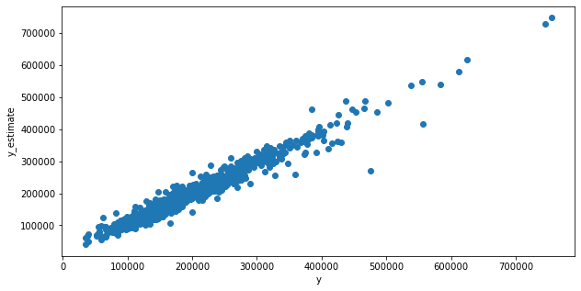
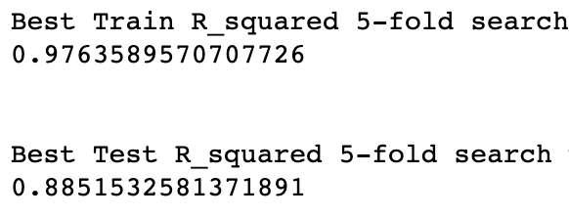
Modeling Verification : xgboost using FAMD components
Performs as equivalently well as the xgboost regression in the feature space, but slightly worse
SalePrice Prediction
SalePrice

Slide 12
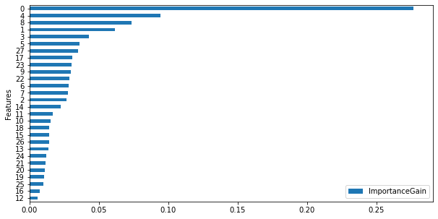
Modeling Verification : xgboost using FAMD components
FAMD component 0 dominates the xgboost regression model of the house prices.

Slide 13
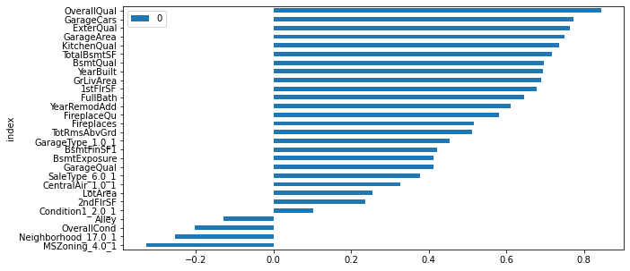
Model interpretation with FAMD
Component 0
Component 0 is characterized by OverallQual.
Assuming OverallQual characterizes the “good house”, features that adds values to houses are as the following: garage size/type/quality, external quality, kitchen quality, basement size/quality, house age, property/living area size, remodeling year, fireplace.
Potential upgrades to the house to increase its value (yay remodeling helps!):
Make/expand garage, preferably attached to the house.
Replace/upgrade external finish.
Upgrade kitchen.
Finish basement if unfinished.
Add fireplace.
Categorical features that adds values to houses
Garage Type 1 : Attached to the house
SaleType 6 : New
Central Air 1 : Yes
Categorical features the negatively impacts house values
MSZoning 4 : Medium density residential
Neighborhood 17: Oldtown

Slide 14
Thank you

Slide 15
Factor analysis for Mixed Data (FAMD)
 | ExplaineInertia | EigenValues | CummExplaineInertia
0 | 0.266627 | 9.234815e-04 | 0.266627
1 | 0.110392 | 3.823509e-04 | 0.377019
2 | 0.080337 | 2.782520e-04 | 0.457356
3 | 0.072814 | 2.521968e-04 | 0.530170
4 | 0.063646 | 2.204412e-04 | 0.593816
5 | 0.058533 | 2.027322e-04 | 0.652349
6 | 0.044824 | 1.552496e-04 | 0.697172
7 | 0.037982 | 1.315533e-04 | 0.735154
8 | 0.035035 | 1.213469e-04 | 0.770190
9 | 0.032418 | 1.122821e-04 | 0.802608
10 | 0.027354 | 9.474319e-05 | 0.829962
11 | 0.024351 | 8.434152e-05 | 0.854313
12 | 0.022042 | 7.634319e-05 | 0.876355
13 | 0.020469 | 7.089434e-05 | 0.896823
14 | 0.017805 | 6.166997e-05 | 0.914629
15 | 0.014497 | 5.021169e-05 | 0.929126
16 | 0.012403 | 4.295891e-05 | 0.941529
17 | 0.011403 | 3.949343e-05 | 0.952931
18 | 0.009148 | 3.168335e-05 | 0.962079
19 | 0.008283 | 2.868869e-05 | 0.970362
20 | 0.006762 | 2.341960e-05 | 0.977124
21 | 0.005674 | 1.965333e-05 | 0.982798
22 | 0.004892 | 1.694296e-05 | 0.987690
23 | 0.003987 | 1.381093e-05 | 0.991677
24 | 0.002913 | 1.008834e-05 | 0.994590
25 | 0.002802 | 9.703896e-06 | 0.997392
26 | 0.002519 | 8.724440e-06 | 0.999911
27 | 0.000089 | 3.096432e-07 | 1.000000
Garage Type 1 : Attached to the house
SaleType 6 : New
Central Air 1 : Yes
MSZoning 4 : Medium density residential
Neighborhood 17: Oldtown

Slide 16
Overall Quality has high feature importance, but we already know what external quality is highly correlated with overall quality.
In [62]:
 | Features | ImportanceGain | CummulativeGain
0 | OverallQual | 0.237730 | 0.237730
1 | ExterQual | 0.215476 | 0.453207
2 | GarageCars | 0.111382 | 0.564589
4 | KitchenQual | 0.083605 | 0.648194
7 | BsmtQual | 0.033796 | 0.681990
5 | GrLivArea | 0.031786 | 0.713776
11 | FullBath | 0.028830 | 0.742606
6 | BsmtFinSF1 | 0.023480 | 0.766086
21 | GarageType_1.0 | 0.022209 | 0.788295
10 | 2ndFlrSF | 0.019108 | 0.807404
3 | CentralAir_1.0 | 0.018053 | 0.825457
9 | TotalBsmtSF | 0.017539 | 0.842996
13 | 1stFlrSF | 0.017426 | 0.860422
12 | GarageArea | 0.015783 | 0.876205
15 | TotRmsAbvGrd | 0.014677 | 0.890882
20 | Alley | 0.013980 | 0.904862
8 | FireplaceQu | 0.011921 | 0.916783
14 | Fireplaces | 0.011642 | 0.928425
24 | YearBuilt | 0.009110 | 0.937535
18 | GarageQual | 0.009104 | 0.946638
16 | MSZoning_4.0 | 0.009055 | 0.955693
23 | LotArea | 0.009016 | 0.964709
17 | YearRemodAdd | 0.008381 | 0.973091
25 | BsmtExposure | 0.006741 | 0.979832
27 | Neighborhood_17.0 | 0.005634 | 0.985466
19 | Condition1_2.0 | 0.005600 | 0.991066
22 | SaleType_6.0 | 0.004825 | 0.995891
26 | OverallCond | 0.004109 | 1.000000

Slide 17
Modeling: Dimension reduction through FAMD
Components 0, 1, 4 show features that are associated with OverallQual

Slide 18
Modeling: Dimension reduction through FAMD
Components 2, 3 show features that are associated with the size of the property such as GrLivArea (2), and 2ndFlrSF (3).

Slide 19
203 Features
& Output
Train set
Test set
Xgboost Regression 1
5-fold CV
Hyperparameter tuning (random grid search)
Trained model 1
Model
Prediction
Select Features
FAMD
Model
Interpretation
Trimmed & Transformed Features
Train set
Test set
Xgboost Regression 2
Trained model 2
Model
Verification

