Slide 2
What features contribute to house values?
High-dimensional data : 80 Features
37 Numerical features
23 Ordinal categorical features – label encode
20 Nominal categorical features – dummify
Total 203 features
Missing value imputation

Slide 3
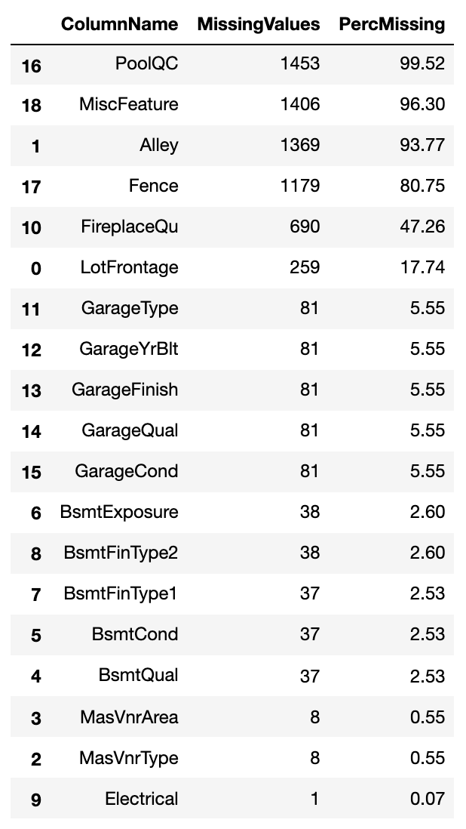
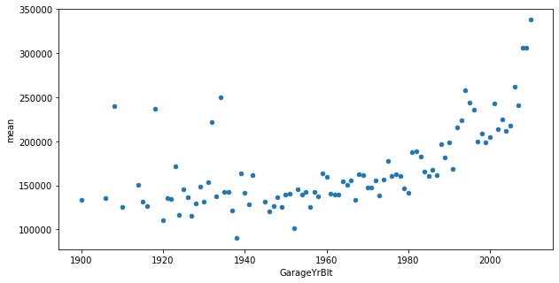
Missing value inspection

Slide 4
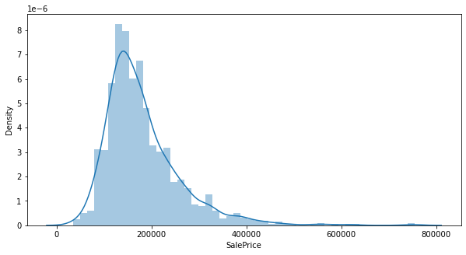

Slide 5
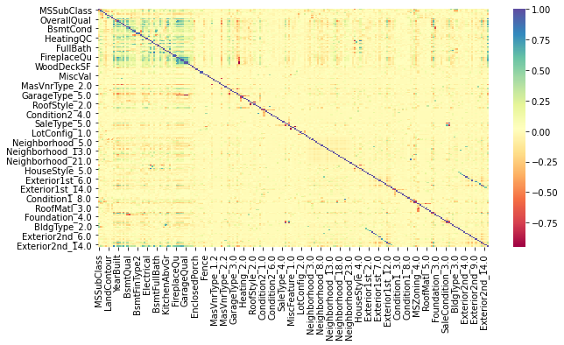

Slide 6
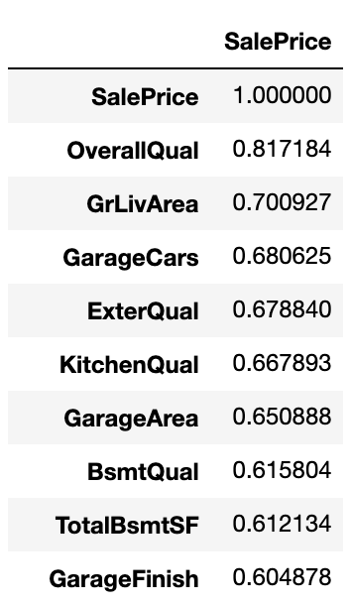
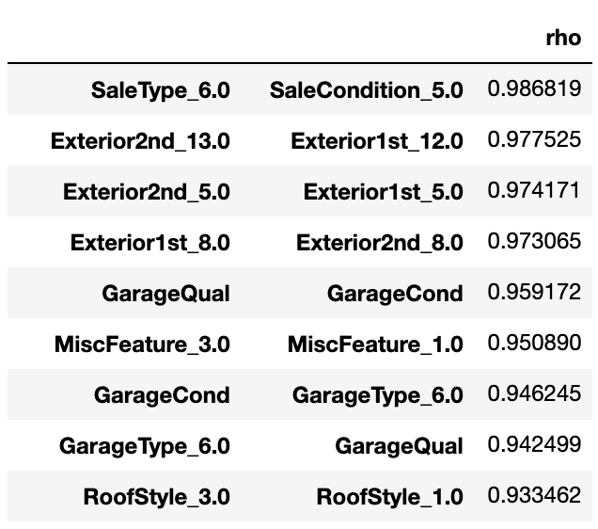


Slide 7
Modeling
Non-normal distribution & severe multicollinearity
Feature selection through Gradient Boosting Model (GBM)
xgboost toolbox
Select features that can attain R2 >= 0.9

Slide 8
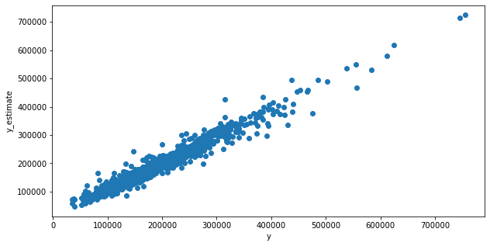
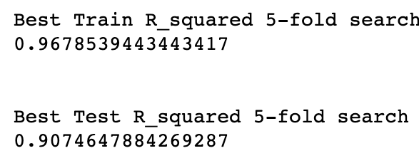
Random grid search with 5-fold CV
28 features remaining

Slide 9
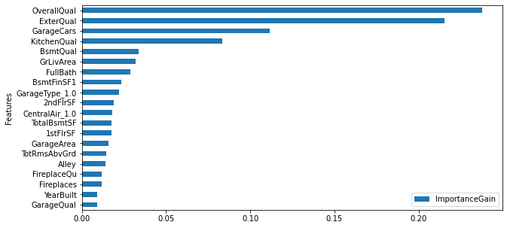
Overall Quality has high feature importance, but we already know what external quality is highly correlated with overall quality.
In [62]:
 | Features | ImportanceGain | CummulativeGain
0 | OverallQual | 0.237730 | 0.237730
1 | ExterQual | 0.215476 | 0.453207
2 | GarageCars | 0.111382 | 0.564589
4 | KitchenQual | 0.083605 | 0.648194
7 | BsmtQual | 0.033796 | 0.681990
5 | GrLivArea | 0.031786 | 0.713776
11 | FullBath | 0.028830 | 0.742606
6 | BsmtFinSF1 | 0.023480 | 0.766086
21 | GarageType_1.0 | 0.022209 | 0.788295
10 | 2ndFlrSF | 0.019108 | 0.807404
3 | CentralAir_1.0 | 0.018053 | 0.825457
9 | TotalBsmtSF | 0.017539 | 0.842996
13 | 1stFlrSF | 0.017426 | 0.860422
12 | GarageArea | 0.015783 | 0.876205
15 | TotRmsAbvGrd | 0.014677 | 0.890882
20 | Alley | 0.013980 | 0.904862
8 | FireplaceQu | 0.011921 | 0.916783
14 | Fireplaces | 0.011642 | 0.928425
24 | YearBuilt | 0.009110 | 0.937535
18 | GarageQual | 0.009104 | 0.946638
16 | MSZoning_4.0 | 0.009055 | 0.955693
23 | LotArea | 0.009016 | 0.964709
17 | YearRemodAdd | 0.008381 | 0.973091
25 | BsmtExposure | 0.006741 | 0.979832
27 | Neighborhood_17.0 | 0.005634 | 0.985466
19 | Condition1_2.0 | 0.005600 | 0.991066
22 | SaleType_6.0 | 0.004825 | 0.995891
26 | OverallCond | 0.004109 | 1.000000

Slide 10
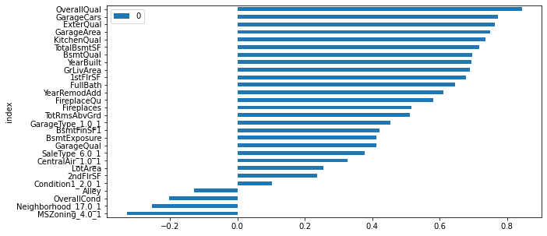
Factor analysis for Mixed Data (FAMD)
 | ExplaineInertia | EigenValues | CummExplaineInertia
0 | 0.266627 | 9.234815e-04 | 0.266627
1 | 0.110392 | 3.823509e-04 | 0.377019
2 | 0.080337 | 2.782520e-04 | 0.457356
3 | 0.072814 | 2.521968e-04 | 0.530170
4 | 0.063646 | 2.204412e-04 | 0.593816
5 | 0.058533 | 2.027322e-04 | 0.652349
6 | 0.044824 | 1.552496e-04 | 0.697172
7 | 0.037982 | 1.315533e-04 | 0.735154
8 | 0.035035 | 1.213469e-04 | 0.770190
9 | 0.032418 | 1.122821e-04 | 0.802608
10 | 0.027354 | 9.474319e-05 | 0.829962
11 | 0.024351 | 8.434152e-05 | 0.854313
12 | 0.022042 | 7.634319e-05 | 0.876355
13 | 0.020469 | 7.089434e-05 | 0.896823
14 | 0.017805 | 6.166997e-05 | 0.914629
15 | 0.014497 | 5.021169e-05 | 0.929126
16 | 0.012403 | 4.295891e-05 | 0.941529
17 | 0.011403 | 3.949343e-05 | 0.952931
18 | 0.009148 | 3.168335e-05 | 0.962079
19 | 0.008283 | 2.868869e-05 | 0.970362
20 | 0.006762 | 2.341960e-05 | 0.977124
21 | 0.005674 | 1.965333e-05 | 0.982798
22 | 0.004892 | 1.694296e-05 | 0.987690
23 | 0.003987 | 1.381093e-05 | 0.991677
24 | 0.002913 | 1.008834e-05 | 0.994590
25 | 0.002802 | 9.703896e-06 | 0.997392
26 | 0.002519 | 8.724440e-06 | 0.999911
27 | 0.000089 | 3.096432e-07 | 1.000000
Garage Type 1 : Attached to the house
SaleType 6 : New
Central Air 1 : Yes
MSZoning 4 : Medium density residential
Neighborhood 17: Oldtown

Slide 11
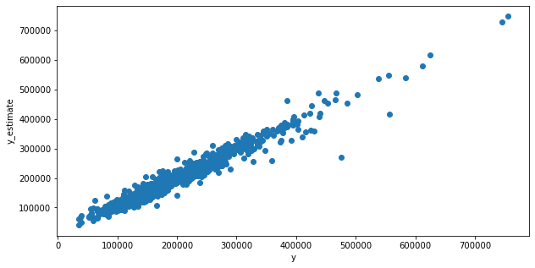
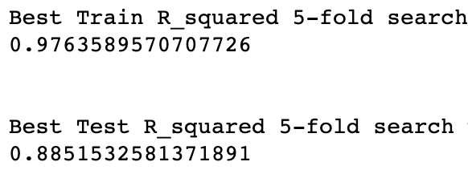
GBM with FAMD components

Slide 12
